Slide 1
Case 6. LN XIII
LDC Debt and Brady Bonds
FINA 7360. International Finance. Spring 2018
By
Joshua Armstead
Eric Dietert
Tatsiana Mikitsionak
Tangen Tran

Slide 2
Outline
Introduction of Brady Bonds
Valuation Methodology
Mexico Par/Disc Bond Valuation
Venezuela Par/Disk Bond Valuation
Opening Price of Costa Rican Principle Series A Bond
Mexico’s Country Risk
Hedging options
Will Mexico default?

Slide 3

Brady Bonds
Due to the multiple default of Latin American countries in the 1980’s, Brady Bonds were introduced by Nicholas Brady.
Brady Bonds gave options to banks as tradable instruments and are broken down in 3 segments: collateral accounts to guarantee principle, rolling interest on bonds to guarantee principle, and cash payments in context of paybacks.
Mexico, Costa Rica, and Venezuela were the first countries introduced to Brady Bonds.

Slide 4
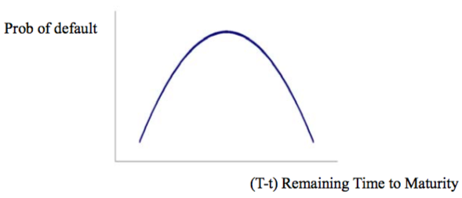
Valuation Methodology
Bond Valuation Method:
Brady Bond Required Inputs:
Cash Flows
Probability of Default
Discount rate
25%

Slide 5



Country Ratings
Mexico - Debt Rating
Venezuela - Debt Rating
Costa Rica - Debt Rating

Slide 6
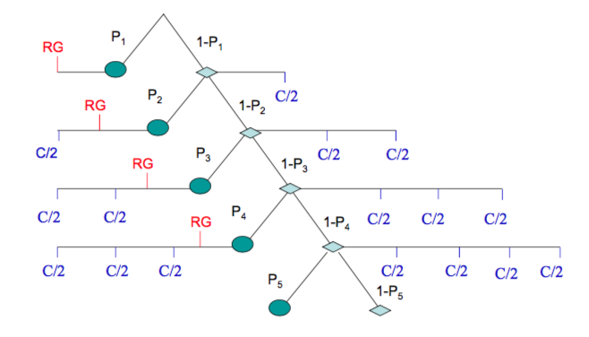
Valuation Methodology
Brady Bond Cash Flows follow a simple binomial tree as shown above, where P is the probability at time t.
It is necessary to get the discounted cash flows before calculating P.

Slide 7
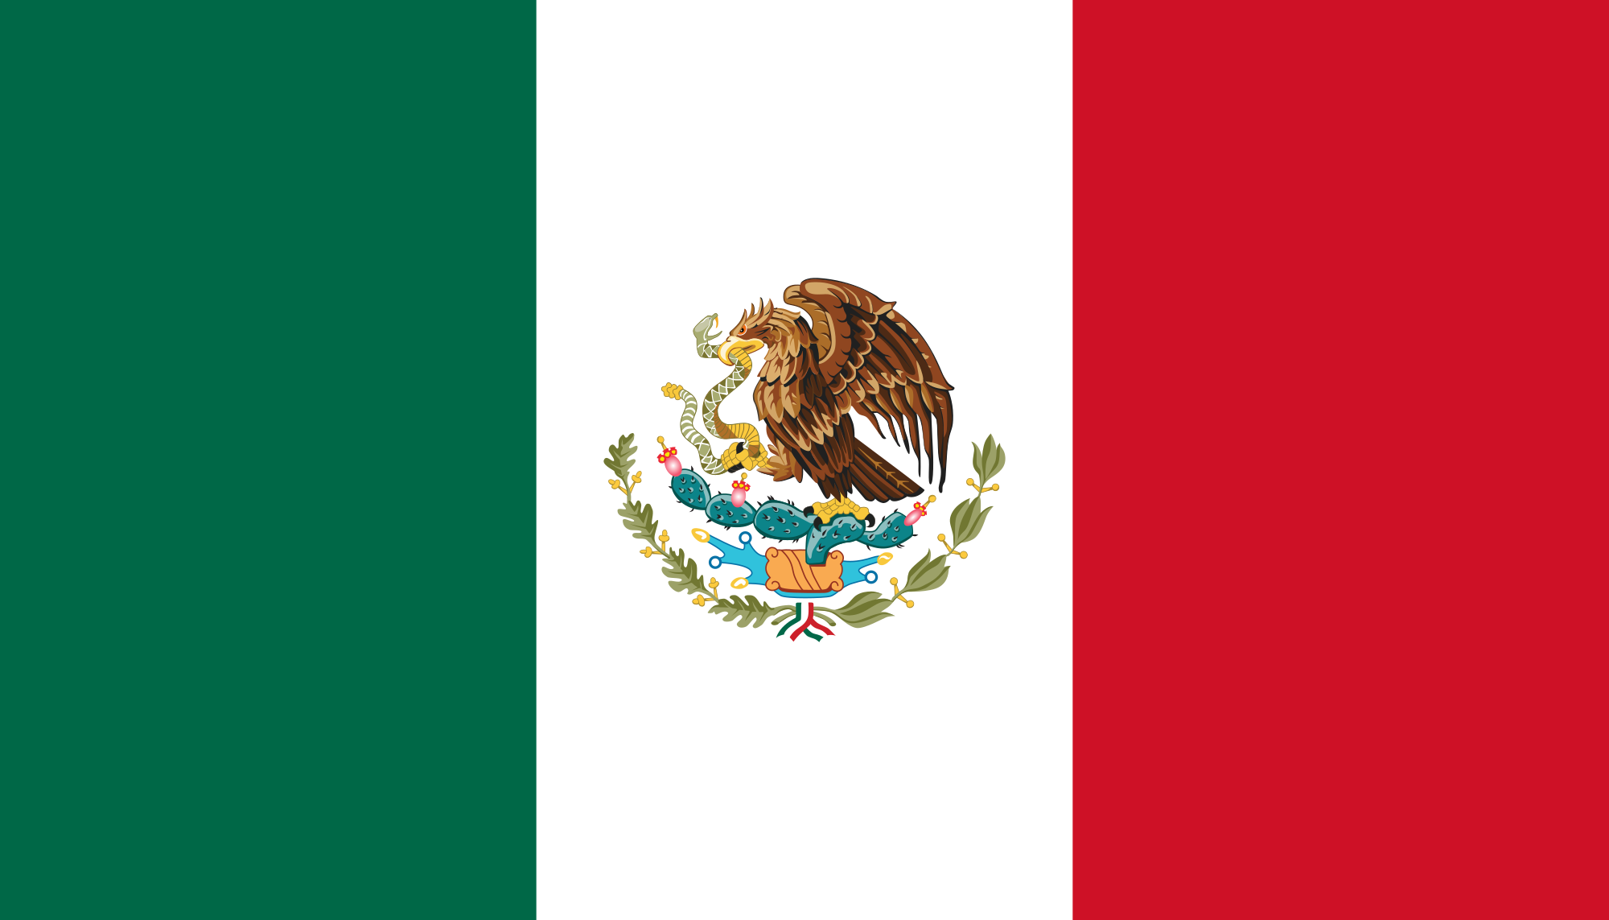
Should Citibank buy Par or Discount Bond?
Question 1
30Y Par Bond. Mexico ( March 1990)
Face Value= $100
Coupon Rate (Fixed)=6.25%
Collateral: 30Y U.S. Treasury YTM=8.63%
RG=18 months
YTM Mexico=12.73% (Aver.1990-2016)
Country Spread=4.10%
Market Value = $40
NPV =$49.50
HPR = 23.77%
30Y Discount Bond. Mexico (March 1990)
Face Value= $100
Coupon Rate (floating) =LIBOR(8.35%)+13/16
Collateral: 30Y U.S. Treasury YTM=8.63%
RG=18 months
YTM Mexico=12.73% (Aver.1990-2016)
Country Spread=4.10%
Market Value = $60
NPV = $68.89
HPR = 14.81%

Slide 8
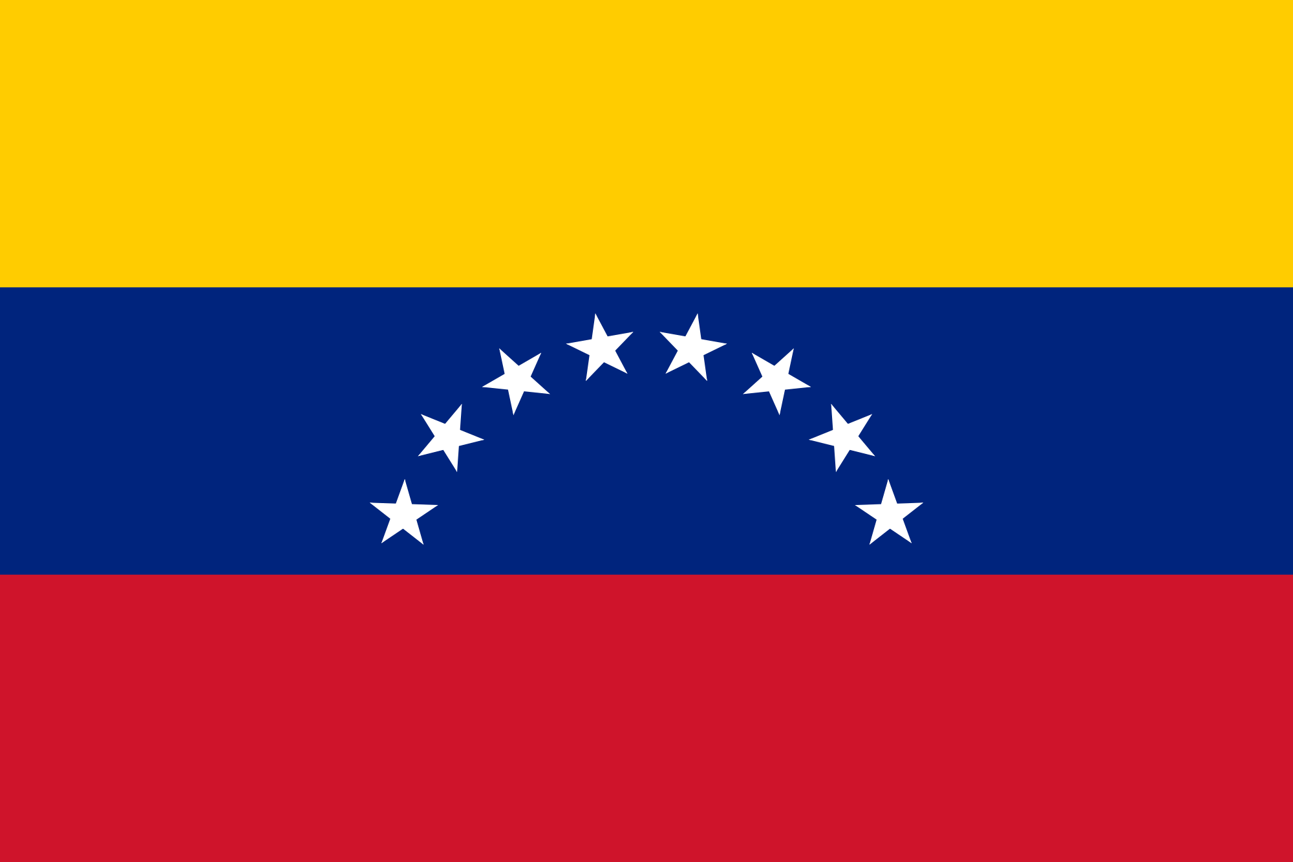
Should Citibank buy Par or Discount Bond?
Question 2
30Y Par Bond. Venezuela ( December 1990)
Face Value= $100
Coupon Rate (Fixed)=6.75%
Collateral: 30Y U.S. Treasury YTM=8.63%
RG=14 months
YTM Venezuela=9.91%
Country Spread=1.28%
Market Value = $50
NPV =$55.83
HPR = 11.68%
30Y Discount Bond. Venezuela (December 1990)
Face Value= $100
Coupon Rate (floating) =LIBOR(8.35%)+13/16
Collateral: 30Y U.S. Treasury YTM=8.63%
RG=14 months
YTM Venezuela=9.91%
Country Spread=1.28%
Market Value = $70
NPV = $72.96
HPR = 4.23%

Slide 9

What is fair value of the Bond?
Question 3
20Y Principal Series A Bond. Costa Rica ( May 1990)
Face Value= $100
Coupon Rate (Fixed)=6.25%
RG=18 months
YTM Costa Rica=10.5%
Country Spread=3.87%
NPV =$54.33 ← suggested price

Slide 10
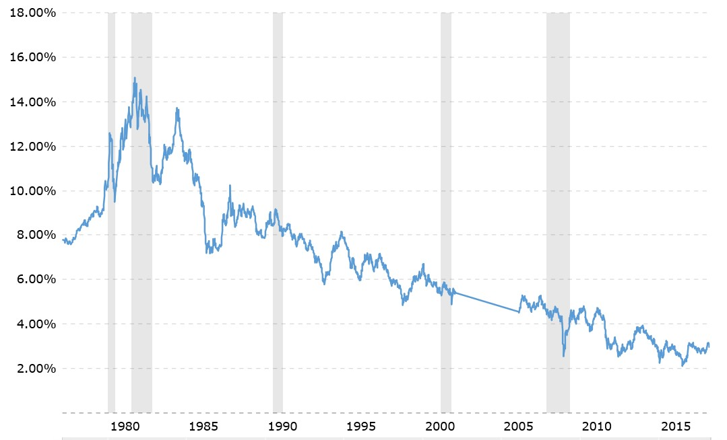
Should Citibank Hold or Sell?
Question 4
30Y Par Bond Mexico (November 1996):
Face Value= $100
Coupon Rate (Fixed)=6.25%
Collateral: 30Y U.S. Treasury YTM=8.63%
RG=18 months
YTM Mexico=12.73% (Aver.1990-2016)
Country Spread=4.10%
Remaining Coupon Payments = 47
E[NPV] = $61.97
Bid Price = $71.50
SELL!
Diversification?:
Given U.S Rate DVBP for Mexican Brady Bonds
  DVBP = Dollar Value of Basis Point
  Par Bonds = 8.48
1% increase in U.S. treasury yield, Mexican Brady Bond price decreases by 8.48%
Brady Bond Price highly dependent (correlated) to U.S. treasury rates

Slide 11
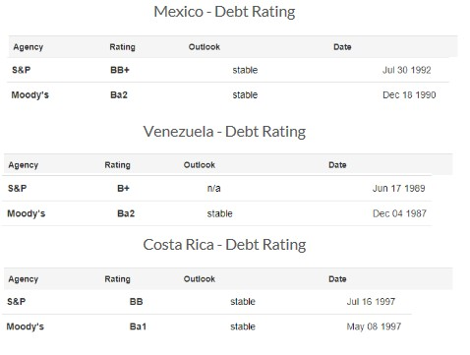
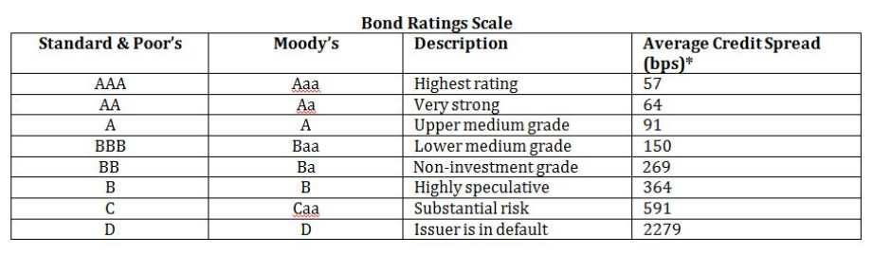
Country Risk Estimation. Mexico
Question 5
Quantitative Method:
Country RIsk (CR) influences the interest on the debt issued by a government of a country
CR (spread/risk premium) over a base (U.S. risk-free rate)
CR = YTM_{UMS} - YTM_{U.S. treasuries}
Example:
  UMS YTM = 11.375%
  U.S. 10-Year bond YTM (2003) = 4.05%
  CR = 7.325% or 732 bps

Slide 12
Question 6
Hedging Options
Possible Hedging Strategies:
Put Option:
Cover the downside risk of the bond
Low liquidity, meaning wide spreads and execution difficulties - Use OTC method
Collar Spread
Covers downside risk with a lower cost
Adds an upside restriction on returns
Credit Default Swap
Secures expected interest payments through maturity
Expensive coverage because of the riskiness of the bonds
Cost Opportunity - Time the swap purchase to align with the highest tolerable default risk level

Slide 13
Question 7
Probability of Default
Current Level of Risk for a Mexican Default
Real GDP growth: 2.3% (2016 Actual)
Inflation Rate: 3.4% (2016 Actual)
External debt/GDP: 39.4% (2016 Actual)
Default history: No default events (on bonds or loans) have been recorded since 1983
A Moody's study from March shows that an agreement for a successfully revised NAFTA treaty would support a slight acceleration in Mexico's growth in 2018-19 to 2.0%-2.5% annually.

Slide 14
Questions?

