Slide 1
Templeton Growth Find

Slide 2
Table of contents
Project summary
Optimal Portfolio
Optimal Constrained Portfolio
Conclusion

Slide 3
Assignment
Evaluate Templeton's international portfolio management and performance by using standard portfolio management theory.
Constructing an optimal and constrained portfolio.
Comparing the new optimal and constrained portfolios to the

Slide 4
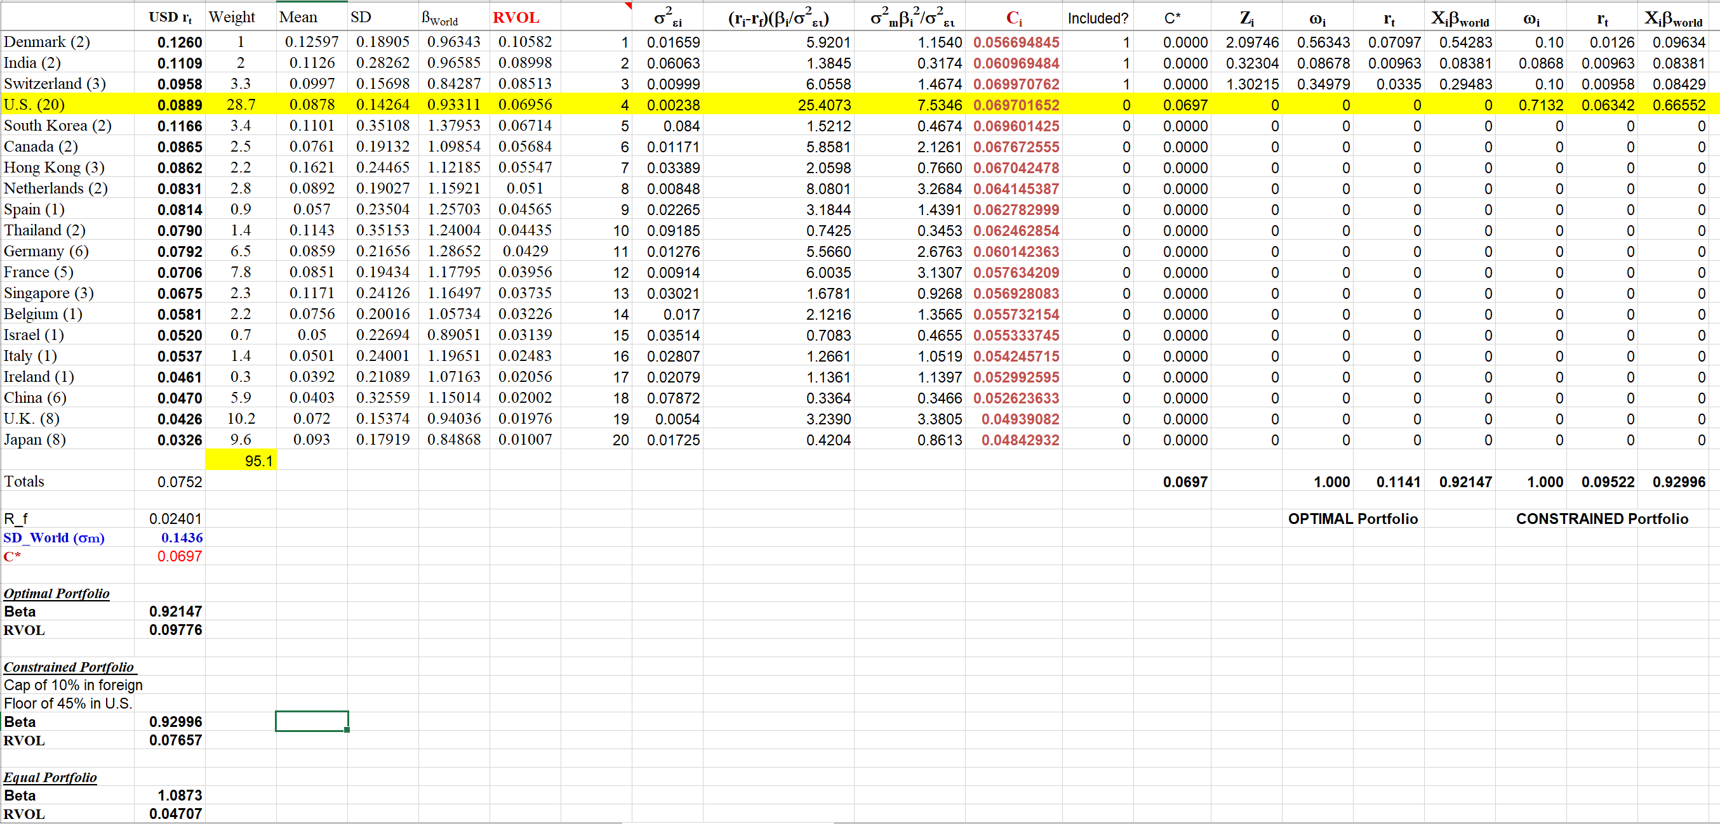
Optimal vs Constrained Portfolio

Slide 5
Optimal vs Constrained Portfolio
After comparing both portfolios, the optimal portfolio is the one that gave a higher return. This was bound to happen since the constrained portfolio had a cap of 10% for each foreign country invested in. Along with a minimum of 45% to be invested in the USA.

Slide 6
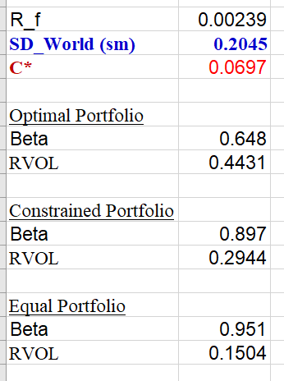
Out of sample performance
We used the same weights as the Optimal Portfolio
We made sure the RVOLs were in descending order
Compared it to what we were able to find out

Slide 7
Conclusion
Using the data we had from what was provided in the years 1993-2019.
The out of sample return returns were not fit for that data
Overall, our optimal portfolio was the best portfolio

