Slide 1
Hedging Transaction Exposure, Popescu, Hagi and Associates

Slide 2
Background
In December 2010, Len Mirman, Founder and CEO of DW inc, approached PHA.
Problem:
Mismatch Inflows and outflows.
Outflows denominated by foreign currency
Inflows denominated by USD
Never hedges and has dealt with fluctuating cost structure.
Wants a predictable cost structure because it
wants to go public

Slide 3
Situation
On Dec 2012, DW ordered Japanese parts valued at 2,000,000,000 JPY.
Delivery is with two months and payment is due within 30 days of delivery.
Problem:
On Dec 6 , DW received confirmation that the Japanese parts would be delivered by April, however the exact date is not guaranteed. Its “expected” to be in mid march with payment due on April 17th.

Slide 4
T.E = Spot rate * 200000000 JPY = 2494000
Range for best/worst under 3 cases.
Extremes:
min -0.08070068854 best 2292732.483
max 0.1971582773 worst 2985712.744
Normal distribution of 98%:
Mean 0.02352238926
Standard Deviation 0.059841
98% CI 2205524.565 2899805.113
VaR (99%) 2899805.113
Simulation distribution of 98%:
TE-LB (.01) 2292732.483
TE-UB (.99) 2941270.845
VaR (99%) 2941270.845

Slide 5
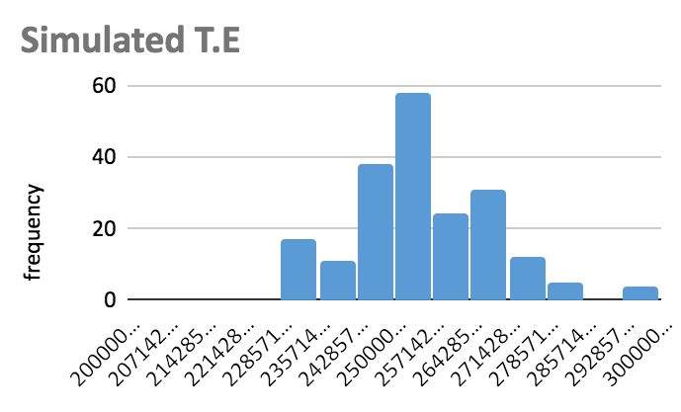
Histogram T.E

Slide 6
PHLX Option market
USD/JPY Premium per JPY X=0.0125 Tot Price/ unit Tot price JPY $200 mil
JPY June 0.008 0.4583 Yes 0.012583 2516600
JPY June 0.009 0.36255 Yes 0.0126255 2525100
JPY June 0.01 0.29542 Yes 0.0129542 2590840
How many contract to buy?
1 contract = 1M. So 200 contracts for 200 M

Slide 7
OTC option
USD/JPY Premium per JPY 0.0125 Tot Price/unit Tot price JPY $200 M
Strike price 0.009 0.4081 Yes 0.013081 2616200
Strike price 0.01 0.31976 Yes 0.0131976 2639520
Expiration = April 16th
TRADED VS OTC :
Total premium cost for JPY of 200 M is lower with Traded option.

Slide 8
Forward Alternative
USD JPY
Interest Rate 3 month 0.1923 0.15205
Interest Rate 6 month 0.26205 0.101
IRPT 3 month = 0.01247167221
IRPT 6 month = 0.01248089255
Spot rate = 0.01247
Avg for 4 month forward rate = 0.01247628238
JPY payment in April = 200000000
2495256.476

Slide 9
Forward Alternative vs Cost of Options
2,516,600
2,495,256
0.08
Option
Forward

Slide 10
Part 2
Now in May 6th :
New Spot Rate (USD/JPY)= 0.01004
What would be the effective total cost of Japanese parts based on recommendations in part 1

Slide 11
3 Month Forward
3 month forward rate = 0.012494
JPY payable amount = 200000000
USD cost of JPY in March = 2498800
Interest rate of JPY = 0.001085
Interest Income = 200M JPY* (Interest rt )^2 *St = 2178.68 (USD)
Total cost of advising 3 month forward rate = 2496621
St in May = 0.01004
USD cost of JPY in May = 2008000
Difference paid = Total cost of 3 month - USD cost in May
$ 488621.0

Slide 12
6 Month Forward
6 month forward rate = 0.012561
St in MAY = 0.01004
Forward rate for MAY using IRPT = 0.010109
Interest rate used for NPV = 0.001165
JPY payment amount = 2000000000
Cash flow in June (USD) = 25122000
Cash flow in May (USD) = 20219804
Difference = 4902196
NPV of difference = 4896492
Cost of JPY on May 6 = 20080000
Total cost for advising 6 month rate = Cost in May+ NPV of diff
24976492

Slide 13
June Futures
June CME Future (in May) = 0.010002
June CME Future (in Dec) = 0.01257
St in May = 0.01004
Interest Rate used for NPV = 0.001165
JPY payment amount = 2000000000
CF in June using old rate (USD) = 25140000
CF in June using new rate (USD) = 20004000
Difference = 5136000
NPV of Difference = 5130024
Cost of JPY on May 6 = 20080000
Total cost for advising June future= NPV of diff + Cost on May
25210024

Slide 14
OTC JPY Option
USD/JPY Premium per JPY Tot Price/unit Tot price JPY $200 M After 1 Month in Bank
Strike price 0.009 0.004081 0.013081 2616200 2615187.566
Strike price 0.01 0.0031976 0.0131976 2639520 2638507.566
On April 17 we receive 200M JPY and then place the it into the bank for 1 month with estimated interest rate of 0.0504%
On May 11 we have 200,100,840 JPY
Use 200M to pay for the parts and exchange the remaining amount
Spot Rate (USD/JPY)= 0.01004
Receive 1012.43 USD

Slide 15
JPY June Options
PHLX Options Premium May Premium Dec Pd- Pm JPY * (pd-pm) JPY* St Total
JPY June 0.008 0.0020465 0.004583 0.0025365 507300 2008000 2515300
JPY June 0.009 0.0020465 0.0036255 0.001579 315800 2008000 2323800
JPY June 0.01 0.0020465 0.0029542 0.0009077 181540 2008000 2189540

Slide 16
Left position open
May 6th : Spot Rate (USD/JPY)= 0.01004
Cost of 200M JPY in USD: 2008000

