Slide 1
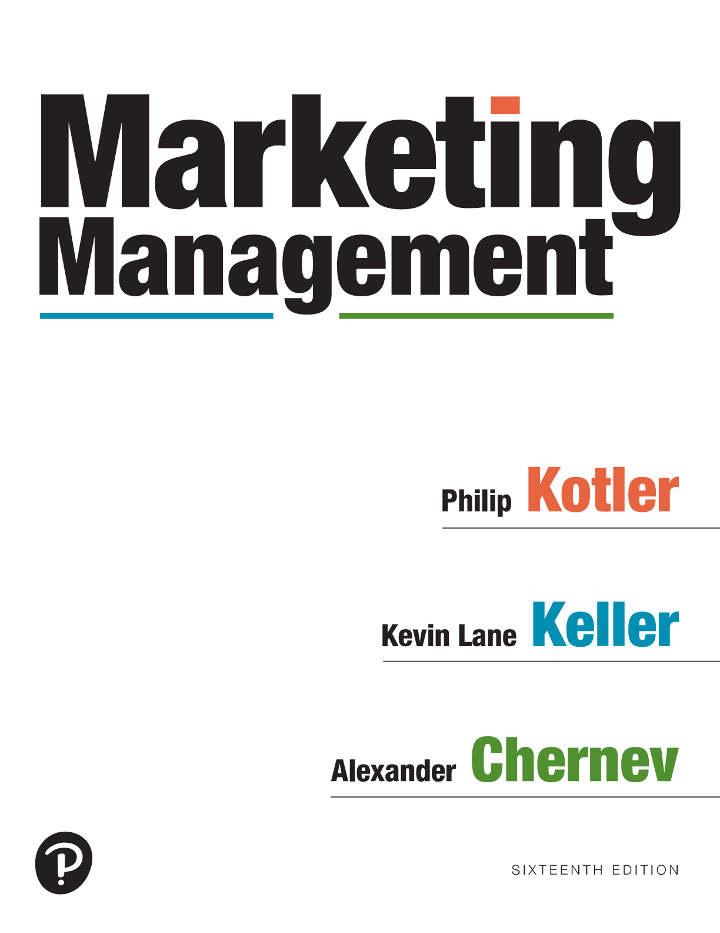
Marketing Management
Sixteenth Edition
Chapter 19
Building Customer Loyalty
Copyright © 2022, 2016, 2012 Pearson Education, Inc. All Rights Reserved
Notes:
If this PowerPoint presentation contains mathematical equations, you may need to check that your computer has the following installed:
1) MathType Plugin
2) Math Player (free versions available)
3) NVDA Reader (free versions available)

Slide 2
Managing Customer Satisfaction and Loyalty
Making a sale is NOT ultimate goal of marketing process
It is the beginning of building customer relationships for the purpose of creating a loyal customer base, engaging and connecting with them
With no loyal customers, company will constantly have to invest in acquiring NEW customers
Imagine a situation where every
consumers buys a product from
a company ONCE only!
Notes:
Customer satisfaction is the key to building customer loyalty. Without fulfilling customer needs, a company would find it challenging to create a loyal customer base.
Satisfaction is a person’s feelings of pleasure or disappointment that result from comparing the perceived performance (or outcome) of a product or service with expectations. If the performance or experience falls short of expectations, the customer is dissatisfied. If it matches expectations, the customer is satisfied. If it exceeds expectations, the customer is highly satisfied or delighted.

Slide 3
The 5-A Customer Acquisition Funnel
First encounter Selective Seek Purchase Tell others
with company’s elimination information Word of mouth
Products/services Not all will appeal about products
interested in Loyalty
Notes:
Figure 19.1 shows the 5_A Customer Acquisition Funnel.
The awareness phase is the gateway to customers’ interaction with the company’s offering. It is in this phase that target customers encounter the company’s offering. This encounter can be driven by the company’s marketing communication, can occur at the point of sale, or may stem from advocacy by other customers and collaborators.
The appeal phase reflects the fact that although customers might become aware of multiple offerings, they do not actively consider all of them. Instead, they tend to shortlist the most appealing offerings in order to form a consideration set composed of offerings that are most likely to fulfill their need. Thus, the appeal phase of the decision process can be viewed as a process of selective elimination, paring down the initial set of offerings that came to customers’ minds.
During the ask phase, customers seek additional information about the offerings in their consideration set. This additional information can come from external sources such as friends and family, the media, and/or the company and its collaborators. For example, customers might call friends for advice, contact the company for more information, browse online reviews, use an app to compare prices, and even try out products at stores.
The act phase marks a transition from information gathering and evaluation to an action typically directed at a particular offering. Customer actions are not limited to purchase: They reflect the total ownership and usage experience, which also includes actual consumption of the product or service as well as the post-consumption experience.
The advocate phase reflects customers’ reactions following their consumption experience. Ideally, customers’ reactions will involve a certain level of loyalty to the company and its offering. These reactions can range from simply repurchasing the offering to ultimately advocating the offering to others. Active advocates recommend products, services, and brands they love without even being asked. They share positive experiences with others and often become evangelists.
The different steps of the decision funnel do not always occur in the linear process depicted in Figure 19.1; they can involve multiple iterations, reconsidering and reevaluating the available data, and gathering new information. And customers do not necessarily go through all of the Five A’s; they might skip one or more of the five phases.
The steps are Awareness, Appeal, Ask, Act, and Advocate.

Slide 4
Balancing Customer Acquisition/Customer Retention
Need to attract new customers while at the same time, retain and cultivate existing ones
Estimate customer conversion rates and retention rates
Satisfied customers are company’s customer relationship capital
Satisfaction is key to building loyalty
Costs 5x more to get new than keep existing customers
Notes:
Effective management of customer acquisition and retention involves clear understanding and accurate estimation of customer conversion and retention rates. By calculating conversion rates—the percentages of customers at the different stages who move to the next stage—managers can identify any bottleneck stage or barrier to building a loyal customer base.

Slide 5
Managing Customer Satisfaction and Loyalty
A highly satisfied customer:
Stays loyal longer
Buys more
Talks favorably about the company
Pays less attention to competing brands
Is less sensitive to price
Offers ideas to the company
Costs less to serve than new customers
Notes:
A highly satisfied customer generally stays loyal longer, buys more as the company introduces new and upgraded products, talks favorably to others about the company and its products, pays less attention to competing brands, is less sensitive to price, offers product or service ideas to the company, and costs less to serve than new customers because transactions can become routine.
The University of Michigan has developed the American Customer Satisfaction Index (ACSI) to measure consumers’ perceived satisfaction with different firms, industries, economic sectors, and national economies. Research has shown a strong and consistent association between customer satisfaction, as measured by ACSI, and a firm’s financial performance in terms of ROI, sales, long-term firm value, and other metrics.0 “Marketing Insight: Net Promoter Score and Customer Satisfaction” explains why some companies believe just one well-designed question is all that is necessary to assess customer satisfaction.

Slide 6
Managing Customer Relationships
Customer Relationship Management (C R M)
The process of carefully managing detailed information about individual customers and all customer touch points to maximize loyalty
Not all customers are equal
Cannot be “all things to all people”
The 80/20 rule:
80% of company’s
profit comes from top
20% of its customers
Notes:
Companies are using information about customers to build long-term relationships.
Customer relationship management (CRM) is the process of carefully managing detailed information about individual customers and all customer touch points to maximize loyalty. Managing customer relationships is important because a major driver of company profitability is the aggregate value of the company’s customer base.
A related concept, customer value management, describes the company’s optimization of the value of its customer base. Customer value management focuses on the analysis of individual data on prospects and customers to develop marketing strategies to acquire and retain customers and drive customer behavior.

Slide 7
Dealing With Customer Complaints
Make it easy for customers to complain
Set up a 24/7 hotline
Reach out to dissatisfied customers
Identify real source of dissatisfaction before finding a solution
Accept responsibility
Resolve the complaint
Only about 5% of dissatisfied
customers contact company.
Remaining 95%??? (stop buying)
Notes:
No matter how perfectly designed and implemented a marketing program is, mistakes will happen. The best thing a company can do—other than minimizing the chance of mistakes occurring in the first place—is make it easy for customers to complain.
Given that many customers may choose not to complain, companies should proactively monitor social media and other places where customer complaints and feedback may be aired.
Given the potential downside of having an unhappy customer, it’s critical that marketers deal with negative experiences properly and promptly.
• Set up a seven-day, 24-hour toll-free hotline (by e-mail, online chat, phone, or fax) to make it easier for the customer to register complaints and for the company to act on them.
• Contact the complaining customer as quickly as possible. The slower the company is to respond, the more dissatisfaction may grow and lead to negative word of mouth.
• Identify the true source of customer dissatisfaction before seeking a solution. Some complaining customers are not looking for compensation so much as for a sign that the company cares.
• Accept responsibility for the customer’s disappointment; do not shift the blame onto the customer.
• Resolve the complaint swiftly and to the customer’s satisfaction, while taking into account the costs of resolving the complaint and the lifetime value of the customer.
Big companies especially are targets for opportunistic customers who attempt to capitalize on even minor transgressions or generous compensation policies. Some firms fight back and even take an aggressive stance if they feel a criticism or complaint is unjustified. Others seek ways to find a silver lining in customer complaints and use them to improve the company’s image and performance.

Slide 8
Customer Lifetime Value (CLV)
Customer lifetime value
The monetary value that customers will create for the company during their lifetime
Improve customer service
Engage customers
Enhance the growth potential of each customer
Manage unprofitable customers
Reward the most profitable customer
Notes:
Customer profitability analysis and the customer acquisition funnel help marketers decide how to manage groups of customers who vary in loyalty, profitability, risk, and other factors.
A company should aim to build customer value across all of its customer touch points. A customer touch point is any occasion when a customer encounters the brand and product—from actual experience to personal or mass communications to casual observation.

