Slide 1
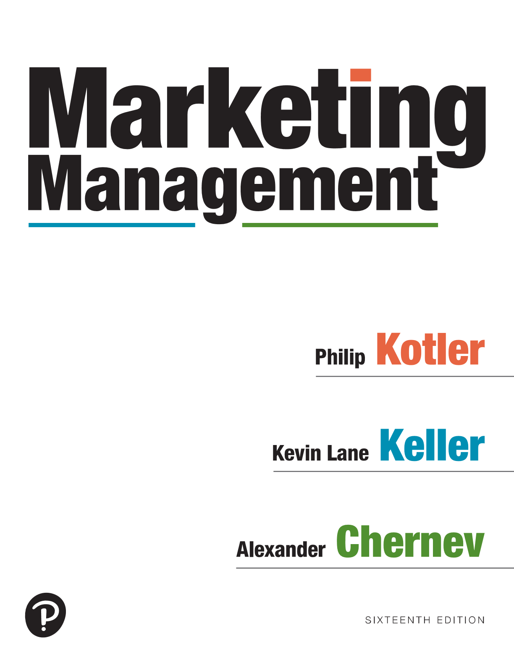

Marketing Management
Sixteenth Edition
Chapter 15
Designing and Managing Distribution Channels
Copyright © 2022, 2016, 2012 Pearson Education, Inc. All Rights Reserved
Notes:
If this PowerPoint presentation contains mathematical equations, you may need to check that your computer has the following installed:
1) MathType Plugin
2) Math Player (free versions available)
3) NVDA Reader (free versions available)

Slide 2
The Role of Distribution Channels
Most companies do not sell directly to consumers. Between them stand a set or intermediaries performing a variety of functions
Distribution channels (AKA Marketing Channels, trade Channels)
  Set of independent yet interdependent
  businesses helping make a product
  or service available for consumers
  Intermediaries:
    Merchants (take title and re-sell)
    Agents/Brokers (no title)
Notes:
Most producers do not sell their goods directly to the final users; between them stands a set of intermediaries performing a variety of functions. These intermediaries constitute a marketing channel (also called a trade channel or distribution channel).
Some intermediaries—such as wholesalers and retailers—buy, take title to, and resell the merchandise; they are called merchants. Others—brokers, manufacturers’ representatives, sales agents—search for customers and may negotiate on the producer’s behalf but do not take title to the goods; they are called agents. Still others— transportation companies, independent warehouses, banks, advertising agencies—assist in the distribution process but neither take title to goods nor negotiate purchases or sales; they are called facilitators.

Slide 3
Distribution Channel Functions
The question for marketers is not whether various channel functions need to be performed—they must be—but, rather, who is to perform them
Activity flow
  Forward flow (storage, movement, title flow, develop communications)
  Backward flow (place orders, payment)
  Both forward and backward (information gathering, price negotiation, finance inventories, risk-taking)
Notes:
.Many of the channel functions involve bi-directional flows of goods and services.
Some of these functions (storage and movement, title, and communications) constitute a forward flow of activity from the company to the customer; others (ordering and payment) constitute a backward flow from customers to the company.
Still others (information, negotiation, finance, and risk taking) occur in both directions.
The question for marketers is not whether various channel functions need to be performed—they must be—but, rather, who is to perform them. Shifting some functions to intermediaries lowers the producer’s costs and prices, but the intermediary must add a charge to cover its work.
If the intermediaries are more efficient than the manufacturer, prices to consumers should be lower. If consumers perform some functions themselves, they should enjoy even lower prices. Changes in channel institutions thus largely reflect the discovery of more efficient ways to combine or separate the economic functions that provide assortments of goods to target customers.

Slide 4
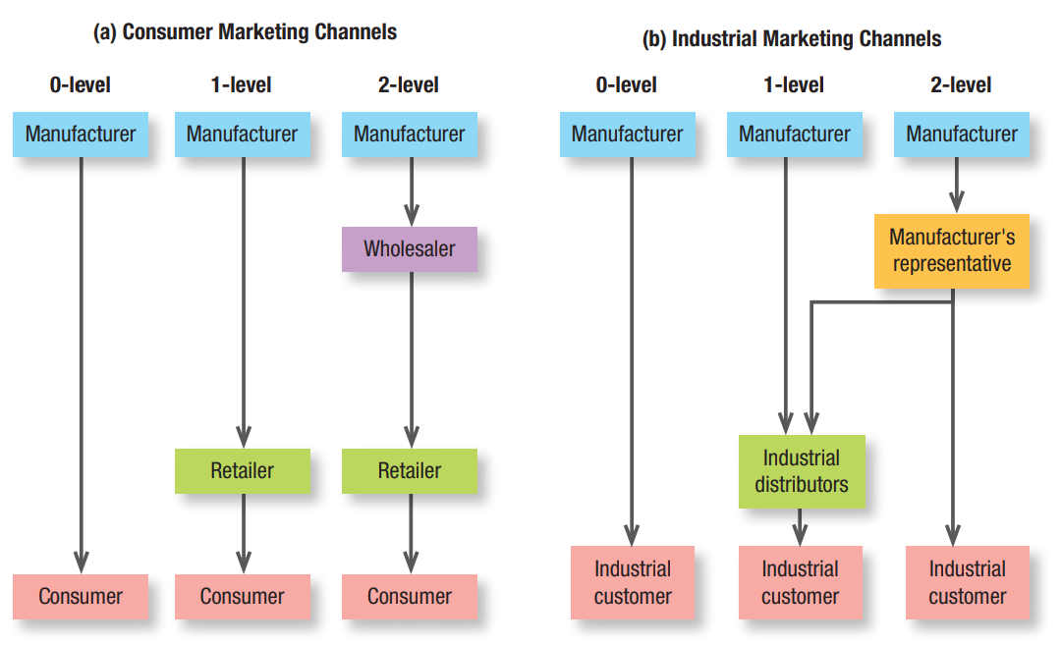
Consumer vs. Industrial Marketing Channels
Notes:
Figure 15.2 shows Consumer and Industrial Marketing Channels..
Distribution channels can be described by the number of intermediaries that exist between the producer and the final customer. The number of intermediaries, also referred to as channel levels, define the length and breadth of the distribution channel.
The first flowchart is titled consumer marketing channels. The flowchart is divided into three columns. The first column labeled 0 level starting from the top followed by the down arrow is as follows: Manufacturer and Consumer. The second column labeled 1level starting from the top followed by down arrows is as follows: Manufacturer, Retailer, and Consumer. The third column labeled 2 level starting from the top followed by down arrows is as follows: Manufacturer, Wholesaler, Retailer, and Consumer.
The second flowchart is titled industrial marketing channels. The flowchart is divided into three columns. The first column labeled 0 levels starting from the top followed by the down arrow is as follows: Manufacturer and Industrial customer. The second column labeled 1level starting from the top followed by down arrows is as follows: Manufacturer, Industrial distributors, and Industrial customer. The third column labeled 2 level starting from the top followed by down arrows is as follows: Manufacturer, Manufacturer’s representative, and Industrial customer. Manufacturer’s representative from 2 levels is connected to Industrial distributors from 1 level with leftward arrow with corner downward.

Slide 5

Multichannel Distribution
Using two or more marketing channels to reach customer segments in one market area
Potential for conflict and issues with control and cooperation
Causes of channel conflict
  Goal incompatibility
  Differences in strategies and tactics
  Power imbalance
  Unclear roles and rights
Notes:
Each channel can target a different segment of buyers, or different need states for one buyer, to deliver the right products in the right places in the right way at the least cost. When this doesn’t happen, channel conflict, excessive cost, or insufficient demand can result. Research has shown that multichannel customers can be more valuable to marketers. Most companies today have adopted multichannel marketing.

Slide 6
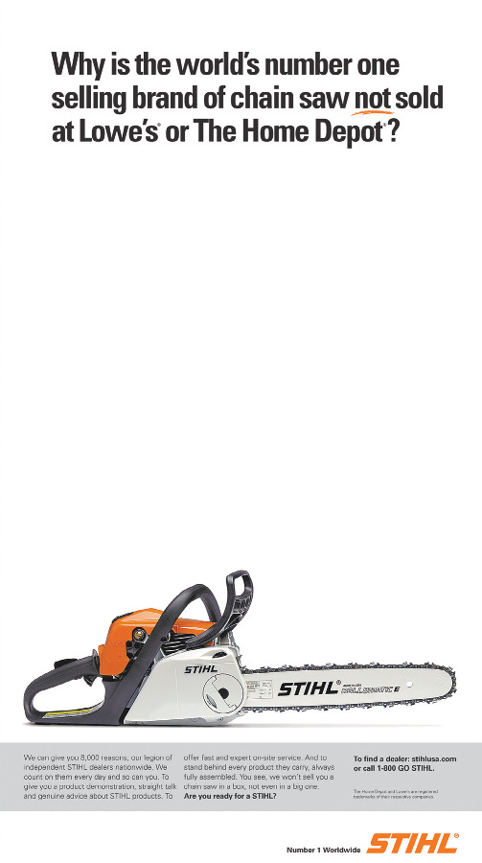
Channel-Management Decisions
Core Distribution Strategies
Number of intermediaries
Exclusive distribution
Selective distribution
Intensive distribution
Notes:
Exclusive distribution severely limits the number of intermediaries. It’s appropriate when the producer wants to ensure more knowledgeable and dedicated efforts by the resellers, and it often requires a closer partnership with them. Exclusive distribution is used for new automobiles, some major appliances, and luxury apparel and accessories.
Both channel partners benefit from exclusive arrangements: The producer obtains more loyal and dependable outlets, and the retailer gets a steady supply of special products and stronger seller support. Exclusive arrangements are legal as long as they do not substantially lessen competition or tend to create a monopoly and as long as both parties enter into them voluntarily.
Selective distribution relies on some but not all of the intermediaries willing to carry a particular product. Unlike exclusive distribution, in which individual retailers do not directly compete with one another (for example, because they are assigned non-overlapping geographic areas), selective distribution might include retailers that compete for the same customers. STIHL is a good example of successful selective distribution.
Intensive distribution places the goods or services in as many outlets as possible. This strategy works well for snack foods, soft drinks, newspapers, candies, and gum—products that consumers buy frequently or in a variety of locations. Convenience stores such as 7-Eleven and Circle K and gas station outlets like ExxonMobil’s On the Run survive by providing simple location and time convenience.

Slide 7
Managing Market Logistics
Supply Chain Management (SCM)
  Includes strategically procuring the right inputs (raw materials, components, and capital equipment), converting them efficiently into finished products, and dispatching them to the final destinations
Notes:
Physical distribution has now been expanded into the broader concept of supply chain management.
The supply chain perspective can help a company identify superior suppliers and distributors and then help it improve productivity and reduce costs.

