Slide 1
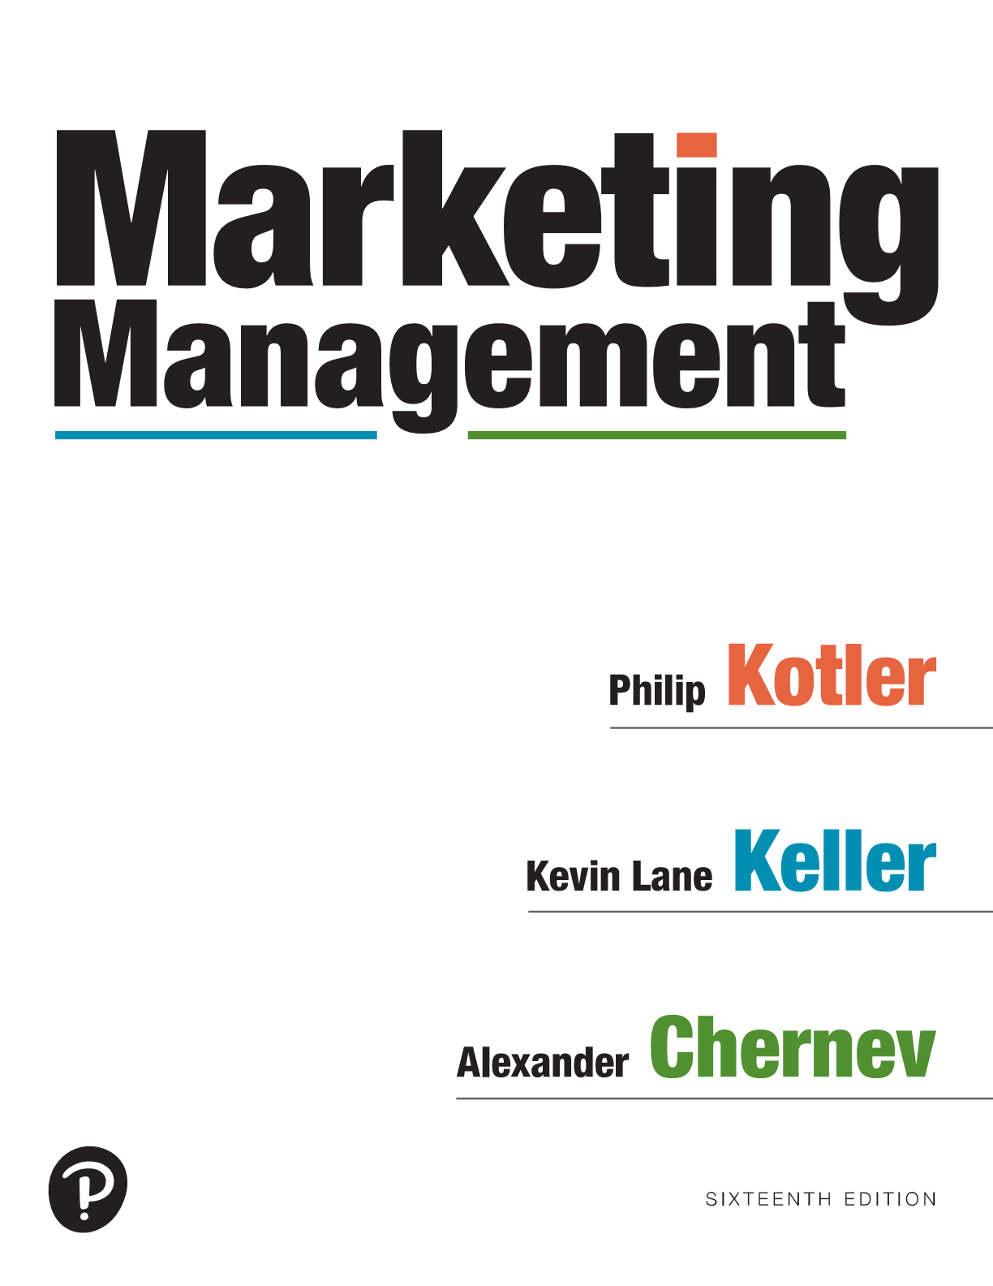
Marketing Management
Sixteenth Edition
Chapter 12
Managing Marketing Communications
Copyright © 2022, 2016, 2012 Pearson Education, Inc. All Rights Reserved
Notes:
If this PowerPoint presentation contains mathematical equations, you may need to check that your computer has the following installed:
1) MathType Plugin
2) Math Player (free versions available)
3) NVDA Reader (free versions available)

Slide 2
Marketing Communications
So.... we’ve developed a great product, priced it attractively, made it available to target customers... what’s left for us to do?
LET THEM KNOW ABOUT IT!!!
Marketing communications
The means by which firms attempt to inform, persuade, and remind consumers about the products and brands they sell
Notes:
In a sense, they represent the voice of the company and its brands; they are a means by which the firm can establish a dialogue and build relationships with consumers. By strengthening customer loyalty, they can contribute to customer equity.
Marketing communications also work by showing consumers how and why a product is used, by whom, where, and when. Consumers can learn who makes the product and what the company and brand stand for, and they can become motivated to try or use it. Marketing communications allow companies to link their brands to other people, places, events, brands, experiences, feelings, and things.

Slide 3
The Communication Process
Notes:
Figure 12.1 shows a macromodel with nine key factors in effective communication. Two represent the major parties—sender and receiver. Two represent the major tools—message and media. Four represent major communication functions—encoding, decoding, response, and feedback. The last element in the system is noise, random and competing messages that may interfere with the intended communication.
Senders must know what audiences they want to reach and what responses they want to get. They must encode their messages so the target audience can successfully decode them. They must transmit the message through media that reach the target audience and develop feedback channels to monitor the responses. The more the sender’s field of experience overlaps that of the receiver, the more effective the message is likely to be.
In the illustration, the flow of arrows is Sender, Encoding, Message Media, Decoding, Receiver, Response, Feedback, and Sender. A box inside the cycle is labeled Noise with four arrows from it in all directions.

Slide 4
Micromodel of Marketing Communication
Steps Involved in Generating a Consumer Response:
Awareness
Knowledge
Liking
Preference
Conviction
Purchase
LEARN
FEEL
DO
Notes:
To increase the odds of success for a communications campaign, marketers must attempt to increase the likelihood that each step occurs. The challenges in achieving success with communications necessitate careful planning.

Slide 5
Designing Effective Communications
What to Say (message strategy)
To Whom Should it be Said (target audience/reach)
How to Say it (creative strategy)
When to Say it (timing)
Who Should Say it (message source)
Where to Say it (media)
How Often Should it be Said (frequency)
Notes:
To increase the odds of success for a communications campaign, marketers must attempt to increase the likelihood that each step occurs. The challenges in achieving success with communications necessitate careful planning.

Slide 6
Developing a Communication Program
Notes:
Figure 12.2 shows he steps involved in developing a communications program.
The ultimate success of a company’s communication campaign depends on the viability of the overall strategy and tactics for managing the company’s offering, which serve as a basis for developing a communication plan.
Thus communication objectives, the choice of target audience, and the design of the communication message typically follow from the company’s overarching marketing plan that defines the offering’s goals, its target customers, and its value proposition.
The steps are Setting the objectives, Identifying the audience, Crafting the message, Deciding on the media, Developing the creative approach, and Measuring performance.

Slide 7
Setting the Communication Objectives
Communications objective
A specific task and achievement level to be accomplished with a specific audience in a specific period
Creating awareness
Building preferences
Inciting action
“Create awareness of the new James Bond movie among 40% of Millennial consumers prior to the movie premiere”
“Increase the number of consumers who believe that toothpaste Brand X has superior whitening power from 10% to 40% in one year”
Notes:
We classify communication objectives according to whether they aim to create awareness by informing the target audience about the offering, to build preferences by persuading the audience of the benefits of the offering, or to incite action by nudging the audience to act in a way that benefits the company and its offering.
Creating awareness provides a foundation for brand equity. Creating awareness involves fostering the consumer’s ability to recognize or recall the brand in sufficient detail to make a purchase.
Building preferences involves communicating an offering’s ability to meet a currently relevant consumer need. Some relevant needs are negatively oriented (problem removal, problem avoidance, incomplete satisfaction, normal depletion).
Inciting action involves motivating consumers to decide to purchase the brand or take purchase-related action. Promotional offers like coupons or two-for-one deals encourage consumers to make a mental commitment to buy.

Slide 8
Determining the communications budget
Objective and task budgeting
Define specific objective, identify tasks to be performed, estimate costs
Consider:
Stage in product life cycle
Product differentiation
Market share
Message complexity
Reach
Competitive communication
Available resources ($$)
Notes:
A practical approach for defining the communication budget is objective-and-task budgeting. This approach calls for marketers to develop a communication budget by defining specific objectives, identifying the tasks that must be performed to achieve these objectives, and estimating their costs. The sum of these costs is the proposed communication budget. The overarching principle is that the total communication budget must be set so the marginal profit from every communication dollar is greater than or equal to the marginal profit from every dollar spent on other marketing activities.
How much resources should a company allocate to marketing communications compared to alternatives such as product improvement, lower prices, or better service? There is no universal rule. How much to spend on marketing communications depends on a variety of factors.
Yet some companies fail to consider all factors and instead single out one particular metric: setting their communication budgets at parity with competitors.
This approach, also referred to as competitive-parity budgeting, is problematic because there are no grounds for believing competitors are more knowledgeable about what the optimal communication budget should be.

Slide 9
Identifying the Target Audience
Start with a clear target audience in mind:
Potential buyers of the company’s product
Current users
Heavy/light users
The Target Audience and the Target Market do not always fully overlap
Notes:
The process must start with a clear target audience in mind: potential buyers of the company’s products, current users, deciders, and influencers, as well as individuals, groups, particular sectors, or the general public. The target audience critically affects the communicator’s decisions about what to say and about how, when, where, and to whom to say it.

Slide 10
Marketing Communications Mix
Advertising
Mobile communication
Events and experiences
Public relations and publicity
Packaging
Personal selling
Online and social media marketing
Direct marketing
Word of mouth
Notes:
The marketing communications mix consists of nine major modes of communication:
• Advertising is any paid form of nonpersonal presentation and promotion of ideas, goods, or services by an identified sponsor via print media (newspapers, magazines, brochures, books, leaflets, directories), broadcast media (radio and television), network media, and display media (billboards, signs, posters, outer packaging, packaging inserts, ad reprints, and point-of-purchase displays). Advertising can build up a long-term image for a product (Coca-Cola ads) or trigger quick sales (a Macy’s ad for a weekend sale). Certain forms of advertising, such as TV, can require a large budget, whereas other forms, such as targeted online ads, do not. The mere presence of mass-media advertising might have an effect on sales: Consumers might believe a heavily advertised brand must be of good quality.
• Online and social media communication involves online activities and programs designed to engage customers or prospects and directly or indirectly raise awareness, improve image, or elicit sales of products and services (websites, e-mails, search ads, display ads, company blogs, third party chat rooms, forums, Facebook and Twitter messages, and YouTube channels and videos). Online marketing and messages can take many forms to interact with consumers when they are in active search mode or when they are just browsing and surfing online for something to do.
• Mobile communication is a special form of online communication that places messages on consumers’ cell phones, smart phones, or tablets (text messages, online communication, and social media communication). Increasingly, online marketing and social media rely on mobile forms of communication such as smart phones or tablets. Mobile communication is timely—messages can be very time-sensitive and reflect when and where a consumer is—and pervasive, meaning that messages are always at consumers’ fingertips.
• Direct marketing involves the use of mail, phone, e-mail, online messaging, or in-person interaction to communicate directly with, or solicit response or dialog from, specific customers and prospects. The advent of data analytics has given marketers the opportunity to learn even more about consumers and develop more personal and relevant marketing communications.
• Events and experiences are company-sponsored activities and programs designed to create brand-related interactions with consumers. Examples include sports, arts, entertainment, festivals, factory tours, company museums, and street activities, as well as events for causes and less formal activities. Events and experiences offer many advantages as long as they are engaging and implicit, meaning that they involve indirect soft sell.
• Word of mouth involves the passing of information from person to person by oral communication. Social media can be viewed as a specific instance of word of mouth, where personal communication occurs online and is observable by others. Marketers can influence naturally occurring word of mouth as well as help to create word of mouth by “seeding” a message that is likely to engage consumers and lead to word-of-mouth communication related to the company and its offerings.
• Publicity and public relations involve a variety of programs directed internally to employees of the company or externally to consumers, other firms, the government, and media to promote or protect a company’s image or its individual product communications (press kits, speeches, seminars, annual reports, charitable donations, publications, community relations, lobbying, identity media, and company magazines). Marketers tend to underuse publicity and public relations, yet a well-thought-out program coordinated with the other elements of the communication mix can be extremely effective, especially if a company needs to challenge consumers’ misconceptions. The appeal of public relations and publicity is based on its high credibility: News stories and features are more authentic and credible to readers than ads.
• Personal selling is a process in which a seller tries to convince a buyer to purchase a particular product or service. Personal selling typically involves face-to-face communication and is highly dependent on the persuasion skills and abilities of the seller. Personal selling often takes place in one of two formats—through retail, where a salesperson interacts with potential customers who come to inquire about a product, and through direct-to-consumer marketing, where a salesperson visits potential buyers to make them aware of a company’s offering.
• Packaging is an effective form of communication, especially in the case of decisions that are made at the point of purchase. The product’s styling, the shape and color of the package, the store décor, and the company’s stationery all communicate an image to buyers and deliver an impression that can strengthen or weaken a customer’s view of a company.

Slide 11
Developing a Media Plan
How to Choose Which Media Vehicle to Use?
TV/Radio – hundreds of stations
Magazines/Newspapers
–thousands of publications
Websites – millions of examples
Media reach (R), frequency (F)
Cost Per Thousand (CPM)
Notes:
The media planner must determine the most cost-effective vehicles within each chosen media type.
Media planners must consider factors such as audience size, composition, and media cost and then calculate the cost per thousand persons reached. First, consider audience quality. For a baby lotion ad, a magazine read by 1 million young parents has an exposure value of 1 million potential buyers; if read by 1 million teenagers, it has an exposure value of almost zero. Second, consider audience-attention probability. Readers of some magazines may pay more attention to ads than do readers of others. Third is the medium’s editorial quality, meaning its prestige and believability. People are more likely to believe a TV or radio ad when it appears within a program they like. Fourth, consider the value of ad placement policies and extra services, such as regional or occupational editions, as well as the lead-time requirements for magazines.

Slide 12
Media Plan Example

