Slide 1
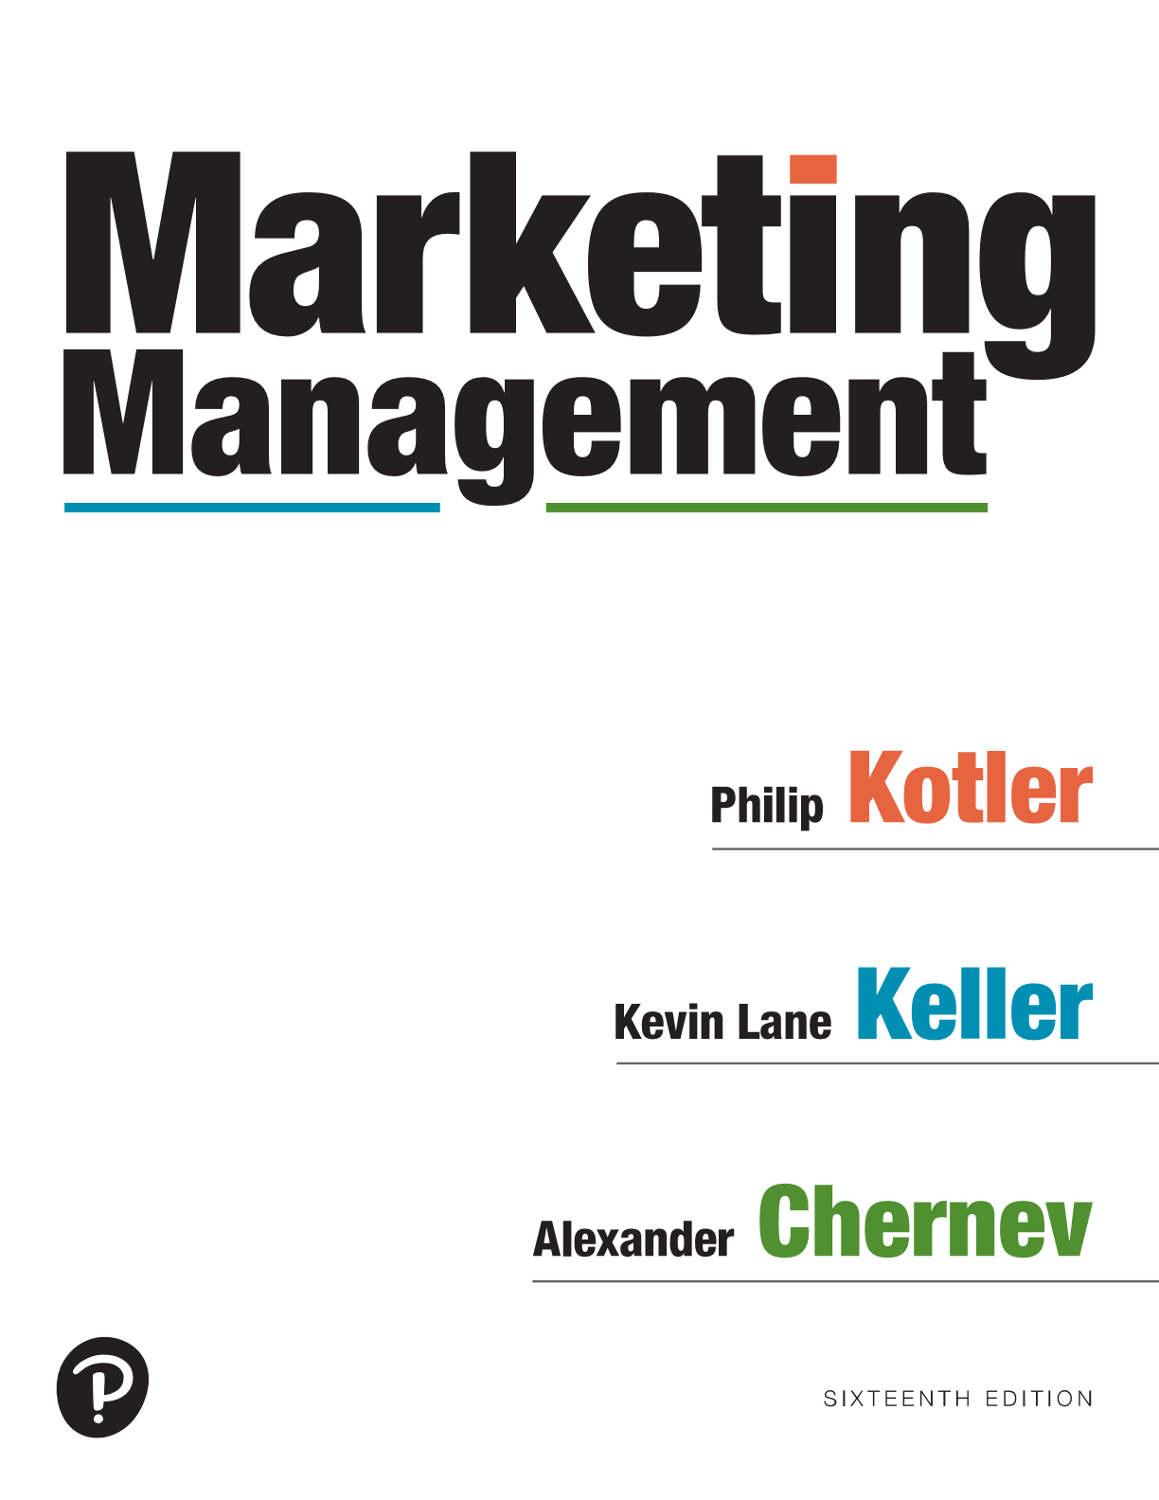
Marketing Management
Sixteenth Edition
Chapter 11
Managing Pricing and Sales Promotions/Incentives
Copyright © 2022, 2016, 2012 Pearson Education, Inc. All Rights Reserved
Notes:
If this PowerPoint presentation contains mathematical equations, you may need to check that your computer has the following installed:
1) MathType Plugin
2) Math Player (free versions available)
3) NVDA Reader (free versions available)

Slide 2
The Pricing Variable
Price is the only variable in the Marketing Mix that produces revenue. All the others produce costs.
Purchase decisions are based on how consumers perceive prices - not actual prices.
Many consumers use price as an indicator of quality
Holistic marketers know their pricing decisions must be consistent with all other aspects of the Marketing Mix
“Price” has many forms: rent, tuition,
fees, rates, wages, tolls, commissions
Notes:
Purchase decisions are based on how consumers perceive prices and what they consider the current actual price to be—not on the marketer’s stated price.
Customers may have a lower price threshold, below which prices signal inferior or unacceptable quality, and an upper price threshold, above which prices are prohibitive and the product appears not worth the money. Different people interpret prices in different ways.
Reference Prices: Although consumers may have fairly good knowledge of price ranges, surprisingly few can accurately recall specific prices. When examining products, however, they often employ reference prices, comparing an observed price to an internal reference price they remember or an external frame of reference such as a posted “regular retail price.” When consumers evoke one or more of these frames of reference, their perceived price can vary from the stated
price.
Image pricing: Many consumers use price as an indicator of quality. Image pricing is especially effective with ego-sensitive products such as perfumes, expensive cars, and designer clothing.
Price Cues: Many sellers believe prices should end in an odd number. Customers perceive an item priced at $299 to be in the $200 rather than the $300 range; they tend to process prices “left to right” rather than by rounding.24 Price encoding in this fashion is important if there is a mental price break at the higher, rounded price. Another explanation for the popularity of “9” endings is that they suggest a discount or bargain, so if a company wants a high-price image, it should probably avoid the odd-ending tactic.

Slide 3
Consumer Psychology and Pricing
Reference prices
Image pricing (perfumes, exotic cars...)
Price cues (odd number ending)
Notes:
Purchase decisions are based on how consumers perceive prices and what they consider the current actual price to be—not on the marketer’s stated price.
Customers may have a lower price threshold, below which prices signal inferior or unacceptable quality, and an upper price threshold, above which prices are prohibitive and the product appears not worth the money. Different people interpret prices in different ways.
Reference Prices: Although consumers may have fairly good knowledge of price ranges, surprisingly few can accurately recall specific prices. When examining products, however, they often employ reference prices, comparing an observed price to an internal reference price they remember or an external frame of reference such as a posted “regular retail price.” When consumers evoke one or more of these frames of reference, their perceived price can vary from the stated
price.
Image pricing: Many consumers use price as an indicator of quality. Image pricing is especially effective with ego-sensitive products such as perfumes, expensive cars, and designer clothing.
Price Cues: Many sellers believe prices should end in an odd number. Customers perceive an item priced at $299 to be in the $200 rather than the $300 range; they tend to process prices “left to right” rather than by rounding.24 Price encoding in this fashion is important if there is a mental price break at the higher, rounded price. Another explanation for the popularity of “9” endings is that they suggest a discount or bargain, so if a company wants a high-price image, it should probably avoid the odd-ending tactic.

Slide 4
Consumer Psychology and Pricing
Reference prices (Comparing an observed price to an internal reference price)
“Fair Price” (what consumers feel the product should cost)
Typical Price
Last Price Paid
Upper-Bound Price (Max consumer would pay)
Lower-Bound Price (Min consumer would pay)
Competitor Price
Expected Future Price
Usual Discounted Price
Notes:
Purchase decisions are based on how consumers perceive prices and what they consider the current actual price to be—not on the marketer’s stated price.
Customers may have a lower price threshold, below which prices signal inferior or unacceptable quality, and an upper price threshold, above which prices are prohibitive and the product appears not worth the money. Different people interpret prices in different ways.
Reference Prices: Although consumers may have fairly good knowledge of price ranges, surprisingly few can accurately recall specific prices. When examining products, however, they often employ reference prices, comparing an observed price to an internal reference price they remember or an external frame of reference such as a posted “regular retail price.” When consumers evoke one or more of these frames of reference, their perceived price can vary from the stated
price.
Image pricing: Many consumers use price as an indicator of quality. Image pricing is especially effective with ego-sensitive products such as perfumes, expensive cars, and designer clothing.
Price Cues: Many sellers believe prices should end in an odd number. Customers perceive an item priced at $299 to be in the $200 rather than the $300 range; they tend to process prices “left to right” rather than by rounding.24 Price encoding in this fashion is important if there is a mental price break at the higher, rounded price. Another explanation for the popularity of “9” endings is that they suggest a discount or bargain, so if a company wants a high-price image, it should probably avoid the odd-ending tactic.

Slide 5
Why do we buy Starbuck’s coffee?
Buyer Psychology and Customer Value
$3.29 $1.69
Notes:
If the firm’s offer contains features not offered by the nearest competitor, it should evaluate their worth to the customer and add that value to the competitor’s price.
If the competitor’s offer contains some features not offered by the firm, the firm should subtract their value from its own price. Now the firm can decide whether it can charge more, the same, or less than the competitor.
Companies offering the powerful combination of low price and high quality are capturing the hearts and wallets of consumers all over the world. Value players, such as Aldi, JetBlue Airways, and Southwest Airlines are transforming the way consumers of nearly every age and income level purchase groceries, apparel, airline tickets, financial services, and other goods and services.

Slide 6
Steps in Setting the Price
Define Pricing Objective
Select Pricing Method
Set Final Price
Determine Demand
Estimate Costs
Analyze Competition
Notes:
Companies spend billions of dollars on sales force promotion tools to gather leads, impress and reward customers, and motivate the sales force. Sales force incentives aim to encourage the sales force to support a new product or model, boosting prospecting and stimulating off-season sales. Sales contests are one popular type of sales force incentive. A sales contest aims at inducing the sales force or dealers to increase sales results over a stated period, with prizes (money, trips, gifts, or points) going to those who succeed.

Slide 7
Step 1: Define the Pricing Objective
Current/Short-term Profit
Market Penetration
Market Skimming
Quality Leadership
Notes:
Four distinctive service characteristics greatly affect the design of marketing programs: intangibility, inseparability, variability, and perishability.

Slide 8
Step 2: Determine Demand Price Elasticity of Demand
Notes:
Figure 11.1 shows inelastic and elastic demand.
In demand curve (a), a price increase from $10 to $15 leads to a relatively small decline in demand from 105 to 100. In demand curve (b), the same price increase leads to a substantial drop in demand from 150 to 50. If demand hardly changes with a small change in price, we say it is inelastic. If demand changes considerably, it is elastic.
Generally speaking, price elasticity is low when (1) the product is distinctive and there are few or no substitutes or competitors; (2) consumers do not readily notice the higher price; (3) consumers are slow to change their buying habits; (4) consumers think the higher prices are justified by factors such as the cost of creating the product, product scarcity, and government taxation; (5) the expenditure is a smaller part of the buyer’s total income or of the total cost of the end product; and (6) part or all of the cost is borne by another party
Graph (a) is titled inelastic demand. The horizontal axis is labeled quantity demanded per period, and the vertical axis is labeled price. The graph shows a sloping line from top left to bottom right passing through (100, $15) and (105, $10). Two horizontal dashed lines and two vertical dashed lines intersect the sloping line at (100, $15) and (105, $10).
Graph (b) is titled elastic demand. The horizontal axis is labeled quantity demanded per period. The graph shows a sloping line from top left to bottom right passing through (50, $15) and (150, $10). Two horizontal dashed lines and two vertical dashed lines intersect the sloping line at (50, $15) and (150, $10), respectively.

Slide 9
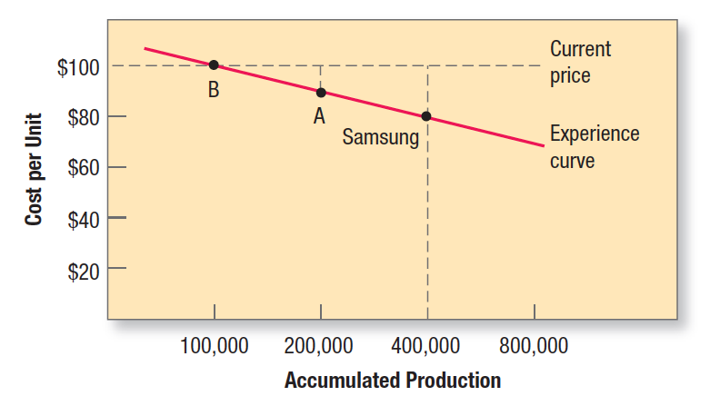
Step 3: Estimate Costs Experience/Learning Curve
Notes:
Suppose Samsung runs a plant that produces 3,000 tablet computers per day. As the company gains experience producing tablets, its methods improve. Workers learn shortcuts, materials flow more smoothly, and procurement costs fall. The result, as Figure 16.3 shows, is that average cost falls with accumulated production experience. Thus the average cost of producing the first 100,000 tablets is $100 per tablet. When the company has produced the first 200,000 tablets, the average cost has fallen to $90. After its accumulated production experience doubles again to 400,000, the average cost is $80. This decline in the average cost with accumulated production experience is called the experience curve or learning curve.
Now suppose three firms compete in this particular tablet market, Samsung, A, and B. Samsung is the lowest-cost
producer at $80, having produced 400,000 units in the past. If all three firms sell the tablet for $100, Samsung makes $20 profit per unit, A makes $10 per unit, and B breaks even. The smart move for Samsung would be to lower its price to $90. This will drive B out of the market, and even A may consider leaving. Samsung will pick up the business that would have gone to B (and possibly A). Furthermore, price-sensitive customers will enter the market at the lower price. As production increases beyond 400,000 units, Samsung’s costs will drop still further and faster, more than restoring its profits, even at a price of $90.

Slide 10
Step 4: Analyze Competitors’ Prices
Companies must take competitors’ costs, prices, and reactions into account
Value-priced competitors
Notes:
If the firm’s offer contains features not offered by the nearest competitor, it should evaluate their worth to the customer and add that value to the competitor’s price.
If the competitor’s offer contains some features not offered by the firm, the firm should subtract their value from its own price. Now the firm can decide whether it can charge more, the same, or less than the competitor.
Companies offering the powerful combination of low price and high quality are capturing the hearts and wallets of consumers all over the world. Value players, such as Aldi, JetBlue Airways, and Southwest Airlines are transforming the way consumers of nearly every age and income level purchase groceries, apparel, airline tickets, financial services, and other goods and services.

Slide 11
Step 5: Selecting a Pricing Method
Three major considerations in price
Costs = price floor
Competitors’ prices = orienting point
Customers’ assessment of unique features = price ceiling
Notes:
Given the customers’ demand schedule, the cost function, and competitors’ prices, the company is now ready to select a price. Companies select a pricing method that includes one or more of these three considerations. We will examine seven price-setting methods: markup pricing, target-return pricing, perceived-value pricing, value pricing, EDLP, going-rate pricing, and auction-type pricing.

Slide 12
Step 5: Selecting a Pricing Method
Markup pricing
Add a standard markup to the product’s cost
Notes:
The most elementary pricing method is to add a standard markup to the product’s cost.
Construction companies submit job bids by estimating the total project cost and adding a standard markup for profit. Lawyers and accountants typically price by adding a standard markup on their time and costs.
Assume the manufacturer wants to earn a 20 percent markup on sales. The manufacturer will charge dealers $20 per toaster and make a profit of $4 per unit. If dealers want to earn 50 percent on their selling price, they will mark up the toaster 100 percent to $40.

Slide 13
Step 5: Break-Even Point for Target-Return Price
Notes:
The manufacturer can prepare a break-even chart to learn what would happen at other sales levels .
Figure 11.2 shows a breakeven chart for determining target-return price and breakeven volume.
Fixed costs are $300,000 regardless of sales volume. Variable costs, not shown in the figure, rise with volume. Total costs equal the sum of fixed and variable costs. The total revenue curve starts at zero and rises with each unit sold. The total revenue and total cost curves cross at 30,000 units. This is the break-even volume.
The horizontal axis is labeled sales volume in units (thousands), and the vertical axis is labeled dollars (in thousands). The horizontal axis ranges from 0 to 50 in increments of 10 units, and the vertical axis ranges from 0 to 1,200 in increments of 200 units. The graph shows a rising line labeled total revenue through (0, 0), (30, 500), (50, 900). Another rising line labeled total cost passes through (0, 300), intersecting total revenue at a point (30, 500), and (50, 600). The point of intersection of two lines is labeled break even point. It shows a horizontal line labeled fixed cost at (0, 300). Two dashed vertical lines intersect the rising lines at (30, 500) and (50, 900), respectively. The distance between the total revenue lines and the total cost is marked with a right brace and labeled target profit. All values are estimated.

Slide 14
Step 6: Set the Final Price
Not one single price
Companies adjust price based on:
Geographic location of customer
Quantity purchased
How customer pays
Purchase timing (dynamic pricing)
Notes:
Pricing methods narrow the range from which the company must select its final price. Companies usually do not set a single price but rather develop a pricing structure that reflects variations in geographic demand and costs, market-segment requirements, purchase timing, order levels, delivery frequency, guarantees, service contracts, and other factors.
Price discrimination occurs when a company sells a product or service at two or more prices that do not reflect a proportional difference in costs.
In first-degree price discrimination, the seller charges each customer a separate price, depending on the intensity of his or her demand.
In second-degree price discrimination, the seller charges less to buyers of larger volumes. With certain services such as cell phone service, however, tiered pricing results in consumers actually paying more with higher levels of usage.
In third-degree price discrimination, the seller charges different amounts to different consumer segments.

Slide 15
Managing Incentives
Incentives (Sales Promotions)
Sales promotion tools, mostly short-term, designed to stimulate quicker or greater purchase of particular products or services by consumers or the trade.
Examples: Digital Coupons and
discounts downloaded to mobile devises
Produce high sales response in short run
but little permanent gain in the long term
Consumers may stockpile
Devalues the company’s offerings
Notes:
Incentives are sales promotion tools, mostly short-term, designed to stimulate quicker or greater purchase of particular products or services by consumers or the trade.

Slide 16
Major Incentive Decisions
Push vs. Pull strategy
Push Strategy uses the manufacturer’s sales force, trade promotion funds, etc. to induce intermediaries to carry, promote and sell the product to consumers
Pull Strategy uses advertising, promotion, etc. to persuade consumers to demand the product from intermediaries, thus inducing the intermediaries to order the item
Notes:
Manufacturers award money to distribution channel members in the form of trade incentives. Unlike consumer incentives that aim to create greater value for buyers, trade incentives aim to increase the attractiveness of the offering for the members of the distribution channel—wholesalers, retailers, and dealers.
Manufacturers, who often find it difficult to police retailers to make sure they are doing what they agreed to do, increasingly insist on proof of performance before paying any allowances. Manufacturers face several challenges in managing trade promotions. Some retailers are doing forward buying — that is, buying a greater quantity during the deal period than they can immediately sell.

Slide 17
Major Consumer Incentive Decisions
Selecting Consumer Incentives
Price reductions
Coupons
Cash refunds
Price packs (BOGO)
Premiums
Frequency programs
Contests/Sweepstakes
Tie-in promotions
Seasonal discounts
Financing
Notes:
The sales promotion planner should take into account the type of market, the sales promotion objectives, competitive conditions, and each tool’s cost effectiveness.

Slide 18
Major Trade Incentive Decisions
Selecting trade incentives
Allowances
Free goods
Price-off
Discount for prompt payment
Notes:
Manufacturers award money to distribution channel members in the form of trade incentives. Unlike consumer incentives that aim to create greater value for buyers, trade incentives aim to increase the attractiveness of the offering for the members of the distribution channel—wholesalers, retailers, and dealers.
Manufacturers, who often find it difficult to police retailers to make sure they are doing what they agreed to do, increasingly insist on proof of performance before paying any allowances. Manufacturers face several challenges in managing trade promotions. Some retailers are doing forward buying — that is, buying a greater quantity during the deal period than they can immediately sell.

