Slide 1
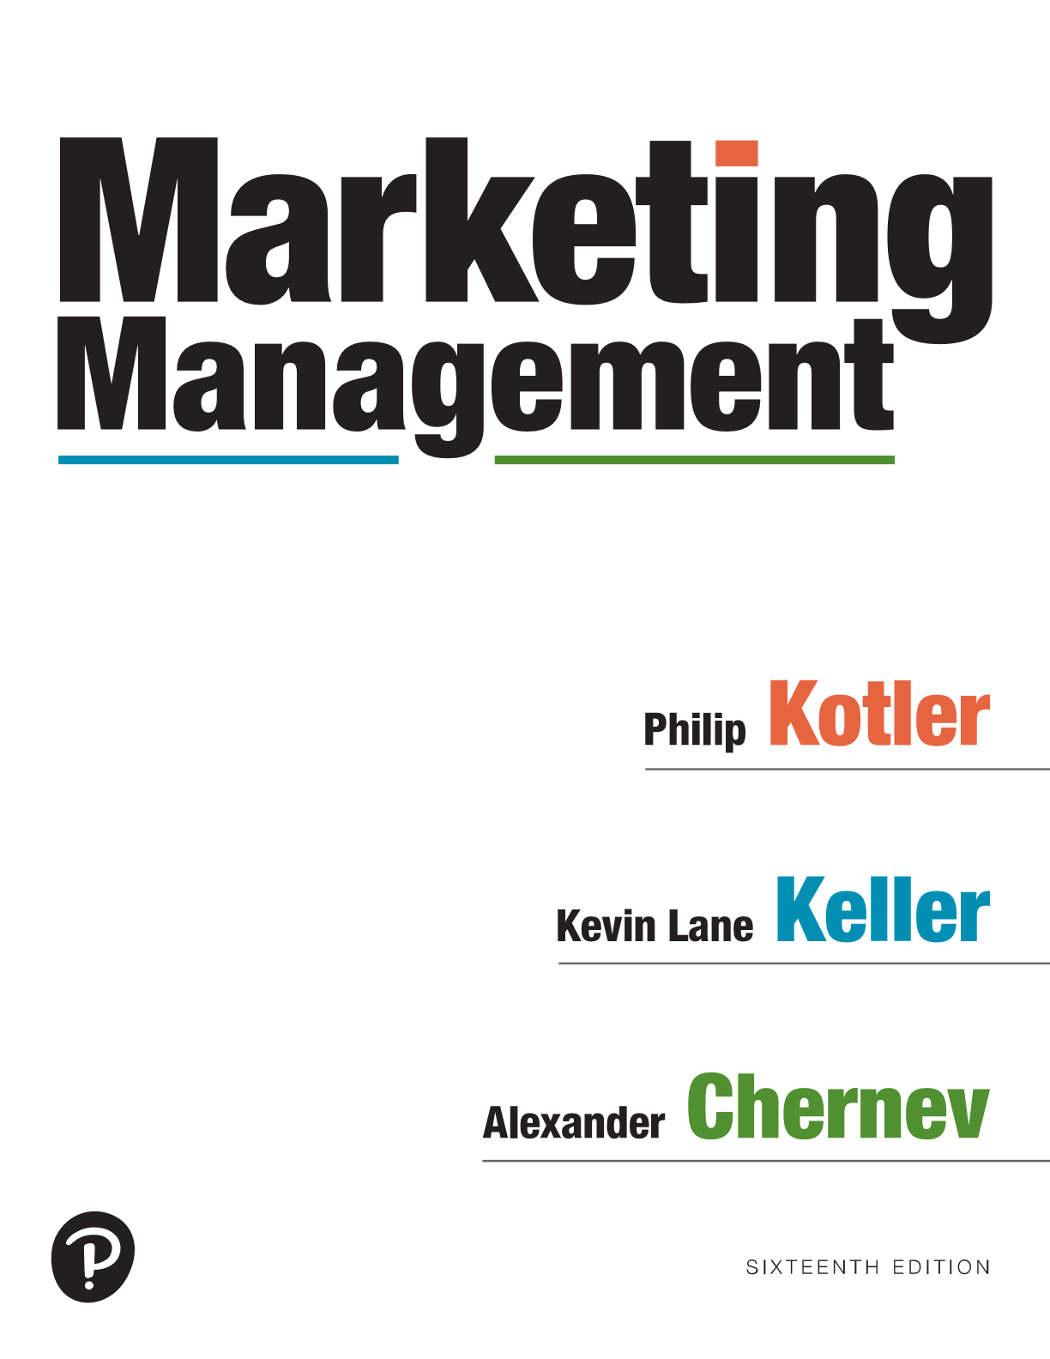
Marketing Management
Sixteenth Edition
Chapter 9
Designing and Managing Services
Copyright © 2022, 2016, 2012 Pearson Education, Inc. All Rights Reserved
Notes:
If this PowerPoint presentation contains mathematical equations, you may need to check that your computer has the following installed:
1) MathType Plugin
2) Math Player (free versions available)
3) NVDA Reader (free versions available)

Slide 2
Types of Services
Government sector (courts, police, fire dept., postal....)
Private Non-Profit sector (museum, churches, colleges)
Business sector (airlines, banks, hotels, law firms….)
Notes:
The service component can be a minor or a major part of the total offering. We distinguish five categories of offerings on this slide.
Restaurants are good examples of hybrid offerings combining products and services. One of the more successful restaurant brands is Panera Bread.

Slide 3
Categories of Services
Tangible good with accompanying service (automobile)
Hybrid (restaurant = goods and service)
Major service with accompanying minor goods/services (airline with food/drinks)
Pure service (tax preparer)
Notes:
The service component can be a minor or a major part of the total offering. We distinguish five categories of offerings on this slide.
Restaurants are good examples of hybrid offerings combining products and services. One of the more successful restaurant brands is Panera Bread.

Slide 4
Characteristics of Services
Intangibility
Inseparability
Variability
Perishability
Notes:
Four distinctive service characteristics greatly affect the design of marketing programs: intangibility, inseparability, variability, and perishability.

Slide 5
Intangibility
Services cannot be seen, tasted, felt, heard, or smelled. Consumers rely on physical cues, price, provider, word of mouth to judge quality
“Tangibilize the intangible”
Place
People
Equipment
Communication
material
Symbols
Price
Notes:
Unlike physical products, services cannot be seen, tasted, felt, heard, or smelled before they are bought.
A person getting cosmetic surgery cannot see the results before the purchase, and the patient in the psychiatrist’s office cannot know the exact outcome of treatment.
To reduce uncertainty, buyers will look for evidence of quality by drawing inferences from the place, people, equipment, communication material, symbols, and price.
Service companies can try to demonstrate their service quality through physical evidence and presentation.

Slide 6
Inseparability
Services are typically produced and consumed simultaneously
Cannot separate provider from service
Notes:
Whereas physical goods are manufactured, then inventoried, then distributed, and later consumed, services are typically produced and consumed simultaneously.
A haircut can’t be stored— or produced without the barber.
Several strategies exist for getting around the limitations of inseparability. The service provider can work with larger groups. The service organization can train more service providers and build up client confidence, as H&R Block has done with its national network of trained tax consultants.

Slide 7
Variability
Must standardize the service
The quality of services depends on who provides them, when and where, and to whom
As such, services are highly variable
People – the fifth “P”
Notes:
Service firms know that variability in their performance puts them at risk. Hilton initiated a major program to create more uniformity in guest experiences. Here are three steps service firms can take to increase quality control.
Invest in good hiring and training procedures.
Standardize the service-performance process throughout the organization.
Monitor customer satisfaction.

Slide 8
Perishability
Services cannot be stored.
Must match supply with demand
How to handle fluctuating demand
Demand side
Differential pricing (peak/non-peak)
Nonpeak demand
Complementary services
Reservation systems
Supply side
Part-time employees
Peak-time efficiency routines
Increased consumer participation
Shared services
Facilities for future expansion
Notes:
Services cannot be stored, so their perishability can be a problem when demand fluctuates.
Perhaps one of the most popular approaches to balancing supply and demand in service delivery is yield pricing.
Demand or yield management is critical—the right services must be available to the right customers at the right places at the right times and right prices to maximize profitability.

Slide 9
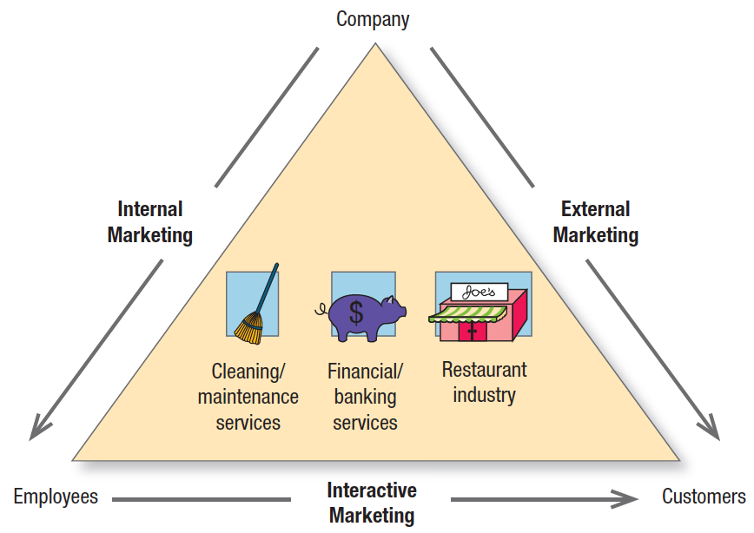
Excelling In Services Marketing
Hiring, Training and Motivating Employees
Notes:
Marketing excellence in services requires excellence in three broad areas: external, internal, and interactive marketing (see Figure 14.3). External marketing describes the normal work of preparing, pricing, distributing, and promoting the service to customers. Internal marketing describes training and motivating employees to serve customers well. Interactive marketing describes the employees’ skill in serving the client. Clients judge service not only by its technical quality (Was the surgery successful?), but also by its functional quality (Did the surgeon show concern and inspire confidence?).

Slide 10
Customer-Centricity
Customer-centricity
Seeing the world in general, and a company’s services in particular, from the customer’s point of view
The best companies are “customer obsessed” and set superior quality standards
Voice Of the Customer (VOC) measurements
Notes:
Top service companies are “customer obsessed.” They have a clear sense of their target customers and their needs, and they have developed a distinctive strategy for satisfying them.
Customer-centricity means seeing the world in general, and a company’s services in particular, from the customer’s point of view.

Slide 11
Service Differentiation
Ease of ordering
Speed and timing of delivery
Installation, training, and consulting
Maintenance and repair
Returns/
Complaints
Notes:
When the physical product cannot easily be differentiated, the key to competitive success may lie in adding valued services and constantly improving their quality.
The main service differentiators are ease of ordering; speed and timing of delivery; installation, training, and consulting; maintenance and repair; and returns.

