Slide 1
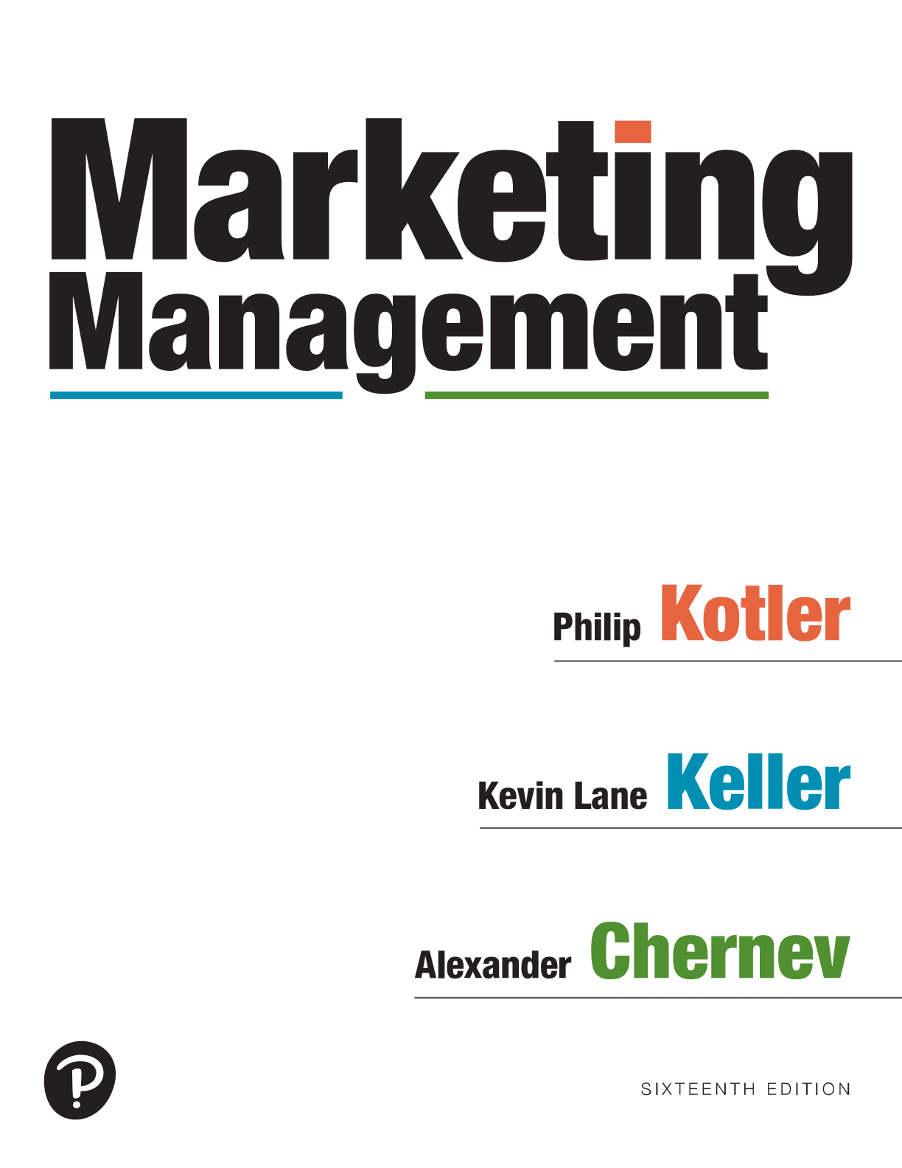
Marketing Management
Sixteenth Edition
Chapter 8
Designing and Managing Products
Copyright © 2022, 2016, 2012 Pearson Education, Inc. All Rights Reserved
Notes:
If this PowerPoint presentation contains mathematical equations, you may need to check that your computer has the following installed:
1) MathType Plugin
2) Math Player (free versions available)
3) NVDA Reader (free versions available)

Slide 2
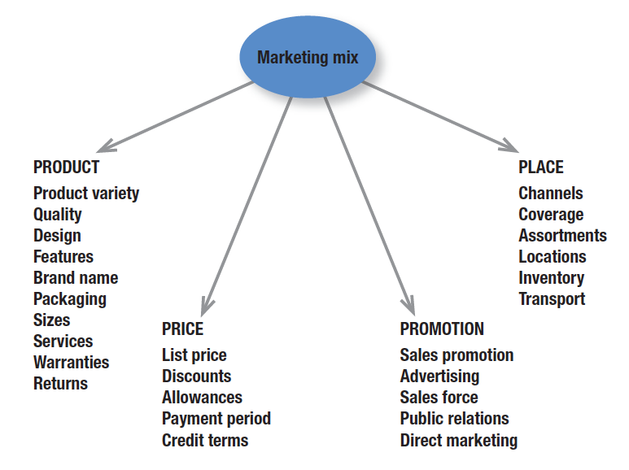
The Marketing Mix The Four Ps
Notes:
Many years ago, McCarthy classified various marketing activities into marketing-mix tools of four broad kinds, which he called the four Ps of marketing: product, price, place, and promotion. The marketing variables under each P are shown in Figure 1.5.

Slide 3
Products
To be successful, companies must offer products and services of superior quality that provide unsurpassed customer value
Product + Brand +Service = Core Drivers of Customer Benefits
Reasons why consumers are willing to purchase a particular offering
Customer Value Proposition: Difference between benefits the customer gets and the costs of each choice
Notes:
Design offers functional and aesthetic benefits and appeals to both our rational and emotional sides.

Slide 4
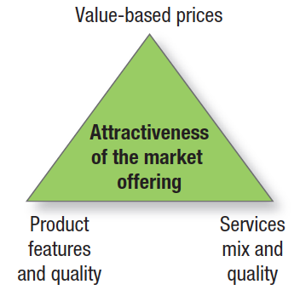
Designing a Product Offering
Notes:
Marketing planning begins with formulating an offering to meet target customers’ needs or wants. The customer will judge the offering on three basic elements: product features and quality, service mix and quality, and price (see Figure 13.1).

Slide 5
Product Differentiation
To successfully compete in any marketplace, products must be differentiated from all other products available
Well-differentiated products can create a competitive advantage
Notes:
To successfully compete in the market, products must be differentiated.
Core functionality. To create customer value, products must deliver on their core benefit. Products that fail to deliver on their core value proposition will inevitably fail in the market. Consider the plight of one-time highflier Nokia.
Features. Most products can be offered with varying features that supplement their basic function. A company can identify and select appropriate new features by surveying recent buyers and then calculating customer value versus company cost for each potential feature.
Performance quality is the level at which the product’s primary characteristics operate. Quality is growing increasingly important for differentiation as companies adopt a value model and provide higher quality for less money. Firms should design a performance level appropriate to the target market and competition—however, not necessarily the highest level possible. They must also manage performance quality through time. Continuously improving the product can produce high returns and market share; failing to do so can have negative consequences. The latter proved to be the case for Kodak and Commodore.
Buyers expect high conformance quality, the degree to which all produced units are identical and meet promised specifications. S

Slide 6
Product Differentiation
Attributes on the basis of which to differentiate include:
Core functionality (must deliver on core benefit)
Features (N.B. Feature Fatigue)
Performance quality (continuous improvement)
Conformance quality (ensures identical products)
Durability (longest-lasting?)
Reliability (best-in-class)
Form (size, shape, physical structure)
Style (look and feel)
Customization (unique)
Notes:
As competition intensifies, design offers a potent way to differentiate and position a company’s products and services.

Slide 7
Direct vs. Indirect Competitors
DIRECT COMPETITION
Same exact product
Same Market
Same Customer Need
INDIRECT COMPETITION
Anything that is considered a substitutable product
Could potentially satisfy the same need
Notes:
Most products exist as a part of a company’s product portfolio and/or product line. Each product must be related to other products to ensure that a firm is offering the optimal set of products to fulfill the needs of its different customer segments.

Slide 8
Direct vs. Indirect Competitors
DIRECT COMPETITION
INDIRECT COMPETITION
Notes:
Most products exist as a part of a company’s product portfolio and/or product line. Each product must be related to other products to ensure that a firm is offering the optimal set of products to fulfill the needs of its different customer segments.

Slide 9
Product Design
Design
Aesthetics -the way a product looks, feels, and functions is a powerful way to differentiate it
Notes:
As competition intensifies, design offers a potent way to differentiate and position a company’s products and services.

Slide 10
Product Portfolio Design
Product portfolio
Encompasses all products offered by a company, including various product categories and product lines
Product portfolio
Width (number of different product lines)
Length (number of items in each line)
Depth (number of variants for each product)
Notes:
Most products exist as a part of a company’s product portfolio and/or product line. Each product must be related to other products to ensure that a firm is offering the optimal set of products to fulfill the needs of its different customer segments.

Slide 11
Product Line
Product line
A group of related products sold by the same company each appealing to different consumers
Each brand has its own brand identity and set of consumers
Notes:
In offering a product line, companies normally develop a basic platform and modules that can be added to meet different customer requirements and lower production costs.
Product line managers need to know the sales and profits of each item in their line to determine which items to build, maintain, harvest, or divest. They also need to understand each product line’s market profile and image.

Slide 12
Product Portfolio Width and Product Line Length for Some Procter & Gamble Products
Product category
Product Category
Product Category
Notes:
Figure 8.1 shows an example of product portfolio width and product line length. Together with depth and consistency, these dimensions permit a company to expand its business in four ways.
It can add new product lines, thus widening its product mix. It can lengthen each product line. It can add more product variants to each product and thereby deepen its product mix. Finally, a company can pursue more product line consistency. To make these product, service, and brand decisions, marketers can conduct product line analysis.
The map has three levels. The first level displays fabric care and shows four different products: Tide, Ariel, bounce, and Downy. The second level displays skin and personal care and shows four different products: Gillette, Ivory, Olay, and Old spice. The third level displays oral care and shows four different products: Crest, Fixodent, oral B, and scope.

Slide 13
Stretching the Product Line
Line stretching – beware of cannibalization
Down-market stretch
Up-market stretch
Two-way stretch
Notes:
Product lines tend to lengthen over time. Excess manufacturing capacity puts pressure on the product line manager to develop new items.
A company lengthens its product line in two ways: line stretching and line filling. Line stretching occurs when a company lengthens its product line beyond its current range, whether down-market, up-market, or both ways.
Down-Market Stretch A company positioned in the middle market may want to introduce a lower-priced line.
Up-Market Stretch Companies may wish to enter the high end of the market to achieve more growth, realize higher margins, or simply position themselves as full-line manufacturers.
Two-Way Stretch Companies serving the middle market might stretch their line in both directions.
Line Filling A firm can also lengthen its product line by adding more items within the present range. Motives for line filling include reaching for incremental profits, satisfying dealers who complain about lost sales because of items missing from the line, utilizing excess capacity, trying to become the leading full-line company, and plugging holes to keep out competitors.
Line Modernization, Featuring, and Pruning Product lines regularly need to be modernized. The product line manager typically selects one or a few items in the line to feature. Using sales and cost analysis, product line managers must periodically review the line for deadwood that depresses profits.

Slide 14
Two-Way Product-Line Stretch:
Quality
Economy
Standard
Good
Superior
High
(Top executives)
Price
Above
average
(Middle managers)
Average
(Salespeople))
Low
(Vacationers)

Slide 15
Managing Warranties and Guarantees
Guarantee
If a product fails to function as promised by the company or as customers expect, the company will provide some type of compensation to the purchaser
Warranties
Cover the repair or replacement of the purchased item and usually do not allow the customer to return the product for a refund
A company’s promise that its products will perform as stated
Adds credibility, reduces risk
Notes:
All sellers are legally responsible for fulfilling a buyer’s normal or reasonable expectations.
Products under warranty can be returned to the manufacturer or designated repair center for repair, replacement, or refund. Whether expressed or implied, warranties are legally enforceable.
Many sellers offer either general or specific guarantees. Guarantees reduce the buyer’s perceived risk. They suggest that the product is of high quality and the company and its service performance are dependable. They can be especially helpful when the company or product is not well known or when the product’s quality is superior to that of competitors.

