Slide 1
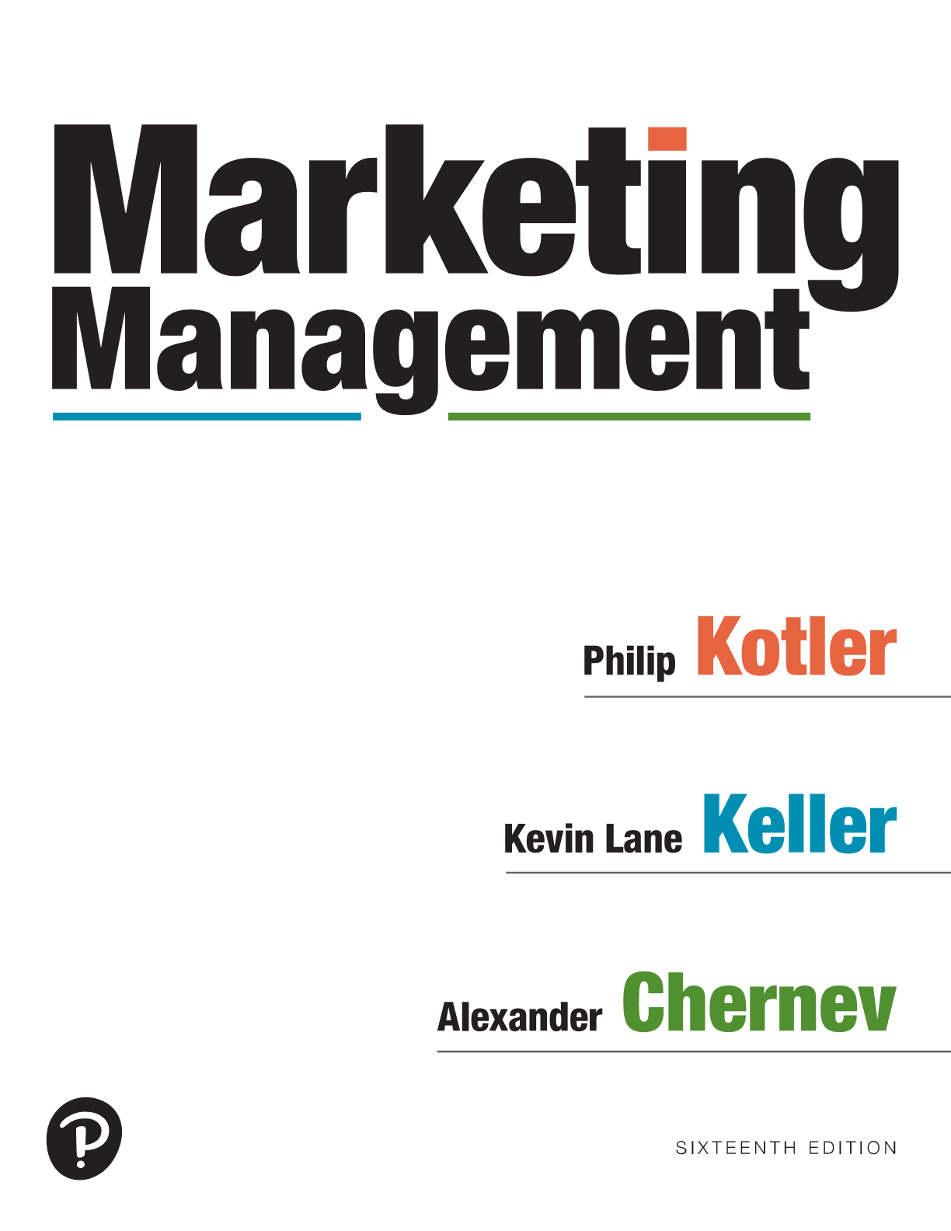
Marketing Management
Sixteenth Edition
Chapter 6
Identifying Market Segments and Target Customers
Copyright © 2022, 2016, 2012 Pearson Education, Inc. All Rights Reserved
Notes:
If this PowerPoint presentation contains mathematical equations, you may need to check that your computer has the following installed:
1) MathType Plugin
2) Math Player (free versions available)
3) NVDA Reader (free versions available)

Slide 2
Target Marketing
Instead of scattering their efforts, successful companies focus their efforts on those consumers they have the greatest chance of satisfying.
Effective targeting requires companies to conduct STP Marketing :
Identify distinct groups of buyers who differ in their needs and wants (Segmentation)
Select one or more market segments to enter (Targeting)
For each segment, establish, communicate and deliver the right benefits for the company’s product (Positioning/Value Proposition)
Notes:
There are many techniques for identifying target customers.
Once the firm has identified its market opportunities, it must decide how many and which ones to target. Marketers are increasingly combining several variables in an effort to identify smaller, better-defined target groups in order to develop an offering that can fulfill these customers’ needs better than the competition.

Slide 3
Identifying Target Customers
Targeting
The process of identifying customers for whom the company will optimize its product offering
Reflects the company’s decision of which customers it will prioritize and serve and which customers it will ignore when designing and communicating its product offering
Notes:
There are many techniques for identifying target customers.
Once the firm has identified its market opportunities, it must decide how many and which ones to target. Marketers are increasingly combining several variables in an effort to identify smaller, better-defined target groups in order to develop an offering that can fulfill these customers’ needs better than the competition.

Slide 4
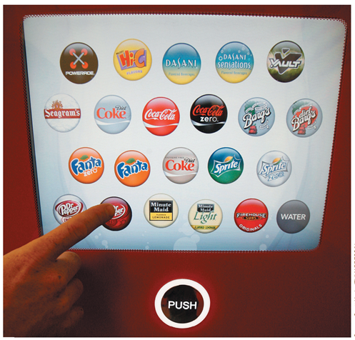
The Logic of Targeting
Mass marketing (Undifferentiated Marketing)
the firm ignores segment differences and
goes after the whole market with one offering.
(Model-T Ford. Different markets for sand and salt can be identified)
Targeted marketing (When consumers have different needs)
Sell different products to different segments of the market
One-to-one/individualized marketing
Mass customization
The ability of a company to meet each
customer’s requirements. To make on
a mass basis, individually designed products,
services, programs, and communications
(Coca Cola’s Freestyle vending machine, create your own flavor)
Notes:
In mass marketing, the firm ignores segment differences and goes after the whole market with one offer. It designs a marketing program for a product with a superior image that can be sold to the broadest number of buyers via mass distribution and mass communications.
The argument for mass marketing is that it creates the largest potential market, which leads to the lowest costs, which in turn can lead to lower prices or higher margins.

Slide 5
Ways to Segment the Consumer Market
Notes:
Demographic factors include age, gender, income, occupation, level of education, religion, ethnicity, nationality, employment status, population density (urban or rural), social class, household size, and stage in the life cycle.
Geographic (geolocation) factors reflect the physical location of target customers. Geographic data describe where the customers are located, in contrast to demographic data, which describe who the target customers are.
Behavioral factors describe customers’ actions. These factors can include customers’ prior experience with the company’s offering, which can be as current customers, competitors’ customers, or new-to-the-category customers. Behavior factors also categorize customers by the frequency with which they purchase the offering, the quantity they purchase, their price sensitivity and sensitivity to the company’s promotional activities, their loyalty, their online versus offline purchases, and the retail outlets they patronize most often.
Psychographic factors involve aspects of an individual’s personality—such as attitudes, value system, interests, and lifestyle. Psychographics link observable and unobservable characteristics of target customers, which is where they differ from demographic, geographic, and behavioral factors. Whereas values, attitudes, interests, and lifestyles can be established by directly questioning customers, psychographic factors often are not readily discernable and must be inferred from the observable characteristics and behavior of customers.

Slide 6
Ways to Segment the Consumer Market
Notes:
Demographic factors include age, gender, income, occupation, level of education, religion, ethnicity, nationality, employment status, population density (urban or rural), social class, household size, and stage in the life cycle.
Geographic (geolocation) factors reflect the physical location of target customers. Geographic data describe where the customers are located, in contrast to demographic data, which describe who the target customers are.
Behavioral factors describe customers’ actions. These factors can include customers’ prior experience with the company’s offering, which can be as current customers, competitors’ customers, or new-to-the-category customers. Behavior factors also categorize customers by the frequency with which they purchase the offering, the quantity they purchase, their price sensitivity and sensitivity to the company’s promotional activities, their loyalty, their online versus offline purchases, and the retail outlets they patronize most often.
Psychographic factors involve aspects of an individual’s personality—such as attitudes, value system, interests, and lifestyle. Psychographics link observable and unobservable characteristics of target customers, which is where they differ from demographic, geographic, and behavioral factors. Whereas values, attitudes, interests, and lifestyles can be established by directly questioning customers, psychographic factors often are not readily discernable and must be inferred from the observable characteristics and behavior of customers.

Slide 7
Demographic Segmentation
Age
Our wants change with age (Generation Y, Z etc.)
Life-cycle stage
Major life events (marriage, divorce, etc.)
Gender
Men and women have different attitudes and behave differently
Income
Income segmentation is a long-standing practice
Race and culture (Multicultural Marketing)
Hispanic Americans
Asian Americans
African Americans
Notes:
One reason demographic variables such as age, family size, family life cycle, gender, income, occupation, education, religion, race, generation, nationality, and social class are so popular with marketers is that they’re often associated with consumer needs and wants.
Another is that they’re easy to measure.

Slide 8
Geographic Segmentation
Divides the market into geographic units such as nations, states, regions, counties, cities, or neighborhoods (urban, suburban)
Notes:
Geographic segmentation divides the market into geographic units such as nations, states, regions, counties, cities, or neighborhoods.
The company can operate in one or a few areas, or it can operate in all areas while heeding local variations. In that way, it can tailor marketing programs to the needs and wants of local customer groups in trading areas and neighborhoods, and it can even cater to the needs of individual customers.
Going online to reach customers in a particular geographic location can open a host of local opportunities, as Yelp has found out.

Slide 9
Behavioral Segmentation
Divides buyers into groups on the basis of their actions
User status (Non-user, Regular, Competitive, Ex)
Usage rate (Light, Medium, Heavy users)
Buyer-readiness stage (Aware, Interested, Desire, etc.)
Loyalty status (Hard Core, Split, Shifting, Switchers)
Occasions (Everyday, Special)
Needs/benefits sought
Notes:
In behavioral segmentation, marketers divide buyers into groups on the basis of their actions.
Many marketers believe variables related to users or their usage—user status, usage rate, buyer-readiness stage, loyalty status, and occasions—are good starting points for constructing market segments.

Slide 10
Toothpaste Market: Needs/Benefits Sought
Notes:
Geographic segmentation divides the market into geographic units such as nations, states, regions, counties, cities, or neighborhoods.
The company can operate in one or a few areas, or it can operate in all areas while heeding local variations. In that way, it can tailor marketing programs to the needs and wants of local customer groups in trading areas and neighborhoods, and it can even cater to the needs of individual customers.
Going online to reach customers in a particular geographic location can open a host of local opportunities, as Yelp has found out.

Slide 11
Product Consumption of Heavy Users
PRODUCT (% USERS)
HEAVY USER
LIGHT USER
Soaps and
detergents (94%)
75%
25%
Toilet tissue (95%)
71%
29%
Shampoo (94%)
79%
21%
Paper towels (90%)
75%
25%
Cake mix (74%)
83%
17%
Cola (67%)
83%
17%
Beer (41%)
87%
13%
Dog food (30%)
81%
19%
Bourbon (20%)
95%
5%

Slide 12
Psychographic Segmentation
Buyers are divided into groups on the basis of:
Personality
Activities/Interests
Attitudes
Values
Lifestyle
Notes:
In psychographic segmentation, buyers are divided into groups on the basis of psychological traits, lifestyle, or values.
Psychographic segmentation is important because demographic, geographic, and behavioral characteristics of consumers do not always accurately reflect their underlying needs.

