Slide 1
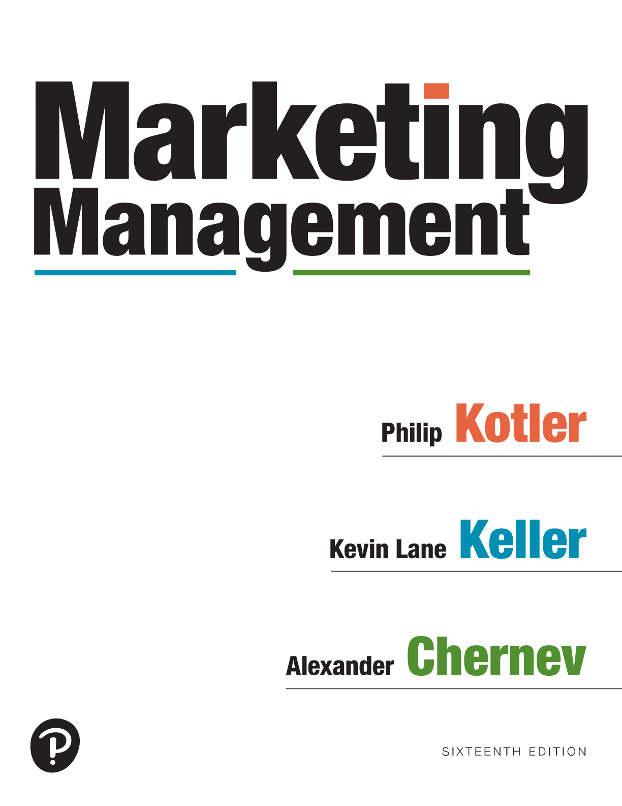
Marketing Management
Sixteenth Edition
Chapter 5
Conducting Marketing Research
Copyright © 2022, 2016, 2012 Pearson Education, Inc. All Rights Reserved
Notes:
If this PowerPoint presentation contains mathematical equations, you may need to check that your computer has the following installed:
1) MathType Plugin
2) Math Player (free versions available)
3) NVDA Reader (free versions available)

Slide 2
The Scope of Marketing Research
Marketing Research provides timely information to help improve decision-making
Short term tactical decisions or longer term strategic decisions can all be addressed by Marketing Research
Market Survey
Product-Preference test
Advertising Message Evaluation
New Product Evaluation
Purchase Intent
Notes:
AMA: Marketing research specifies the information required to address these issues, designs the method for collecting information, manages and implements the data collection process, analyzes the results, and communicates the findings and their implications.

Slide 3
The Scope of Marketing Research
Marketing Research is all about generating marketing insights and what they mean to marketers
how and why we observe certain effects in the marketplace
Notes:
Good marketing insights often form the basis of successful marketing programs.

Slide 4
Example of Marketing Insight
For almost 20 years, Walmart’s advertising slogan was:
A research study revealed Walmart had two competitive advantages:
1. Functional benefit: “offers low prices”
Emotional benefit: “makes me feel like a smart shopper”
This lead to a new advertising slogan:
This changed Walmart’s negative reputation for cheap merchandise, shifting consumer perception away from price alone to how shopping at Walmart could help them attain a better lifestyle.
Notes:
Good marketing insights often form the basis of successful marketing programs.

Slide 5
The Marketing Research Process
Exploratory Research
Notes:
Figure 5.1 shows the marketing research process.
To take advantage of all the resources and practices available, good marketers adopt a formal marketing research process that follows the five steps shown.
Starting from the top, the five steps of the marketing research process are as follows. Define the problem, Develop the research plan, Collect the information, Analyze the information, and Make the decision.

Slide 6
Defining the Problem
Only when the problem has been clearly defined can research be defined and conducted effectively
Inadequate problem definition is leading cause of research failure
Define the research objectives
Notes:
Marketing managers must be careful not to define the problem too broadly or too narrowly for the marketing researcher.
To help design the research, management should first spell out the decisions it might face and then work backward. Now management and marketing researchers are ready to set specific research objectives.
Some research is exploratory—its goal is to identify the problem and to suggest possible solutions. Some is descriptive—it seeks to quantify demand, such as how many first-class passengers would purchase ultra high-speed Wi-Fi service at $25. Some research is causal—its purpose is to test a cause-and-effect relationship.

Slide 7
Developing the Research Plan Sources of Data
Internal External
Secondary Data
(Already Exists)
Primary Data
(Newly Gathered)

Slide 8
Developing the Research Plan
Research approaches
Observational research
Ethnographic research
Focus group research
Survey research
Behavioral research (Store scanner data, catalog purchases, customer databases. Actual purchases more reliable than what consumers say they do)
Notes:
Observational Research: Researchers can gather fresh data by observing unobtrusively as customers shop or consume products. Sometimes they equip consumers with pagers and instruct them to write down or text what they’re doing whenever prompted, or they hold informal interview sessions at a café or bar.
Ethnographic research uses concepts and tools from anthropology and other social science disciplines to provide deep cultural understanding of how people live and work. The goal is to immerse the researcher into consumers’ lives to uncover unarticulated desires that might not surface in any other form of research.
Focus Group Research: A focus group is a gathering of 6 to 10 people carefully selected for demographic, psychographic, or other considerations and convened to discuss various topics at length for a small payment. A professional moderator asks questions and probes based on the marketing managers’ agenda; the goal is to uncover consumers’ real motivations and the reasons they say and do certain things. Sessions are typically recorded, and marketing managers often observe from behind two-way mirrors. To allow more in-depth discussion, focus groups are trending smaller in size.
Survey Research: Companies undertake surveys to assess people’s knowledge, beliefs, preferences, and satisfaction and to measure these magnitudes in the general population.
Behavioral Research: Customers leave traces of their purchasing behavior in store scanning data, catalog purchases, and customer databases. Marketers can learn much by analyzing these data. Actual purchases reflect consumers’ preferences and often are more reliable than statements they offer to market researchers. Experimental research is designed to capture cause-and-effect relationships by eliminating competing explanations of the findings. If the experiment is well designed and executed, research and marketing managers can have confidence in the conclusions.

Slide 9
Focus Groups
Notes:
A focus group is a gathering of 6 to 10 people carefully selected by researchers based on certain demographic, psychographic, or other considerations and brought together to discuss various topics of interest at length. Participants are normally paid a small sum for attending. A professional research moderator provides questions and probes based on the marketing managers’ discussion guide or agenda. In focus groups, moderators try to discern consumers’ real motivations and why they say and do certain things. They typically record the sessions, and marketing managers often remain behind two-way mirrors in the next room. To allow for more in-depth discussion with participants, focus groups are trending smaller in size. Focus-group research is a useful exploratory step, but researchers must avoid generalizing from focus-group participants to the whole market, because the sample size is too small and the sample is not drawn randomly.

Slide 10
Survey Research: Types of Questions
Notes:
Table 5.1 shows types of questions in a questionnaire.
Table 5.1 provides examples of both close-ended questions and open-ended questions.
Closed-end questions specify all the possible answers, and the responses are easier to interpret and tabulate.
Open-end questions allow respondents to answer in their own words. They are especially useful in exploratory research, where the researcher is looking for insight into how people think, rather than measuring how many think a certain way.
The table is as follows. The table has 7 Rows and 3 columns. The columns have the following headings from left to right. Name, Description, Example. The Row entries are as follows. Line 1. Dichotomous, A question with two possible answers, In arranging this trip, did you personally phone American, question mark. Yes or No. Line 2. Multiple choice, A question with three or more answers, With whom are you traveling on this flight, question mark. Six checkboxes with texts, No one, Spouse, Spouses and children, children only, Business associates, friends, relatives, and An organized tour group. . Line 3. Likert scale, A statement with which the respondent shows the level of agreement, disagreement, Small airlines generally give better service than large ones. 1. Strongly disagree. 2. Disagree. 3. Neither agree nor disagree. 4. Agree. 5. Strongly agree. Line 4. Semantic differential, A scale connecting two bipolar words. The respondent selects the point that represents his or her opinion. I find American Airlines. Large to small. Experienced to inexperienced. Modern to old fashioned. Line 5. Importance scale, A scale that rates the importance of some attribute, To me, airline in flight service is. 1. Extremely important. 2. Very important. 3. Somewhat important. 4. Not very important. 5. Not at all important. . Line 6. Rating scale, A scale that rates some attribute from poor to excellent, American inflight service is. 1. Excellent. 2. Very good. 3. Good. 4. Fair. 5. poor. . Line 7. Intention to buy scale, A scale that describes the respondent’s intention to buy, If ultra high speed wi-fi service were available on a long flight, i would. 1. Definitely buy. 2. Probably buy. 3. Not sure. 4. Probably not buy. 5. Definitely not buy.

Slide 11
Collecting the Information
Sampling plan
Sampling unit: Whom should we survey?
Sample size: How many people should we survey?
Sampling procedure: How should we choose the respondents?
Contact methods:
Online
In person
Mail and email
Telephone
Notes:
The data collection phase of marketing research is generally the most expensive and error prone.
Some respondents will be away from home, offline, or otherwise inaccessible and must be contacted again or replaced. Others will refuse to cooperate or will give biased or dishonest answers. In order to control costs while maintaining high-quality responses, a company must develop a meaningful sampling and data collection plan.
After choosing the research approach and instruments, the marketing researcher must put together a sampling plan designed to obtain high-quality responses while keeping costs in line. This calls for three decisions:
Whom should we survey?
How many people should we survey?
How should we choose the respondents?

