Slide 1


Marketing Management
Sixteenth Edition
Chapter 3
Analyzing Consumer Markets
Copyright © 2022, 2016, 2012 Pearson Education, Inc. All Rights Reserved
Notes:
If this PowerPoint presentation contains mathematical equations, you may need to check that your computer has the following installed:
1) MathType Plugin
2) Math Player (free versions available)
3) NVDA Reader (free versions available)

Slide 2
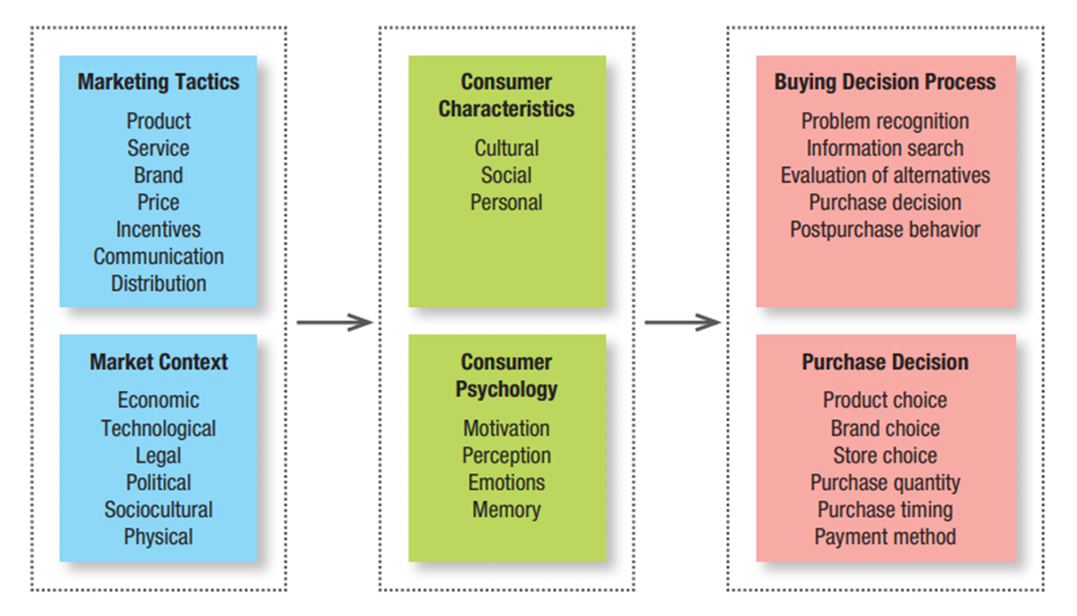
Model of Consumer Behavior
4 Ps
AKA
External
Macro
Environment
Notes:
Figure 3.1 shows the model of consumer behavior. As shown in the model, the tactics shaping the offering and the context of the market in which the offering will be sold are filtered through the cultural, social, and personal lenses of target customers, as well as being influenced by consumer motivation, perception, emotions, and memory. This, in turn, influences the consumer buying process—a journey that entails recognition of a need, a search for the best means to fulfill that need, and evaluation of the available options to finally arrive at the ultimate decision of what, when, where, and how much to buy, and how to pay for these purchases.
Starting from the left, the flowchart reads Marketing Tactics. Product, Service, Brand, Price, Incentives, Communication, and Distribution. Market Context. Economic, Technological, Legal, Political, Sociocultural, and Physical. Consumer Characteristics. Cultural, Social, and Personal. Consumer Psychology. Motivation, Perception, Emotions, and Memory. Buying Decision Process. Problem recognition, Information search, Evaluation of alternatives, Purchase decision, and Postpurchase behavior. Purchase Decision. Product choice, Brand choice, Store choice, Purchase quantity, Purchase timing, and Payment method.

Slide 3
External Macro Environment
Marketing Context
Political Economic Social/Cultural Technological Environmental Legal
(Physical)
Demographic
Natural
Economic
Technological
Socio-cultural
Political-legal
Notes:
Firms must monitor six major forces in the broad environment: demographic, economic, social-cultural, natural, technological, and political-legal. Their interactions will lead to new opportunities and threats.

Slide 4

Influences on Consumer Behavior
Consumer Characteristics
Cultural Factors
Social Factors
Personal Factors

Slide 5
Influences on Consumer Behavior
Cultural Factors
  Culture Fundamental determinant of person’s wants. Exerts broadest & deepest influence
  Subcultures Nationality, religions, race, geographic region
  Social classes
Notes:
Culture, subculture, and social class are particularly important influences on consumer buying behavior. Culture is the fundamental determinant of a person’s wants and behavior.
Each culture consists of smaller subcultures that provide more specific identification and socialization for their members. Subcultures include nationalities, religions, racial groups, and geographic regions.
Virtually all human societies exhibit social stratification, most often in the form of social classes, relatively homogeneous and enduring divisions in a society, hierarchically ordered and with members who share similar values, interests, and behavior.

Slide 6
Influences on Consumer Behavior
  Reference groups include groups that have a direct or indirect effect on a person’s beliefs, decisions, and behavior
  Family
  Family of orientation (born onto)
  Family of procreation (your children)
Social Factors
Notes:
In addition to cultural factors, social factors such as reference groups, family, and social roles and statuses affect our buying behavior.
Reference groups include all the groups that have a direct (face-to-face) or indirect influence on their attitudes or behavior.

Slide 7
Reference Groups
Primary group is family
Aspirational groups
Dissociative groups (reject)
Opinion leader or influencer offers informal advice or information about a specific product or product category
Notes:
Groups having a direct influence are called membership groups. Some of these are primary groups with whom the person interacts fairly continuously and informally, such as family, friends, neighbors, and coworkers. People also belong to secondary groups, such as religious, professional, and trade-union groups, which tend to be more formal and require less continuous interaction.
Aspirational groups are those a person hopes to join; dissociative groups are those whose values or behavior an individual rejects.
Where reference group influence is strong, marketers must determine how to reach and influence the group’s opinion leaders. An opinion leader is the person who offers informal advice or information about a specific product or product category, such as which of several brands is best or how a particular product may be used.

Slide 8
Influences on Consumer Behavior
Personal Factors
  Age/life cycle stage
  Occupation and economic circumstances
  Personality and self-concept
  Lifestyle (A.I.O) and values
Notes:
Our taste in food, clothes, furniture, and recreation is often related to our age. Consumption is also shaped by the family life cycle and the number, age, and gender of people in the household at any point in time.
In addition, psychological life-cycle stages may matter. Adults experience certain passages or transformations as they go through life.
Marketers try to identify the occupational groups that have above-average interest in their products and services and even tailor products for certain occupational groups: Computer software companies, for example, design different products for brand managers, engineers, lawyers, and physicians.
By personality, we mean a set of distinguishing human psychological traits that lead to relatively consistent and
enduring responses to environmental stimuli including buying behavior. We often describe personality in terms of such traits as self-confidence, dominance, autonomy, deference, sociability, defensiveness, and adaptability.
Consumers often choose and use brands with a brand personality consistent with their actual self-concept (how we view ourselves), though the match may instead be based on the consumer’s ideal self-concept (how we would like to view ourselves) or even on others’ self-concept (how we think others see us).
People from the same subculture, social class, and occupation may adopt quite different lifestyles. A lifestyle is a person’s pattern of living in the world as expressed in activities, interests, and opinions.

Slide 9
Consumer Psychological Processes
Motivation
Perception
Learning
Memory
Notes:
Marketing and environmental stimuli enter the consumer’s consciousness, and a set of psychological processes combine with certain consumer characteristics to result in decision processes and purchase decisions. The marketer’s task is to understand what happens in the consumer’s consciousness between the arrival of the outside marketing stimuli and the ultimate purchase decisions.
Four key psychological processes—motivation, perception, learning, and memory—fundamentally influence consumer responses.

Slide 10
Motivation
Needs
  Basic human requirements
  (air, food, water, clothing, shelter)
  Wants (specific object that might
  satisfy a need)
  Demands (wants backed by an ability to buy)
  A need becomes a motive when it is aroused to a sufficient level of intensity to drive us to act
Notes:
Understanding consumer motivation begins with understanding the needs consumers aim to fulfill with their actions.
Needs are the basic human requirements, such as air, food, water, clothing, and shelter.
Some needs are biological and arise from physiological states of tension such as hunger, thirst, or discomfort. Other needs are psychological and arise from psychological states of tension such as the need for recognition, esteem, or belonging.
Needs become wants when directed to specific objects that might satisfy the need. Our wants are shaped by our society.
Demands are wants for specific products backed by an ability to pay. Many people want a Mercedes but only relatively few can buy one.

Slide 11
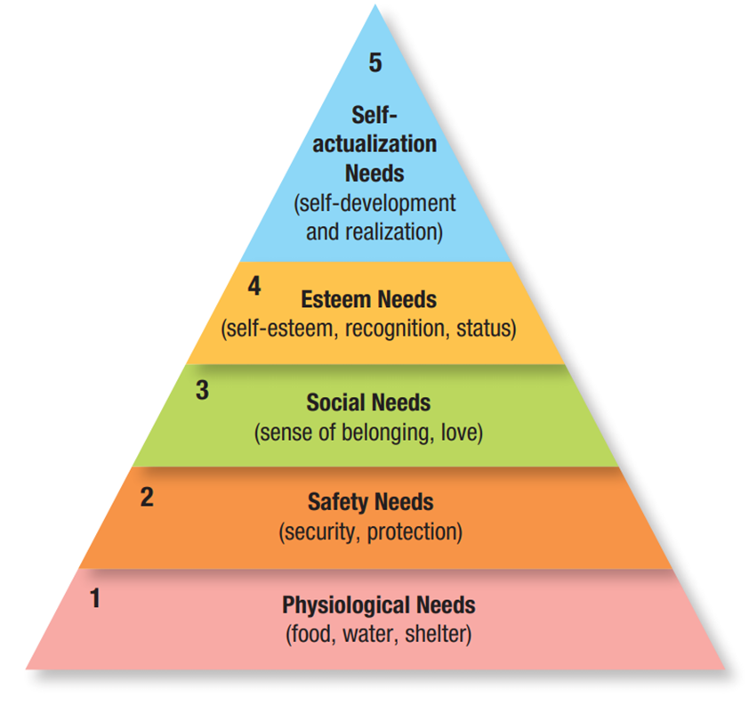
Maslow’s Hierarchy of Needs
Notes:
Figure 3.2 shows Maslow’s Hierarchy of Needs. One of the best-known theories of human motivation, that of Abraham Maslow, carries important implications for consumer analysis and marketing strategy. Maslow sought to explain why people are driven by particular needs at particular times.
His answer is that human needs are arranged in a hierarchy from most to least pressing—from physiological needs to safety needs, social needs, esteem needs, and self-actualization needs. People try to satisfy their most important needs first and then move to the next important. For example, a starving man will not take an interest in the latest happenings in the art world (need 5), or in the way he is viewed by others (need 3 or 4), or even in whether he is breathing clean air (need 2) until he has enough food and water (need 1), after which the next most important needs will become salient.
From bottom to top, the stages are as follows. 1. Physiological needs (food, water, shelter). 2. Safety needs (security, protection). 3. Social needs (sense of belonging, love). 4. Esteem needs (self esteem, recognition, status). 5. Self actualization needs (self development and realization).

Slide 12


Slide 13
Perception
Perception
  How we select, organize, and interpret information to create meaningful picture of the world
Selective attention
  Marketers must work hard to attract attention of consumers
Selective distortion
  We interpret information in a way that fits our preconceptions
Selective retention
  Limited ability to retain information
Notes:
A motivated person is ready to act—how is influenced by his or her perception of the situation. In marketing, perceptions are more important than reality because they affect consumers’ actual behavior.

Slide 14
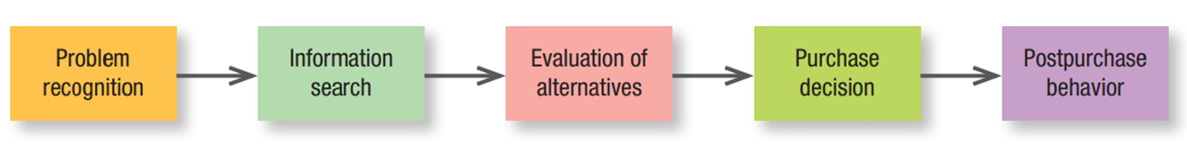
The Consumer Buying/Decision Process
Notes:
Figure 3.3 shows the Five-Stage Model of the Consumer Buying Process.
Consumers don’t always pass through all five stages; they may skip or reverse some. When you buy your regular brand of toothpaste, you go directly from the problem-recognition stage to the purchase decision, skipping information search and evaluation. The model in Figure 3.3 provides a good frame of reference, however, because it captures the full range of considerations that arise when a consumer contemplates a new purchase or a high-involvement product that entails functional, psychological, or monetary risk.
From left to right, the stages are as follows. Problem recognition, information search, evaluation of alternatives, purchase decision, and postpurchase behavior.

Slide 15
The Buying/Decision Process
Information search
  Personal sources (family, friends, neighbors, acquaintances)
  Commercial sources (ads, websites, salespeople, etc.)
  Public sources (social media, ratings organizations)
  Experiential sources (handling, examining, using product)
Notes:
The relative amount of information and influence of these sources vary with the product category and the buyer’s characteristics.
Generally speaking, although consumers receive the greatest amount of information about a product from commercial—that is, marketer-dominated—sources, the most effective information often comes from personal or experiential sources or public sources that are independent authorities.

Slide 16
The Buying Decision Process
The Marketer’s job doesn’t end with the purchase
Postpurchase behavior
Expectation vs. performance
  Satisfaction/Dissatisfaction
  Postpurchase actions
  Postpurchase uses and disposal
Notes:
Satisfaction is a function of the closeness between expectations and the product’s perceived performance. If performance falls short of expectations, the consumer is disappointed; if it meets expectations, the consumer is satisfied; if it exceeds expectations, the consumer is delighted.
A satisfied consumer is more likely to purchase the product again and will also tend to say good things about the brand to others. Dissatisfied consumers may abandon or return the product. They may seek information that confirms its high value. They may take public action by complaining to the company, going to a lawyer, or complaining directly to other groups (such as business, private, or government agencies) or to many others online. Private actions include deciding to stop buying the product (exit option) or warning friends (voice option).
Marketers should also monitor how buyers use and dispose of the product. A key driver of sales frequency is product consumption rate—the more quickly buyers consume a product, the sooner they may be back in the market to repurchase it.

