Slide 1
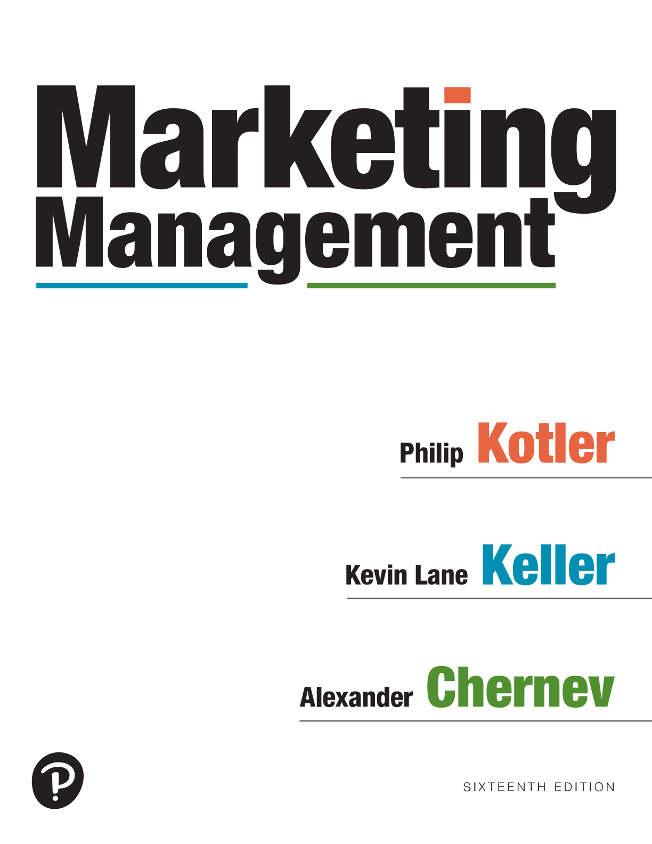
Marketing Management
Sixteenth Edition
Chapter 2
Marketing Planning and Management
Copyright © 2022, 2016, 2012 Pearson Education, Inc. All Rights Reserved
Notes:
If this PowerPoint presentation contains mathematical equations, you may need to check that your computer has the following installed:
1) MathType Plugin
2) Math Player (free versions available)
3) NVDA Reader (free versions available)

Slide 2
The Strategic Planning Process
Product/
Notes:
Figure 2.1 shows the strategic planning process. Generally speaking, marketing planning and management can occur on three different levels: corporate, business unit, and specific market offering.
Corporate headquarters is responsible for designing a corporate strategic plan to guide the whole enterprise. It makes decisions on the amount of resources to allocate to each business unit, as well as on which businesses to start or eliminate.
Each business unit develops a plan to carry that business unit into a profitable future.
Finally, each market offering involves a marketing plan for achieving its objectives.

Slide 3
Corporate Planning Activities
Defining the corporate mission
Building the corporate culture
Establishing strategic business units (SBUs)
Assigning resources
Notes:
Companies undertake four planning activities: defining the corporate mission, building the corporate culture, establishing strategic business units, and assigning resources to each strategic business unit.

Slide 4
Defining the Corporate Mission
A mission is a clear, concise, and enduring statement of the reasons for an organization’s existence
Often referred to as its core purpose, a company’s mission is a long-term goal that provides company employees and management with a shared sense of purpose, direction, and opportunity
What is our business?
Who is the customer?
What is of value to the customer?
What should our business be?
Our mission is to organize the world’s information and make it universally accessible and useful.
Notes:
A mission is a clear, concise, and enduring statement of the reasons for an organization’s existence. Often referred to as its core purpose, a company’s mission is a long-term goal that provides company employees and management with a shared sense of purpose, direction, and opportunity.
To define its mission, a company should address Peter Drucker’s classic questions: What is our business? Who is the customer? What is of value to the customer? What will our business be? What should our business be?
These simple-sounding questions are among the most difficult a company will ever face. Successful companies continuously ask and answer them.

Slide 5
Building the Corporate Culture
What is a corporate culture?
Some define it as “the shared experiences, stories, beliefs, and norms that characterize an organization.”
“Our Culture is often imitated, and never duplicated. Every Employee is responsible for promoting and preserving our Culture. We also have a Culture Services Department that is charged with championing a Culture through which every Employee knows he or she matters.
Our Culture is woven into all aspects of our business and our Employees’ lives, from the way Employees treat each other to the way that our Company puts our Employees first. Three vital elements of our Culture are appreciation, recognition, and celebration.” ​​​
Notes:
Creating a viable corporate culture is often the key to market success, as the experience of Southwest Airlines shows.
What exactly is a corporate culture? Some define it as “the shared experiences, stories, beliefs, and norms that characterize an organization.”
Walk into any company and the first thing that strikes you is the corporate culture—the way people dress, talk to one another, and greet customers.
A customer-centric culture can affect all aspects of an organization. Enterprise Rent-A-Car features its own employees in its latest “The Enterprise Way” ad campaign. Through its “Making It Right” training program, Enterprise empowers all employees to make their own decisions. One ad in the campaign, themed “Fix Any Problem,” reinforces how any local Enterprise outlet has the authority to take actions that maximize customer satisfaction.

Slide 6
Strategic Business Units (SBUs)
Strategic Business Unit (S B U):
Is a single business, or a collection of related businesses, that can exist separately from the rest of the company
Has its own set of competitors
Has a manager responsible for strategic planning and profit performance, who controls most of the factors affecting profit
Has two SBUs
Notes:
Many large companies manage a portfolio of different businesses often referred to as strategic business units, each requiring its own strategy.
A strategic business unit (SBU) has three characteristics:
(1) It is a single business, or a collection of related businesses, that can exist separately from the rest of the company; (2) It has its own set of competitors; and (3) It has a manager responsible for strategic planning and profit performance, who controls most of the factors affecting profit.

Slide 7
Allocating Resources to SBUs
Assess each S B U’s competitive advantage and the attractiveness of the market in which it operates
Grow
Harvest
Hold
Divest
Notes:
Once it has defined its SBUs, management must decide how to allocate corporate resources to each unit. This is often done by assessing each SBU’s competitive advantage and the attractiveness of the market in which it operates.
When assessing individual business units, a company might also consider existing synergies among them. Such synergies can be related to company processes (e.g., research and development, manufacturing, and distribution) or to personnel (e.g., experienced management, qualified engineers, and knowledgeable sales force).
Based on the assessment of its portfolio of business units, the company could decide whether to grow, “harvest” (or draw cash from), or hold on to a particular business.
Portfolio management focuses on two types of factors: (1) opportunities presented by a particular industry or market and (2) the company’s resources, which determine its ability to take advantage of the identified opportunities. Here, market opportunities are typically defined in terms of overall market/ industry attractiveness factors such as its size, growth, and profitability. A company’s resources, on the other hand, reflect its competitive position in the marketplace and are often measured in terms of factors such as strategic assets, core competencies, and market share.

Slide 8
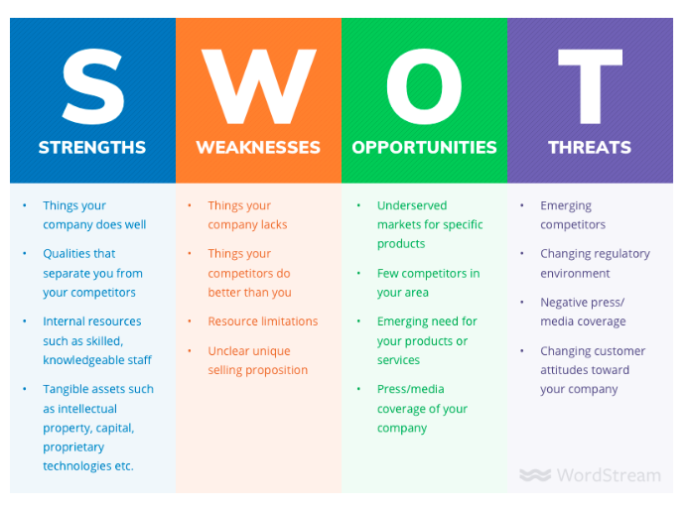
Notes:
The overall evaluation of a company’s strengths, weaknesses, opportunities, and threats is called SWOT analysis. It’s a way of monitoring the external and internal marketing environment.

Slide 9
Developing Market Offerings
Marketing Strategy involves choosing a well-defined market in which the company will compete and determining the value it intends to create in this market
Target market
Value proposition
Marketing Tactics, also called the marketing mix, make the company’s strategy come alive
The market offering is the actual product that the company deploys in order to fulfill a particular customer need
Notes:
In order to create value for target customers, collaborators, and company stakeholders, it is necessary for a company to clearly identify the target market in which it will compete and to design an offering that will deliver a meaningful set of benefits to target customers.
These activities encompass the two key components of a company’s business model: strategy and tactics.
Strategy involves choosing a well-defined market in which the company will compete and determining the value it intends to create in this market.
Tactics, also called the marketing mix, make the company’s strategy come alive: They define the key aspects of the offering developed to create value in a given market. The tactics logically follow from the company’s strategy and reflect the way the company will make this strategy a market reality. Tactics shape everything from the offering’s benefits and costs to the means by which target customers learn about and buy the offering.

Slide 10
Marketing Tactics - Designing, Communicating, and Delivering Customer Value
Notes:
Figure 2.5 shows how the seven marketing tactics can be regarded as a process of designing, communicating, and delivering customer value. The value-design aspect of the offering comprises the product, service, brand, price, and incentives, while communication and distribution form the information-value and delivery-value aspects of the process.
The illustration is divided into three parts. Developing value at the top includes Product, Service, brand, Price, and incentives. Communicating value on the left includes Communication and delivering value on the right includes Distribution. Arrows follow all values from three dimensions at the center labeled value.

Slide 11
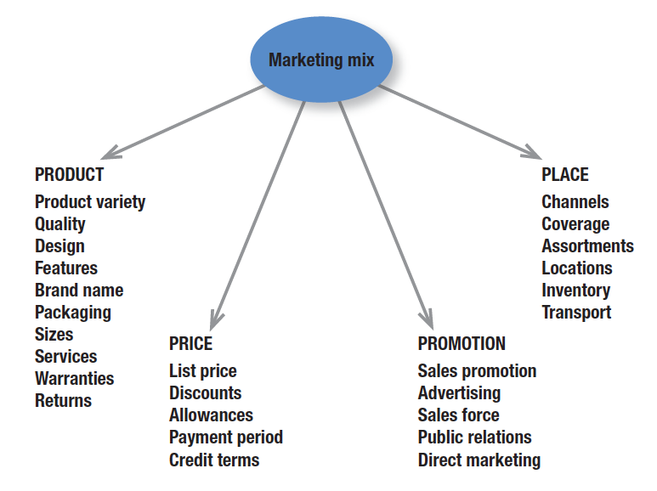
The Marketing Mix The Four Ps
Notes:
Many years ago, McCarthy classified various marketing activities into marketing-mix tools of four broad kinds, which he called the four Ps of marketing: product, price, place, and promotion. The marketing variables under each P are shown in Figure 1.5.

Slide 12
The Annual Marketing Plan
The Marketing Plan directs and coordinates all the firm’s marketing activities
Executive summary— “elevator pitch”
Situation overview—an overall evaluation of the internal and external environments
G-S T I C section—the core of the marketing plan
Set a Goal (KPM)
Develop a Strategy (Target Market, Value Proposition)
Design the Tactics (Market Offering, 4Ps)
Define Implementation Plan (Organizing/Resources)
Identify Control Metrics (Monitor/Evaluate Results)
Notes:
The executive summary can be regarded as the “elevator pitch” for the marketing plan. It presents a streamlined and succinct overview of the company’s goal and the proposed course of action. Typically, the executive summary consists of one or two pages that outline the pertinent issues faced by the company—an opportunity, a threat, or a performance gap—and the proposed action plan.
The situation overview provides an overall evaluation of the environment in which the company operates, as well as of the markets in which the company competes and/or will compete. Thus, the situation overview is composed of two sections: the company overview that outlines the company’s history, culture, resources (competencies, assets, and offerings, and the market overview that outlines the markets in which the company currently manages offerings and those that the company could potentially target for future offerings.

