Slide 1
Private Equity
Project Part 1

Slide 2
Calculating Unlevered FCF

Slide 3
Instructions
Calculating cash flows
Income statement includes the information that we need to calculate cash flows or the net cash in the hands of the corporation after paying all expenses, taxes, and capital expenditures.
This is the cash available to investors (both equity and debt investors):
CF = Sales – Operating Expenses – Taxes – capital expenditures
– change in NWC
Operating Expenses = COGS + SG&A+R&D
Taxes = (Sales – Operating Expenses – Depreciation)x (Tax Rate)
CF = [Sales x Operating margin – Dep.](1-Tax Rate) + Dep. – CapEX – Change in NWC

Slide 4
Instructions
Issues to notice
NWC = Inventory + Receivables – Payables + Cash
Or use Current Assets – Current Liabilities
Cash → used for operations
Firms also hold liquid assets or “excess cash” to finance future investments.
Why deduct the change in NWC?
CF = [Sales x Operating margin – Dep.](1-Tax Rate) + Dep. – CapEX – Change in NWC

Slide 5
Obtaining Data

Slide 6
Financial Data (back 10 years)
Company’s website
Yahoo or Google finance
sec.gov
Go to sec.gov → FILINGS→ Company Filings → search by company ticker or name → 10-K (interactive data or the documents themselves)

Slide 7
Herfindahl Index

Slide 8
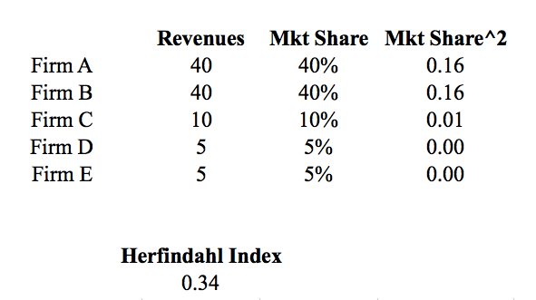
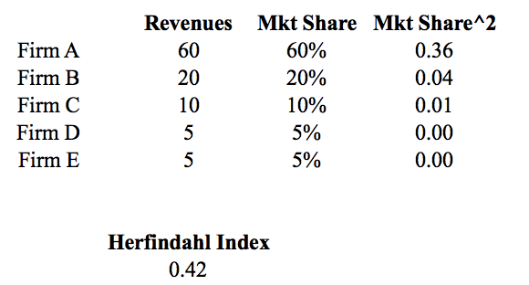
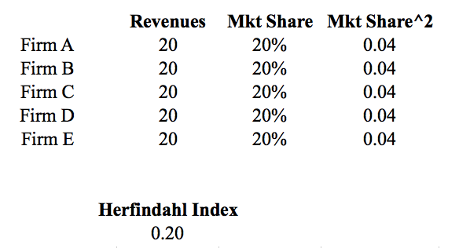
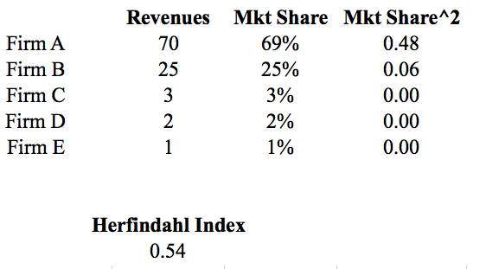
Calculating Herfindahl Index

Slide 9
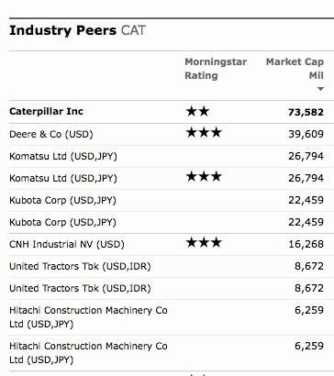

Finding Competitors of CAT
Morningstar is a good source of information about industry peers

Slide 10





$39.89B
$24.18B
$84.25B
$18.24B
$26.6 B

Slide 11
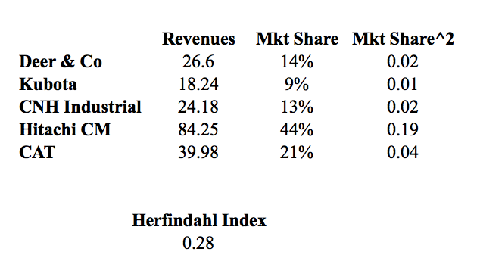
Herfindahl Index

