Slide 1
The PE Transaction Assignment Part B

Slide 2
Plan for Today
Setting the stage
Leverage, IRR, MOIC and Valuation
The PE Transaction
Introduce Part B
Target firm analysis
The premium
Assumptions
Example in Excel

Slide 3
Buying and selling a house

Slide 4
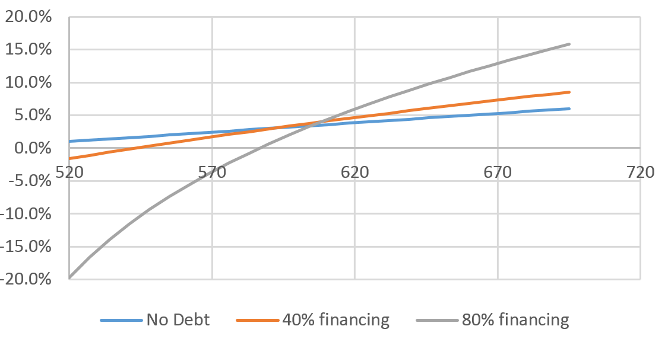
Leverage and Returns
Annual return on investment (IRR) as a function of selling price
Cost $500,000
Mortgage interest rate 4%

Slide 5
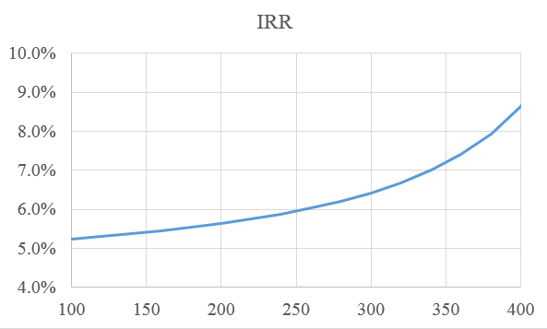
Leverage and Returns
Assume
Expected annual price appreciation 5% which implies a selling price in five years of $638,140
IRR as a function of loan amount while assuming selling price of $638K

Slide 6
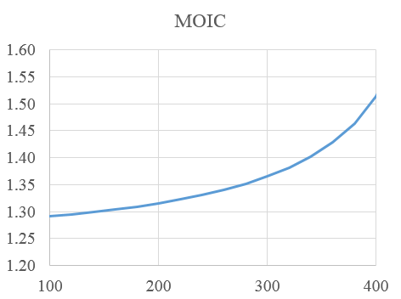
Leverage and Returns
MOIC is the ratio of selling payoff over investment
MOIC as a function of loan amount while assuming selling price of $638K

Slide 7
Value and Leverage

Slide 8
Recapitalization
During the LBO process the leverage of the target firm increases substantially.
Target Starting Point
Issuing $30 debt
Assets | Liabilities
A = $100 | E = $70
 | D = $30
Assets | Liabilities
A = $100 | E = $70
Cash = $30 | D(old) = $30 D(new) = $30
Repurchasing Shares worth $30
Assets | Liabilities
A = $100 | E = $40
 | D = $60

Slide 9
Leverage and Value Recapitalization IRR and MOIC
During the LBO process the leverage of the target firm increases substantially.
Example:
Consider a simple unlevered firm with a perpetual stream of annual FCF’s of $105 next year with growth rate of 3%, and risk appropriate cost of equity capital of 10%.
The current market value of the firm is $105/(0.1-0.03) = $1,500
The future value one year from now $108.15/(0.1-0.03) =$1,545 together with the FCF yields the enterprise value of $1650.

Slide 10
Leverage and Value Recapitalization IRR and MOIC
IRR and MOIC implied by the transaction
If the investment is liquidated after one year:
The IRR of this transaction is clearly 10%, the cost of equity.
The MOIC is $1650/$1500 = 1.1

Slide 11
Leverage and Value Recapitalization
Now, suppose that the firm wishes to increase debt to 40% or D=$600, E = $900. Also, suppose that the cost of debt is 5%.
Example:
The current market value of the firm remains $1,500. The interest payment at the end of the first year is $600(5%) = $30. A one year investment in firm equity requires $900 up front investment and yields a payoff of $1545 - $600 + 105 – 30 = $1020 (disregarding taxes).

Slide 12
Leverage and Value Recapitalization IRR and MOIC
IRR and MOIC implied by the levered transaction
If the investment is liquidated after one year:
The IRR of this transaction is 13.33%
The MOIC is $1020/$900 = 1.1333

Slide 13
Leverage and Value Recapitalization
Suppose that performance is risky
The value of the cash flows next year will be $126 or $84 (up/down 20%) with equal probabilities and average of $105.
Firm going-forward value next year will be either $129.78/0.07 = $1854 or 86.52/0.07 = $1,236 with expectation of $1,545.
Including cash flows, enterprise values are $1854 + 126 = $1,980 or = $1,236 + 84 = $1,320

Slide 14
Leverage and Value Recapitalization IRR and MOIC
IRR and MOIC implied by the risky transaction
If the investment is liquidated after one year:
The IRR of this transaction is -12% or 32% (on average 10%)
The MOIC is 0.88 or 1.32 (on average 1.10)
$1,236 with expectation of $1,545.

Slide 15
Leverage and Value Recapitalization
Suppose that performance is risky and position is levered
The value of the cash flows next year will be $126 or $84 (up/down 20%) with equal probabilities and average of $105.
Firm value next year will be either $129.78/0.07 = $1854 or 86.52/0.07 = $1,236 with expectation of $1,545.
A one year investment in firm equity requires $400 up front and yields a payoff of $1854 - $600 + 126 – 30 = $1350 or $1236 - $600 + 84 – 30 = $690

Slide 16
Leverage and Value Recapitalization IRR and MOIC
IRR and MOIC implied by the levered transaction
If the investment is liquidated after one year:
The IRR of this transaction is -23.33% or 50% (on average 13.33%)
The MOIC is 0.766 or 1.5 (on average 1.1333)

Slide 17
Leverage and Value punch line
Increasing leverage will increase expected IRR and MOIC
IRR increased from 10% to 13.3% and MOIC increased from 1.1 to 1.13 when leverage of 40% was introduced
Increasing leverage will increase risk of IRR and MOIC
IRR in the range (-12%,32%) and MOIC in the range (0.88,1.32) without leverage
IRR in the range (-23%,50%) and MOIC in the range (0.76,1.5) with leverage of 40%

Slide 18
Value Creation
The PE transaction adds value from the tax shield and the economic efficiency improvements from the intervention of the PE general partners in management
V = TaxShield + Economic = T+Ec
Target Starting Point
PE announcement (Efficient Market)
Issuing $30 debt
Assets | Liabilities
A = $100 | E = $70
 | D = $30
Assets | Liabilities
A = $100 | E = $70+T+Ec
T + Ec | D = $30
Assets | Liabilities
A = $100 | E = $70 + T+Ec
T+ Ec Cash = $30 | D(old) = $30 D(new) = $30
Repurchasing Shares worth $30
Assets | Liabilities
A = $100 | E = $40 + T+Ec
T + Ec | D = $60
What is the value to the PE firm from the transaction in an efficient market?

Slide 19
The PE Transaction Overview Assignment Part B

Slide 20
Assignment Part B
The assignment has three parts
B1: Stock valuation (DCF) and analysis of potential target firm (independent assignment)
B2: Relative performance and debt capacity of potential target firms (group assignment)
B3: The PE proposition (group assignment)

Slide 21
The PE Transaction The Target Firm

Slide 22
The PE Transaction Target Firm Analysis
Market Valuation
Economic forecast and DCF valuation
Sensitivity analysis w.r.t to critical assumptions: growth rates, profit margins
Under/over valuation?
Value Creating
Compare to peers in the industry along three performance measures, identify potential avenues for improvement based on industry analysis or peer benchmarks
Decide on explicit performance targets
Include improved metrics to yield new valuation
Assessing the target firm – three steps
Step 1: Establish market valuation under assumptions about growth and profitability margins
Step 2: Potential for value creation in a 5 – 7 year horizon
Step 3: Explore the firm’s debt capacity

Slide 23
The PE Transaction Debt Capacity Analysis
Interest Coverage Ratio
Coverage ratio measures the ability of the firm to meet its current interest expenses out of earnings
The relation between: Debt Level, Interest, and Coverage Ratio
Considering a perpetual bond or a bond that pays interest until maturity
Coverage Ratio = $\frac{EBIT}{Interest Expense}$
$$Dr=\frac{EBIT}{Coverage Ratio}$$
$$\frac{D}{EBIT}=\frac{1}{r (Coverage Ratio)}$$

Slide 24
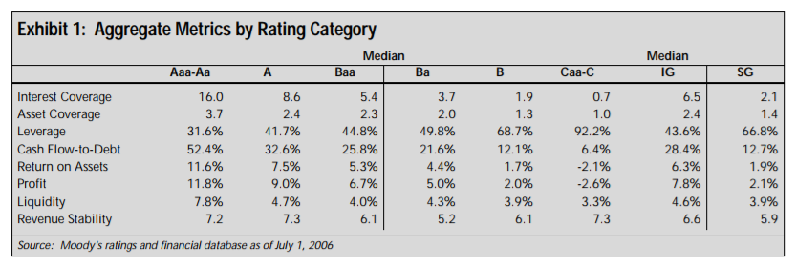
The PE Transaction Coverage Ratio and Credit Ratings
Coverage Ratio = $\frac{EBIT}{Interest Expense}$

Slide 25
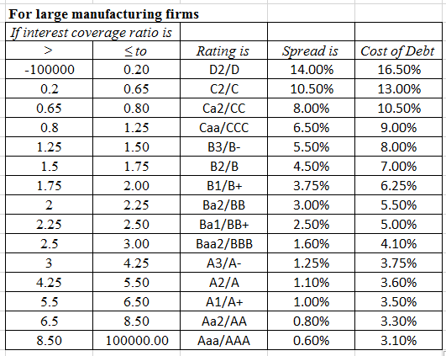
The PE Transaction Coverage Ratio and Interest Rates Aswath Damodaran, NYU

Slide 26
The PE Transaction Leverage and Interest Rate
Based on Moody’s data
Calculating Leverage Alternatives
Suppose that your firm’s value is $1500, EBIT is $100, and has no debt.
To obtain 40% leverage, $600 must be issued.
5% interest implies $30 interest expense, 3.33 Coverage Ratio, which in turn implies around 8% interest
8% interest implies $48 interest expense, 2.08 Coverage Ratio, which in turn implies a rate of around 9%
9% interest implies $54 interest expense, 1.85 Coverage Ratio, which in turn implies around 9% interest

Slide 27
The PE Transaction Higher Leverage Option
Calculating Leverage Alternatives
Suppose that your firm’s value is $1500, EBIT is $100, and has no debt.
To obtain 60% leverage, $900 must be issued.
9% interest implies $81 interest expense, 1.23 Coverage Ratio, which in turn implies around 11% interest
11% interest implies $99 interest expense, 1.01 Coverage Ratio, which in turn implies a rate of around 12%
12% interest implies $108 interest expense, 0.92 Coverage Ratio. We will consider transactions where the EBIT alone can cover the proposed interest expense (lower leverage).

Slide 28
The PE Transaction The Premium

Slide 29
The PE Transaction The Premium
Consider the example we started with.
The house is worth $500,000
A new legislation passes to allow the construction of a second “guest-house” unit.
Such a guest house required $100,000 investment and generates rental revenues worth $$225,000.
The current owners, however, do not have the ability to carry through such construction project.
At what price should the owners be willing to settle?

Slide 30
The PE Transaction Purchase Price
The acquisition premium is defined as
Acquisition Premium =
$\frac{Transaction Price}{ Market Price Prior to Acquisition Announcement}$ - 1
The PE firm will enter transactions while considering the total gains from its acquisition or intervention
Total Gains from Acquisition = Added Value due to tax shield and Improved Performance

Slide 31
The PE Transaction Purchase Price
What is the division of the total gains from trade between the PE firm and the existing shareholders of the target firm?
One shall consider:
The pre-announcement market price
The pre-intervention valuation
The post-intervention valuation
The transaction price
Estimation of total benefits of trade
Bargaining power/ market conditions
Average premium around 15%

Slide 32
The PE Transaction Assumptions

Slide 33
The PE Transaction Assumptions
40-60% leveraged transaction
Internal rate of return (IRR) of above 25%,
MOIC above 2,
Exit in 5-7 years
PE fund will pay a premium of 10-15%
PE fund will use FCFs to pay down outstanding debt

Slide 34
The PE Transaction Example

