Slide 1

Initial Public Offering (IPO)

Slide 2
Initial Public Offering (IPO)
Introduction
  Financing Growth
  The role of Venture Capital backing
  The costs and benefits from going public
  The IPO process
Example: Facebook
Trading Simulation
IPO Valuation/Returns
  Empirical evidence

Slide 3
Introduction

Slide 4
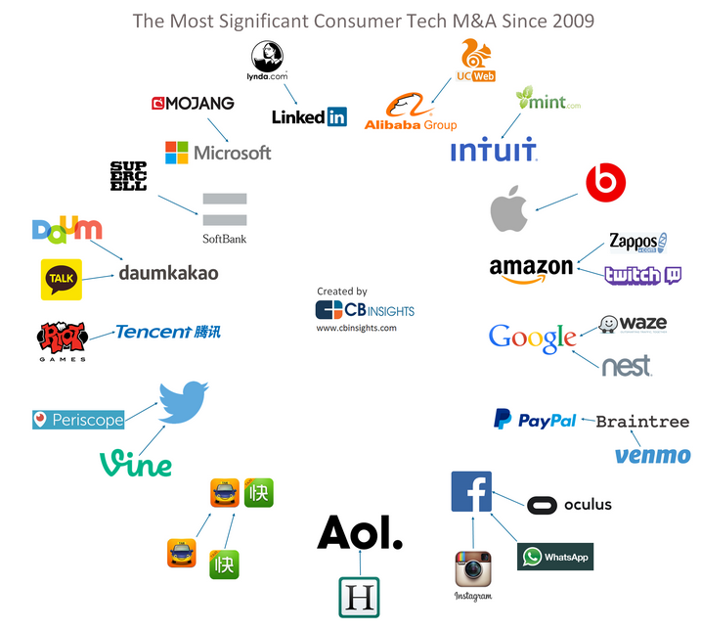
Growth
Growth can be obtained through expanding organic and inorganic growth
Organic growth is the process of business expansion by increased output, customer base expansion, or new product development, as opposed to mergers and acquisitions, which is inorganic growth.
Corporations often expand operations in new directions through inorganic growth and the acquisitions of new emerging technologies, ventures, and brands

Slide 5
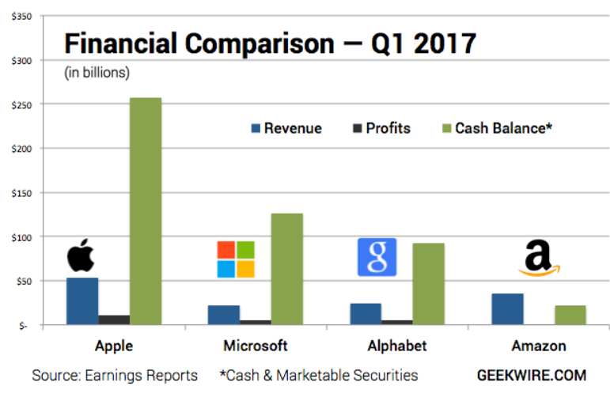
Financing Growth
As expansions (economies of scale) becomes possible firms seek the required funds to meet their needs.
The main alternatives for funding are retained earnings, public securities and private equity and debt
Retained earnings: common for larger firms that have an established business in place that generates a steady stream of cash flows. Several public companies have abundant cash to satisfy their needs.

Slide 6
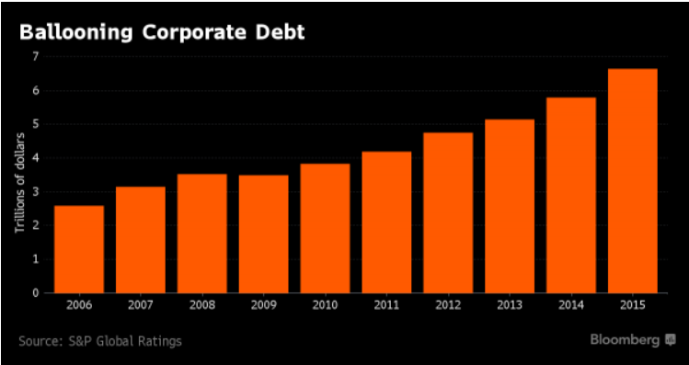
Financing Growth
Public corporations have access to public equity markets
Debt and equity are a very important source of capital
Debt has become historically cheap due to the low levels of interest rates. Several corporations take advantage of these low interest rates to issue debt in order to finance their capital requirements and repurchase equity.

Slide 7
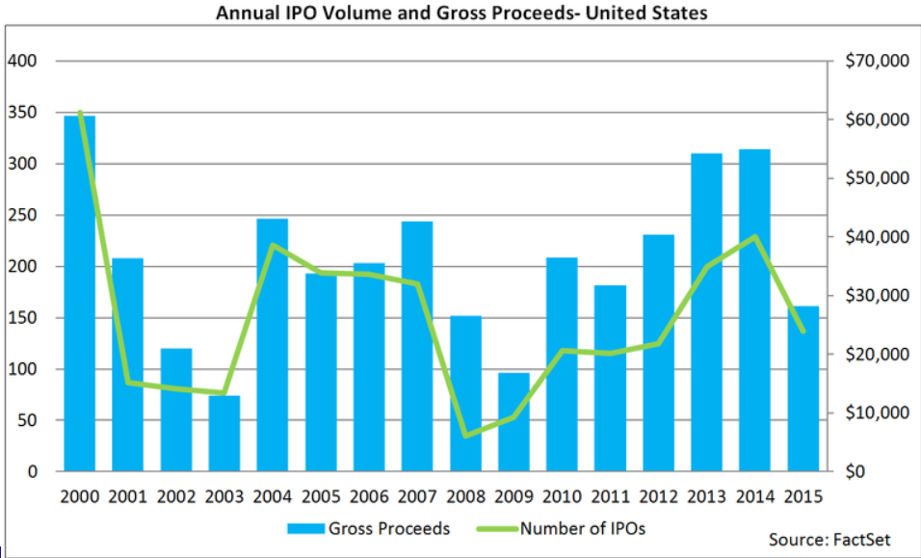
Public Equity Financing - IPO
Young ventures with short track records and substantial risk would find it very difficult to attract bank financing.
In order to access the public capital markets young private firms must go public

Slide 8
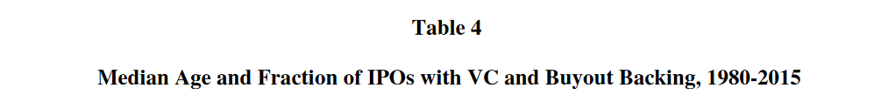
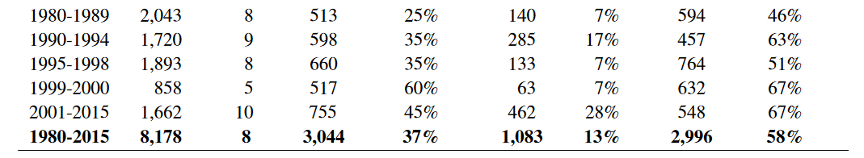
The Role of Venture Capital and Private Equity in IPO firms
VC or PE funds play in important role in IPO firms
Source: Initial Public Offerings: Updated Statistics
Jay R. Ritter

Slide 9
Benefits from Going Public
Benefits of going public
Access to funds to satisfy investment needs
Facilitate profitable exit by founders and employees(!)
Lower cost of capital due to liquidity and diversification. Shares are move valuable to investors when they are more liquid and can be held as part of a diversified portfolio.
Market timing. Raising funds at times that the stock market valuations are high (possibly times of over-valuation)
Costs
Transaction costs. Investment banker fees (around 7% of fund raised).
Founders often give up control (counter example…Google)
Regulation by Securities and Exchange Commission (SEC). Requirement of Audited Financial Statements.
(Under) Prising

Slide 10
The Process of Going Public
Approach an underwriter or investment bank and prepare a prospectus for investors
The prospectus is a detailed financial document that includes several relevant details about past performance, risks, opportunities and so forth. Approved by the SEC.
In the book-building process the investment bank goes on a road-show and approaches several investors to market the firm and better understand market demand for the firm’s shares
The underwriter and the firm decide on the size of the offering, which is the number of shares to be sold to the public at the offering, and the offer-price at which shares are to be allocated to the IPO investors

Slide 11



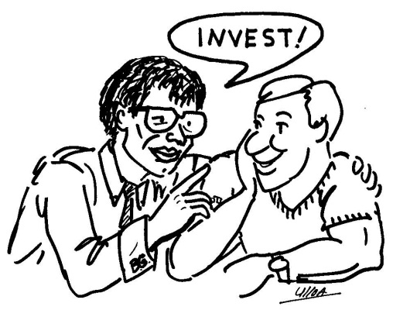
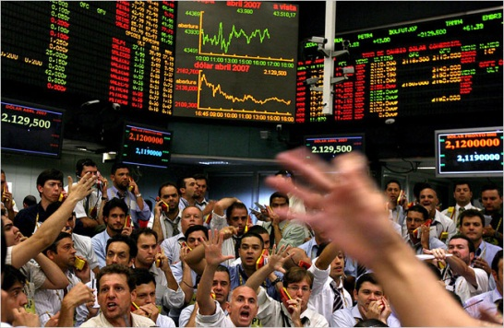
Initial Public Offering
Underwriter Investment Bank
IPO firm
Shares
Shares allocated to investors
Issue Price
Shares traded in Stock Exchange
IPO investors
Shares traded on the exchange

Slide 12
The Allocation of Shares to Investors
During the book building process investors submit their demand for shares
IPOs are often over-subscribed. This means that there is more demand than what is being allocated at the offering
The investment bank has the discretion to choose how to allocate the limited number of shares among the many investors that have signed up for the IPO

Slide 13

The Auction Alternative
The firm submits IPO prospectus directly to the Securities and Exchange Commission (SEC)
The firm sells its shares directly to the public via auction
Investors submit demand schedules, specifying how many shares they are willing to buy at a range of given prices.
By far less commonly used in the U.S. relative to the book building procedure

Slide 14


Slide 15

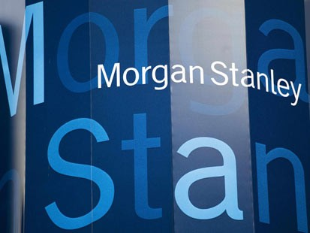
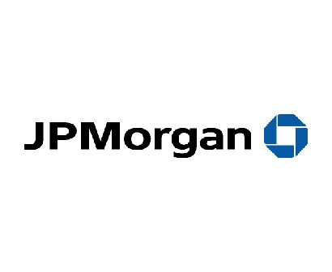


162 million shares
39%
84.9million shares
20%
63.2 million shares
15%

Slide 16
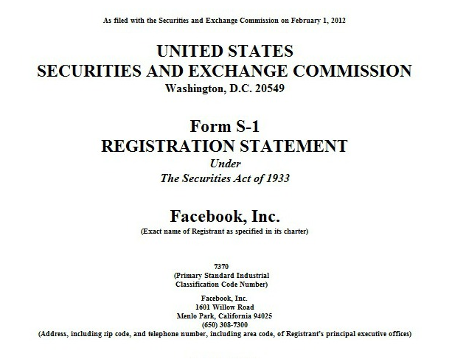

Slide 17
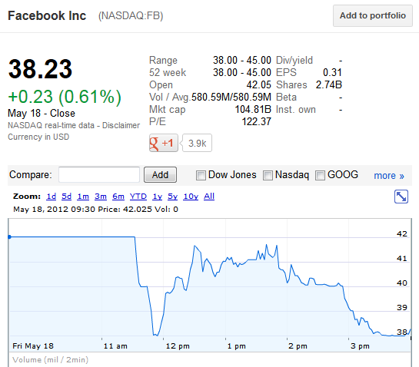
First Day of Trade

Slide 18


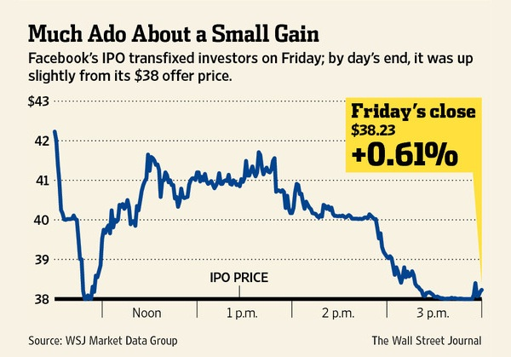
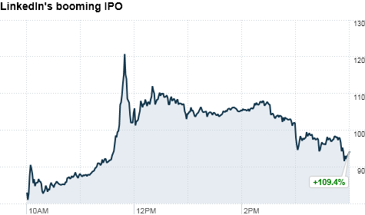
Comparison to social media IPO Linked In

Slide 19
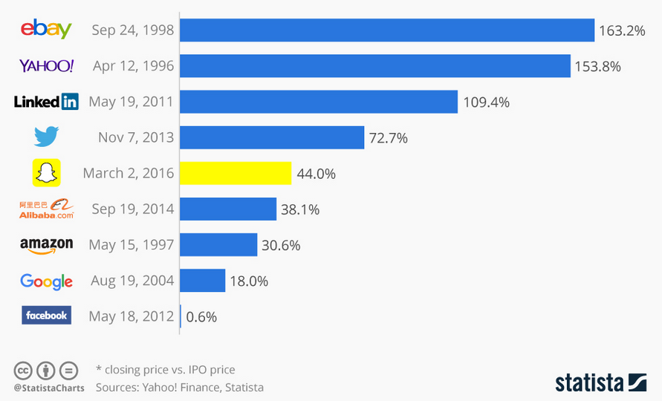
First Day Returns

Slide 20
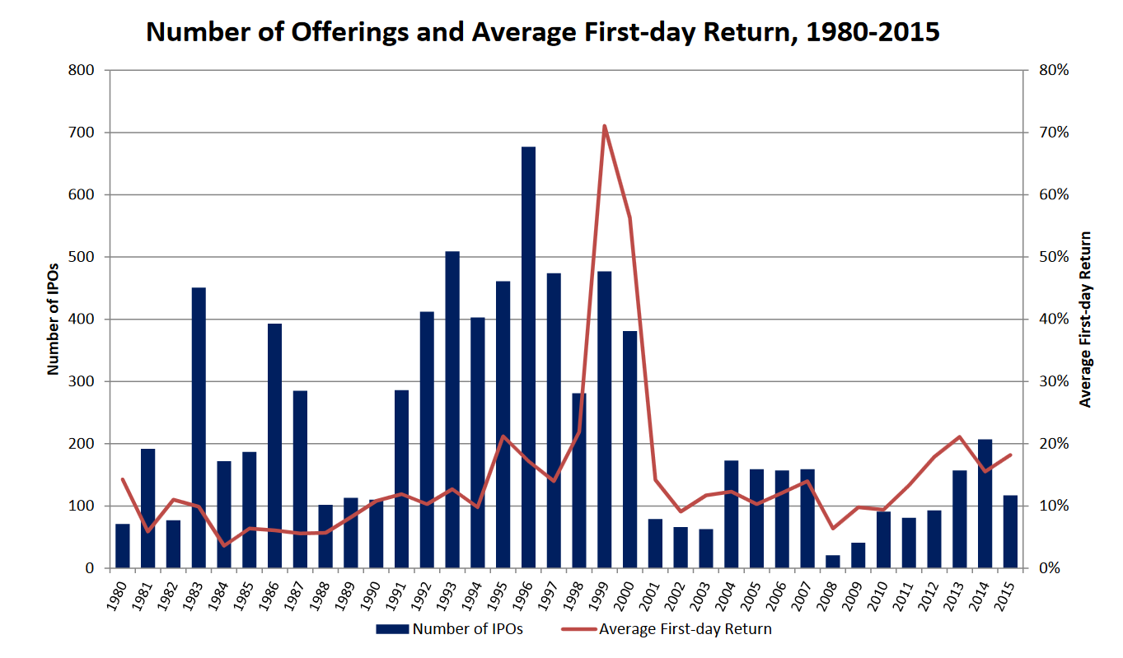






First Day Returns Statistics
16.3%
1959-2009
19.9%
2000-2004
137.4%
1990-2010
43%
2000-2004
12%
1989-1993

Slide 21
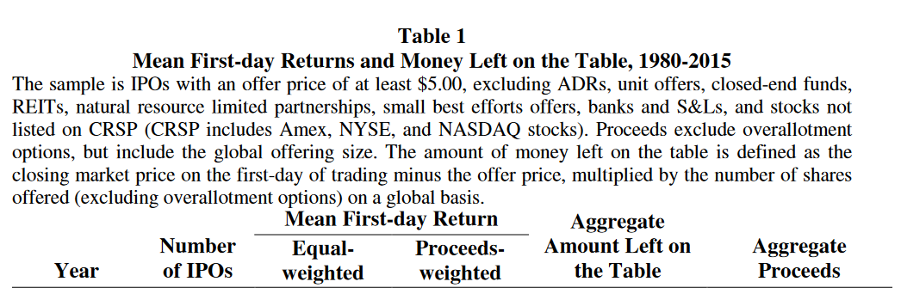
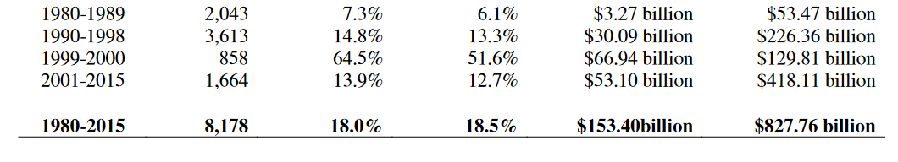
First Day Returns
Source: Initial Public Offerings: Updated Statistics
Jay R. Ritter

Slide 22
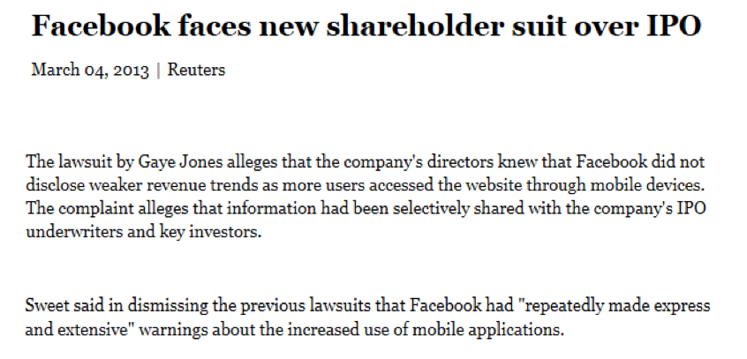
The Aftermath of the Facebook IPO
“the informational disadvantages to the less informed public proved harmful”
…
[Darrell E.] Issa [head of the House Oversight and Government Reform Committee] wrote in a June 19 2012 letter that in the case of Facebook’s IPO

Slide 23
IPO Trading Simulation

Slide 24
Instructions
You have the opportunity to invest a total of $40 million in four IPO firms.
Demand
For each IPO firm you need to decide whether or not to invest $10 million in the IPO firm. If you choose not to invest in a particular IPO then your money is kept in a zero interest bank account.
Allocation
Each IPO firm is raising up to $20 million. You will get your share allocation out of the total allocation demand submitted by all investors.
For example, if total demand is for $50 million and you have requested $10 million then your demand represents one fifth (or 20%) of total demand and your allocation will therefore be
$20 x (20%) = $4 million.
If total demand is $20 million or lower you will receive the full amount of shares you have asked for.

Slide 25

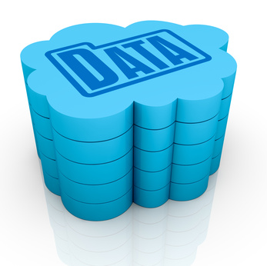
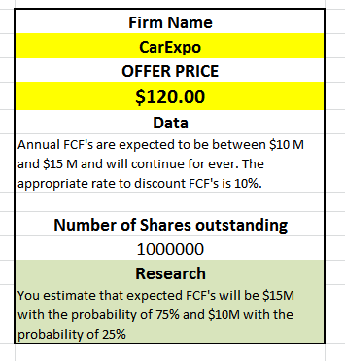

Public and Proprietary Data
Publicly
disclosed information (Prospectus)
Private
research

Slide 26
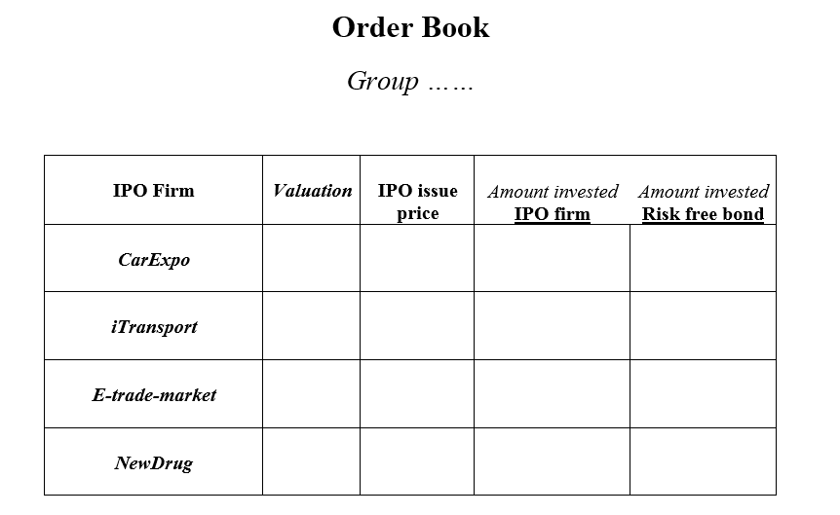
Investment Sheet

Slide 27

IPO Valuation
First day Returns
Price risk
The risk that that you are paying too much for the shares
Allocation risk
The risk of not being allocated shares when the IPO is oversubscribed

Slide 28

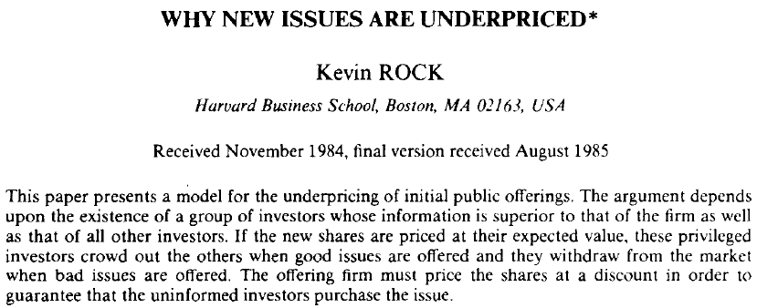
“I wouldn’t want to belong to any club that would accept me as a member” Groucho Marx
When you bid for an IPO and receive a large allocation then this means that it was probably not over-subscribed.

Slide 29
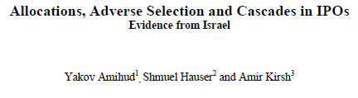
If the winner’s curse is driving down the IPO prices, then allocation risk matters.
We should find an impact on the expected first day returns on investment in IPOs after taking into account investors’ allocations

Slide 30
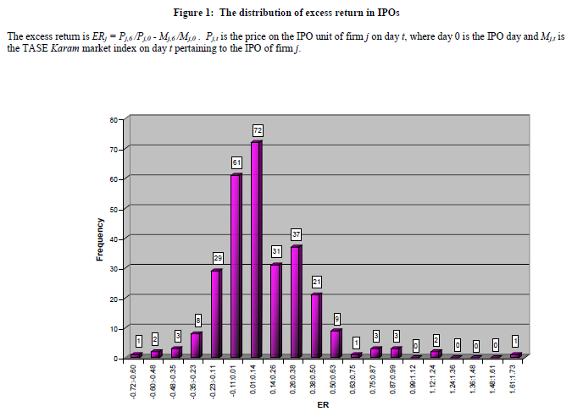
IPO Returns – some evidence
Amihud et al. (1995)

Slide 31
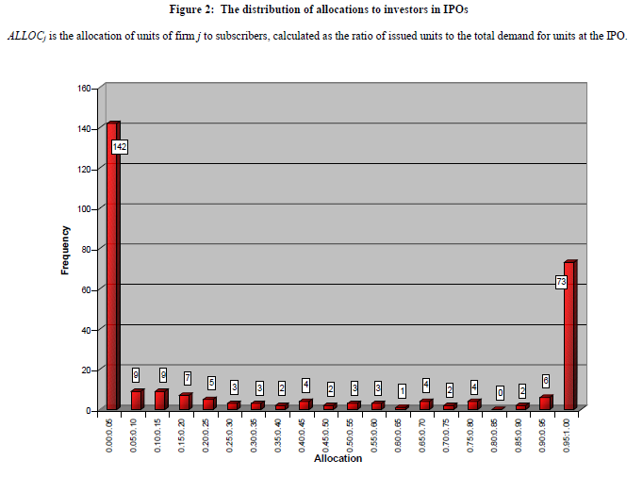

Slide 32
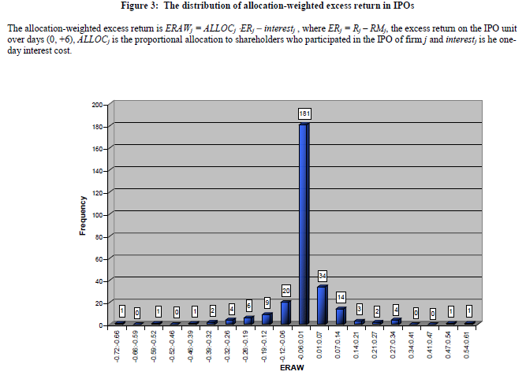
Allocation-Weighted returns

Slide 33
