Slide 1
Agency costs and firm leverage
Chapter 16.5- 16.6

Slide 2
outline
The separation of ownership and control
Asset Substitution
Moral Hazard
Free Cash Flow problem
Leverage and
the conflict between employees and shareholders
competition

Slide 3
The Asset Substitution problem
Debt holders provide funds and shareholders make the decisions
The problem: Shareholders might promote share price at the expense of debt holders
Risk shifting
Debt overhang
Asset substitution
problem
Shareholders
Debt holders
Management

Slide 4
Asset substitution problem - overview
Shareholders’ and debt-holder’s
share of cash flows
shareholders
payoff
Debt-holders
Firm value

Slide 5
Equity as a Call Option
Shareholders hold a Call Option on the total payoff of the levered firm
Random total payoff of the firm = y
Random payoff to shareholders = e
Random payoff to debt holders = d
Face value of debt = D
e = max(y-D,0)) and d = min(D,y)

Slide 6
Asset substitution problem - overview
Debt holders’ payoff is concave (less risky)
Payoff d
D
Debt-holders
D
Firm value y

Slide 7
Asset substitution problem - overview
Shareholders’ payoff is convex (more risky)
shareholders
Payoff e
D
Firm value y

Slide 8
Value of equity and investment risk
The payoff e to equity holders and d to debt holders are:
e = max(y-D,0)) and d = min(D,y)
When risk increases (while expected profit same)
The expected value of equity increases E(e)
The expected value of debt decreases E(d)

Slide 9
Shareholder value and investment risk
“Low-risk” investment
shareholders
payoff
Debt holders
Firm value

Slide 10
Shareholder value and investment risk
“High-risk” investment
shareholders
payoff
Debt holders
Firm value

Slide 11
Shareholder value and investment risk
Shareholders’/debt-holders’ preferences?
shareholders
payoff
Debt holders
Firm value

Slide 12
Risk Shifting Problem
Exploiting debt holders
Since management is hired by the board of directs as elected by the shareholders it acts in the best interest of shareholders
This is part of the fiduciary duty of directors and management
Should management take actions that reduce firm value but increase the value of equity?

Slide 13
Risk shifting problem Example
Example (page 503) Bexter executives are considering a new strategy that seemed promising but appears risky after closer analysis. The new strategy requires no upfront investment, but it has only a 50% chance of success. If it succeeds it will increase firm value to $1.3 million, but if it fails the value of assets will be $0.3 million. The value of Bexter under the new strategy is $0.8 million relative to $0.9 million under the old strategy. Bexter has $1 million of debt outstanding.

Slide 14
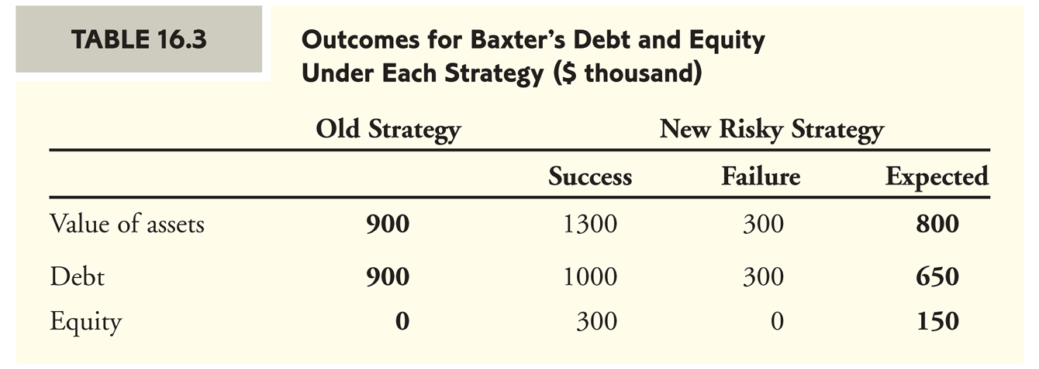
Example continued
Comparing the alternatives

Slide 15
Risk shifting problem summary
Equity holders have control over the type of investments the firm chooses
Shareholders can gain by making sufficiently risky investments, even if they have a negative NPV
Introduces an over-investment problem

Slide 16
Risk shifting problem summary
Anticipating this problem, debt holders will “discount” or pay less for the debt initially
At the time the debt is issued, shareholders benefit if they limit their ability to exploit debt holders (“tie their hands”) down the road - for example through debt covenants
What firms are most subject to the risk shifting problem?
heterogeneous investment opportunities
Flexibility to take on risks
Opaque/complicated investments

Slide 17
Debt overhang problem
When the debt payment exceeds the value of assets the firm is in financial distress
As a result, future payoffs from new and old investments will be allocated first to debt holders and not to equity holders
The problem: firms in financial distress may forego profitable investment opportunities

Slide 18
The Debt Overhang problem example
Example (continued) Suppose Bexter does not pursue the risky strategy mentioned earlier. But it has an opportunity to invest $100,000 and gain a 50% risk-free return (that is, certain payoff of $150,000 in one year). If the current risk free rate is 5% then this is clearly a positive NPV. The only problem is that Bexter does not have the money to cover the initial investment of $100,000. Can it raise the money by issuing new equity?

Slide 19
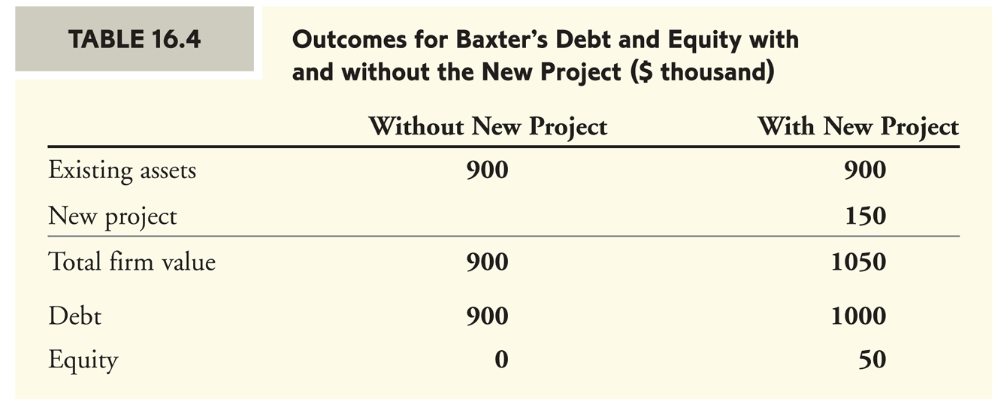
Example continued
Comparing the alternatives

Slide 20
Will the project be executed?
Suppose that the existing equity holders allocate the required $100,000 of fresh capital
Assets
Old assets 900 | Debt holders 1000
New assets 150 | Equity holders 50
Total 1,050 | Total 1,050
This will lead to a loss of $50,000 to equity holders.
Existing equity holders will not allocate the required funds

Slide 21
Will the project be executed?
Suppose instead that new equity (preferred stock) is issued at market value of $100,000
Assets
Old assets 900 | Debt holders 1000
New assets 150 | New Equity holders 50
 | Old equity holders 0
Total 1,050 | Total 1,050
The firm will not be able to raise more than $50,000 in new equity

Slide 22
What is the issue here?
Most of the payoff of the project goes to the debt holders
consequently equity holders
Cannot issue new (preferred) equity
Wish not to inject new funds of their own
Cannot issue new (junior) debt
The positive NPV project is not executed

Slide 23
A possible resolution?
The board of directors is asking debt holders permission to issue senior debt at market value of $100,000 in order to help recovery
Should debt holders agree?

Slide 24
Will the project be executed?
Suppose that new (senior) debt is issued at market value of $100,000
Assets
Old assets 900 | Senior debt holders 100
New assets 150 | Junior debt holders 950
 | Equity holders 0
Total 1,060 | Total 1,050
Debt holders will benefit but not equity holders….still lack of incentive

Slide 25
A possible resolution?
The board of directors is asking debt holders to reduce the debt liability to $940,000 in order to help recovery (i.e., “give up” $60,000 in debt)
Should debt holders agree?

Slide 26
Will the project be executed?
Suppose that new equity (preferred stock) is issued at market value of $100,000
Assets
Old assets 900 | Debt holders 940
New assets 150 | New Equity holders 100
 | Old equity holders 10
Total 1,050 | Total 1,050
The project is executed!
Old equity holders gain $10,000 in value.

Slide 27
Debt overhang - summary
When firms are in financial distress, i.e. are close to the state of default
Equity holders’ ability (and incentives) to undertake valuable projects that will lead to recovery is limited
Debt holders’ concessions (via bankruptcy procedure or renegotiation) are required and can lead to recovery

Slide 28
Moral Hazard Problem
The manager works hard to increase firm value but shares consequent gains from her actions with shareholders
Leverage mitigates agency problems due to the conflict of interest between the manager and the owners of the firm
Concentration of ownership
Reduction of wasteful investment
Commitment The Moral Hazard problem
Investors: Shareholders or debt holders
Moral Hazard
problem
Management

Slide 29
Moral hazard and ownership - example
Example: Ross Jackson, a furniture designer, wants to start his own business. An initial investment of $100,000 is required. Ross can either borrow the funds or raise the money by selling shares in the firm.
The benefits from the business depend on Ross.
If Ross works hard (work), then with probability 50% the business will be worth $170,000 next year and with probability 50% it will be worth $80,000.
If Ross doesn’t work hard (shirk) then the probability of success goes down from 50% to 20%.
Assume a risk free rate of 0%

Slide 30
Example continued
How can Ross create value (work versus shirk)?
To succeed Ross must
Hire a designing team of the highest quality
Present a unique and fresh furniture collection
Successfully market the collection
Outline a five year strategic plan for the company
Closely manage the designing team
This requires from Ross endless hours and thought and extreme devotion to the firm
What motivates Ross to succeed?

Slide 31
What motivates Ross to succeed in his business?
The feeling of self-accomplishment
New career opportunities in the future
Admiration by investors
The thrill of success
Avoiding the feeling of guilt following failure
….
Is that enough?
Can we further motivate Ross?

Slide 32
Pay for performance
Ross can be motivated to choose action “work” over “shirk” it by doing so it increases his expected payoff by a sufficient amount.
Examples include: employee option grants, bonus payments, managerial stock ownership and more
How much is required in expected payoff to motivate Ross to work hard?

Slide 33
Example continued
Suppose that: Ross values his disutility from working hard relative to shirking at $10,000.
That is:
Ross will choose “work” over “shirk” if his expected payoff from choosing “work” exceeds his expected payoff from choosing “shirk” by more than $10,000.

Slide 34
No financing is needed
Suppose Ross has the money for the investment:
What is the expected value of the firm after the investment is made by Ross if Ross works hard?
What is the expected value of the firm after the investment is made by Ross if Ross shirks?
Will Ross work hard?

Slide 35
Financing is needed
Suppose Ross does not have enough funds to finance the investment and has to seek external financing.
Ross has two alternatives to consider:
Equity financing: Ross can sell a fraction α of the firm to an external equity holder for an equity investment of $100,000
Ross’s payoff is (1-α)V
Debt financing: Ross can take a loan for the investment amount of $100,000 with debt repayment amount of $D
Ross’s payoff is max(0,V-D)

Slide 36
Equity financing
If Ross works hard, what fraction of ownership α* will investors require for their investment of $100,000?
If Ross works hard, what are Ross’s payoffs in the two states (under α*)?

Slide 37
Equity financing continued
If Ross works hard, what is his expected payoff (under α*)?
If Ross shirks, what is his expected payoff (under α*)?
Would Ross work or shirk (under α*)?

Slide 38
Debt financing
If Ross works hard, what payment D* is required from the bank for its loan of $100,000.
If Ross works hard, what are Ross’s payoffs in the two states (under D*)?

Slide 39
Debt financing continued
If Ross works hard, what is his expected payoff (under D*)?
If Ross shirks, what is his expected payoff (under D*)?
Would Ross work or shirk?

Slide 40
Comparing the two financing alternatives
If Ross uses Debt financing the value of the firm is
If Ross uses Equity financing the value of the firm is

Slide 41
Moral Hazard and Ownership summary
The manager must exert (costly) effort to increase firm value but often does not realize the full benefit
Other stake holders also benefit from the manager’s efforts
This reduces the manager’s incentives to exert effort and may lead to lower firm values
Debt financing in this case provides the manager with the incentives to exert effort to increase firm value

Slide 42
The Free Cash Flow problem
CEO’s hold 1% of equity on average
May lead to
Perk consumption
Empire building (size and executive pay)
Investment and perk consumption require cash
Free Cash Flow Hypothesis
Wasteful spending is more likely to occur when firms have high levels of cash flows in excess of what is needed to make all positive-NPV investments and payments to debt holders.
Leverage increases scrutiny by creditors adding an additional layer of management oversight

Slide 43
Agency benefits of leverage Commitment
Leverage can improve upon management’s bargaining position
For example when American Airlines negotiated with its labor union (April, 2003) the firm was able to win a wage concessions due to its risk of bankruptcy
Leverage may change firm’s position with competitors
Highly leveraged firms may act more aggressively to preserve market share since it cannot afford going into bankruptcy
Alternatively, a financially constrained firm might be too conservative and act less aggressively since it can’t afford to take risky strategies

