Slide 1
Bond Valuation
Chapter 8

Slide 2
outline
Terminology
The Yield to Maturity and Bond Prices
Corporate Bonds
Further questions

Slide 3
Bond Terminology

Slide 4
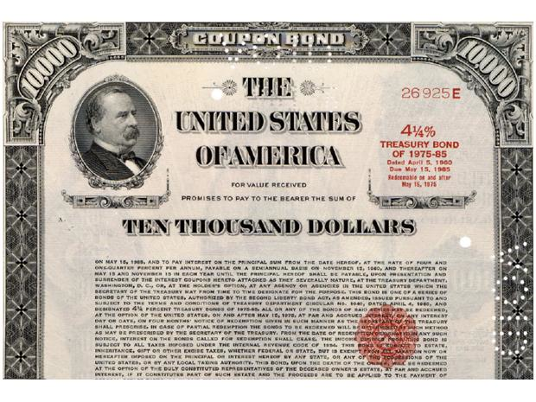
Face value
Coupon rate
Maturity date

Slide 5
Bond Terminology
Bonds make two types of payments:
The promised interest payments are called coupons. These coupons are paid periodically – every six months, annually
until the maturity date of the bond.
The principal or face value of the bond is the notional amount used to calculate the interest payments. The face value is paid at maturity.
Bonds can trade at a price that is greater than (premium), smaller than (discount), or equal to (par) the face value.
Coupon payments (CPN) are determined by the coupon rate as follows:

Slide 6
Zero-Coupon Bonds
zero-coupon bonds have a coupon rate of 0%.
Treasury bills (U.S. government bonds with a maturity of up to one year) are zero-coupon bonds
Zero-Coupon bonds are also called pure discount bonds since they trade a discount relative to their face value
Consider a one year, zero-coupon bond with face value $100,000 and price $96,618.36. The discount reflects the opportunity cost of capital – while the bond pays no “interest” as an investor you are compensated for the time value of money

Slide 7
Coupon Bonds
Pay face value at maturity and regular coupons throughout the life of the bond
Treasury Notes are coupon baring bonds backed by the U.S. Treasury with original maturity of 1-10 years
Treasury Bonds are coupon baring bonds backed by the U.S. Treasury with original maturity of over 10 years

Slide 8
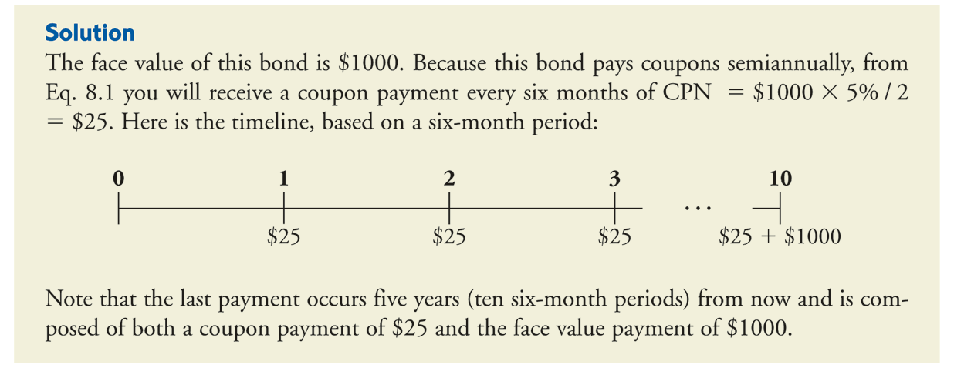
Coupon Bonds

Slide 9
Yield to Maturity and Bond Prices

Slide 10
Yield to Maturity
The Yield to Maturity of a bond or YTM (or just yield) is the discount rate that sets the present value of the promised bond payments equal to the current market price of the bond.
The bond YTM is basically the IRR of the investment in the bond
Considering the zero-coupon bond from before:

Slide 11
Yield to Maturity
What do we learn from the fact that a one-year Treasury bill is trading at YTM of 3.5%?
Since the Treasury bill is risk free (the face value is paid with certainty), it must be that the competitive market risk-free interest rate for a one year is 3.5%

Slide 12
Yield to maturity of an n-Year Zero-Coupon Bond

Slide 13
Calculating Yield to Maturity

Slide 14
Yield to maturity of a Coupon Bond with Maturity N

Slide 15
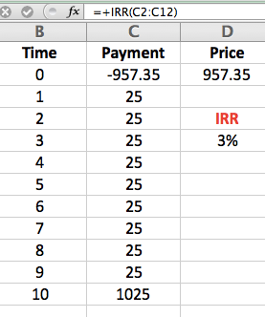
Calculating Yield to Maturity of Coupon Bonds
This 3% yield is for half a year. Thus, we can say that the bond has a yield to maturity equal to a 6% APR with semiannual compounding

Slide 16
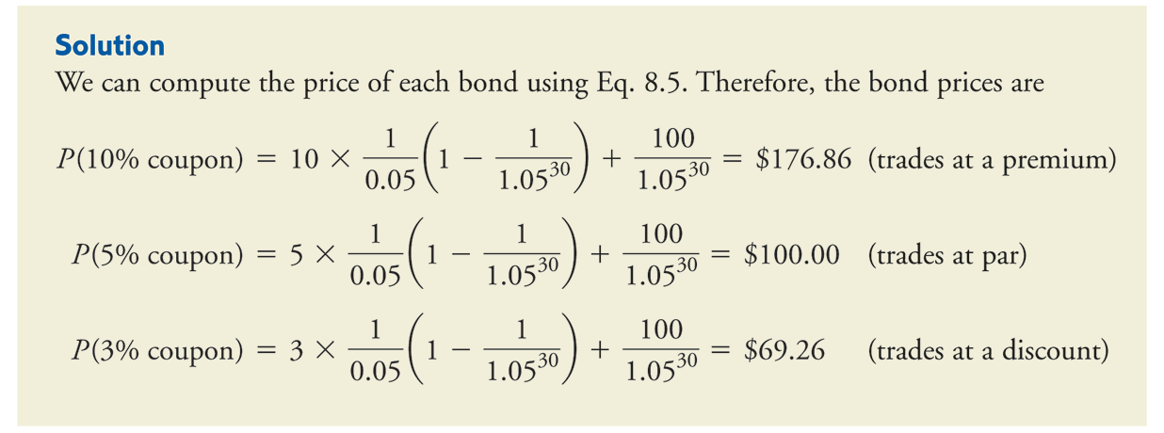
Calculating Bond Prices from the YTM

Slide 17
Bond Prices Dynamics
The price of a bond can change due to shifts in the interest rate (shifts in YTM) and can change over time as its remaining maturity (or term) shortens and the number of future coupons declines
An increase in the YTM will decrease the price of the bond
While holding the YTM fixed the price of the bond can either increase or decrease overtime depending on whether the coupon rate is higher or lower than the bond YTM

Slide 18
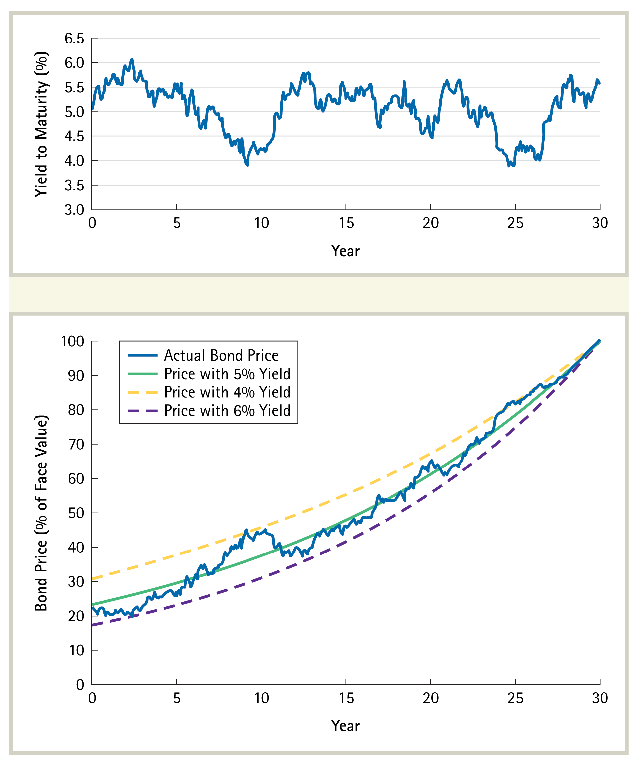
Bond Prices Dynamics
The graph illustrates changes in price and yield for a 30 year discount bond over its life.

Slide 19
Corporate Bonds

Slide 20
Risk of Default
Unlike Treasury bonds that are backed by the U.S. government and are therefore considered risk-free, corporate bonds are backed by the corporation
Corporations might not be able to keep their promise to bond holders and pay their debt obligations

Slide 21
Yield to Maturity of Corporate Bonds
The YTM of corporate bonds is calculated the same way it is calculated for Treasury bonds
But in the case of corporate bonds the YTM does not represent the IRR on an investment in the bond
This is because the promised payments need not be the actual payments in corporate bonds
The YTM is always higher than the expected return of investing in the bond

Slide 22
Measuring the Risk of Default – Credit Ratings
Credit rating agencies evaluate the likelihood of default and provide bond ratings to help investors understand the risks they are exposed to when investing in corporate bonds
Ratings range from AAA for “best quality bonds”, to BBB for “bonds with speculative characteristics”, to CCC for bonds of “poor standing”

Slide 23
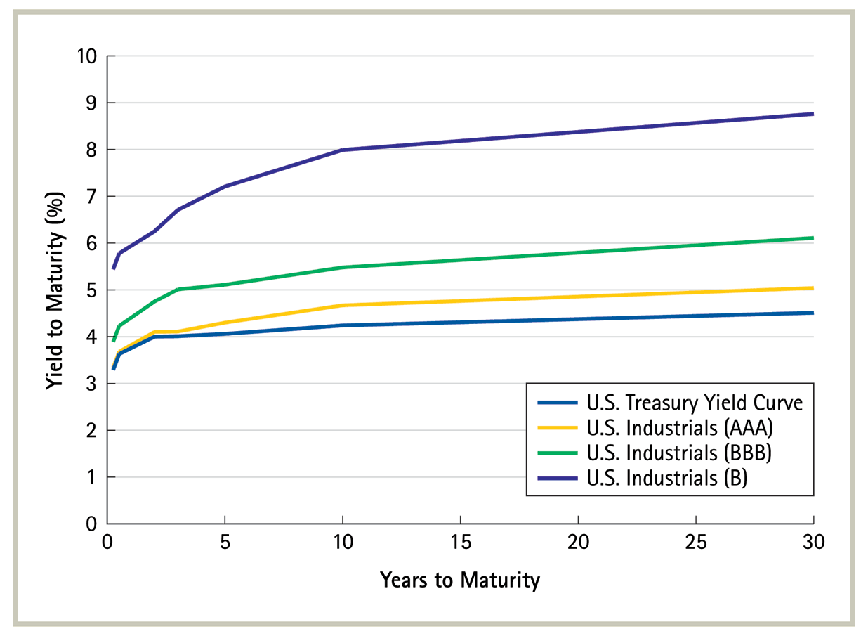
Credit Ratings and Corporate Yield Curves (2005)

Slide 24
Further questions

Slide 25
IRR on an Investment in a Bond
Question 12 (2nd Edition): Suppose you purchase a 10-year bond with 6% annual coupons. You hold the bond for four years, and sell it immediately after receiving the fourth coupon. If the bond’s yield to maturity was 5% when you purchased and sold the bond,
What was flows will you pay and receive from your investment in the bond per $100 face value?
What is the internal rate of return of your investment?

Slide 26
IRR on an Investment in a Bond
The purchase price
Selling price following fourth coupon

Slide 27
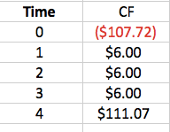
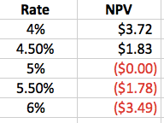
IRR on an Investment in a Bond

Slide 28
Price Sensitivity
Question 13 (2nd Edition):
Consider the following bonds:
Bond | Coupon Rate (annual payment) | Maturity (years)
A | 0% | 15
B | 0% | 10
C | 4% | 15
D | 8% | 10
What is the percentage change in the price of each bond if its yield to maturity falls from 6% to 5%?
Which of the bonds A-D is most sensitive to a 1% drop in interest rates from 6% to 5% and why? Which bond is least sensitive? Provide an intuitive explanation for your answer.

Slide 29
Price Sensitivity
Bonds of longer maturities and zero coupon bonds are more sensitive to changes in the interest rate.

