Slide 1
Assignment Nine
Actuarial Operations

Slide 2
The Actuarial Function
What is an actuary? (film)
Actuarial Functions
  Ratemaking
  Estimation of unpaid liabilities – reserves
  Predictive mining tools

Slide 3
Other Actuarial Tasks
Analyzing reinsurance needs to determine the level and concentration of risk the insurer can retain versus the cost of reinsurance
Estimating future cash flows so that assets will be available when claims are to be paid
Assessing corporate risk by testing the adequacy of surplus under potential adverse conditions (catastrophe, sudden change in asset values, soft pricing, and inflation, for example)
Providing financial and statistical information to regulators and applicable statistical agents (with accounting and finance areas)
Participating in corporate planning and budgeting

Slide 4
Actuarial Services
Staff
Consultants
Actuarial operations
Use of rating organizations
Advisory organizations

Slide 5
Ratemaking Goals
Develop a rate structure involving insurers to compute while earning a reasonable profit
Rates must cover
  All losses
  All expenses
  An amount for profit and contingencies

Slide 6
Ideal Characteristics of Rates
Be stable – time issue
Be responsive – best possible estimates
Provide for contingencies – a security issue
Promote risk control – lowers rates
Reflect difference in risk exposure
  Rates reflect exposure differences

Slide 7
Rate Components
An amount needed to pay future claims and loss adjustment expenses
An amount needed to pay future expenses, such as acquisition expenses
An amount for profit and contingencies

Slide 8
Ratemaking Terms
Exposure base
Pure premium
Expense provision
LAE
Loading for profit and contingencies

Slide 9
Investment Income
Two Functions
  Write policies, collect premium, pay losses
  Remainder underwriting profit
Investments – funds to invest dependent on
  Types of insurance written
  Loss reserves
  Unearned premium reserves

Slide 10
Factors Affecting Ratemaking
Costs of future events uncertain
Estimation of losses
Delays in data collection and use
Change in the cost of claims
Insurer’s projected expenses
Target level of profit and contingencies

Slide 11
Delays in Loss Experience
Delays by insureds in reporting losses to insurers
Time required to analyze data and prepare a rate filing
Delays in obtaining state approval of filed rates
Time required to implement new rates
Time period during which rates are in effect, usually a full year

Slide 12
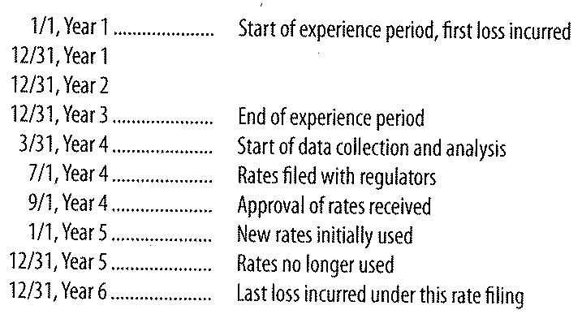
Chronology of a Rate Filing

Slide 13
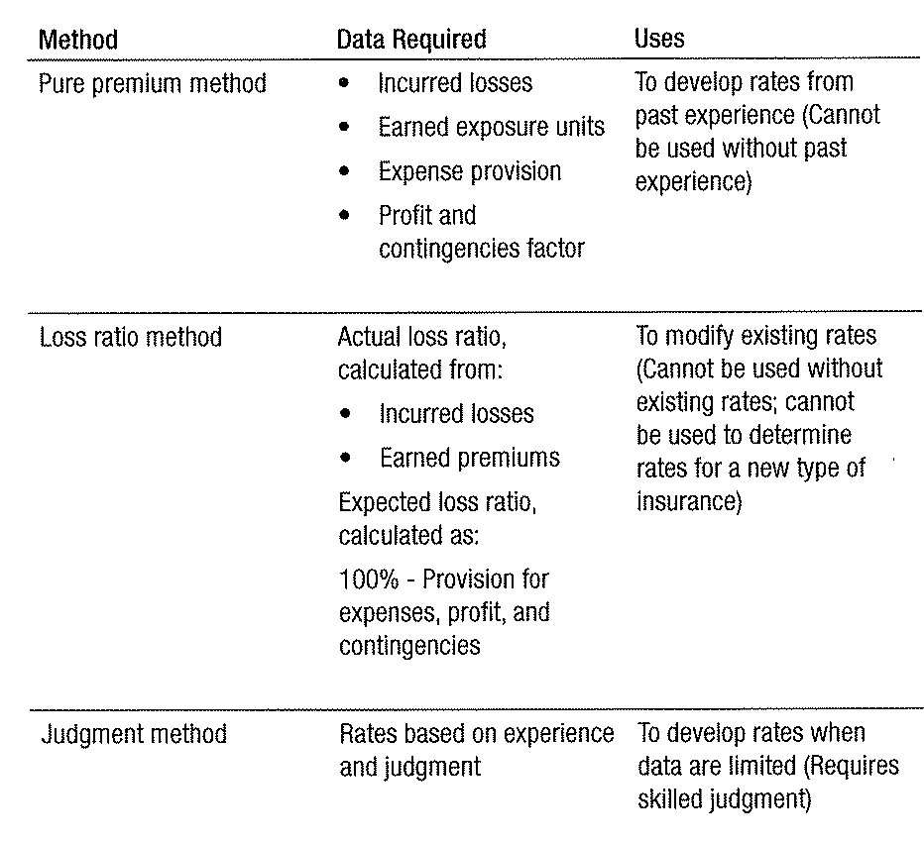
Ratemaking Method

Slide 14
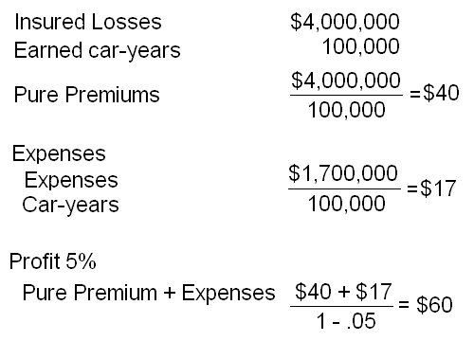
Pure Premium Example

Slide 15

Loss Ratio Method
Judgment Method
  All based on experience of underwriter or actuary
  Still need ocean marine, inland marine, aviation, terrorism

Slide 16
Ratemaking Process Overview
Used for creating or revising rates
Collect data
Adjust data
Calculate overall indicated rate change
Determine territorial and class relatives
Prepare rate filings and submit to regulatory authorities as required

Slide 17
Data Aggregation Methods
Policy – Year Method
Calendar – Year Method
Accident – Year Method
Report – Year Method

Slide 18
Policy – Year Method
Policy year statistical period
Only way to match losses, premiums and exposure units for a particular group of policies
Policy year – all policies issued in a given twelve month period
Policy year statistics equal sum of all

Slide 19
Disadvantages
Involves longer delays in gathering
Involves extra expenses since used only for ratemaking
Can span two calendar years
Some estimate ultimate values
With computers extra cost less significant

Slide 20
Calendar – Year Method
Oldest and least accurate method
Statistics available quickly
Little expense involved
Derived from data compiled for accounting purposes
Accounting does not include incurred losses, earned premiums and exposure units

Slide 21
Earned Premiums
EP: unearned premium at beginning of year
  + Written premiums for year
  – Unearned premiums end of year
Incurred losses: loss reserves at end of year
  + Losses paid during year
  – Loss reserves beginning of year

Slide 22
Calendar – Year Method
Inaccuracies substantial with liability insurance due to delays with data of occurrence and when paid
Unlikely for inland marine, auto physical damage
Is lease accurate data collection method
Bulk reserves not typically calculated at class or territorial level

Slide 23
Accident – Year Method
A compromise between Policy – Year and Calendar – Year
Earned premiums – same as calendar year
Incurred losses – all losses and claims arising from insured events that occur during period
Open or closed, so long as occurring during period
Does not include changes in reserves for event from earlier periods eliminating source of greatest error in Calendar – Year
Require to be reported in Schedule P

Slide 24
Concerns
Earned premium nor incurred losses tied directly
Are slightly more expensive to compile
Accounting records do not distinguish
Can result in parts of single claim in several years
Non-suitable for long payout – workers compensation and liability

Slide 25
Report – Year Method
Similar to Accident – Year Method but claims are aggregated when claim is reported not when it occurred
Where claims made has same benefits as aggregate year
Many insurers do not write claims made ∴ Least Common

Slide 26
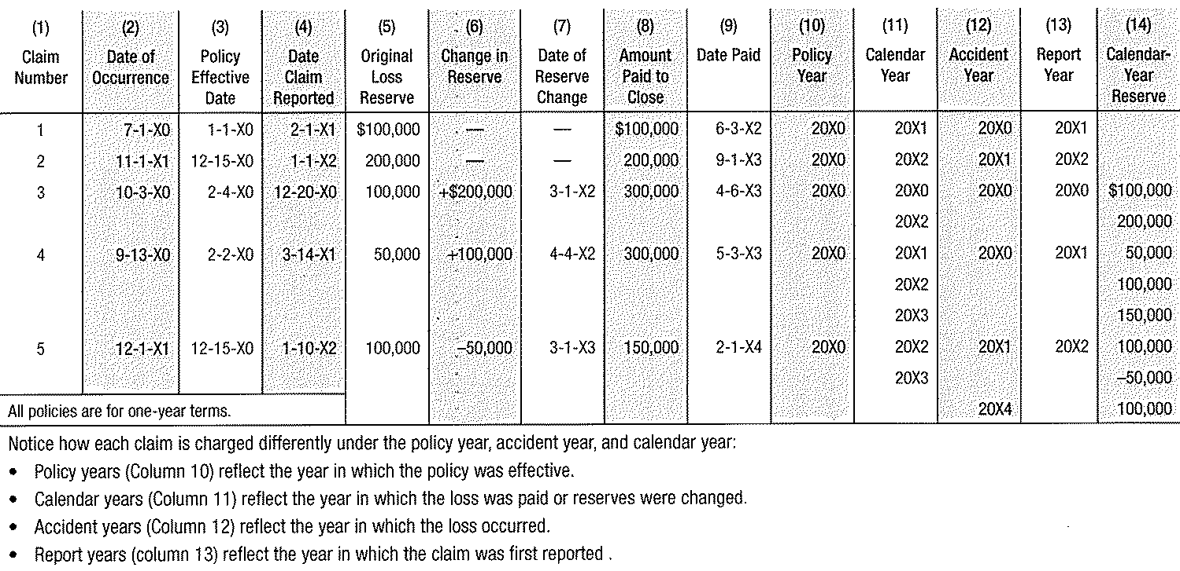
Hypothetical Data Aggregated

Slide 27
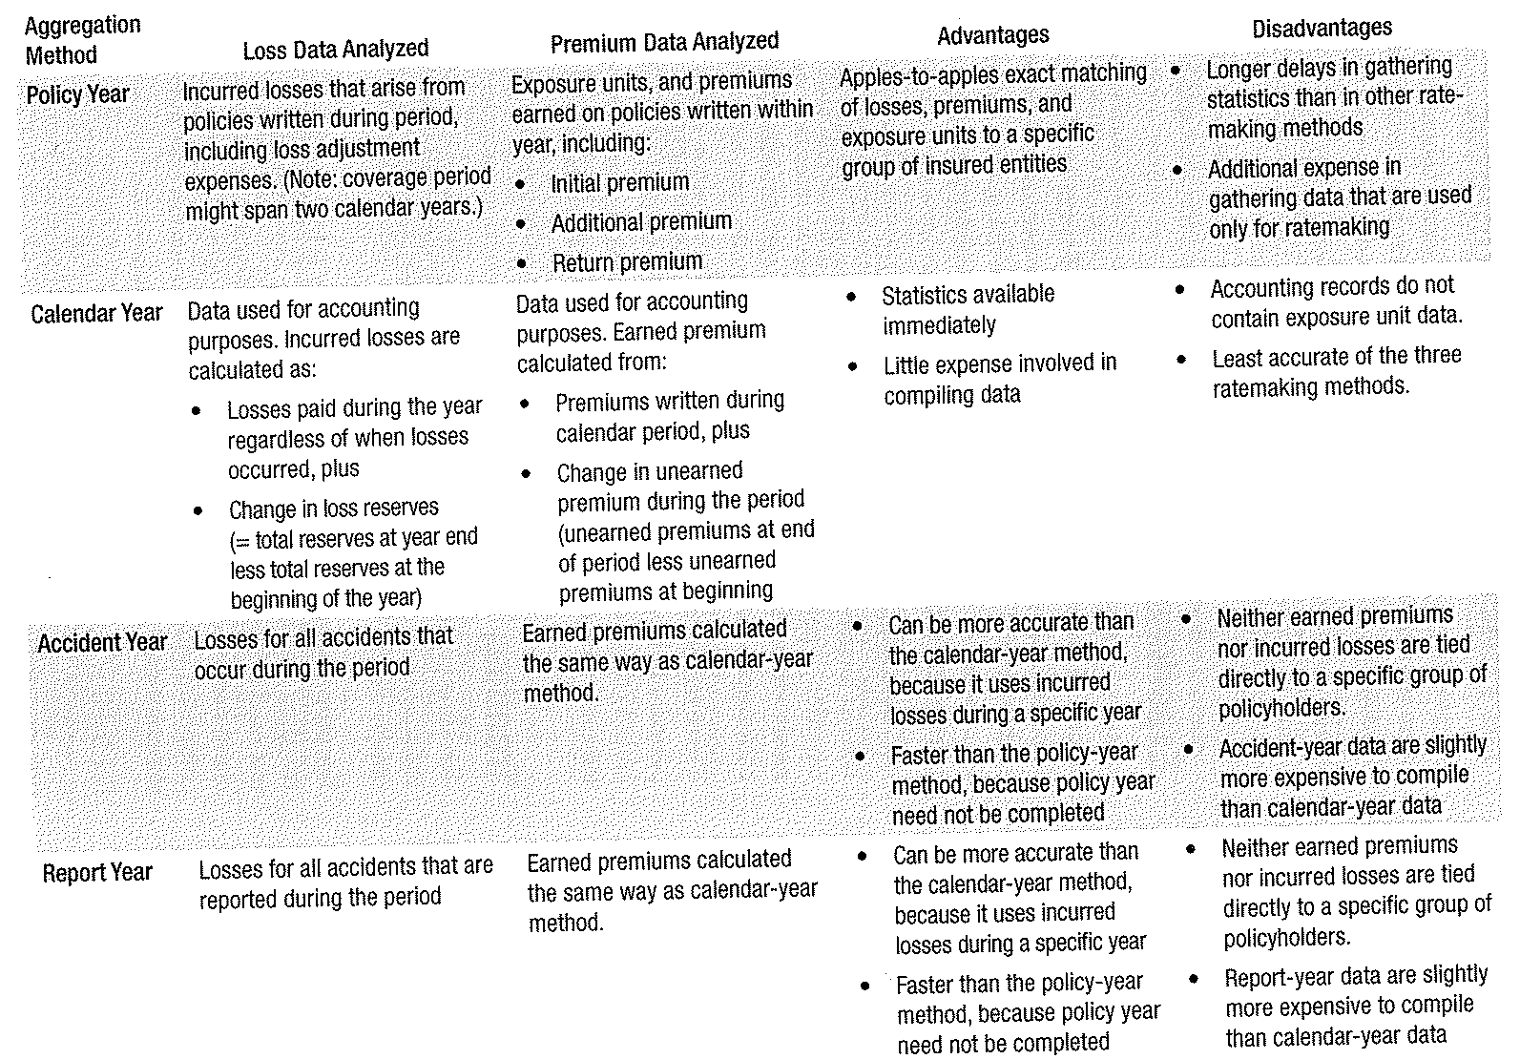
Aggregation Methods Compared

Slide 28
Factor Variances by Types of Insurance
Experience period
Trending
Large loss limitations
Credibility
Increased limits factors

Slide 29
Loss Reserves and Analysis
Largest liability on balance sheet
Represent security that claim will be paid
Depicts actual costs of business

Slide 30
Purpose of Loss Reserves
Insurers are required by law and good accounting practices to establish reserve for losses
Provide a complete picture of financial status
Liability carried on balance sheet is for future payments – reserves
Actuaries and senior management are responsible
Definition
  A loss reserve is a liability on an insureds balance sheet for a loss that has occurred, has been reported to the insurer and for which payment will be made in future years

Slide 31
Types of Loss Reserves
Case reserves
Bulk reserves
IBNR – pure IBNR

Slide 32
Importance of Accuracy
NAIC requires insurer annual statement
  Must have reserves certified by an actuary or other qualified professional
Effect of inaccuracy substantial
  Overestimation impacts financial strength
  Underestimation can lead to insolvency

Slide 33
Analysis of Loss Reserves
Estimation
Expected loss ratio
Loss development
Bornhuetter-Furguson (a combination)

Slide 34
Loss Development
Four Steps
Compile the experience into a loss development triangle
Calculate the age-to-age development factors
Select the development factors to be used
Apply factors to experience to make projections

Slide 35
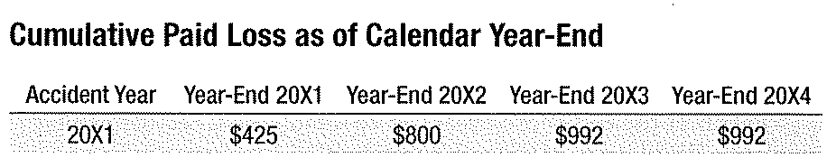
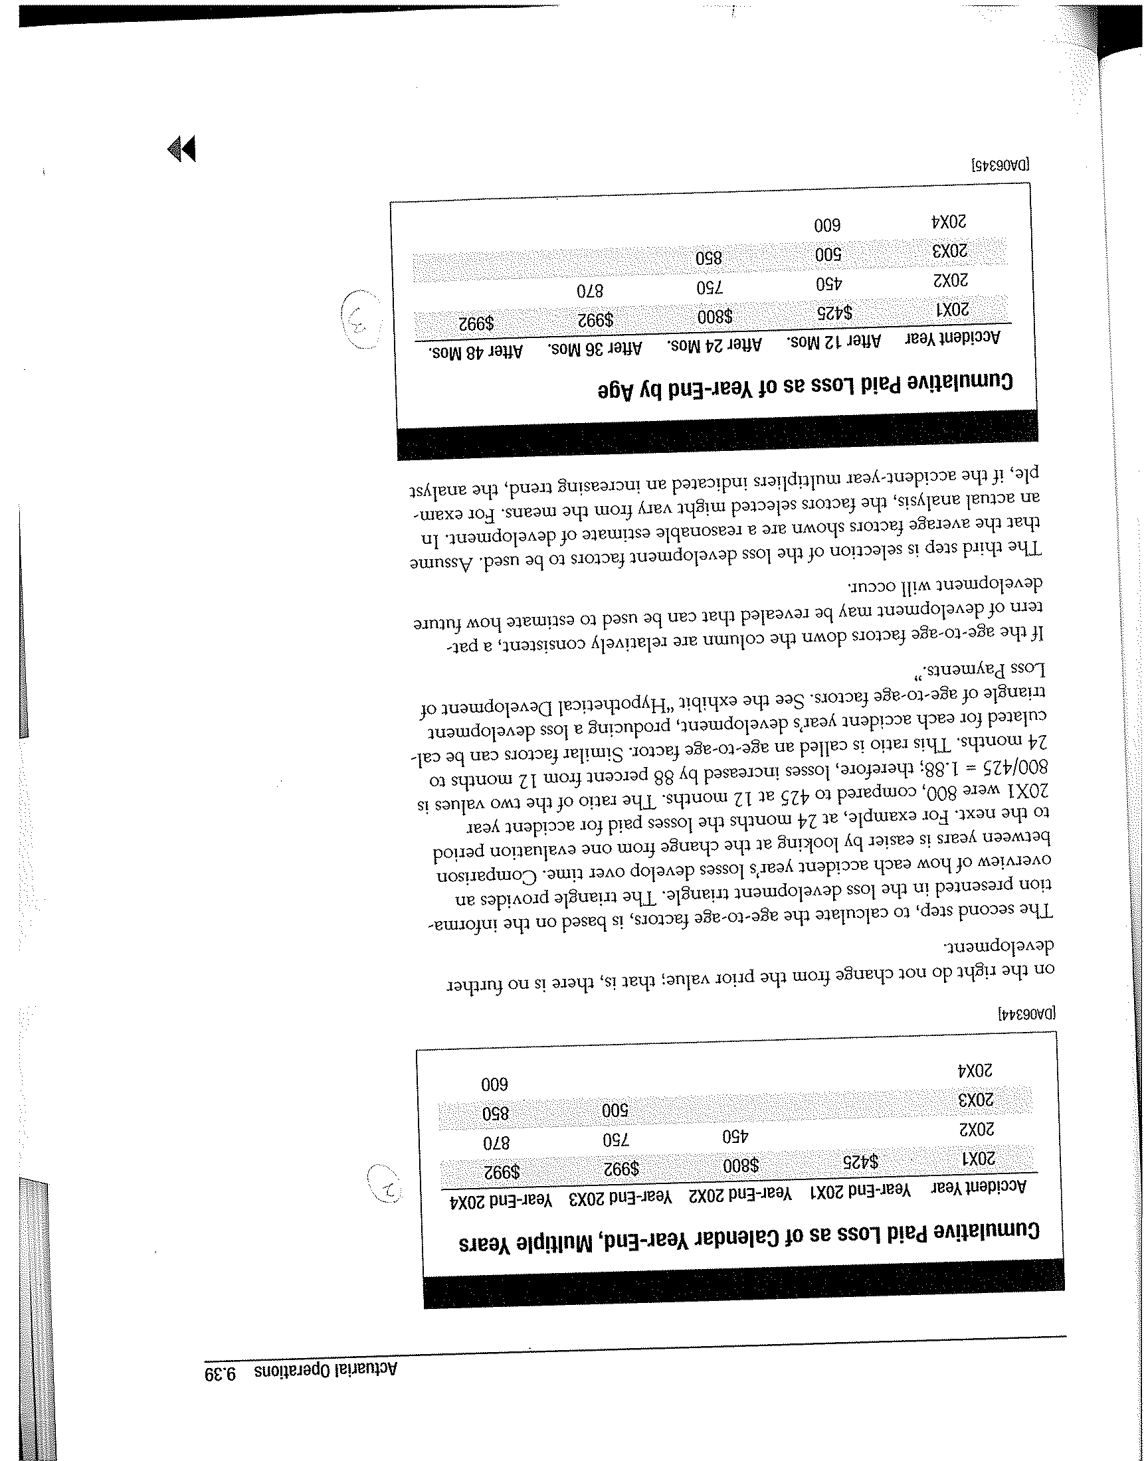
Loss Development Triangle

Slide 36
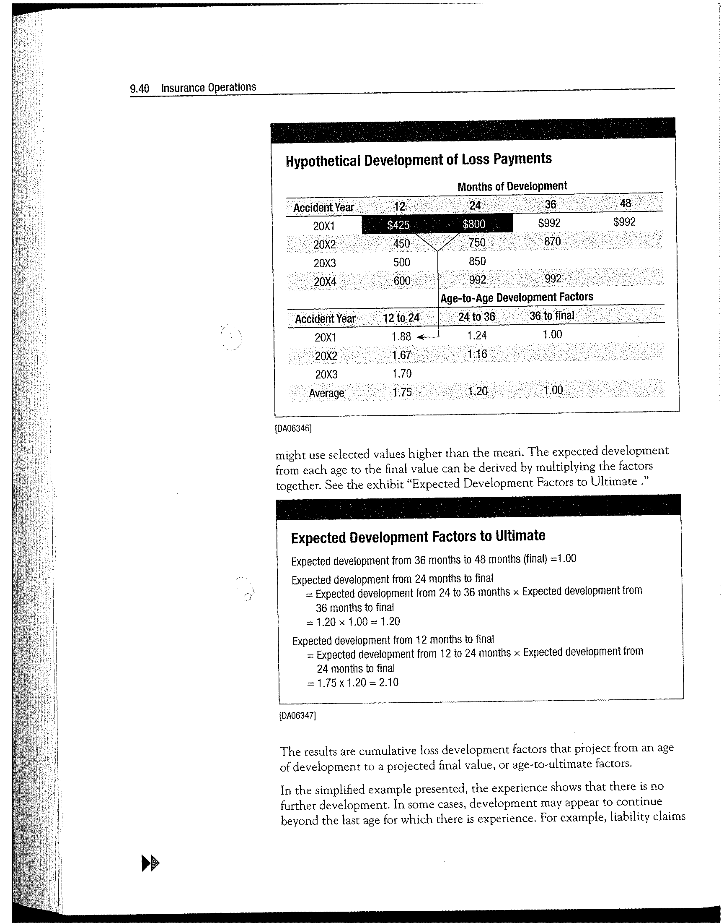
Development of Loss Payments

Slide 37
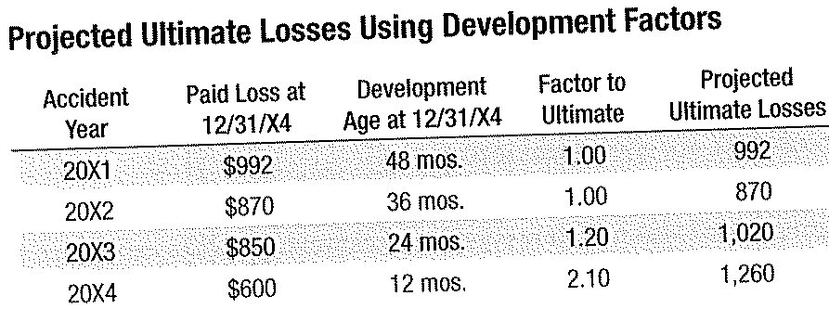
Use of Ultimate Factors

Slide 38
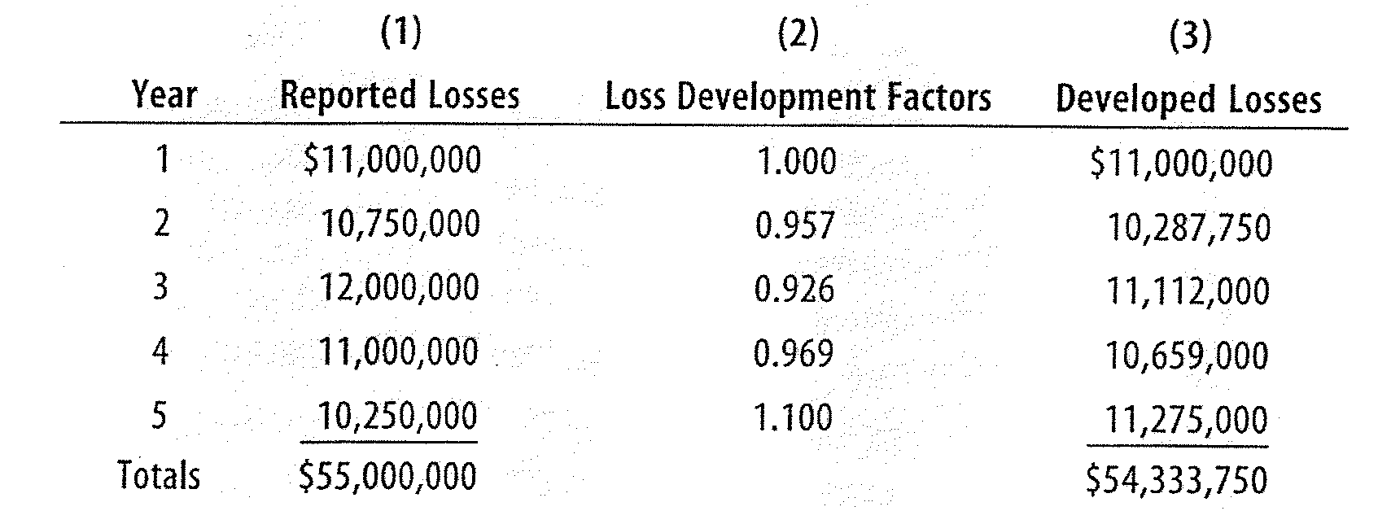
Developed Losses

Slide 39
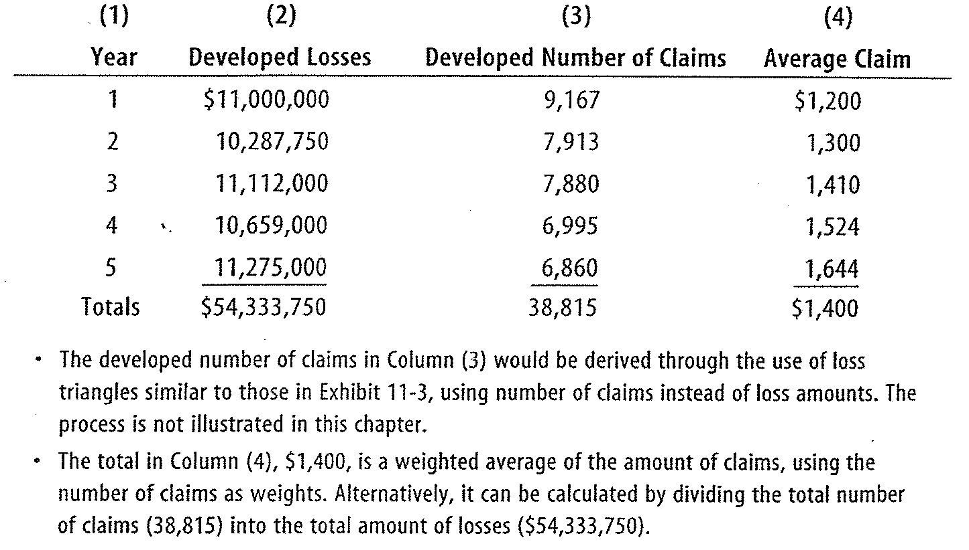
Example – Developed Losses & Claims

