Slide 1
Assignment Three
Insurance Marketing and Distribution

Slide 2
Definitions
Insurance Consumer –
  All buyers of insurance, including individuals, families, business, government bodies, and others
Distribution Systems –
  Communicate information between buyer, buyer and seller
  Move the product between seller and buyers of the seller
Intermediary –
  An agent, broker or employee of the seller who performs these functions
Agent –
  A person or firm in an agency relationship authorized by the principal (insurance company) to act on behalf of the principal
Broker –
  An independent business owner or firm that represents policyholders and prospective policyholders in their dealing with insurers

Slide 3
Property – Casualty Insurance
Marketplace – highly competitive meeting point between customers needs and insurers abilities
Customer – needs, knowledge, methods of assessing, market negotiating, alternates
Individuals – insurers are able to pool loss exposures to determine premiums
Small Business – usually limited knowledge
Middle Markets – may have risk manager
National Accounts – Fortune 500 companies, chemical and manufacturing organizations, large municipalities

Slide 4
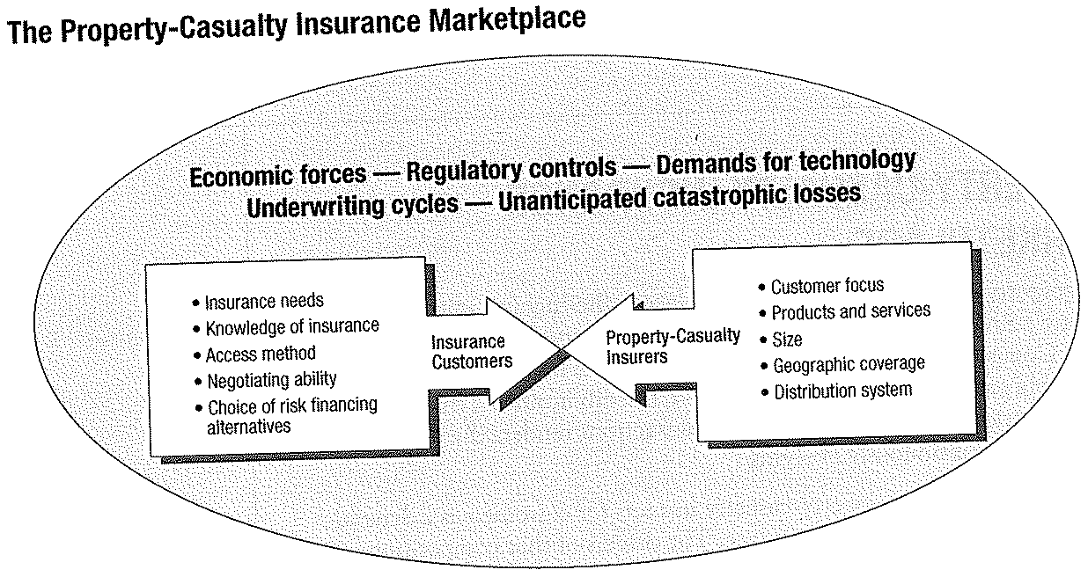

Slide 5
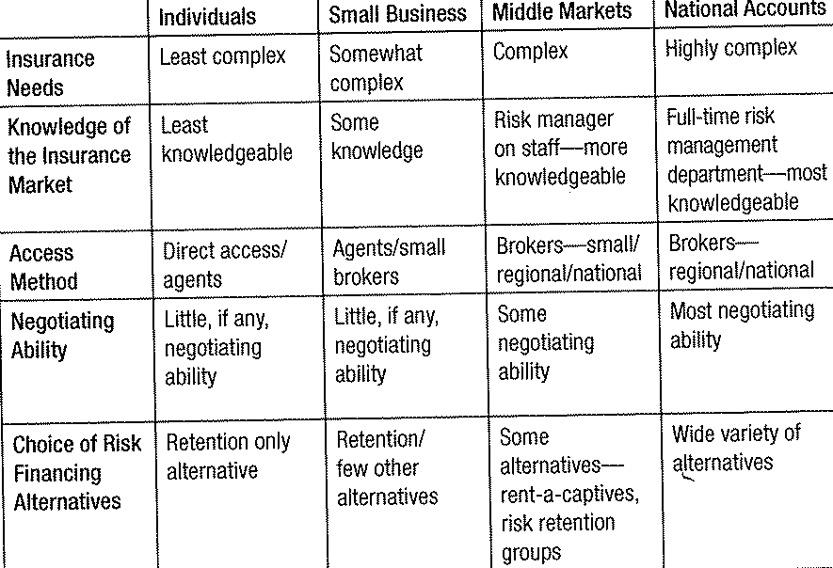
Comparison of Insurance Customers

Slide 6
Marketing Differentiation
Level of Competition
Customer Focus
Products and Services
Size
Geographic Area
Distribution System

Slide 7
Unique Factors
Economic Forces
Regulatory Controls
Demand for Technology
Underwriting Cycles
Unanticipated Catastrophe Losses

Slide 8
Marketing Activities
Marketing Research
  Systematic gathering and analyzing data on project basis
  Research Methods – predicative analysis
  Segmentation – to differentiate themselves
    Target Marketing
    Niche Marketing
  Behavioristic
  Geographic
  Demographic
  Psychographic

Slide 9
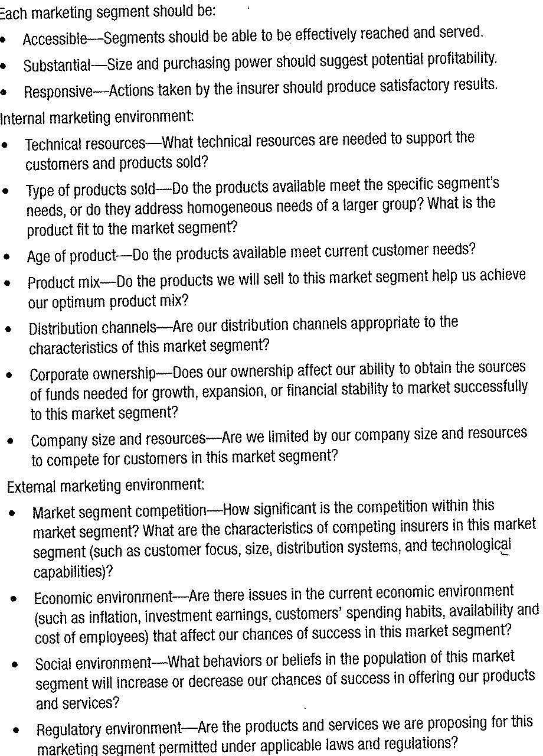
Market Segment Selection

Slide 10
Market Development
Entering a new market, territory, customer type, new product
Project managers – generate and screen ideas

Slide 11
Market Information
Delivering timely and cost effective information essential to decision making
Major Types
  Internal Accounting – can provide report and analysis capability by product of systems that keep track of commissions and billings
  Market Monitoring – provides intelligence about external environment providing current, unfiltered and unbiased information

Slide 12
Other Marketing Activities
Planning – provides tools for management
Development – what products and services to be sold and to which market
Advertising and Promotion – mass media or none at all
Customer and Public Relations – provides a forum for communication
Sales Fulfillment – satisfactory delivery

Slide 13
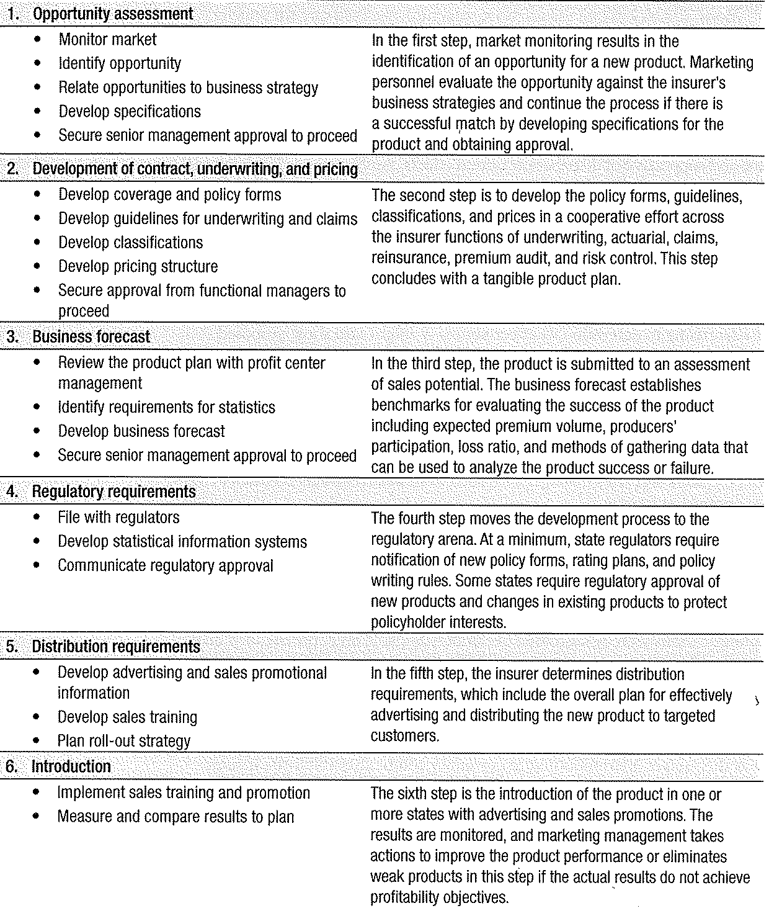
Product Development Steps

Slide 14
Distribution Systems and Channels
The necessary people and physical facilities to report the sale of insurance products and services
Main Insurance Distribution Systems
  Independent Agency and Brokerage System
  Exclusive Agency Marketing System
  Direct Writer Marketing System
Other
  Internet
  Call Center
  Direct Response
  Group Marketing
  Financial Institution

Slide 15
Independent Agency and Brokerage Marketing System
Are independent contractors
  Can be sole proprietorship, partnership, corporation
Ownership of agency expirations – an agency’s most valuable asset
Compensations
  Flat percent commission
  Contingent on profit sharing
  Disclosure creates transparency
National and Regional Brokers
  Requires sophisticated knowledge and services
  Regional, Nationally and Internationally
  (see list as handout)

Slide 16
Others
Independent Agent Networks
MGA’s
Surplus Line Brokers (NAPSLO)
Exclusive Agency Marketing
Direct Writer Marketing
Internet
Call Centers
Direct Response
Group Marketing
Financial Institutions
Mixed

Slide 17
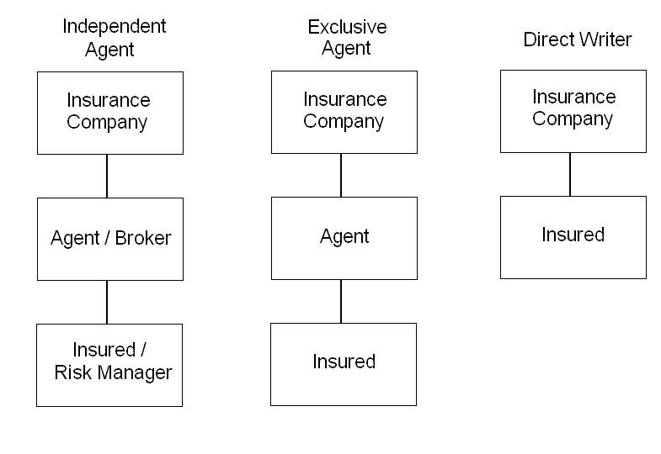
Distribution Systems

Slide 18
Functions Performed by Producers
Prospecting – referrals, advertising, telephone, cold canvass (calls)
Sales – commissions on sales source of income
Risk Analysis – determining prospects’ needs
Policy issuance

Slide 19
Functions Performed by Agent (cont.)
Collections of Premiums
  Direct billing
  Agency billing
Claims – all agents involved to some degree
Consulting – part of ongoing risk analysis
Customer service

Slide 20
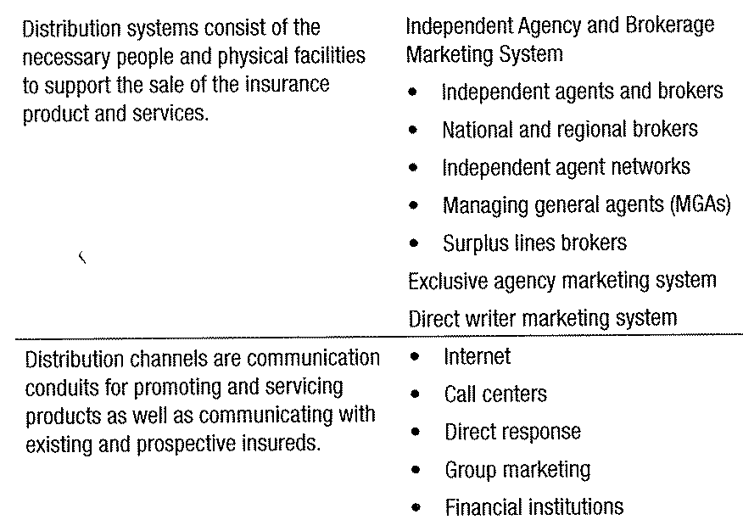
Distribution Systems and Conduits For Insurance Marketing

Slide 21
Customers Needs and Characteristics
Key Factors
  Products and Services – customer expectations
  Price – always a factor?
  Response Time – speedy response expected

Slide 22
Insurer’s Profits
Insurer Strategies and Goals
Insurer Strengths
  Financial Resources
  Core Capabilities
  Expertise and reputation of producers
Existing and Target Markets
Geographic Location
Degree of Control Required
  Most central-direct writer
  All systems require insurer control
  Direct response – insurer complete control

Slide 23
Convergence of Traditional
Marketing Systems
Exclusive agency and direct writer serve individual needs
General concerns are on price
Insurers driven by competition
Gramm – Leach – Bliley lifted any restrictions on bank holding companies
More toward multiple distribution channels
Allstate, Farmers, Nationwide, Progressive exclusive agents and independent agents
Vertical integration

