Slide 1
Assignment Two
Insurance
Regulation

Slide 2
Issues
Locus of Regulatory Control
State or Federal
The extent of regulation
Collaboration among insurers

Slide 3
Milestones
U.S. Constitution
Paul vs. Virginia – 1869
Sherman Anti-trust Act – 1890
SEUA decision
McCarran – Ferguson Act – 1945
Insurance Services Office (ISO) Attorneys General Lawsuit – 1988
Gramm-Leach-Bliley Act – 1999
Dodd – Frank 2011
FIO

Slide 4
Paul vs. Virginia
Samuel B. Paul a Virginal Insurance Agent
Licensed in Virginia
Desired to represent New York Insurers
NY Company did not make deposit
Virginia refused to license Paul
Supreme Court ruled Virginia ruling unconstitutional
Could not regulate except in Virginia

Slide 5
Sherman Anti-Trust Act
Insurance a private contract
Free market determined prices
Trusts combined to dominate market
Prompted consumer rebellions
Trusts were an abuse of economic power
Congress enacted Sherman Anti-Trust Act 1890
Rating Bureaus an answer to tariffs
States expanded regulation thru rating bureaus

Slide 6
SEUA Decision
200 stock companies
Controlled 90% of fire and allied lines
Six states – Alabama, Florida, Georgia, North Carolina, South Carolina, Virginia
Suit filed by AG of Missouri
Case first dismissed in Georgia
Supreme Court ruled was commerce and thus subject to congressional regulation – 1944
The Sherman Act, The Clayton Act and FTC Act applies to Insurance

Slide 7
McCarran – Ferguson Act
1945 – gave NAIC and insurers state regulation
“In the public interest”
Business of Insurance
The risk of policy holder or insured shared and underwritten by the insurer
Insurer and insured have a direct contractual connection
Activity is unequal to entities within insurance business

Slide 8
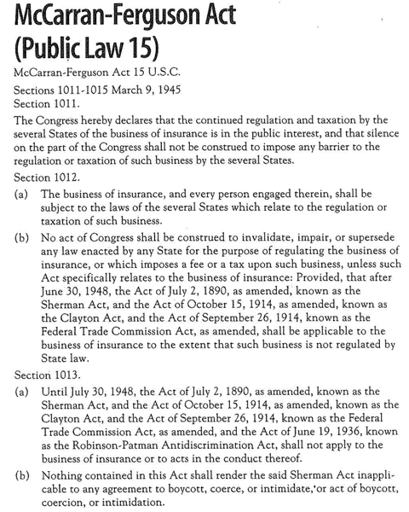

Slide 9
Birth of NAIC
First NCIC – National Convention of Insurance Commissioners
NAIC – National Association of Insurance Commissioners 1930s
Presiding group that tends to regulate
1946 – two model regulation bills
1947 – Act relating to Unfair Methods of Competition and Unfair Deceptive Acts and Practices
1947 – most states enacted laws similar to NAIC model in an effort to preempt federal regulation

Slide 10
ISO and Attorneys General Lawsuit
ISO – 6 separate bureaus, 9 local/regional – 1971
Reorganized by 2002, a for profit corporation
1988 AGs of California, New York, Texas and 4 others filed suit
1994 insurers, 20 attorneys general, and some private Co’s settled
$36 million to establish Public Entity Institute

Slide 11
Financial Services Modernization
Need quickened with affiliation of banks and insurance companies
Gramm-Leach-Bliley
Became law November 1999
Includes reciprocal licensing
New Issues – privacy of personal finance information

Slide 12
Federal Insurance Office
Frank-Dodd Financial Service Law
September 2010
Not a regulatory body, has no authority
Has vast powers to collect data
March 2011 – Michael McRaith new head
Formerly director of Illinois Department of Insurance
Advisory Group – mostly insurance advisors or hope to be
Financial Stability Oversight Council

Slide 13
Why Regulate?
Protect Consumers
Maintain Solvency
Avoid Destructive Competition

Slide 14
State Insurance Departments
Legislative branch makes the laws
Judicial branch (court system) interprets laws
Executive branch implements laws
Insurance departments are part of Executive Branch
Insurance Commissioners
Appointed (Texas)
Elected

Slide 15
Funding Insurance Departments
Funding comes from
Premium Taxes – most goes to general funds for state
Licensing Fees
Filing Fees
Small portion spent on insurance regulation

Slide 16
NAIC
Model Laws
Sharing Financial Information
Accreditation

Slide 17
NAIC Accreditation Program
Each states insurance laws and regulations must meet basic standard of NAIC models
State regulatory methods must be acceptable to the NAIC
The states insurance department practices must be adequate as defined by NAIC

Slide 18
Federal Regulation
Still exists even with McCarran – Ferguson Act
Sherman Act prohibits boycott, etc.
Anti-Trust
Federal Employment laws
IRS
SEC
ERISA
Insurance Fraud Protection Act

Slide 19
Pros: State vs. Federal Regulation
Proponents of Federal Regulation
Can provide uniformity in regulation – 50 states
More efficient
Attract higher quality personnel

Slide 20
Cons: State vs. Federal Regulation
Opponents of Federal Regulation
More responsive to local needs
Uniformity can come through NAIC
More innovation opportunities
Already exist with known strengths and weaknesses
Desirable decentralization
State regulators have been responsive in reducing complexity of regulation

Slide 21
Systemic Risk
Most insurance people feel does not exist
FIO could be a venue to collect data to support providing data as requested Treasury or Congress
Systemic Risk – potential for a major disruption in the function of an entire market or financial system
AIG – 2008 $185 billion bailout

Slide 22
Areas Regulated
Formation and Licensing of Insurers
Licensing of Personnel
Solvency Regulation
Contract (Insurance Policy) Regulation
Rate Regulation
Market Conduct
Consumer Protection

Slide 23
Formation - Domestic
Capital & Surplus
Risk Based Capital Requirements
Asset-credit-underwriting-off-balance sheet
Foreign Insurers
Alien Insurers
Non-Admitted Insurers
Risk Retention Groups

Slide 24
Licensing
Those who sell, give advice, represent insurers
Producers
Insurance consultants
Claim adjusters

Slide 25
Solvency
Methods to Ensure
Financial Requirements
Review of Financial Annual Statements
IRIS/FAST
Onsite field examination

Slide 26
Financial Solvency Core Principals

Slide 27
Guaranty Funds
Reasons for Insolvency
Rapid Premium Growth
Inadequate rates and reserves
Excessive expenses
Lax controls over MGAs
Uncollectible reinsurance
Fraud

Slide 28
Challenge in Solvency Regulation
Time lag in determining problem insurers
Inadequate resources
Lack of professional qualifications for field examiners
Inadequate sharing of information

Slide 29
Characteristics of State Guaranty Funds
Post loss assessment except New York
Policies usually terminate within 30 days
Coverage varies by state but no surplus lines except New York
Claims subject to maximum limits
Some states provide for refund of premium
Have mandatory deductibles
Recovery either by rate increase or reduce state premium taxes

Slide 30
Rates & Rate Regulation
Objectives
Adequate
Not excessive
Not unfairly discriminatory

Slide 31
Rating Laws
Mandatory
Prior Approval
File and Use
Use and File
Flex
Open Competition

Slide 32
Prior Approval vs. Competitive

Slide 33
Strict Rate Regulation
Proponents of prior appraisal
Requires insurers to justify requests for increase
Promote insurer solvency
Help keep rates reasonable
Proponents of open competition
Inadequate rates
Could distort incentives for controlling claim costs
Might lead insurers to abandon a state
Less expensive to administer
Allow rates to be adjusted quickly
Keeps rates reasonable and equitable

Slide 34
Insurance Contracts
Regulated by
Legislation
Insurance Department rules, regulations, guidelines
Courts

Slide 35
Market Conduct & Sales Practices
Dishonesty/Fraud
Misrepresentation
Twisting
Unfair Discrimination
Rebating

Slide 36
Underwriting
Constrain insurers ability to accept, decline or modify applications
Establish allowable classification
Restrict timing of cancellations and non-renewals

Slide 37
Unfair Claim Settlement Practices
Misrepresentation
Failing to make a good faith effort to settle
Attempts to settle for less than obvious value
Failing to approve or deny within a reasonable time
Bad faith actions

Slide 38
Unofficial Regulators
NAIC
Financial Rating Organizations
Insurance Advisory Organizations
Insurer Trade Organizations
Consumer Organizations

Slide 39
Financial Rating Organizations
AM Best
Duff and Phelps
Moody’s
Standard & Poors
Weiss Ratings

Slide 40
Insurance Advisory Association
Insurance Services Office (ISO)
American Association of Insurance Services (AAIS)
National Council on Compensation Insurance (NCCI)

Slide 41
Professional & Trade Associations
For fee, have access to legislative developments
Can participate on committees to influence legislation
Trade Associations influence extend to national, state and local levels
Legislators often use incorrect information without trade organizations input
Lobbying

Slide 42
Insurance Industry

Slide 43
Insurance Industry (cont.)

Slide 44
Commercial Insurance Deregulation
Complexity increased pressure for simpler system
Large commercial have expertise necessary
+20 states deregulating commercial rate/form
Must meet minimum premium level, minimum revenue
Could include having a full-time manager

Slide 45
The Business of Insurance
One or more of these characteristics
The risk of the policyholder or insured is shared and underwritten by the insurer
A direct contractual connection exists between insurer and the insured
The activity is unique to entities within the insurance industry

