Slide 1
Assignment Eleven
Insurer Strategic Management

Slide 2
Strategic Management Process
Strategy formulation – creating a plan
Strategy implementation – putting plan into action
Strategy evaluation – monitoring the results

Slide 3
Strategy Formulation
Based on mission or value statement
Formulation steps
Analyses of external and internal environments
Development of long-term strategies
Determination of strategy or organization levels
Implementation
Strategy execution – making them work

Slide 4
Strategy Steps

Slide 5
Strategy Evaluation
Establish standards
Create and apply measurements
Compare actual results to standards
Evaluate and implement corrective actions if goals are not met

Slide 6
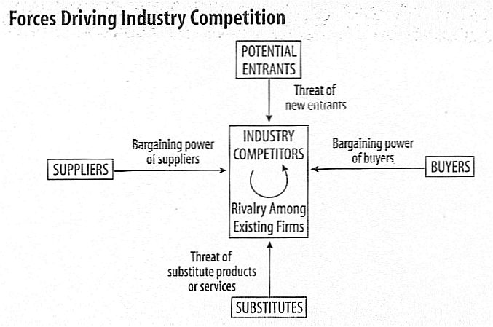
Five Forces and SWOT Methods
Success depends on firm’s ability to analyze changing environment

Slide 7
SWOT Analysis
Strengths, Weakness, Opportunities and Threats
Strengths and Weakness
Managerial expertise
Available product lines
Skill levels and competencies of staff
Current strategies
Customer loyalty
Growth levels
Organizational structure
Distribution channels

Slide 8
SWOT Analysis Table

Slide 9
Strategy at Different Levels
Corporate
Business
Functional

Slide 10
Global Expansion
Why expand globally
Trends in global expansion
Strategic reasons for global expansion
Global market considerations
Approaches to global expansion

Slide 11
Global Markets

Slide 12
Reasons for Global Expansion
Revenue growth
Global competiveness
Market considerations
Market analyses
Economic considerations
Political risks

Slide 13
Approaches to Expansion
Strategic alliance
Joint venture
Merger
subsidiary

Slide 14
Case Study – Greenly Insurance Co.
Goals
Business strategies
Issues

Slide 15
SWOT Case Study - Greenly

Slide 16
Changes Might Include
Redesign its web site to add on-line quote capability or other interactive options
Expand into a new state as a direct writer
Implement a pilot program to test new products or coverage options
Redesign the company magazine to emphasize new developments and to better target second-generation policyholders
Refocus community involvement efforts on issues more likely to appeal to second generation policyholders and effectively promote those efforts
Retrain claims staff to improve customer satisfaction

Slide 17
Global Operations
A key strategic decision if more than domestic
Pace of growth accelerated with
WTO
NAFTA
EU
ASEAN
CARICOM
Advances in technology and transportation

Slide 18
Influences on Global Expansion
Culture
Language
Regulations
Laws
Economic considerations
Political risks

Slide 19
Global Insurance Operations
Driven by large commercial risks
Incidental operations can be provided
World differences
Property-casualty or life and health life or non-life
Personal or commercial or mass risks
General insurance

