Slide 1
PowerPoint Slides for Professors
Spring 2010 Version
This file as well as all other PowerPoint files for the book, “Risk Management and Insurance: Perspectives in a Global Economy” authored by Skipper and Kwon and published by Blackwell (2007), has been created solely for classes where the book is used as a text. Use or reproduction of the file for any other purposes, known or to be known, is prohibited without prior written permission by the authors.
Visit the following site for updates:
http://facpub.stjohns.edu/~kwonw/Blackwell.html.
To change the slide design/background,
[View] → [Slide Master]
W. Jean Kwon, Ph.D., CPCU School of Risk Management, St. John’s University 101 Murray Street New York, NY 10007, USA
Phone: +1 (212) 277-5196 E-mail: Kwonw@stjohns.edu

Slide 2
Risk Management and Insurance: Perspectives in a Global Economy 12. Enterprise Risk Management
Click Here to Add Professor and Course Information

Slide 3
Study Points
The evolution of enterprise risk management
Risk management fundamentals
The ERM framework
The risk management process

Slide 4
ERM Evolution (Figure 12.1)
Corporate level
ERM
Interdepartmental level
Plus strategic risk
Plus financial risk
Plus other operational risk
Departmental level
Hazard risk only
No integration
Partial integration
Full integration

Slide 5
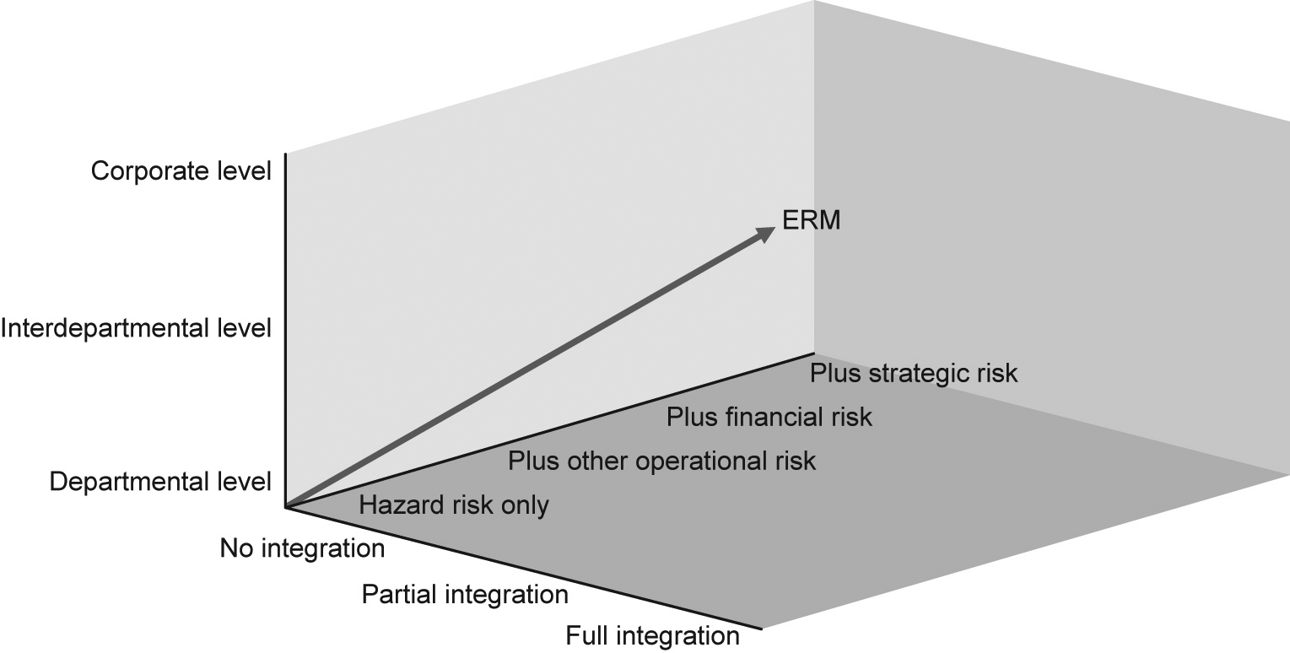
ERM Evolution (Figure 12.1) (textbook version)

Slide 6
Risk Management Fundamentals
Risk management for corporations
Attempts to manage those risks that entail the possibility of economic harm
A reduction in the value of existing wealth
An increase in future expenditures
A reduction in future income
An increase in the discount rate
The firm should identify all opportunities and threats, quantify and prioritize them, and find means to manage them collectively and effectively to enhance firm value.
It should be indifferent whether a risk is financial, operational or strategic.

Slide 7
ERM Goals
ERM deals with all risks critical to the maintenance and enhancement of firm value.
The risk manager should be indifferent whether a risk is financial, operational or strategic.
A firm can alter its risk portfolio in three ways:
Modify its operations
Adjust its capital structure
Employ targeted financial instruments

Slide 8
ERM Goals
The Committee of Sponsoring Organizations of the Treadway Commission (COSO)
An effective ERM approach should be oriented toward several sub-goals:
Ensure that the firm’s risk appetite is aligned with its overall strategy;
Enhance risk response decisions
Reduce operational surprises and losses
Identify and act on (new) business opportunities from successfully managing risks
Allow management effectively to assess the firm’s capital needs and improve capital allocation

Slide 9
Impact of RM on Cash Flow Volatility (Figure 12.2)
Post-risk management
Likelihood
Pre-risk management
Cash Flow

Slide 10
The ERM Frameworks
The COSO Framework
The Australian/New Zealand Standard
AS/NZS 4360
The U.K. Risk Management Standard
The IRM–AIRMIC–ALARM standard

Slide 11
The ERM Process

Slide 12
The ERM Process (Figure 12.3)
ERM Committee
(Senior Management, Board, Department Heads and Risk Manager)
Goal Setting
Risk Reporting and Communication
Goal Achievement
Environmental Analysis
Risk Analysis
Risk Response
Plan Administration
Internal Environment
Risk Quantification
Control
Implementation
External Environment
Risk Mapping
Financing
Monitoring
Review

Slide 13
Environmental Analysis – Internal
Sources of information
Financial statements
Examination of production operations
Questionnaires
Brainstorming sessions with key personnel
Scenario planning
Risks
Operational
Financial

Slide 14
Environmental Analysis – Internal
Operational risks
Earnings can be affected by a host of risks.
Assets can be damaged, destroyed and stolen, and some become obsolete over time.
Employee-related risks such as injury or death, resignation (including being fired), strike or being the object of kidnappings and ransom.
Legal liability is a major concern for businesses in several countries.
Table 12.1
Political risks are especially relevant for MNCs.

Slide 15
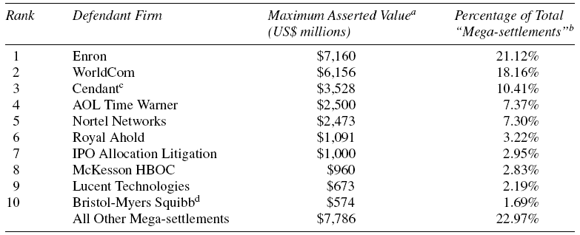
Top 10 Class Action Settlements (Securities Litigation)
Source: Stanford Securities Class Action Database jointly maintained by Cornerstone Research (2006)

Slide 16
Environmental Analysis – Internal
Financial risks
Currency or foreign exchange rate risk
Interest rate risk
Input price risk
Output price risk
Credit (counterparty) risk

Slide 17
Environmental Analysis – External
Threats and opportunities external to the organization fall into the strategic risk category.
Strategic risks stemming from macroeconomic and other primarily external influences and trends
Strategic risks usually being the responsibility at the highest levels of the organization
Case
What seems to be purely an operational risk issue can escalate into a disastrous reputational problem
The Royal Dutch/Shell case in Insight 15.5

Slide 18
Risk Quantification
Quantitative risks
Net present value (NPV) and internal rate of return (IRR) analyses
The capital asset pricing model (CAPM)
Value at risk (VaR)
Qualitative risks
Scenario planning
Brainstorming
Decision tree analysis
Classification And Regression Trees (CART)
Hazard and Operability (HAZOP) method
Program and Evaluation Review Technique (PERT)
Figure 12.4

Slide 19
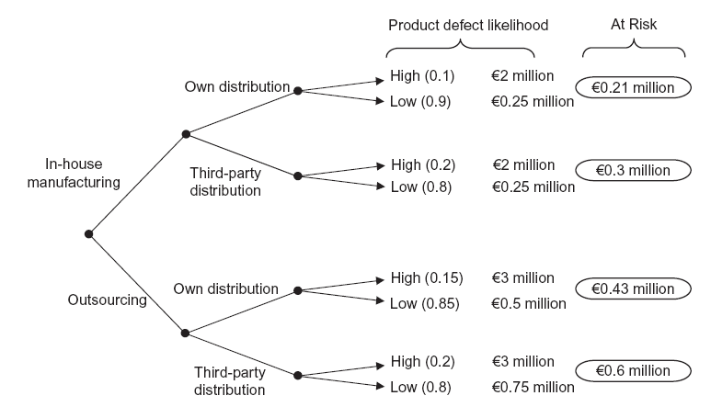
Decision Tree Analysis (Figure 12.4)
The euro amounts are not based on any specific calculation.

Slide 20
Risk Mapping
Upon completion of the analysis process, the firm should be able to quantify all risks identified objectively or subjectively and then ranks the risks in the order of priority
Two approaches
The IRM-AIRMIC-ALARM approach (Table 12.2)
Risk mapping (Figure 12.5)

Slide 21
The IRM-AIRMIC-ALARM approach (Table 12.2)
The ERM committee is expected to enter types of risks in each cell (window).

Slide 22
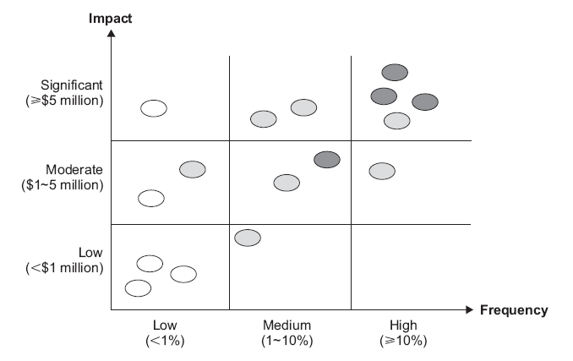
Risk Mapping (Figure 12.5)

Slide 23
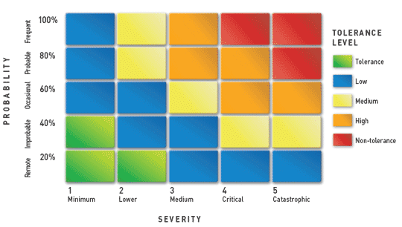
Risk Mapping (new)
Source: http://www.mapfre.com/fundacion/html/revistas/gerencia/n098/img/fotos/m103_02.gif

Slide 24
Risk Response
Risk control techniques
Avoidance
Loss prevention
Loss reduction
Risk-related management standards
International Organization for Standardization
ISO 9000 series
ISO 14000 series
Agenda 21
Table 12.3

Slide 25
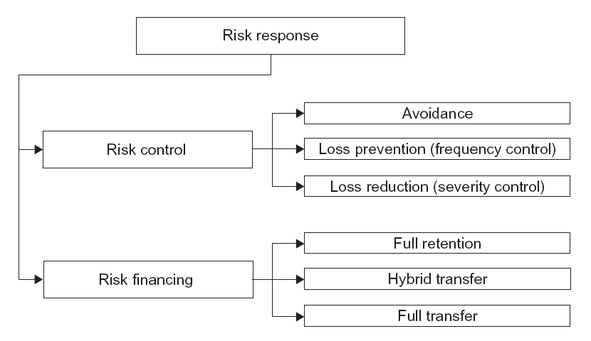
Risk Control and Financing (Figure 12.7)

Slide 26
Yearly Comparison of Development (Figure 12.6)
Communication
5
4
3
Policy Administration
2
Risk Identification
1
Risk Response
Risk Analysis
Year 2005
Year 2006

Slide 27
Risk Response
Refer also to Chapter 22 (Nonlife Insurance) for liability insurance products.
Risk financing techniques
Internal loss financing (retention)
Chapter 13
External loss financing
Chapter 14
Contractual transfer
Non-insurance transfer (e.g., hold harmless agreement)
Indemnification agreement
Hedging
Insurance
Part IV of this book

Slide 28
Plan Administration
An international RM program follows the same process as managing purely domestic risks.
Businesses can alter their risk profiles by:
Changing operations
Altering their capital structure, and
Using targeted financial instruments
The techniques for addressing operational risks generally are universal in concept but differ substantially in their application internationally.

Slide 29
Plan Administration Using a multinational program as an example

Slide 30
Plan Administration – Decentralized Program
Relies heavily on local operations/foreign subsidiaries to make their own risk management decisions
Benefits
Local office accountability enhanced
Local management show a strong interest in managing risk
Local operations/subsidiaries establish strong ties with local governments and communities.
Insurance contracts issued in compliance with local regulations
Concerns
The MNC exercises little control over local RM activities
Lack of coordination between the corporate and local offices, thus thwarting ERM efforts.

Slide 31
Plan Administration – Centralized Program
The corporate office exerts primary control over the risk management activities of remote operations and subsidiaries.
Benefits
Uniform approaches to risk, allowing stronger coordination internationally and consistency with the ERM approach
Target financial instruments, such as insurance, being more consistent
Concerns
Conflict between corporate and local offices over local autonomy
Cost-of-risk allocations among subsidiaries
The corporate office may fail to respond on a timely basis to changes in local conditions

Slide 32
Controlled Master Program (CMP) (new)
LOCAL
HOME (MASTER)
LOCAL
LOCAL
LOCAL
LOCAL
LOCAL
LOCAL
Source: Kwon (2004)

Slide 33
Discussion Questions

Slide 34
Discussion Question 1
Find a definition of risk management from a reliable source and compare it with the definition of ERM in this book.

Slide 35
Discussion Question 2
Why is it important to have an effective communication channel involving (the most) senior management in ERM?

Slide 36
Discussion Question 3
What similarities and differences can you find from the three risk management standards discussed in this book – the COSO framework, Australian/New Zealand standard, and the U.K. risk management standards?

Slide 37
Discussion Question 4
Other than the risks discussed in this book, identify and discuss one risk that firms can easily quantify and another that cannot be objectively quantified.

Slide 38
Discussion Question 5
Identify a representative MNC in your home country:
Classify its risks into financial, operational, and strategic.
Which risks, in your view, could cause (i) a significant reduction in the value of the existing wealth of the firm, (ii) an increase in future expenditures, and (iii) a reduction in future income?
Attempt to create a risk map using the identified risks.

Slide 39
Discussion Question 6
If the MNC that you identified has a risk management program, find out whether it is an ERM program? If not, what should the MNC do to have a true ERM program?

Slide 40
Discussion Question 7
The degree to which international risk management programs are centralized or decentralized increasingly will be patterned after the basic organizational structure and operating philosophy of the firm, rather than by external constraints. What are the external constraints?

