Slide 1

PowerPoint Slides
for Professors
Spring 2010 Version
This file as well as all other PowerPoint files for the book, “Risk Management and Insurance: Perspectives in a Global Economy” authored by Skipper and Kwon and published by Blackwell (2007), has been created solely for classes where the book is used as a text. Use or reproduction of the file for any other purposes, known or to be known, is prohibited without prior written permission by the authors.
Visit the following site for updates:
http://facpub.stjohns.edu/~kwonw/Blackwell.html.
To change the slide design/background,
[View] → [Slide Master]
W. Jean Kwon, Ph.D., CPCU
School of Risk Management, St. John’s University
101 Murray Street
New York, NY 10007, USA
Phone: +1 (212) 277-5196
E-mail: Kwonw@stjohns.edu

Slide 2
Risk Management and Insurance: Perspectives in a Global Economy
10. The Legal Environment
Click Here to Add Professor and Course Information

Slide 3
Study Points
Major legal systems of the world
Substantive and procedural law
Tort law variations internationally
International variations in contract law
Choice of law and free trade

Slide 4
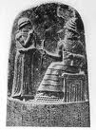


Major Legal Systems of the World

Slide 5
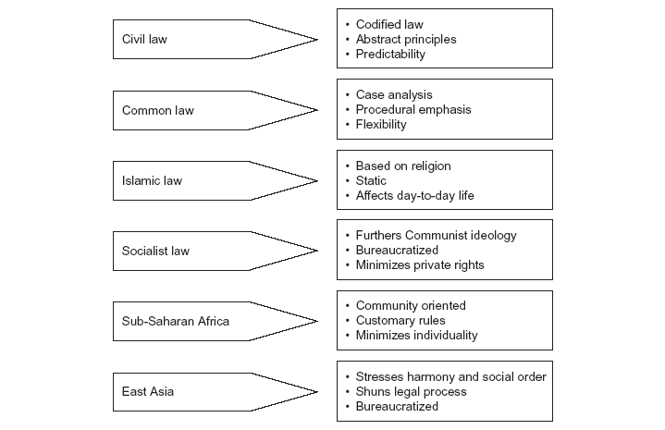
Major Legal Systems (Figure 10.1)

Slide 6
Civil Law and Common Law
Civil Law
Common Law
Describe and limit individual rights with respect to contracts (including business relationships), torts and statutes
Civil law nations expect their legislatures to codify laws that anticipate contingencies.
A collection of judge-made principles that reflect usages and customs embodied in court decisions handed down from antiquity
The Doctrine of Stare Decisis
Common law nations expect their courts to make case-by-case decisions that together comprise the law of contracts and torts.
Table 10.1

Slide 7

Islamic Law
Three principles sources
  The Qur’an
  The Sunnah (decisions and sayings of Muhammad)
  The Shariah (collective reasoning of scholars)
See also pages 586-587.
Check “Kwon (2007), “Islamic Principles and Takaful Insurance,” Journal of Insurance Regulation (September) for a detailed description of the principles and insurance. E-mail request using Kwonw@stjohns.edu.

Slide 8
Roots of Islamic Principles (new)
Qur’an
(God’s Final Code of Life)
Sunnah
(Tradition of Prophet Muhammad)
Ijtihad
(Independent Legal Reasoning)
Individual Scholastic Work
Ijma (Collective Reasoning)
Qiyas (Legal Analogy)
Shariah
Istihsan (Preference)
Istislah (Public Welfare)
Urf (Custom)

Slide 9
Takaful Life Insurance Operation (new)
Interest-free Loan for Underwriting Loss
Repayment Using Future Premiums/Profits
Premiums (Policyholders’ Fund)
Capital (Shareholders’ Fund)
Individual (Savings) Account
Special (Risk) Account
Shariah Conforming Investment
Insurance Benefits & Claims Expenses
Underwriting Profit
Net Investment Profit
Operating Profit
S%
(1 – S)%
Insurer Expenses

Slide 10
Takaful Nonlife Insurance Operation (new)
Interest-free Loan for Underwriting Loss
Repayment Using Future Premiums/Profits
Insureds (Participants)
Insurer-Operator (Shareholders)
Premiums (Takaful Fund)
Shariah Conforming Investment
Insurance Benefits & Claims Expenses
Loss Reserves
Net Underwriting
Profit
Net Investment
Profit
Operating Profits
S%
(1 – S)%
Insurer Expenses

Slide 11
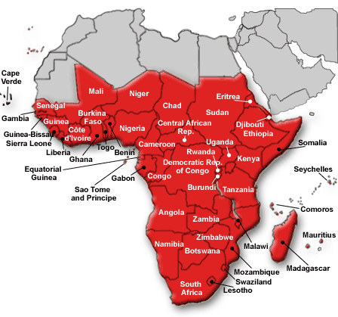
Laws in Sub-Saharan Africa
A long tradition of unwritten customs that focus primarily on resolving disputes among tribal families and individuals
  Tribal judges often assume the role of arbitrator or mediator.
Be mindful of the differences between law as written and law as practiced

Slide 12

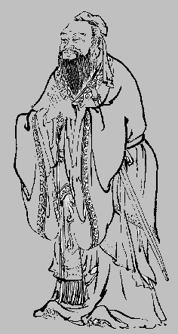
Laws in (East) Asia
China, Japan, Korea and Taiwan
The Confucian ideal of the family
Use of a formal legal system by individuals and businesses is viewed as disruptive to the societal goal of harmony.
  Case of Japan in pages 237-238

Slide 13
Substantive and Procedural Law

Slide 14
Substantive Development
Defines, creates and regulates rights
Civil law traditionally divided into two substantive categories: tort and contract
  Tort to compensate for damage suffered, where liability is based on the wrongdoer’s socially unreasonable conduct
  Damages for breach of contract are sought when a party fails to perform any promise that forms the whole or part of an agreement
  Insurance coverage and prospective tort damages can vary considerably by jurisdiction.
The task of understanding international trends in tort and contract law is challenging.
  The UN Convention on Contracts for the International Sale of Goods

Slide 15
Procedural Development
Prescribes methods of enforcement of rights or obtaining redress for their violation
International contracting parties often insert arbitration clauses that subject the parties to international arbitral tribunals
  The International Chamber of Commerce
  The UN Commission on International Trade Law
  The UN Convention on the Recognition and Enforcement of Foreign Arbitral Awards (a.k.a., the New York Convention)
International trade also influenced by governmental actions and “commercial diplomacy”
  The Generalized System of Preferences

Slide 16



Tort Law Variations Internationally
Refer also to Chapter 22 (Nonlife Insurance) for liability insurance products.

Slide 17
The Law of Torts
Intentional tort
  The actual or implied intent to harm another person or his (her) property
Negligence
  The required standard of care is what a reasonable person of ordinary prudence would have done in the circumstances.
Strict liability
  Liability regardless of fault
Tort costs
  Figure 10.2

Slide 18
Tort costs (Figure 10.2)

Slide 19
Product Liability
The legal liability of the manufacturer (and sometimes the distributor or seller) for a product that causes injury to the purchaser or user
  Principle of caveat emptor
  Principle of privity of contract
Legal basis for lawsuits
  Tort law
    Design defect
    Manufacturing defect
    Marketing (warning) defect
  Strict liability
  Contractual liability

Slide 20
Product Liability
Product safety
  International Organization for Standardization (ISO)
    ISO 9000 series
Failure to meet such a standard can result in liability when a customer has suffered from a design defect, manufacturing defect or marketing defect of the product.
Refer to pages 307-309 about ISO9000 and 14000.

Slide 21
Product Liability – Regulation
The U.S.
  Neither U.S. nor foreign manufacturers can rely on a single, comprehensive national product liability law except for:
    The Consumer Product Safety Act
    The Model Uniform Products Liability Act
      This model act is purely advisory.
  U.S. tort principles assign liability to manufacturers, suppliers and
  their agents for injuries by consumers and users resulting from the use of their products that are defective or when the use itself involves an unreasonable risk of harm.
  Punitive damage
  Jury system
Insight 10.1 for mass tort class action in the U.S.

Slide 22
Product Liability – Regulation
The E.U. Products Liability Directive
  The basis of civil and criminal liability within E.U. member states for damages caused by defective products to individuals
  Seeks to harmonize national rules
  Affects importers and any persons or entities using trade names or trademarks as well
  Proposes member states to adopt statutes of limitation and repose
The E.U. General Product Safety Directive
  Defines a “safe product” and provides a matrix for assessing safety

Slide 23
Product Liability – Regulation
Japan
  Attitudes in Japan toward compensation for loss cannot be separated from its history and culture that support institutional authority.
  Changes were made in its product liability law, effective in 1995.
    Defines “liable manufacturers” and employs the principle of strict liability
  Plaintiffs in Japan depend greatly on the country’s extensive alternative dispute resolution system.
  Private conciliation cases, chotei, are encouraged.
  Even in this relatively favorable environment, Japanese manufacturers are now attuned more than ever to the product liability.

Slide 24
Automobile Liability
The law commonly prescribes the party responsible for paying damages as a result of the negligent operation or use of a vehicle.
  Vehicle owners often also can be held responsible for the harm to others caused by the negligent operation of their vehicles by someone to whom they have given permission to use their vehicle.
Legal variations
  Most countries mandate that motor vehicle owners must maintain liability insurance in connection with their ownership and use of their automobile.
  Differences exist worldwide in coverage scope and limits.
  Table 10.3

Slide 25
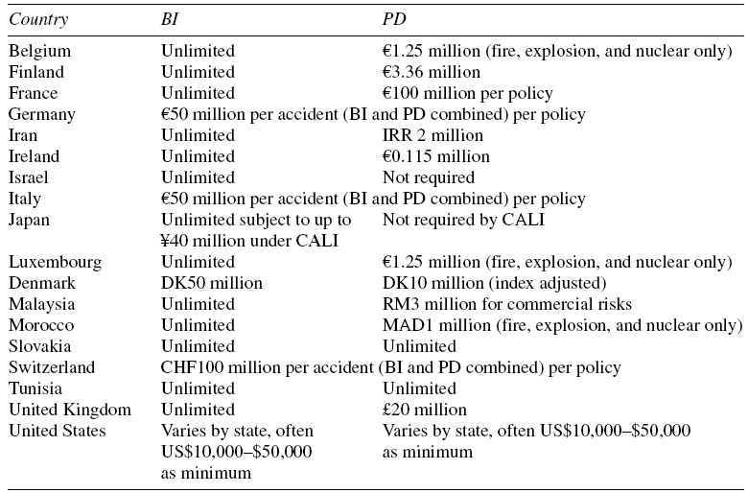
Automobile Liability Insurance (Table 10.3)

Slide 26
Automobile Liability – Issues
Uninsured and underinsured motorists
Assigned risk plans
  Arrangements for assigning “unwanted” insureds to a servicing insurer so as to guarantee coverage and commonly at subsidized premium rates
  Also known as residual markets, high-risk insurance markets, joint underwriting associations (JUAs) and automobile reinsurance pools
No fault insurance
  Pure no-fault insurance plan
  Add-on no-fault insurance plan
  Modified no-fault insurance plan

Slide 27
Corporate Governance Liability
The Sarbanes-Oxley Act of 2002 (U.S.)
  CEO and CFO certification
The Walt Disney Company Case (2005) – fiduciary duties
  Business judgment rule
  Fiduciary duty of due care
  Fiduciary duty of loyalty

Slide 28
Environmental Risks and the Law
Two treaties
  The 1972 UN Conference of the Human Environment (Stockholm)
    Introduced “sustainable development”
  The 1997 Kyoto Protocol
Copenhagen 15
Chapter 6 also covers this topic but from a different angle.

Slide 29
Environmental Laws – Variations
The U.S.
  The “polluter pays” principle
  Three key acts
    The Clean Air Act (CAA) of 1970 (air quality)
    The Clean Water Act of 1987 (water quality)
    The Comprehensive Environmental Response, Compensation and Liability Act of 1980 (CERCLA) (hazardous waste)
The E.U.
  Has adopted the precautionary principle
  Selected directives and programs
    The “Clean Air for Europe” (CAFE) in 2002
    The Waste Framework Directives effective in 2006

Slide 30
Environmental Laws – Variations
Japan
  Significant industrial pollution and harm to its citizens during the post WWII recovery period
    Itai-Itai in 1950
  Selected laws
    The Basic Environment Law in 1993
    The Environmental Impact Assessment Law in 1997
  Japan today enforces a wide spectrum of environmental laws and regulations dealing with air and water pollution and hazardous waste.

Slide 31

Contract Law Variations Internationally

Slide 32
Performance
Breach of contract
  Common law countries typically provide for monetary damages, measured as the differences between the value of the performance actually received and the value contracted for.
  Civil law systems have traditionally denied monetary awards unless the breaching party was guilty of substantial fault or fraud.
    In lieu of monetary damages, civil law countries permit the buyer of a product or service unilaterally to reduce the price it pays to offset damages caused by the seller.
    To support the concept of reduction in price, civil law courts often grant decrees of “specific performance.”

Slide 33
Contract Negotiations
Contract negotiations
  The parties and their lawyers often develop a formal contract through several informal meetings as well as drafts of contracts circulated on various aspects of the contractual relationship.
  The courts in most common law countries will not impose any pre-contractual liability stemming from the negotiations, based on the doctrine of “freedom of negotiation.”

Slide 34
Fault in Negotiating
Caveat emptor vs. culpa in contrahendo (fault in negotiating)
  Many civil law countries impose an overall duty to negotiate in good faith once a legally relevant relationship has come into existence.
  In many civil law countries, the doctrine of culpa in contrahendo would impose liability on the party who failed to discharge his or her duty to inform.
  In most common law countries, while the seller’s acts might be ethically defective, the prospective purchaser would be left with no recourse at law as no contractual relationship existed.

Slide 35
Choice of Law and Free Trade
Growth in free trade rests in part upon contractual stability.
Most international contracts provide either for a certain nation’s law to apply (i.e., a choice of law provision) or for an arbitral procedure to control dispute resolution.
MNCs need to be aware that legal systems reflect cultural differences.

Slide 36
Discussion Questions

Slide 37
Discussion Question 1
What is the fundamental difference between civil law and common law?

Slide 38
Discussion Question 2
Why are tort costs in the U.S. (as a percentage of GDP) significantly higher than in the other industrialized nations of the world?

Slide 39
Discussion Question 3
Give several reasons why manufacturers of products sold in Japan have had little need for product liability insurance in the past. What effect on product liability insurance demand would you expect a high export volume to have?

Slide 40
Discussion Question 4
Distinguish between the contract concepts of “caveat emptor” and “culpa in contrahendo.” Do you believe that these concepts also should apply to contracts of financial services (e.g., insurance) (a) between individuals and insurers and (b) between large corporations as insureds and insurance companies?

Slide 41
Discussion Question 5
Do you agree or disagree with the following proposition: “With increasing globalization, national legal systems will converge.” Explain your reasoning.

