Slide 1
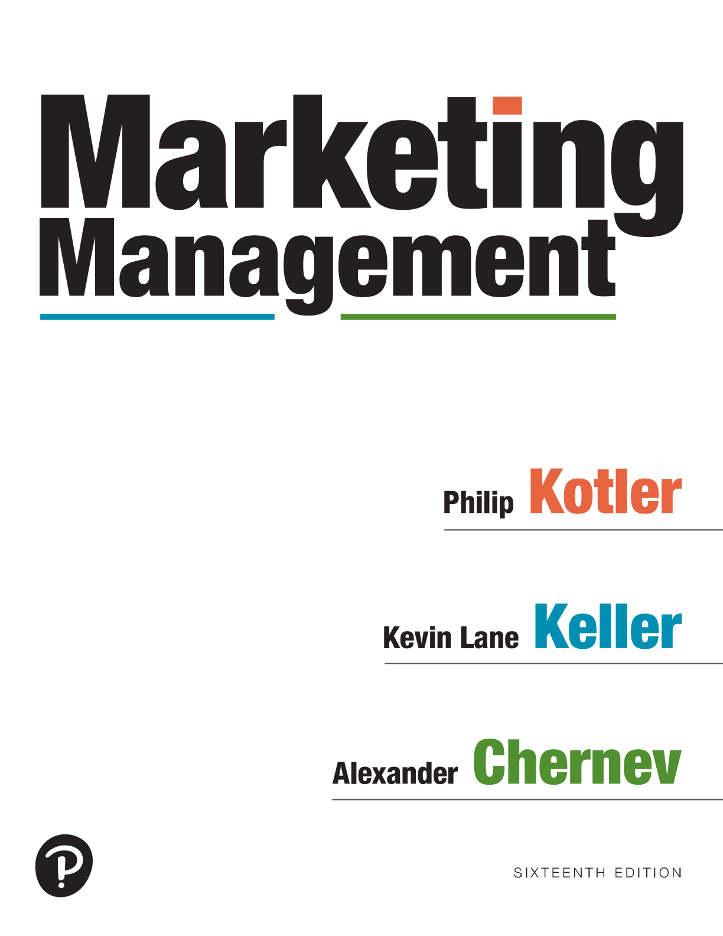
Marketing Management
Sixteenth Edition
Chapter 17
Driving Growth in Competitive Markets
Copyright © 2022, 2016, 2012 Pearson Education, Inc. All Rights Reserved
Notes:
If this PowerPoint presentation contains mathematical equations, you may need to check that your computer has the following installed:
1) MathType Plugin
2) Math Player (free versions available)
3) NVDA Reader (free versions available)

Slide 2
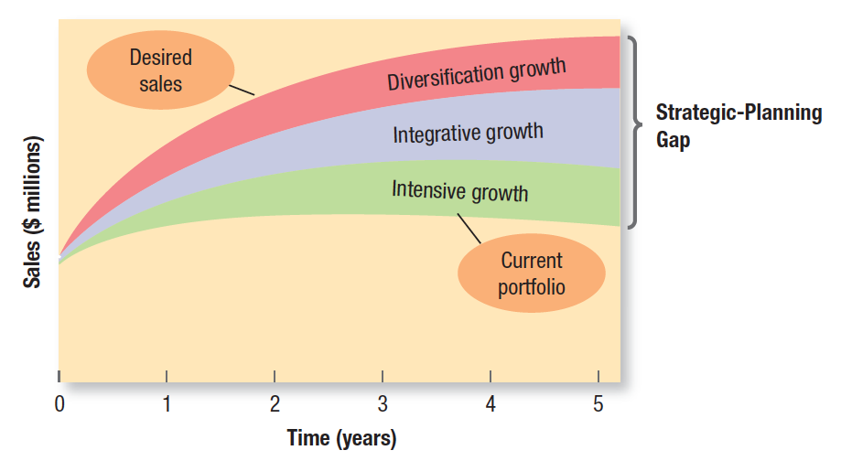
Assessing Growth Opportunities
Copyright © 2022, 2016, 2012 Pearson Education, Inc. All Rights Reserved
Notes:
If this PowerPoint presentation contains mathematical equations, you may need to check that your computer has the following installed:
1) MathType Plugin
2) Math Player (free versions available)
3) NVDA Reader (free versions available)

Slide 3
Ansoff’s Product–Market Growth Matrix
Notes:
Figure 17.1 shows the Product-market Growth Framework.
The company first considers whether it could gain more market share with its current products in their current markets using a market-penetration strategy.
Next, it considers whether it can find or develop new markets for its current products using a market-development strategy.
Then it considers whether it can develop new products for its current markets with a product-development strategy. Later, the firm will also review opportunities to develop new products for new markets through a diversification strategy.
In the illustration, the boxes are arranged in two rows and two columns. The first and second columns are labeled Current customers and new customers, and the first and second rows are labeled Current products and New products. The box on the top left is labeled Market penetration. The box on the top right is labeled Market development. The box at the bottom left is labeled Product development, and the box at the bottom right is labeled Diversification.

Slide 4
How Companies Can Grow
Organic growth – growth from withine- growth from within
Mergers and acquisitions (M&A)
Backward integration (buy a supplier)
Forward integration (buy a wholesaler or retailer)
Horizontal integration (buy a competitor)
The M&A process
Notes:
A company can grow in two ways: by increasing output and enhancing revenues and profits internally (an approach that is commonly referred to as organic growth) or by relying on mergers and acquisitions. Market-penetration and market-development strategies typically follow the path of organic growth, whereas product development and diversification can involve both organic growth and growth by mergers and acquisitions.
A business can increase sales and profits through backward, forward, or horizontal integration within its industry.
How might a company use mergers and acquisitions to grow its business?
The company might acquire one or more of its suppliers to gain more control or generate more profit through backward integration.
It might acquire some wholesalers or retailers, especially if they are highly profitable, in forward integration.
Finally, the company might acquire one or more competitors, provided the government does not bar this horizontal integration. However, these new sources may not deliver the desired sales volume. In that case, the company must consider diversification.
In addition to considering new market opportunities, a company must carefully prune, harvest, or divest itself of tired old businesses to release needed resources for other uses and reduce costs.

Slide 5
The Product Life Cycle Concept Assumes
Products have a limited life
Product sales pass through four distinct stages, each posing different challenges, opportunities and problems to the seller
Profits rise and fall at different stages
Products require different marketing, financial, manufacturing and purchasing strategies in each stage
Notes:
Because it takes time to roll out a new product, work out technical problems, fill dealer pipelines, and gain consumer acceptance, sales growth tends to be slow in the introduction stage. Profits are negative or low, and promotional expenditures are at their highest ratio to sales because of the need to (1) inform potential consumers, (2) induce product trial, and (3) secure distribution in retail outlets.44 Prices tend to be higher because costs are high, and firms focus on buyers who are the most ready to buy.

Slide 6
Product Life Cycle
Notes:
Figure 17.2 shows sales and profit life cycles.
A company’s positioning and differentiation strategy must change as its product, market, and competitors change over the PLC
The graph plots Sales and Profits ($) versus Time. The horizontal axis is labeled Time, and the vertical axis is labeled sales and profit ($). The points in the horizontal axis are Introduction, Growth, Maturity, and Decline. Two concave curves are drawn. The first concave up the increasing curve starts from the origin on an x y plane and ranges until introduction end, increases until Maturity, and then flows as a concave down until Decline ends. The other curve starts below the origin on the x y plane, rises until the midpoint of Growth and Maturity, and then slopes down. Three vertical dotted from the horizontal axis touches both the curves.

Slide 7
Introduction Stage
Sales growth is low
Profits are negative or low
Promotional expenditures are high
Prices are higher
Focus is on buyers who are the most ready to buy
Notes:
Because it takes time to roll out a new product, work out technical problems, fill dealer pipelines, and gain consumer acceptance, sales growth tends to be slow in the introduction stage. Profits are negative or low, and promotional expenditures are at their highest ratio to sales because of the need to (1) inform potential consumers, (2) induce product trial, and (3) secure distribution in retail outlets.44 Prices tend to be higher because costs are high, and firms focus on buyers who are the most ready to buy.

Slide 8
Growth Stage
To sustain rapid market share growth:
Improve product quality and add new features
Add new models and flanker products
Enter new market segments
Increase distribution coverage and enter new distribution channels
Shift from awareness and trial communications to preference and loyalty communications
Lower prices to attract the next layer of price-sensitive buyers
Notes:
By spending money on product improvement, promotion, and distribution, the firm can capture a dominant position. It trades off maximum current profit for high market share and the hope of even greater profits in the next stage.

Slide 9
Maturity Stage
Strategies:
Market growth
Convert nonusers
Attract competitors’ customers
Increase usage among current users
Increase the number of usage occasions
Increase consumption with each occasion
Create new usage occasions
Product modification
Quality improvement
Feature improvement
Style improvement
Notes:
Two key ways to reverse the decline course for a company are market growth and product modification.
Market Growth. A company might try to expand the market for its mature brand by maximizing the two factors that make up sales volume: number of users and usage rate per user.
A company can expand the number of users through either or both of the following strategies:
• Convert nonusers. This approach is also referred to as primary demand stimulation. The key to the growth of air freight service was the constant search for new users to whom air carriers could demonstrate the benefits of using air freight rather than ground transportation.
• Attract competitors’ customers. This approach is often referred to as steal-share strategy.
A company can increase the usage rates among current users through the following strategies:
• Increase the number of usage occasions. For example, Campbell’s began promoting its soups for usage in the summer. Heinz might recommend using vinegar to clean windows.
• Increase consumption on each occasion.
• Create new usage occasions

Slide 10
Decline Stage
Harvesting and Divesting
Harvesting
Divesting
Eliminating Weak Products
Notes:
Sales decline for a number of reasons, including technological advances, shifts in consumer tastes, and increased domestic and foreign competition. All can lead to overcapacity, increased price cutting, and profit erosion. As sales and profits decline, some firms withdraw. Those remaining may reduce the number of products they offer, exiting smaller segments and weaker trade channels, cutting marketing budgets, and reducing prices further. Unless strong reasons for retention exist, carrying a weak product is often very costly.
Eliminating Weak Products Besides being unprofitable, weak products consume a disproportionate amount of management’s time, require frequent price and inventory adjustments, incur expensive setup for what are usually short production runs, draw advertising and sales force attention better used to make healthy products more profitable, and cast a negative shadow on company image.
Harvesting and Divesting Strategies for harvesting and for divesting are quite different. Harvesting calls for gradually reducing a product or business’s costs while trying to maintain sales. When a company decides to divest a product with strong distribution and residual goodwill, it can probably sell it to another firm.

Slide 11
Product Life Cycle Strategies
Blank | Introduction | Growth | Maturity | Decline
Product | Offer a basic product | Improve the product and develop product-line extensions | Diversify product offerings | Phase out weak products
Price | Charge cost-plus | Price to penetrate market | Price to match or beat competitors’ Price | Cut price
Communications | Build product awareness and trial among early adopters and dealers | Build awareness and interest in the mass market | Stress brand differences and benefits and encourage brand switching | Reduce to minimal level needed to retain customers
Distribution | Build selective distribution | Build intensive distribution | Build more intensive distribution | Phase out unprofitable outlets

Slide 12
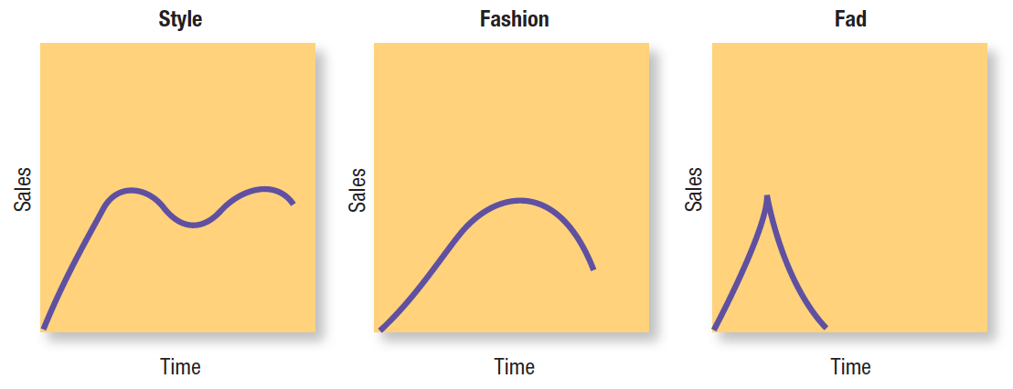
Alternative Product Life Cycle Patterns
Fads
Trends
Megatrends
Notes:
There are two special categories of product life cycles: fads and trends.
• A fad is “unpredictable, short-lived, and without social, economic, and political significance.” A company can cash in on a fad such as Crocs clogs, Elmo TMX dolls, and Pokémon gifts and toys, but getting it right requires luck and good timing. Fads come quickly into public view, are adopted with great zeal, peak early, and decline very fast. Their acceptance cycle is short, and they tend to attract only a limited following searching for excitement or wanting to distinguish themselves from others. It is important to note that sometimes it is hard to tell whether a product is a fad or not. For example, GoPro cameras have been frequently referred to as a fad, but they have stuck around.
• A trend is a direction or sequence of events with momentum and durability. Trends are more predictable and durable than fads; they reveal the shape of the future and can provide strategic direction. A trend toward health and nutrition awareness has brought increased government regulation and negative publicity for firms seen as peddling unhealthful food. Macaroni Grill revamped its menu to include more low-calorie and low-fat offerings after The Today Show called its chicken and artichoke sandwich “the calorie equivalent of 16 Fudgesicles” and Men’s Health declared its 1,630-calorie dessert ravioli the “worst dessert in America.”

Slide 13
Brand Re-invention
1860s
Notes:
There are two special categories of product life cycles: fads and trends.
• A fad is “unpredictable, short-lived, and without social, economic, and political significance.” A company can cash in on a fad such as Crocs clogs, Elmo TMX dolls, and Pokémon gifts and toys, but getting it right requires luck and good timing. Fads come quickly into public view, are adopted with great zeal, peak early, and decline very fast. Their acceptance cycle is short, and they tend to attract only a limited following searching for excitement or wanting to distinguish themselves from others. It is important to note that sometimes it is hard to tell whether a product is a fad or not. For example, GoPro cameras have been frequently referred to as a fad, but they have stuck around.
• A trend is a direction or sequence of events with momentum and durability. Trends are more predictable and durable than fads; they reveal the shape of the future and can provide strategic direction. A trend toward health and nutrition awareness has brought increased government regulation and negative publicity for firms seen as peddling unhealthful food. Macaroni Grill revamped its menu to include more low-calorie and low-fat offerings after The Today Show called its chicken and artichoke sandwich “the calorie equivalent of 16 Fudgesicles” and Men’s Health declared its 1,630-calorie dessert ravioli the “worst dessert in America.”

Slide 14
Brand Re-invention
Notes:
There are two special categories of product life cycles: fads and trends.
• A fad is “unpredictable, short-lived, and without social, economic, and political significance.” A company can cash in on a fad such as Crocs clogs, Elmo TMX dolls, and Pokémon gifts and toys, but getting it right requires luck and good timing. Fads come quickly into public view, are adopted with great zeal, peak early, and decline very fast. Their acceptance cycle is short, and they tend to attract only a limited following searching for excitement or wanting to distinguish themselves from others. It is important to note that sometimes it is hard to tell whether a product is a fad or not. For example, GoPro cameras have been frequently referred to as a fad, but they have stuck around.
• A trend is a direction or sequence of events with momentum and durability. Trends are more predictable and durable than fads; they reveal the shape of the future and can provide strategic direction. A trend toward health and nutrition awareness has brought increased government regulation and negative publicity for firms seen as peddling unhealthful food. Macaroni Grill revamped its menu to include more low-calorie and low-fat offerings after The Today Show called its chicken and artichoke sandwich “the calorie equivalent of 16 Fudgesicles” and Men’s Health declared its 1,630-calorie dessert ravioli the “worst dessert in America.”

