Slide 1
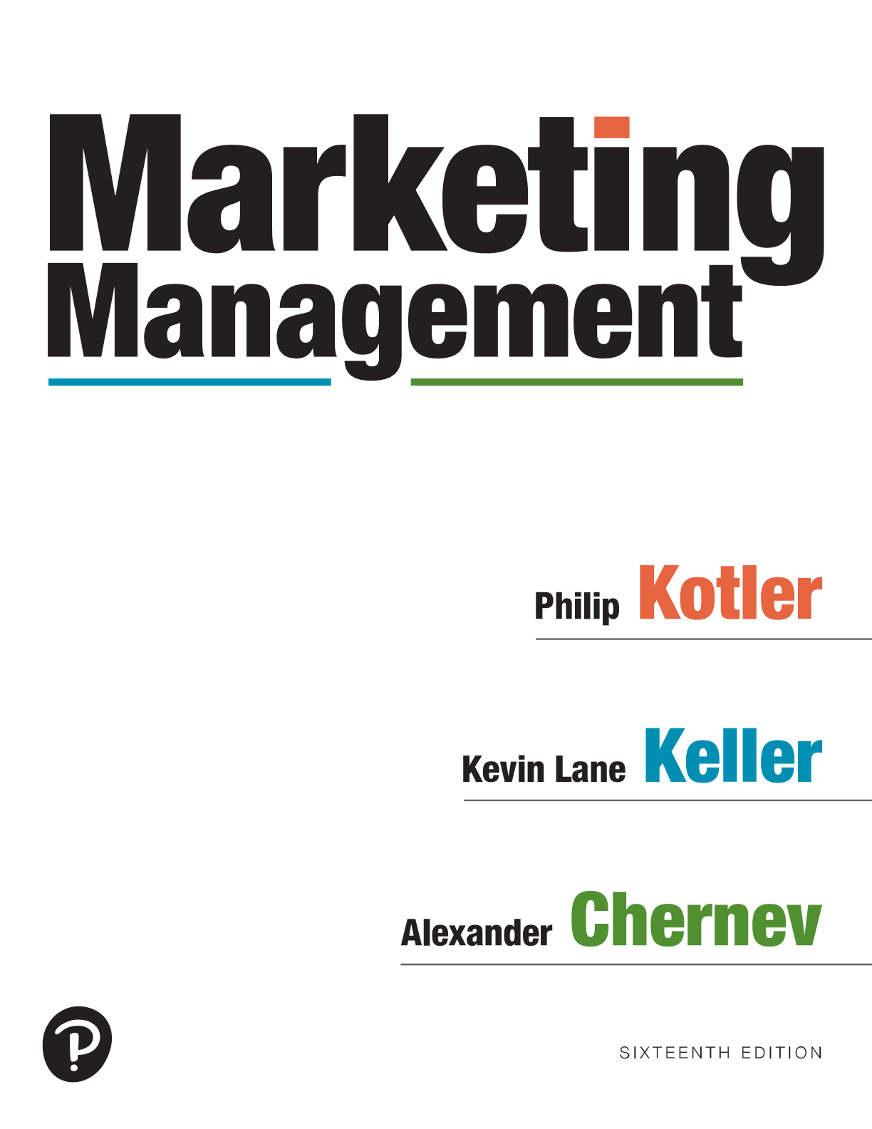
Marketing Management
Sixteenth Edition
Chapter 1
Defining Marketing for the New Realities
Copyright © 2022, 2016, 2012 Pearson Education, Inc. All Rights Reserved
Notes:
If this PowerPoint presentation contains mathematical equations, you may need to check that your computer has the following installed:
1) MathType Plugin
2) Math Player (free versions available)
3) NVDA Reader (free versions available)

Slide 2
Marketing and Marketing Management
Marketing is about identifying and meeting human and social needs in a way that meets the organization’s goals
definition:
Marketing is the activity, set of institutions, and processes for creating, communicating, delivering, and exchanging offerings that have value for customers, clients, partners, and society at large
Notes:
Our social definition of marketing: Marketing is a societal process by which individuals and groups obtain what they need and want through creating, offering, and freely exchanging products and services of value with others.

Slide 3
Marketing and Marketing Management
Marketing Management is the art and science of choosing target markets and getting, keeping, and growing customers through creating, delivering, and communicating superior customer value
Notes:
Our social definition of marketing: Marketing is a societal process by which individuals and groups obtain what they need and want through creating, offering, and freely exchanging products and services of value with others.

Slide 4
What is Marketed? The Offering
Goods/Products
Services
Events
Experiences
Persons
Places
Properties
Organizations
Information
Ideas
Notes:
Marketing involves 10 different domains: goods, services, events, experiences, persons, places, properties, organizations, information, and ideas.

Slide 5
Marketing is not “Selling” Selling is Only the Tip of the Iceberg……
“There will always be a need for
some selling. But the aim of marketing is to make selling superfluous. The aim of marketing is to know and understand the customer so well that the product or service fits him and sells itself. Ideally, marketing should result in a customer who is ready to buy. All that should be needed is to make the product or service available.”
Peter Drucker (1909-2005)
Management Theorist
Making a sale vs. making a customer

Slide 6
Simple Marketing System AKA The Exchange Process
Exchange/Transaction
Notes:
Figure 1.2 shows how sellers and buyers are connected by four flows. Sellers send goods and services and communications such as ads and direct mail to the market; in return they receive money and information such as customer attitudes and sales data. The inner loop shows an exchange of money for goods and services; the outer loop shows an exchange of information.
In the illustration, a box on the left labeled Industry (a collection of sellers) and a box on the right labeled Market (a collection of buyers) are connected via arrows. Two arrows labeled Communication and Goods, services point from Industry to Market, and two arrows labeled Money and Information point from Market to Industry.

Slide 7
The Basic Profit Equation
Profit =
Notes:
Marketing is about identifying and meeting human and social needs. One of the shortest good definitions of marketing is “meeting needs profitably.”
The American Marketing Association offers the following formal definition: Marketing is the activity, set of institutions, and processes for creating, communicating, delivering, and exchanging offerings that have value for customers, clients, partners, and society at large.

Slide 8
The Basic Profit Equation
Profit = Revenues – Costs
Notes:
Marketing is about identifying and meeting human and social needs. One of the shortest good definitions of marketing is “meeting needs profitably.”
The American Marketing Association offers the following formal definition: Marketing is the activity, set of institutions, and processes for creating, communicating, delivering, and exchanging offerings that have value for customers, clients, partners, and society at large.

Slide 9
The Basic Profit Equation
Profit = Revenues – Costs
To increase this
Notes:
Marketing is about identifying and meeting human and social needs. One of the shortest good definitions of marketing is “meeting needs profitably.”
The American Marketing Association offers the following formal definition: Marketing is the activity, set of institutions, and processes for creating, communicating, delivering, and exchanging offerings that have value for customers, clients, partners, and society at large.

Slide 10
The Basic Profit Equation
Profit = Revenues – Costs
To increase this
increase
this
or
decrease
this
Notes:
Marketing is about identifying and meeting human and social needs. One of the shortest good definitions of marketing is “meeting needs profitably.”
The American Marketing Association offers the following formal definition: Marketing is the activity, set of institutions, and processes for creating, communicating, delivering, and exchanging offerings that have value for customers, clients, partners, and society at large.

Slide 11
The Customer Bucket
Notes:
The marketplace is dramatically different from even 10 years ago, with new marketing behaviors, opportunities, and challenges emerging.

Slide 12
The Four Pillars of Holistic Marketing
Offers an integrated approach to managing Marketing strategy and tactics.
Recognizes that everything matters in Marketing and that a broad, integrated perspective is often necessary.
Notes:
Figure 1.4 provides a schematic overview of four broad components characterizing holistic marketing: relationship marketing, integrated marketing, internal marketing, and performance marketing.
In the illustration, a circle labeled Holistic marketing is at the center, and four boxes on four sides point at it with arrows. The box at the top is labeled Internal marketing. The box on the right is labeled Integrated marketing. The box at the bottom is labeled Relationship marketing, and the box on the left is labeled Performance marketing.

Slide 13
Relationship Marketing
Aims to build mutually satisfying, deep, long-term relationships with key constituents in order to earn and retain their business, such as:
Customers
Employees (everyone impacts the customer)
Marketing partners (suppliers, distributors, retailers, agencies)
Financial community (shareholders, investors, financial analysts)
The ultimate outcome of relationship marketing is a unique company asset called a marketing network, consisting of the company and its supporting stakeholders with whom it has built mutually profitable business relationships.
Notes:
Increasingly, a key goal of marketing is to develop deep, enduring
relationships with people and organizations that directly or indirectly affect the success of the firm’s marketing activities.

Slide 14
Integrated Marketing
Coordinates all marketing activities and programs and directs them to create, communicate, and deliver consistent value and a consistent message to consumers
Must design marketing activities keeping all other activities in mind
Notes:
Integrated marketing coordinates all marketing activities and marketing programs and directs them toward creating, communicating, and delivering consistent value and a consistent message for consumers, such that “the whole is greater than the sum of its parts.”
This requires that marketers design and implement each marketing activity with all other activities in mind.

Slide 15
Internal Marketing
The task of hiring, training, and motivating able employees who want to serve customers well
EVERONE in an organization must understand, appreciate and support the company’s marketing efforts
Don’t promise excellent service if you can’t deliver it
Notes:
Marketing succeeds only when all departments work together to achieve customer goals: when engineering designs the right products, finance furnishes the right amount of funding, purchasing buys the right materials, production makes the right products in the right time horizon, and accounting measures profitability in the right ways.
Such interdepartmental harmony can truly coalesce, however, only when senior management clearly communicates a vision of how the company’s marketing orientation and philosophy serve customers.

Slide 16
Performance Marketing
Evaluating Marketing Activities
Financial accountability
Environmental impact
Ethical impact
Legal impact
Social impact
Market Share
Customer Loss Rate
Product Quality
Brand Equity
Return on Marketing Investment (ROMI)
Customer Lifetime Value (CLV)
Notes:
Performance marketing requires understanding the financial and nonfinancial returns to business and society from marketing activities and programs.
When they founded Ben & Jerry’s, Ben Cohen and Jerry Greenfield embraced the performance marketing concept by dividing the traditional financial bottom line into a “double bottom line” that also measured the environmental impact of their products and processes. That later expanded into a “triple bottom line” to represent the social impacts, negative and positive, of the firm’s entire range of business activities.
Patagonia is one of a small number of benefit (B) corporations in the United States that must each year explain how their mission is benefiting both stakeholders and society, Patagonia aims to combine environmental consciousness with maximizing shareholder returns.

Slide 17
Defining the Role of Marketing in the Organization
Production concept (consumers prefer products that are widely available and inexpensive)
Product concept (consumers prefer products offering the highest quality, the best performance, or innovative features
Selling concept (consumers, if left alone, won’t buy enough of the organization’s products)
Marketing concept (job of marketing is not to find the right customers for your products but to develop the right products for your customers)
Market-value concept (Everything matters in marketing—therefore a broad, integrated perspective is often necessary) AKA Holistic Marketing
Notes:
A company must decide what overarching philosophy will guide a company’s marketing efforts, determine how to organize and manage the marketing department, and, ultimately, find the best means to build a customer-centric organization that can deliver value to company stakeholders.
The production concept is one of the oldest concepts in business. It holds that consumers prefer products that are widely available and inexpensive.
The product concept proposes that consumers favor products offering the highest quality, the best performance, or innovative features.
The selling concept holds that consumers and businesses, if left alone, won’t buy enough of the organization’s products.
The marketing concept emerged in the mid-1950s as a customer-centered, sense-and-respond philosophy. The job of marketing is not to find the right customers for your products but to develop the right products for your customers.
The market-value concept is based on the development, design, and implementation of marketing programs, processes, and activities that recognize their breadth and interdependencies. The value-based view of marketing acknowledges that everything matters in marketing—and that a broad, integrated perspective is often necessary.

