Slide 1
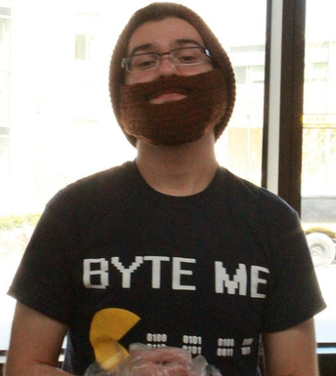
The MIS Major
at
Bauer

Slide 2
In general the MIS major teaches you how to design and build computer systems to:
solve business problems
and
exploit new business opportunities
Information systems are rapidly expanding across ALL areas of business. Business computer systems, digital communication, databases are everywhere, at every level of companies.
The demand for new systems in the mobile, social media and transaction processing spaces is staggering. Most any career forecast will show MIS-related jobs consistently holding multiple rankings in the "top ten career" choices.

Slide 3
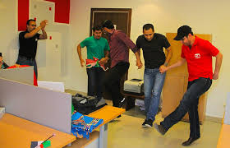
Top 3 reasons to be in MIS
Reason #1: MIS is: exciting, interesting and continuously changing:
IT IS FUN --
NOT BORING
Reason# 2: You get to build profitable things:
YOU BUILD NEW SYSTEMS
Reason #3: MIS is a people business:
YOU CONSTANTLY INTERACT WITH PEOPLE

Slide 4
How to be successful
Perform
...Grades count in the marketplace for entry level jobs. ...Take the ALL the tough courses no wussy courses -- they are a waste of time and money ...Do your work ON TIME (Don't put things off till the last minute)
Get involved
… Join the MIS Student Organization (MISSO)
Work hard -- play harder
...You get to be a college student just once. So, have fun now -- a requirement.
…You have to make your grades too -- NO Bs or Cs or Ds -- just As.
…SO, NO sleeping -- just work hard and play harder.

Slide 5
Bachelor of Business Administration Salary Report (Undergraduate) Spring 2014, May 22 2014 Average Starting Salary by Major Bauer College of Business, University of Houston from the Rockwell Career Center
MAJOR AVE $ JOBS
Management Information Systems $62,512 39
Supply Chain Management $53,784 29
Finance $53,481 34
Accounting $50,922 45
Entrepreneurship $49.625 4
Marketing $46,700 20
Management $40,560 10
AVERAGE SALARY $53,291 181

Slide 6
Common Tracks and Specialization Track 1: "Business Analyst" (aka "Systems Analyst") -- (50% of grads)
This is the typical entry level job description for most MIS majors.
The analyst role is a "people skill" role. Typically the tasks are:
Defining user requirements for new systems
Convert the requirements to technical specifications for the application developers
Manage the testing and implementation plans
Co-ordinate training
Post-implementation tasks (maintenance and upgrade planning)

Slide 7
Common Tracks and Specialization Track 2 "Application Developer" (10% of grads)
The most technical track. Requires skill development in:
Logical program design
User interface design
Database interfaces
Efficiency and scaling
Mobile application development is the "hottest" area in this track.

Slide 8
Common Tracks and Specialization Track 3: "Database Administrator" (10% of grads)
The incredible expansion of database technology makes this role one of the hottest areas in MIS. Leads to specializations in:
Data Warehousing (how to store data)
Data Mining (how to retrieve data)
Business Intelligence (how to analyze data for profit)
"Big Data"
Collaboration (how to share data)

Slide 9
Common Tracks and Specialization Track 4: "Infrastructure and Security" (10% of grads)
Hardware: servers, storage and network communications
Server Administrator
Data Storage Administrator (SANs-- storage area network aka "private clouds")
Networking Administrator
local-area-networks (aka LANs)
wide-area-networks (aka WANs)
private-mobile-networks (aka PMNs or cellular networks)
Everything has to be secure

Slide 10
Common Tracks and Specialization Track 5: "Risk Management" (10% of grads)
Also an option for accounting majors in the 5-year Accounting program (called “compliance analyst” in MIS departments.
Focuses on technology audits (e.g., Sarbanes-Oxley)
Compliance using frameworks such as COBIT, COSO & ITIL
"Controls focused" -- measure "actual" performance and compares to a "standard" to determine if performance is "in control" or "out of control"
Most placements are with the Big 4 accounting firms "advisory services" groups

Slide 11
Common Tracks and Specialization Track 6: “Consulting" (10% of grads)
An MIS consultant performs advisory services on virtually all MIS topics: systems development; infrastructure; and strategic planning. The jobs are extremely “challenging” because they require a wide range of skills: both interpersonal and technical.
Extensive travel is often required
Skills have to often be developed quickly to meet the customer needs
After a few years, your ability to manage projects and sell new business becomes critical to your success.
Most projects are of short duration (a few months) and over your career you will see a vast array of companies, problems and solutions.

Slide 12
Challenges
Time Management -- grades first, social life second
...there is NO leisure time
College life -- a shared experience
… you need to find like-minded colleagues
...Build your social network
Focus on you career placement
…do things you can do to assure you get a job
... Professional organizations (like the MISSO) are the most important
Overcoming your fear of complexity. You don't have to have ANY computer skills to become an MIS major
...We will teach you everything you need to know. All that is required is a
commitment to learn.

Slide 13
Critical Skills
Skill #1: Systems Analysis and Design/Project Management
How systems are designed, developed and implemented
System analysts determine the end-users needs (aka requirements)
The system analysts help designs the technical solution and manages the technical team that create the software
Then, the users are trained and the system is implemented
As a Project Manager (a senior role) you manage:
the client (user) relationships;
the systems analysts;
the technical development team;
the trainers;
the implementation plan;
and most importantly user expectations.

Slide 14
Critical Skills
Skill #2: Client-server skills (technically -- how the systems are constructed) The Client/sever model (aka 3-tier-architecture) refers to the way most computer systems are built.
Client-side (front-end) Browser tools HTML, CSS, XML Scripting Reqd. Course: MIS 3371 Transaction Processing I | → Request → ← Response ← | Server (middle-ware) Programming Tools: ASP.NET PHP Reqd. Course: MIS 4372 Transaction Processing II | → SQL Request → ← Data Response ← | Database (back-end) SQL (Structured Query Language) How to talk to a ANY database Database Engines: Oracle Microsoft SQL Server MySQL Reqd. Course: MIS 3376 Database I

Slide 15
Currently Most Popular Elective Courses in MIS
Mobile Apps
Cloud and Collaboration
Geographic Information Systems (GIS)
Energy Trading Systems
User Experience
Emerging:
Business Intelligence

Slide 16
Choosing the right job
How do you pick the job once you have some job offers ?
Pick the job where you like people you will be working with.
Do NOT take a job because:
the pay is good
your friends and relatives want you to take a specific job
the company has a great name and reputation
it is near your home
You have to go to work everyday and if you don't like the people environment, no amount of money, prestige or convenience will overcome your misery.

Slide 17
Why is one passionate about MIS
it is the most fun job you can have AND
you can often work from home
it pays REALLY well
challenging roles
continuous learning
and

Slide 18
MIS -- is a Party in Your Head -- Everyday

