Slide 1
http://www.bauer.uh.edu/parks/mis3371.htm

Slide 2
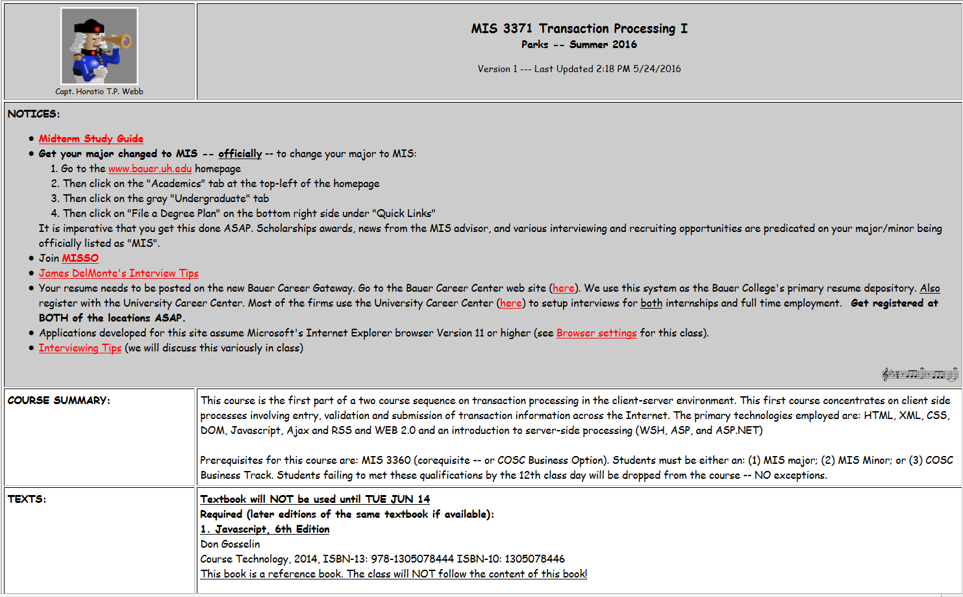

Slide 3
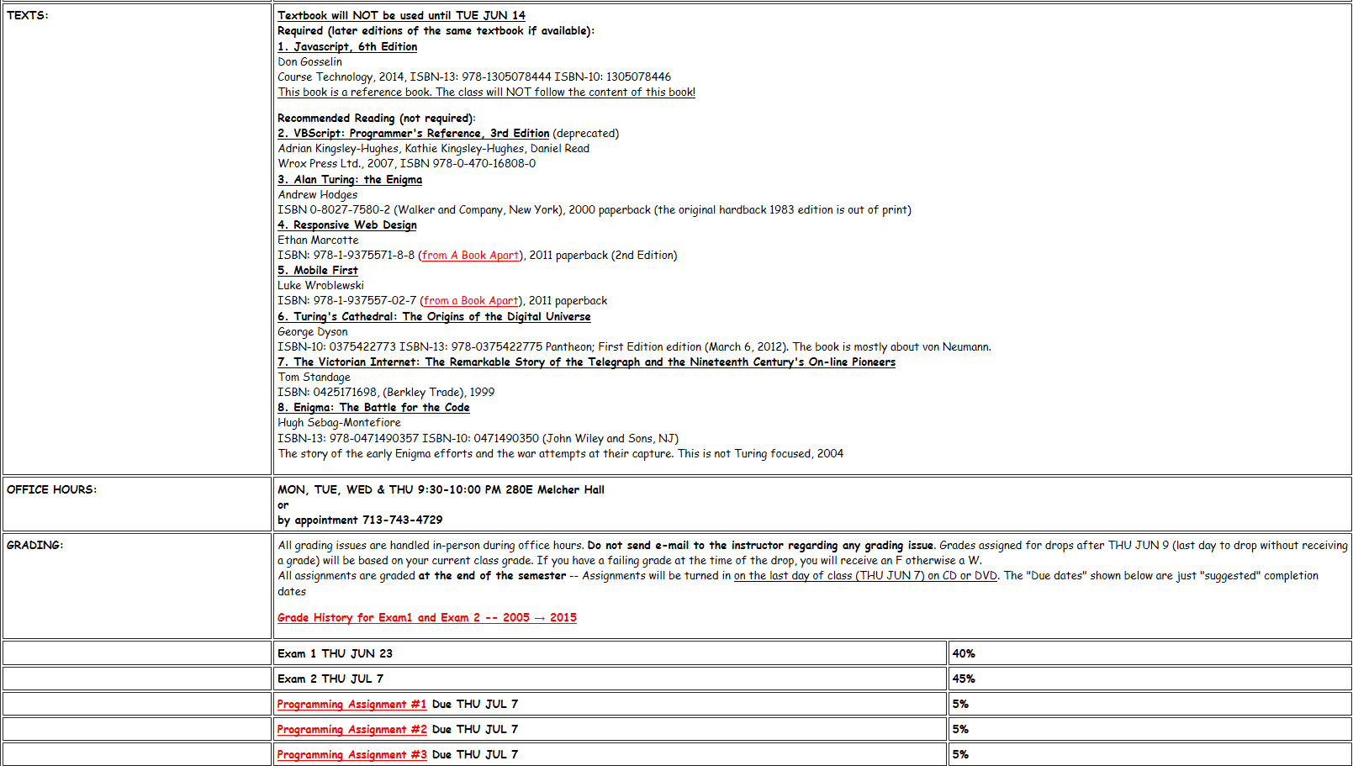

Slide 4
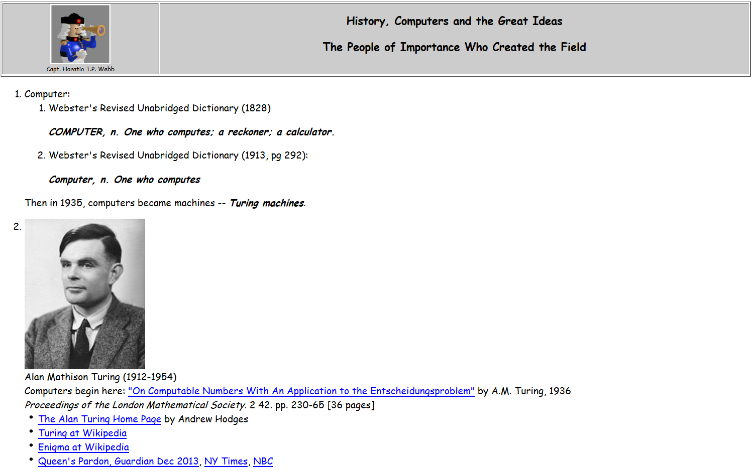

Slide 5
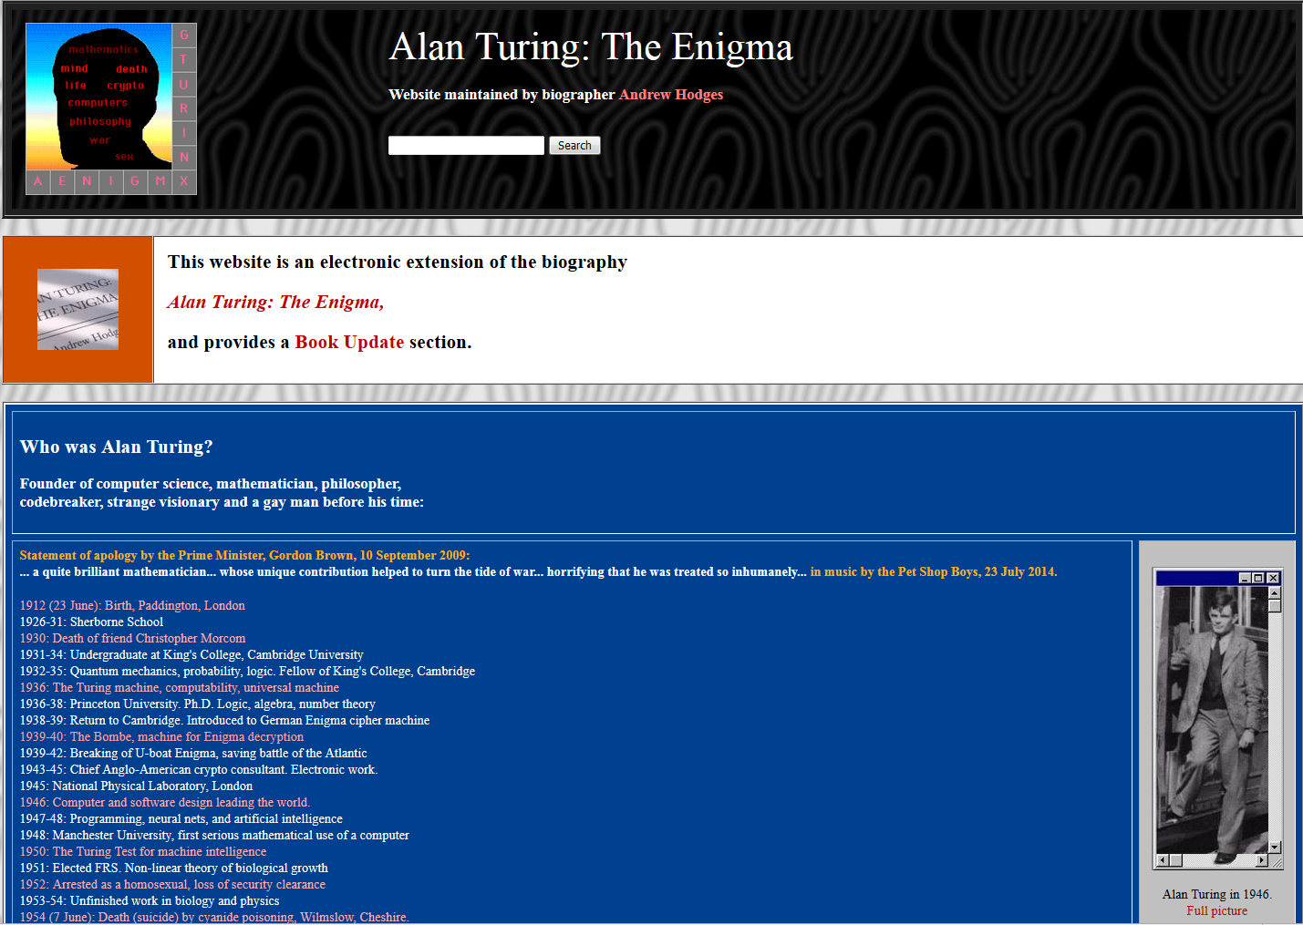
This is THE book!

Slide 6
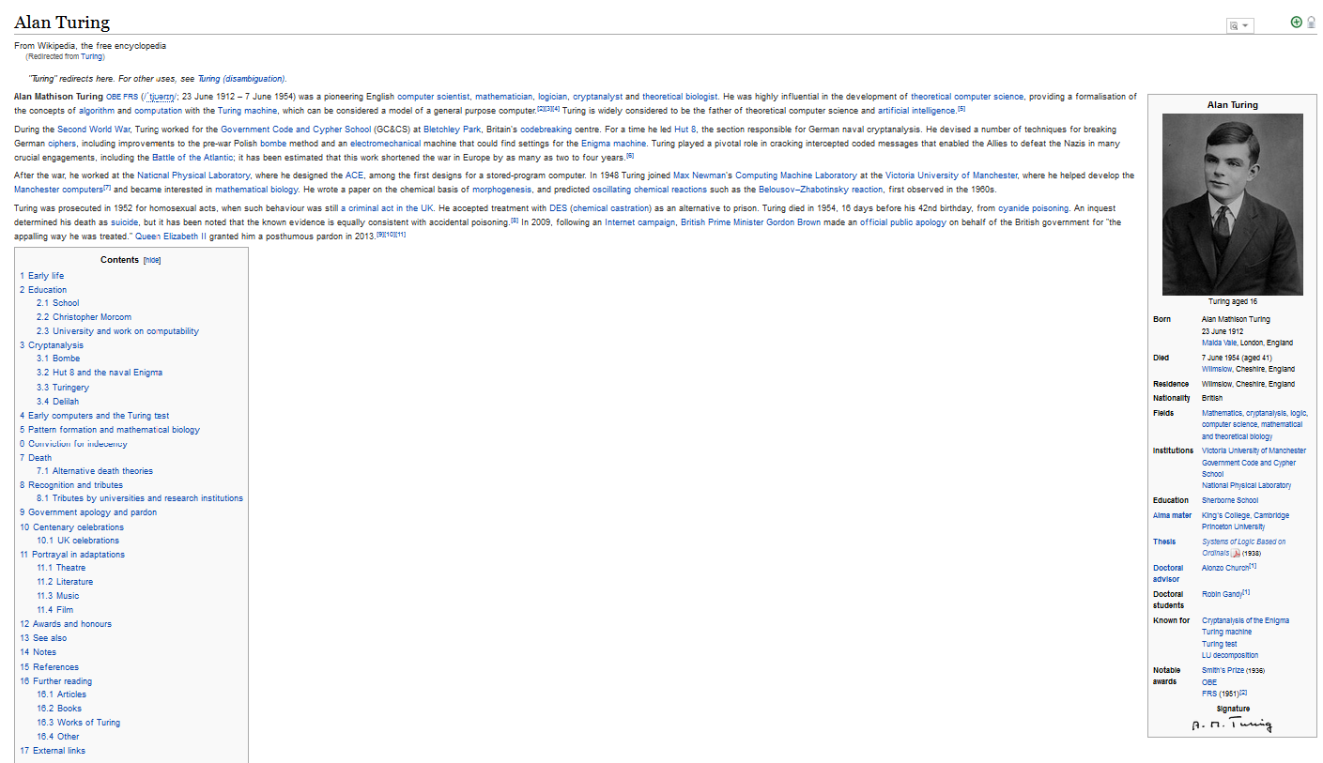
THE HERO OF THIS STORY
Alan Mathison Turing (1912-1954)
Who conceived the idea of the computer
in a field of flowers in 1935
And who we owe credit for computers and how they
work. They are all “turing machines”
We owe him our careers.

Slide 7
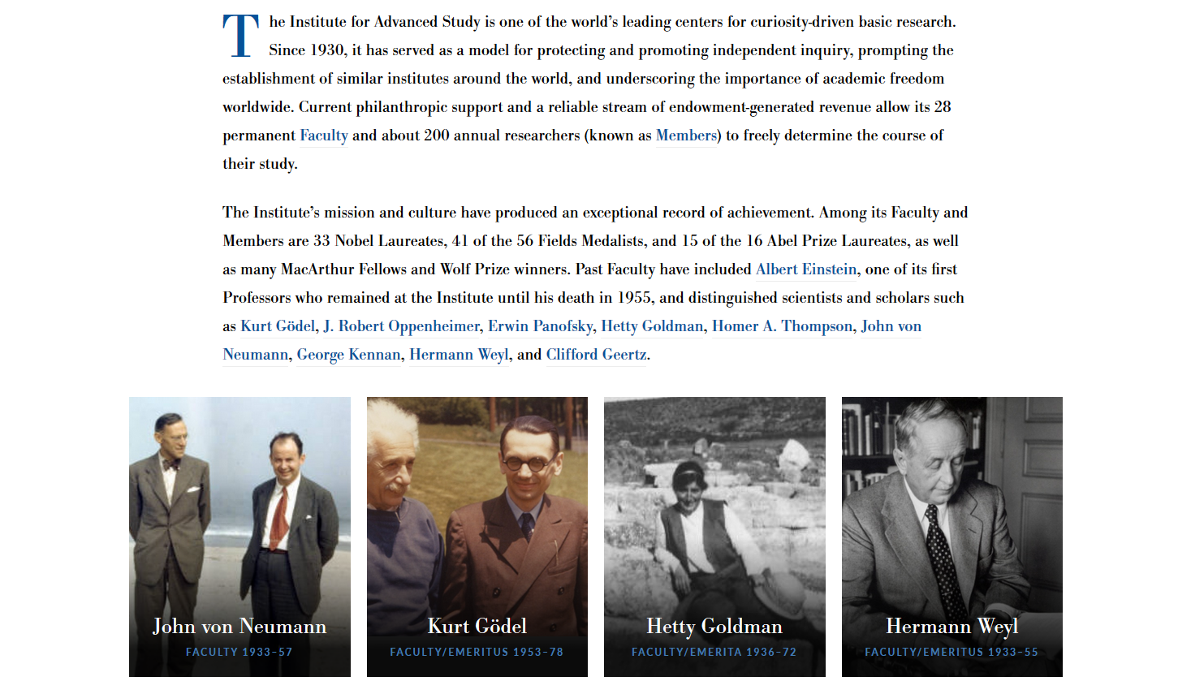
The Institute
For Advanced
Studies
IAS
Princeton
University

Slide 8
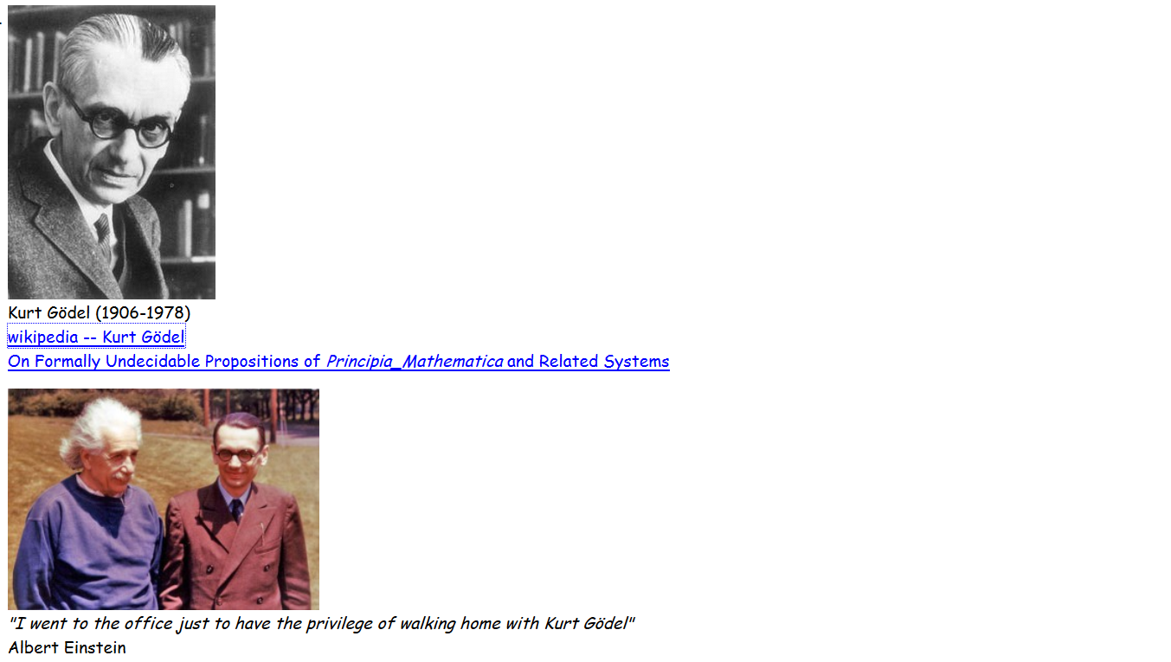
Kurt Gödel (1906-1978)
1931, The Incompleteness Theorem (age 25)
IAS at Princeton: visited in 1934, 1935, 1938, 1940 (permanent 1946)
He starved to death in Princeton in 1978 – deathly afraid of being poisoned.
One reason to think Gödel was the smartest of them all is the quote by Einstein.

Slide 9
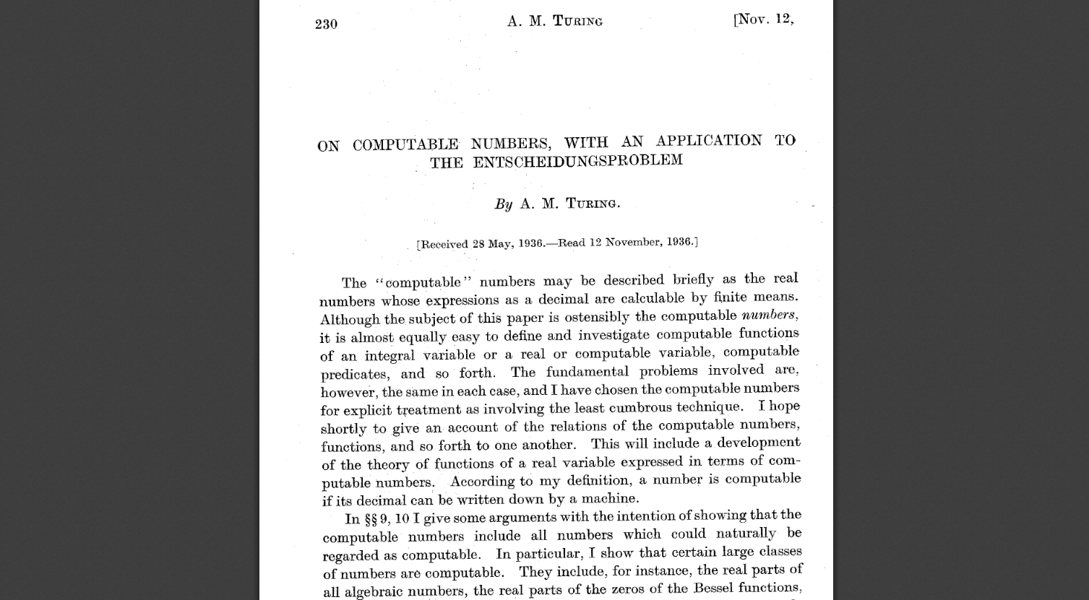
The paper asks the
question whether
all problems can be
solved (decided).
The
“decision problem”
is the:
Entscheidungsproblem
in the title.
This is the paper
where the computer was
Invented.
A.M. Turing, 1936
Proceedings of the London Mathematical Society.
242. pp. 230-65
[36 pages]

Slide 10
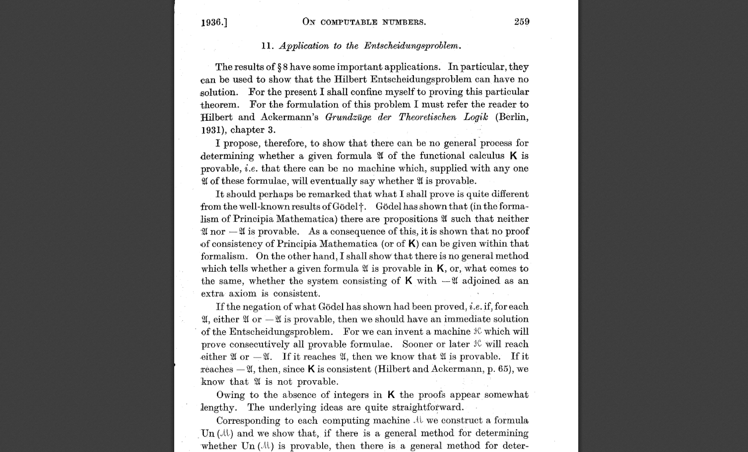
The Incompleteness
Theorem.
Is the sentence
“I am Lying”
true or false?
It is neither. It is
undecidable.
Turing’s machine would
try forever and never stop.
Ta-da!
Based on a
demonstration
of how
Godel’s
Incompleteness
Theorem
would be interpreted by
a machine.
He described the machine. It was the computer!

Slide 11
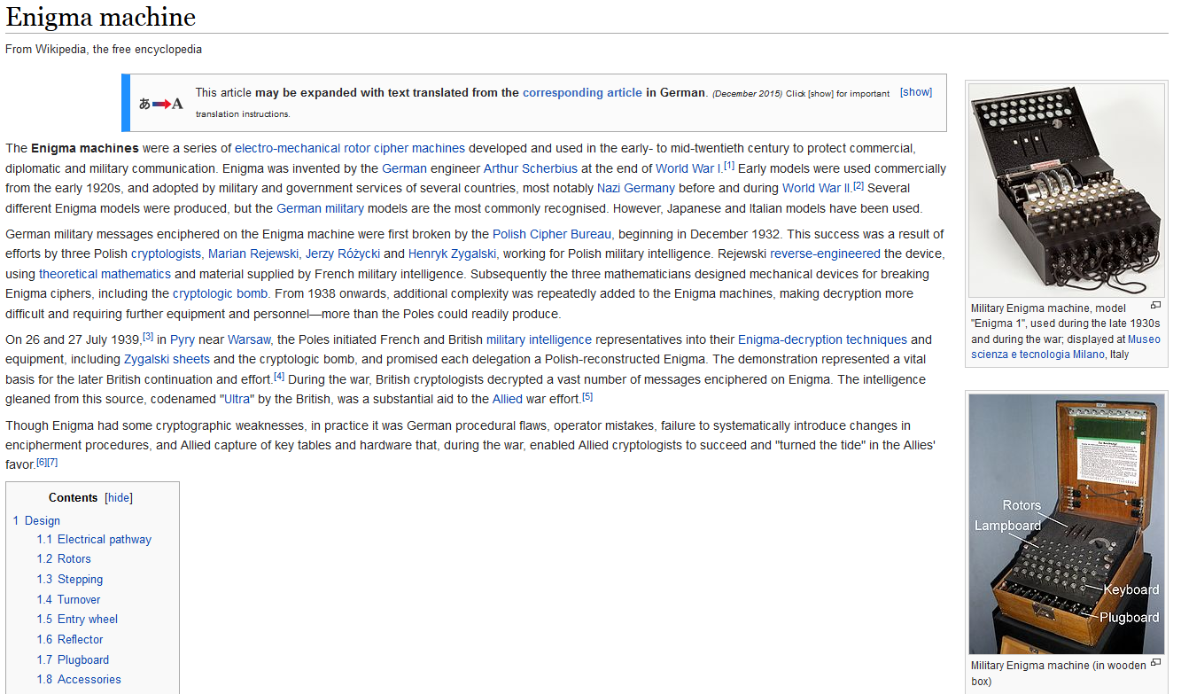
The German Secret decoding device. Used by the
German military during World War II. Turing’s “bombe” helped break the code.

Slide 12
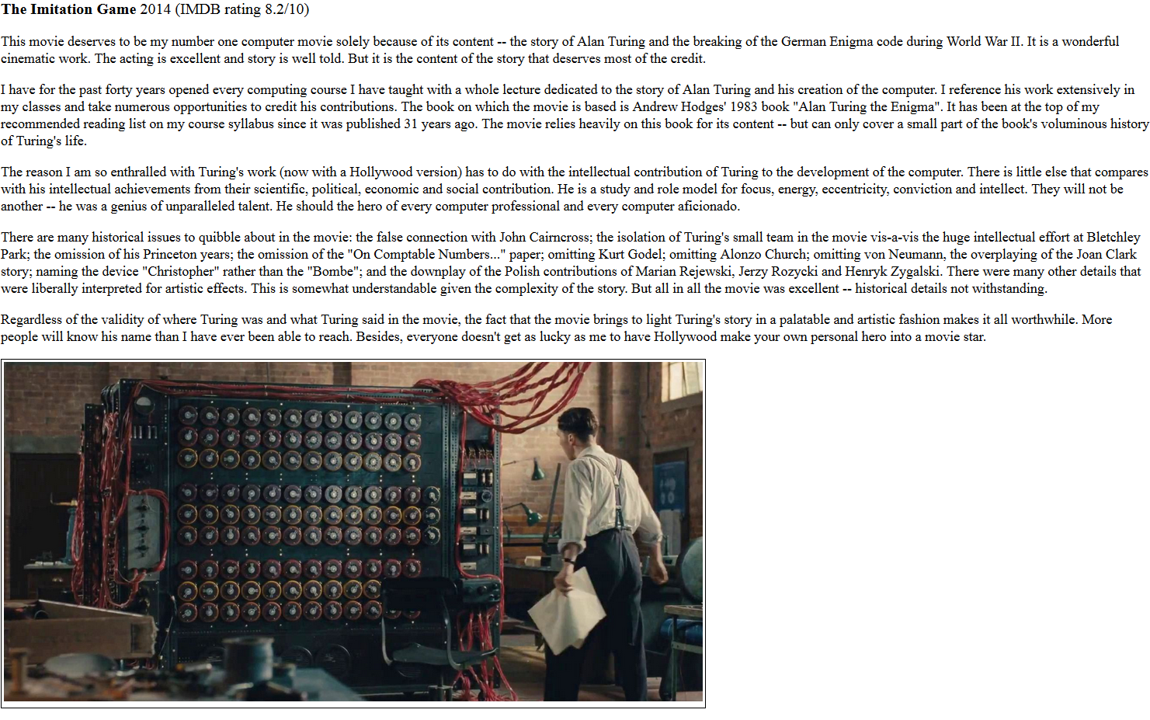
This 2014 movie is the only easily accessible version of Turing’s life – in particular the World War II years.
It is full of inconsistencies and misses
some major points. But will stand as
the best treatment of the smartest
guy who ever lived – and that’s just my opinion.

Slide 13
Can a Machine think? (1951 BBC radio program)
Turing says he does not know – but provides a way to answer the question.
The Imitation Game:
You play the game as the interrogator.
There are two curtains.
Behind one is a machine (a computer).
Behind the other is a person.
You can ask any question (electronically) to the entity behind either curtain.
The objective is to decide which is the machine and which is the person.
If you cannot decide – then the machine can think?

Slide 14
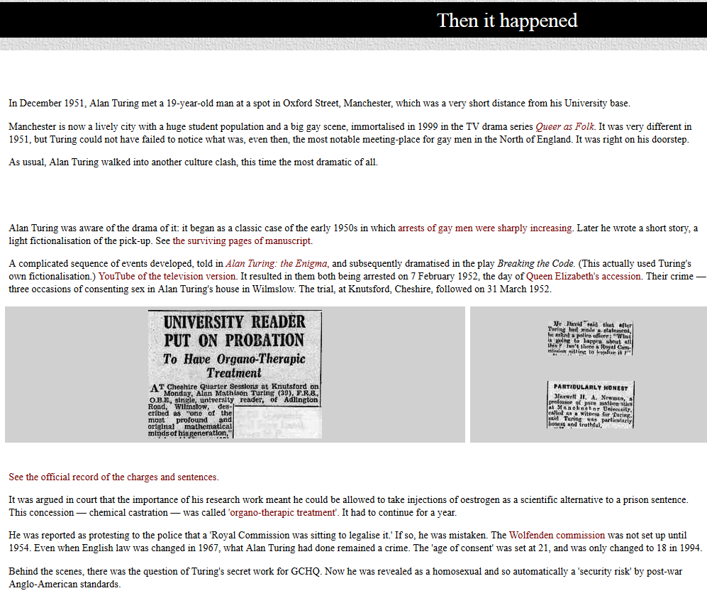

Slide 15
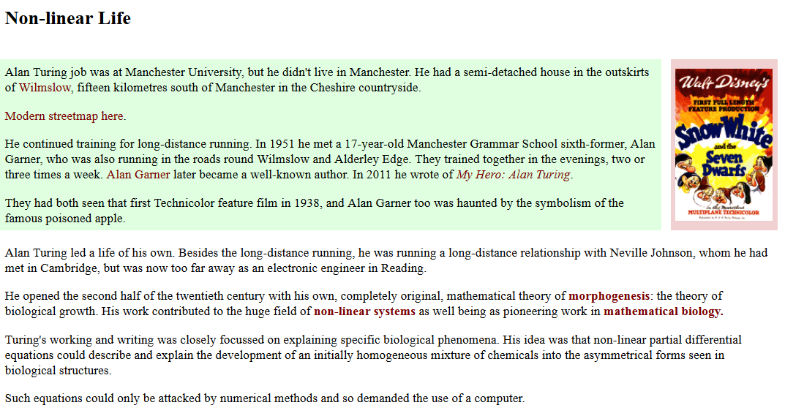
1952 Turing wrote “The Chemical basis for the Morphogenesis” (the foundations of mathematical biology and how biological structures arise)

Slide 16
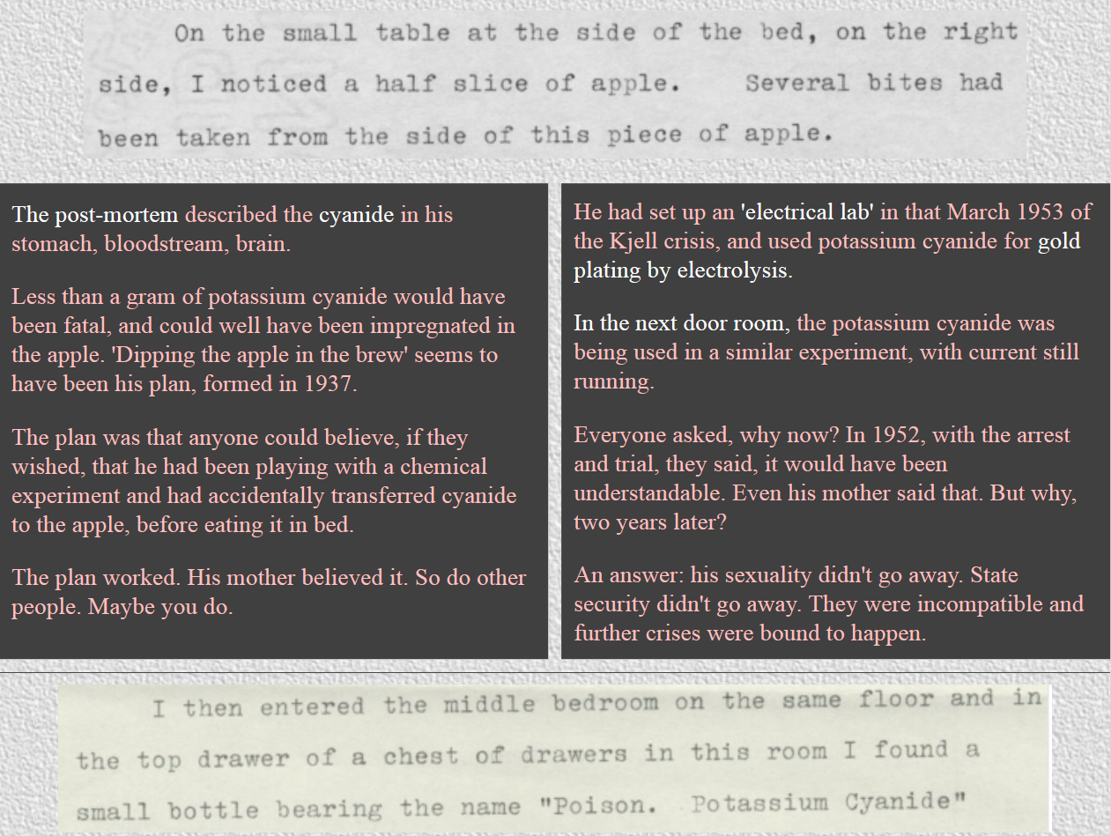

Slide 17
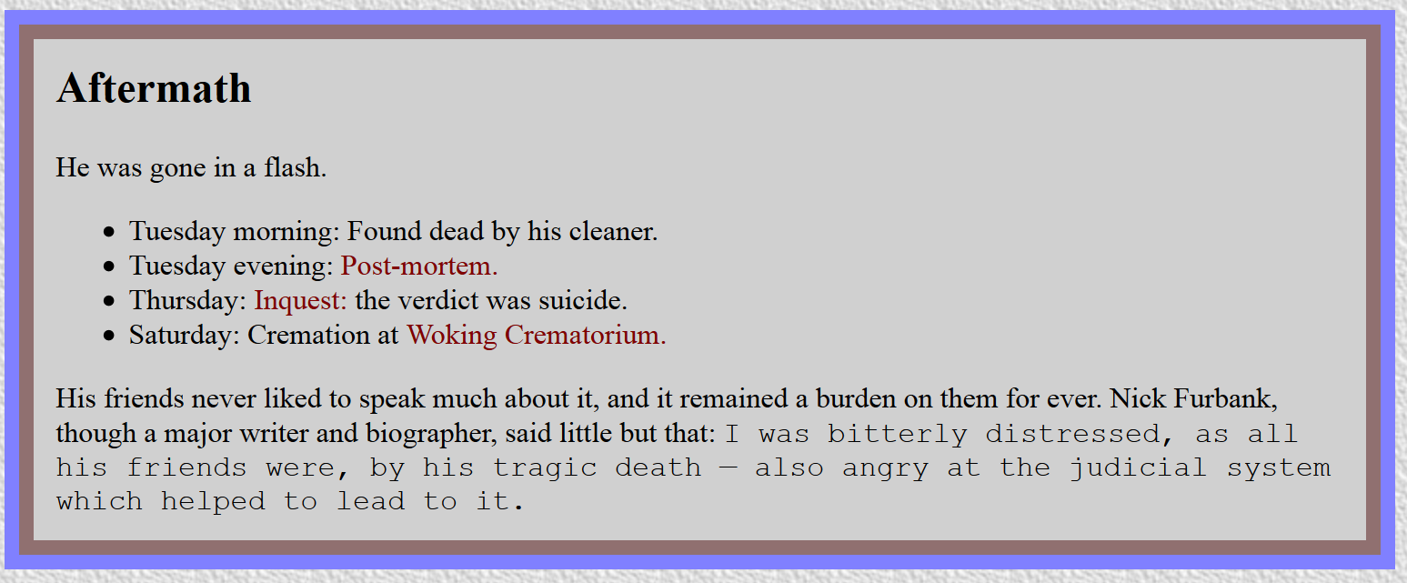

Slide 18
