Slide 1
Introduction to Private Equity and Venture Capital

Slide 2
Plan for today
Private versus Public Corporations
Financial securities they issue and the investors that hold them
Separation of ownership and control
Venture capital
Examples of funds and target firms
VC structure and role of LPs and GPs
Historical perfromance
Buyout funds (PE)
Some examples
Trends
Value creation
The LBO transaction

Slide 3
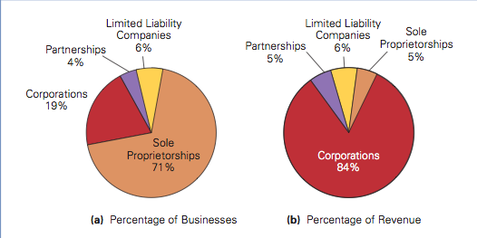
Distribution of Firms

Slide 4
Funding through Financial Securities
Private Firms
Bank Loans
Private debt agreements
Private equity
Ownership of firm equity that is no traded publically
Public equity
Shares traded on the stock market
Corporate
Debt
Bond notes or fixed-income securities issued over an exchange
Public Firms
(registered with the SEC)

Slide 5
Holding of Financial Securities
Gov. Bonds
Mutual funds
Hedge funds
Pension funds
Endowments
Private Equity funds
Angel investors
Founders and business owners
Corporate stocks and bonds
Financial derivatives and shorts
Private Equity

Slide 6
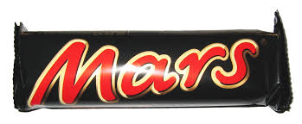
Ownership structure

Slide 7
Ownership and Control in Public corporations
In order to take advantage of economies of scale firms approach public capital markets to satisfy their financing needs
The result is dispersed ownership - large number of investors hold debt (corporate bonds) and equity (stock) of the firm
Separation of Ownership and Control
Notes:
Large businesses such as the big-four auditing firms are partnerships, Goldman Sachs went public in 1998 from being a partnership.
revised

Slide 8
Flow of funds in the public corporation
Decision making and control
Hired CEO/CFO Board of directors
Projects
investments
Corporation
Investors
banks, individuals, corporations, pension funds, mutual funds, ……
Revenues
Notes:
The main two decisions of the financial manager are: how to invest? How to raise the funds required and distribute proceeds?
Financial securities provide funds to the firm.

Slide 9
Flow of funds in the Private Company
Decision making and control: Owner/Founder
(possibly together with key investors as VC or PE fund managers)
Projects
investments
Owner/Founder
Family and friends
Bank
VC/PE investors
Private firm
Revenues
Notes:
The main two decisions of the financial manager are: how to invest? How to raise the funds required and distribute proceeds?
Financial securities provide funds to the firm.

Slide 10
General “Private Equity” Funds
A general name given to funds that invest in equity of either public companies or private ventures, hold substantial equity in these companies, play an active management or advisory role.
A distinction is often made between PE funds (buyout) and Venture Capital

Slide 11
Venture Capital Funds

Slide 12
Venture Capital Target firms
Young firms deploying new technologies with high potential for growth seek venture capital to finance research and development, product development, market penetration and so forth.
Venture capitalists offer more than funds to the firms they finance and often have representatives on the board of directors, conduct frequent meetings with the management team, hire/fire top key executives (CEO/CFO), bring their experience and expertise to the firm
Venture capital funding and investments are very cyclical and vary with market conditions

Slide 13
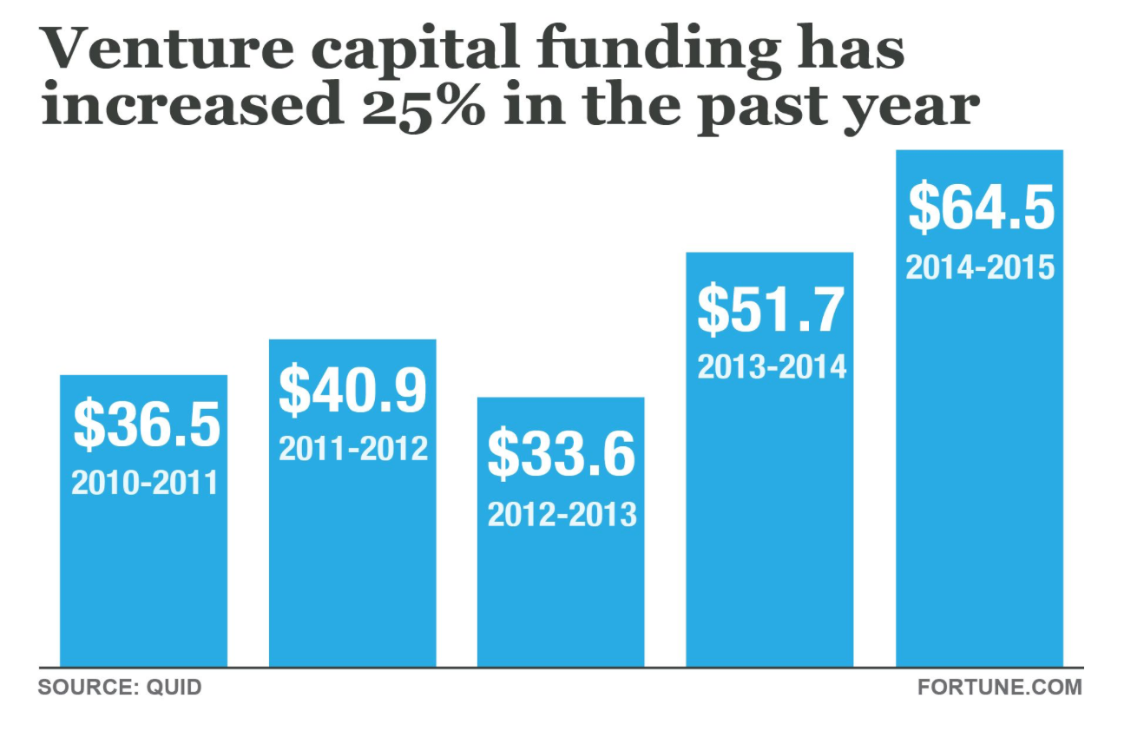
Recent trends in VC funding

Slide 14
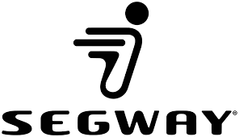
Leading VC funds

Slide 15
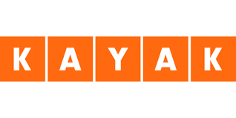
Leading VC funds

Slide 16
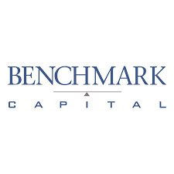
Leading VC funds

Slide 17
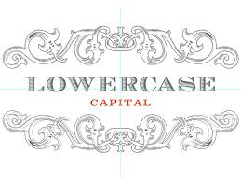
Leading VC funds

Slide 18
Venture Capital Structure
Venture capital funds are naturally focused on a certain industry (e.g., bio-tech, clean-tech) but within this criteria are quite diversified.
VC funds finance several portfolio companies simultaneously to allow for operational and informational synergies and positive externalities to the benefit of investors (e.g., cherry picking)
The fund is structured as a limited partnership.
Limited partners commit money (“closed-end”)

Slide 19
Typical Venture Capital firm
Portfolio firms
Portfolio firms
Portfolio firms
Portfolio firms
Fund A
Fund B
Fund C
Fund D
Limited partners
Limited partners
Limited partners
Limited partners

Slide 20
Typical Venture Capital Fund
Portfolio firm 2 Syndicate Series C & D
Portfolio firm 3 Lead Investor Series A
Portfolio firm 10 Syndicate Series A & B
Portfolio firm 1
Lead Investor
Series A & B
Fund B: Bio-Tech
$120 million committed capital
Managed by a two General Partners
Limited partner 1
Committed $2 million
Limited partner 2 Committed $500 K
Limited partner 7
Committed $5 million
Limited partner 16 Committed $200K

Slide 21
General Partners
Industry experts, often with past experience as successful entrepreneurs decide to start or join a VC fund.
With their industry reputation they raise around $100 million of committed capital from wealthy individuals, endowments, pension funds, insurance companies, and other investors.
A limited partnership (VC fund) is formed. This means that full ownership of the fund is owned by the limited partners (the investors). This has important tax implications.
GP’s are often compensated according to the 2/20 rule (sometimes deal-based but often based on total fund performance)

Slide 22
General Partners
GPs decide how to allocate funds – what firms to back and how much capital to spend on each portfolio firm. Screening
Negotiating terms with portfolio firms, setting milestones, and valuation terms are all critical responsibilities of the GPs. Contracting
GPs decide when and under what terms to sell a portfolio firm (e.g., through acquisition or IPO). The Exit.
GPs can reject follow-up financing to any particular portfolio firm at any time.
Importantly, GPs take an active role in management of their portfolio firms. Nurturing

Slide 23
General Partners
Funds exist for about 10 years, but this period can be extended further if needed. In this period GPs must identify their portfolio firms, realize growth and improvement in performance through numerous rounds of financing, and orchestrate the Exit.
Venture capitalists often fund firms through several financing rounds according to pre-determined milestones.
Focus is on the spectrum of relatively young stage start-ups. Returns and risks are high.
Most attractive exit is the IPO market. Expected conditions in the IPO market impact VC investing strategies and the amount of capital that flows into the VC industry.

Slide 24
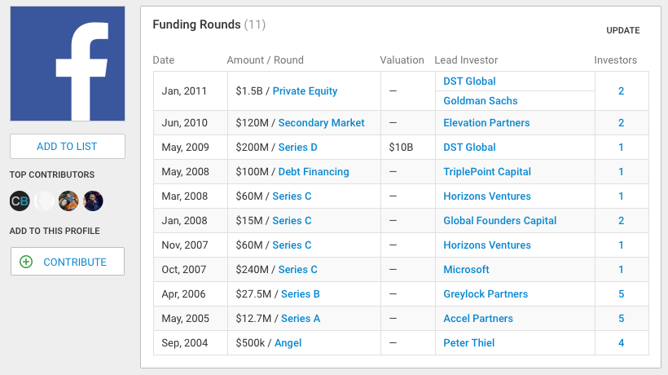
Example - Staging of Capital

Slide 25
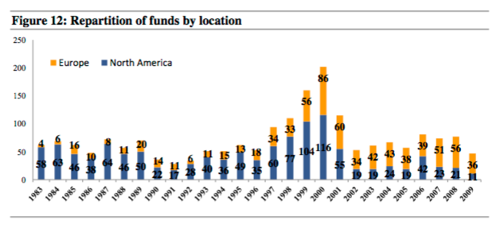
Returns to limited partners
The average return to VC is estimated at around 9%
Study by Koch 2014 looked at VC funds from the US and Europe:

Slide 26
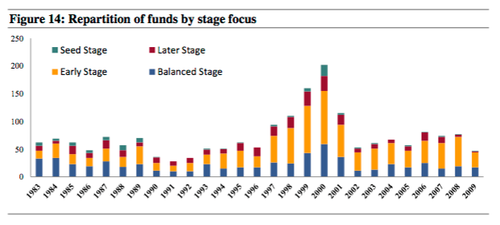
Returns to limited partners
Fund focus:

Slide 27
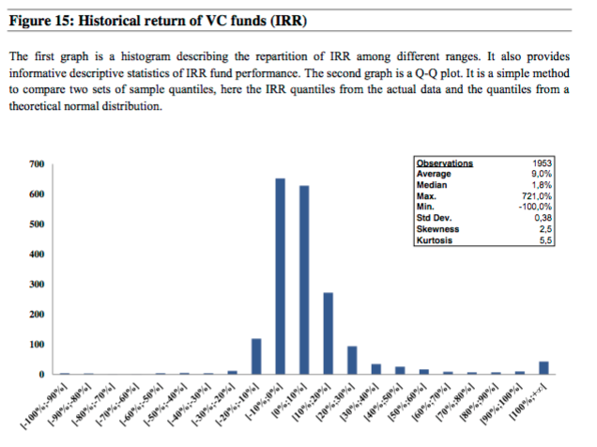
Returns to Limited Partners
The empirical returns distribution estimation

Slide 28
Returns to Limited Partners
The empirical returns by year

Slide 29
Buyout (PE) Funds

Slide 30
Private Equity
Buyout funds are structures as limited partnership and follow similar structure to that detailed for Venture capital funds
There are several differences between PE and VC funds
These differences include the type of firms they invest in, the sources for value creation, the use of both debt and equity, among others

Slide 31
The Size of the PE Mkt
Blackstone, Carlyle, and KKR are three of the most prominent PE firms
Aggregate PE AUM and the PE firms themselves have grown substantially over the years since the early 80’s
Forty years ago PE firms had about 10 investment professionals each, now the larger ones have over 100
In 1980 nominal dollars committed to PE in the U.S. was $200 million. By 2007 is it over $200 billion.

Slide 32
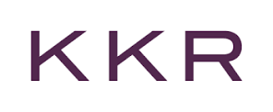
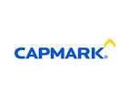
Some Deal Examples in the PE Industry
Carlyle, Merrill Lynch and Clayton Dubilier & Rice. Deal value $15 billion in 2005. Hertz IPO’ed in 2006
KKR. Deal value $16.7 billion in 2005. Capmark filed for bankruptcy in 2009.
Blackstone. $26 billion in 2007.
KKR, TPG and Goldman. $44.73 billion in 2007. . $26 billion in 2007.
KKR. RJR Nabisco. $31.1 billion in 1989 (or over $55 inflation adjusted).

Slide 33
The Size of the PE market
In 2008 there were 33 global PE funds (22 in the US) with more than $10 billion of assets under management. The top investors by size include CalPERS, CasSTERS, and PSERS
Like in the VC arena GPs in PE funds are by large compensated according to an annual management fee (percentage of committed capital) and “carried interest” or a share of the profits that equals 20%.

Slide 34
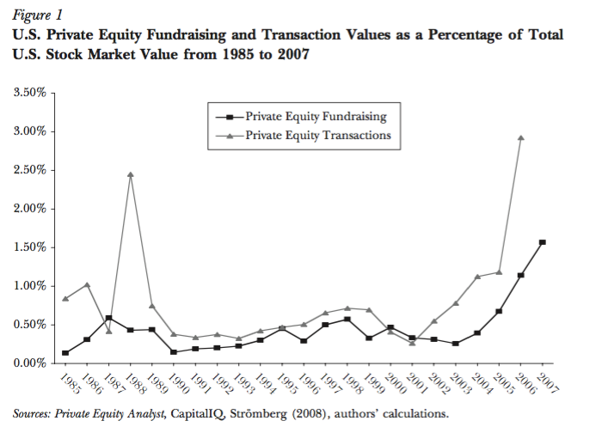

Slide 35
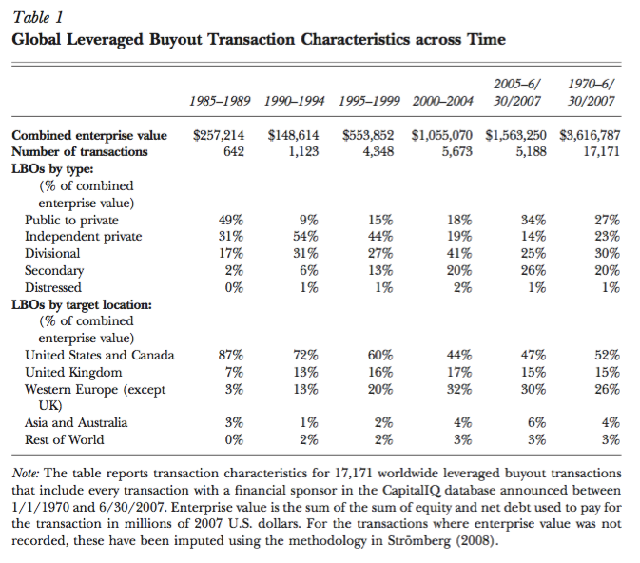

Slide 36
Exit
Since PE funds are of limited life the terms of exit are very important for the limited partners
The common ways of exit are:
Sale to strategic buyer (38% of exits)
Sale to another PE fund (24%)….this is more common recently
IPO (14%)….this has become less common

Slide 37
Creating Value
GPs have historically created value through three main channels:
Governance and financial engineering
management incentives are strengthen. Management ownership increases by a factor of 4X. Locked till exit transaction.
CEO receives 5.4% of equity ownership and management team 16% on average
In public companies the CEO holds 1.57% and the management team 3.58% on average
Leverage puts substantial pressure on management not to waste money and honor the interest and principal payments.
Leverage also has tax benefits that are weighted against the increased risk from bankruptcy
GPs are active board members in their portfolio companies. 30-50% of CEOs are replaced in the first 100 days and over 60% in four years.

Slide 38
Creating Value
GPs have historically created value through three main channels:
Operational engineering
By bringing their expertise to their portfolio companies the PEs improve operational efficiency. For example, the ratio of operating-income to sales has been found to increase by 10 to 20% following PE transaction
97% of GPs report improving operational as a main return driver
Promoting follow up acquisitions
Redefining company strategy and business model

Slide 39
Creating Value
GPs have historically created value through three main channels:
Not to forget…Buying-low-and-selling-high
GPs view themselves as able to screen target firms and find market opportunities of under-valuation
Some investments (especially) private targets allow for proprietary deal sourcing
Favorable exit terms, increased multiples relative to purchase together with increased performance

Slide 40
Valuation
GPs’ valuation methodologies
A vast majority deploys gross IRR (Internal Rate of Return) and MOIC (Multiple of Invested Capital) …. Over 90% reported
Use of comparable company multiples is also very common…over 70% reported
Few report to use WACC (Weighted Average Cost of Capital) or APV (Adjusted Present Value) ….about 10%
In contrast, the majority of CEO’s of public companies report that they rely on WACC-like methods for valuation

Slide 41
Performance Targets
GP’s aim for a gross IRR of about 25% on average
CAPM-based rate is almost 18%
A risk free interest rate of about 4%, an equity risk premium of 6% and equity beta of average portfolio company of 2.3
This is consistent with the Net IRR required by the limited partners
GP’s report a gross MOIC target of 2.85
At the five year horizon this implies an IRR of about 23%

Slide 42
Private Equity Transactions
The PE fund buys majority of ownership in existing mature firm
When the target is public, shares are purchased from existing shareholders at a premium (typically 15 – 50%)
Cash required for the transaction is provided through new debt (against the assets of the target firm) from banks and equity from the PE funds (with modest participation of around 1% by the general partners). The Leveraged Buyout structure.

Slide 43
LBO structure
The buyout is typically financed with 60 to 90% debt (less recently) from a bank, investment bank or more recently institutional investors such as hedge funds also purchase this debt
The remaining 40 to 10% equity is financed from the PE fund (the management team of the target often is required to participate as well)
At the end of the process the target firm if public becomes privately held

Slide 44
Short in-class group assignment Leverage, IRR, and MOIC
You are an advisor for MAX Capital, a PE firm that is considering the following investment opportunity.
Target firm’s equity costs $5 billion (all equity firm)
PE can purchase the equity with a loan carrying interest of 5%.
The upside potential is to sell the company in three to eight years for $10 billion. The estimate is that this will happen only with probability 50%. Otherwise it will sell it for what it is worth today ($5 billion).
MAX Capital needs your help in structuring the deal and deciding what leverage level to choose.
How should MAX Capital structure this investment to obtain a gross MOIC above 2 and IRR above 15%?
Start by calculating the IRR and MOIC for the unlevered transaction and then consider financing with debt.

