Slide 1
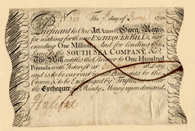
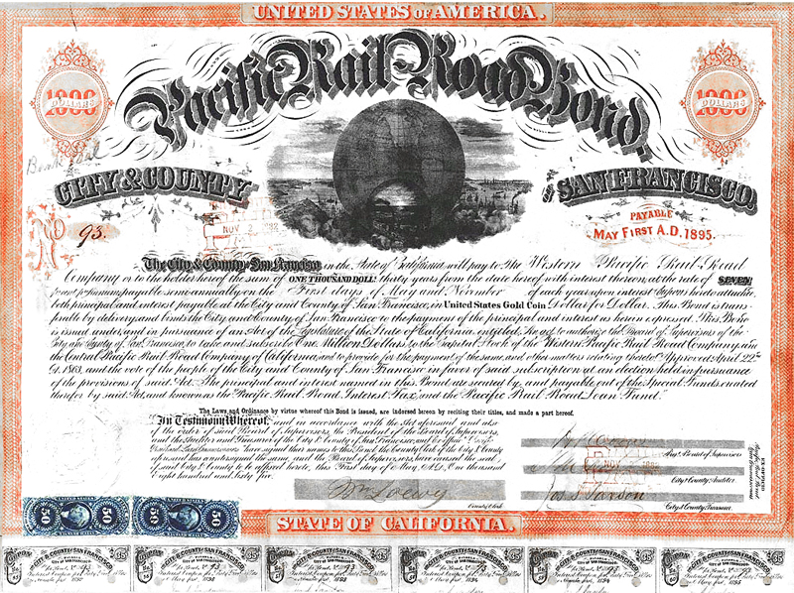
Corporate Finance
Pacific Rail Road 1865
South Sea Company 1720

Slide 2
Welcome
Nisan Langberg
Email nlangberg@uh.edu
Office: 210E
Ming Chen (Teaching assistant)
Email mingchen2011@gmail.com

Slide 3
Goal
Students will gain fundamental understanding of the main considerations underlying central financial decisions in modern public corporations.
Methodology
Students will master the required theoretical background and apply it through problem sets, mini cases and HBS case presentations

Slide 4
Outline
Logistics
Course Schedule
Methodological Background
The Public Corporation

Slide 5
Logistics

Slide 6
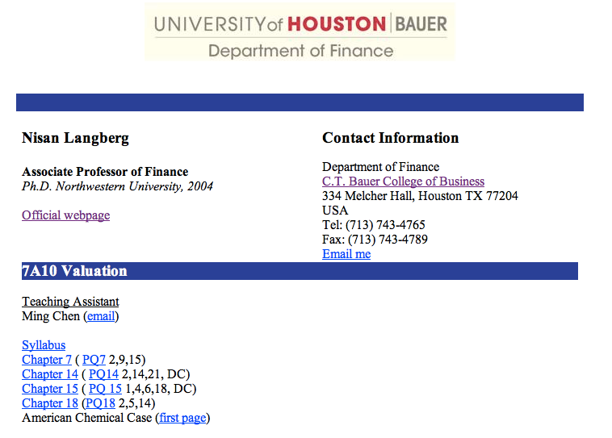
Class Material
On our website
http://www.bauer.uh.edu/nlangberg/teaching_710.htm

Slide 7
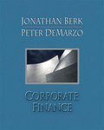
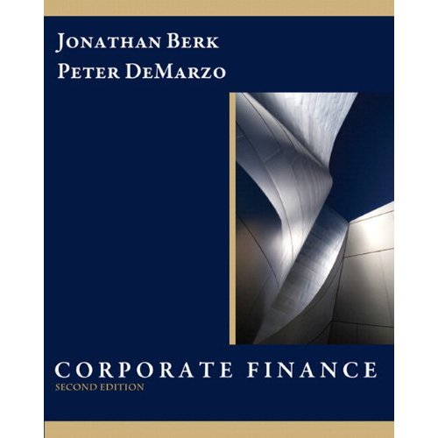
Text book
I will teach and assign problems using the book Corporate Finance by Jonathan Berk and Peter DeMarzo, Pearson, 2nd 3Rd editions
HBS cases are available on the HBS website

Slide 8
Buying the book?
I do recommend buying the book
The course is closely built around the text book
Very good reference book to have handy if one plans to work in corporate finance
Taught in leading business schools in the world
Students are not required to purchase the book

Slide 9
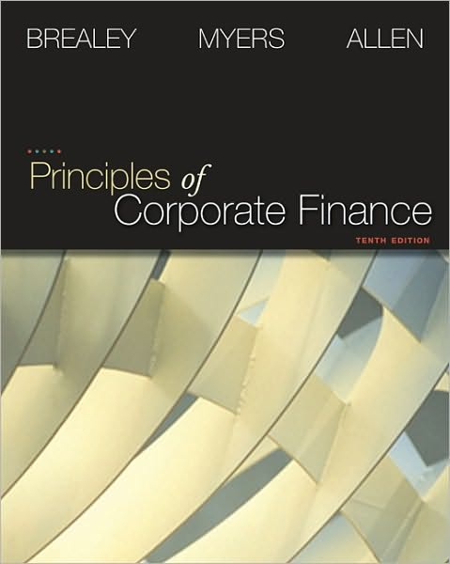
Additional/Alternative Reading
Further/alternative reading is Brealey, Myers & Allen, Principles of Corporate Finance, McGraw-Hill Irwin, 8th edition or higher

Slide 10
Group Assignments
I encourage work in groups
Groups are limited to four students

Slide 11
Grade
4 Homework assignments: 25%
Case: 15%
Final exam: 60%

Slide 12
Office hours
appointment by email
welcome to stop by my office
Send specific questions by email

Slide 13
Course Schedule

Slide 14
Course outline
August 29
Introduction
Capital budgeting (DB Chapter 7)
How to evaluate an investment opportunity
Calculating free cash flows
Predicting future free cash flows
Estimating the project’s risk
Calculating the NPV of the project

Slide 15
Course outline
September 5
Modigliani Miller (DB Chapter 14)
First theory of capital structure
Capital structure and firm value
Leverage and firm value
The relation between leverage, risk, and the cost of capital

Slide 16
Course outline
September 12
Modigliani Miller (continued)
PQ chapter 7 due

Slide 17
Course outline
September 19
Interest tax shield (DB Chapters 15)
Interest tax deduction
Valuing the interest tax shield
Recapitalizing
Personal taxes
Optimal capital structure with taxes
PQ chapter 14 due

Slide 18
Course outline
Optional:
Whirlpool Europe case
Estimating cash flows/ Project valuation
September 26
Capital budgeting with leverage (DB Ch. 18)
WACC, APV
Project based cost of capital
PQ chapter 15 due

Slide 19
Course outline (Sunday)
October 3
Review of homework assignments with Ming Chen the teaching assistant
October 10
Student presentations American Chemical Corporation
October 12
Makeup class
October 17
Final Exam

Slide 20
Methodological background Chapters: 4,6,10,12

Slide 21
The Time Value of Money – Ch. 4
Valuation of cash flows: PV and FV
Annuity
A stream of “n” periodic payments “CF”
Perpetuity
An annuity that continues forever
Growing Annuity/Perpetuity
Payments grow at rate “g” every period

Slide 22
Investment Decision Rules – Ch. 6
NPV = PV (benefits) – PV (costs)
Alternatives:
Payback period
Internal Rate of Return or IRR
Any positive NPV project should be adopted to increase firm value
Mutually exclusive investment opportunities
Positive NPV trading strategy?

Slide 23
Chapter 10 Capital Markets and Pricing of Risk
Risk and Return tradeoff
Diversification

Slide 24
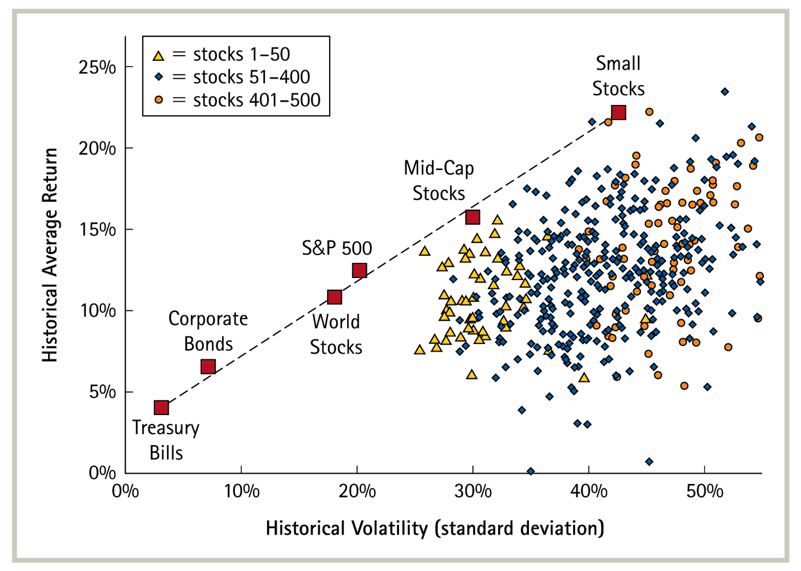
Risk Return Tradeoff
Historical Volatility and Return 1926-2004

Slide 25
Diversification

Slide 26
Systematic and Idiosyncratic Risk
Firm-Specific (or idiosyncratic) risk is eliminated by holding a diversified portfolio
Market-Wide (or systematic) risk is undiversifiable
Examples
The risk that Toyota recalls breaks on its Highlander
Sales of the new Mini from Apple
The risk that tax rates go up

Slide 27
Capital Asset Pricing Model-Ch. 12
CAPM
r_{i} = r_{f} + β_{i} (r_{mkt} – r_{f})+e_{i}
Return on asset “i”
Noise term
Risk free rate
Return on the market
Risk premium
“beta” of stock

Slide 28
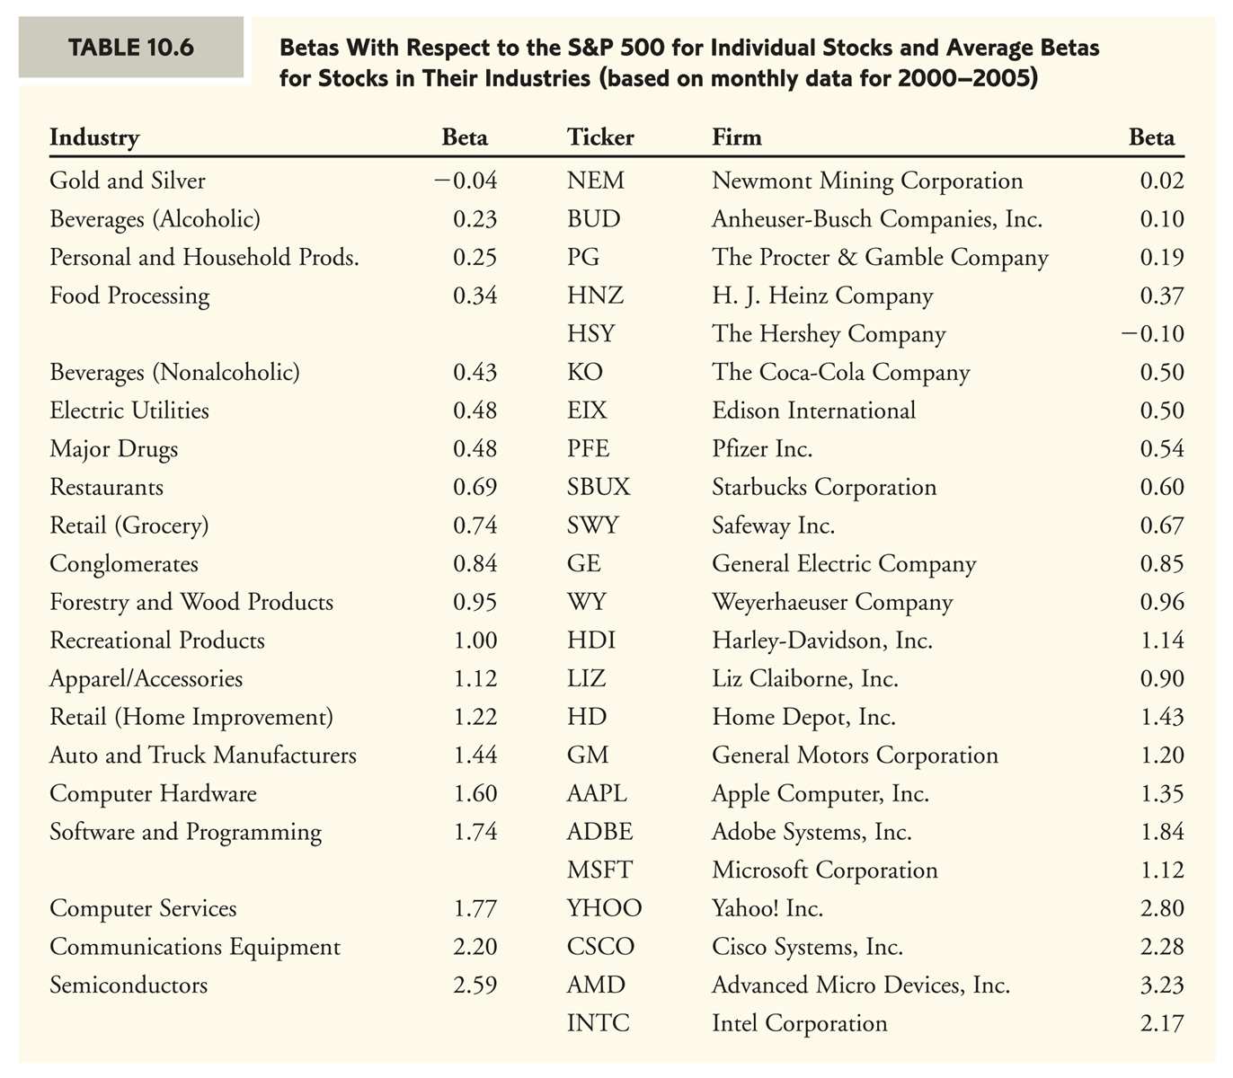

Slide 29
The Public Corporation

Slide 30
Four types of businesses
Sole proprietorships
Partnerships
Limited liability companies
The Public Corporation
Notes:
Large businesses such as the big-four auditing firms are partnerships, Goldman Sachs went public in 1998 from being a partnership.
revised

Slide 31
Distribution of Firms

Slide 32
Ownership and Control
In order to take advantage of economies of scale firms approach public capital markets to satisfy their financing needs
The result is dispersed ownership - large number of investors hold debt (corporate bonds) and equity (stock) of the firm
The result – Separation of Ownership and Control
Notes:
Large businesses such as the big-four auditing firms are partnerships, Goldman Sachs went public in 1998 from being a partnership.
revised

Slide 33
Flow of funds in the public corporation
Chief financial officer
Projects
investments
Investors
banks, individuals, corporations, pension funds, mutual funds, ……
Revenues
Notes:
The main two decisions of the financial manager are: how to invest? How to raise the funds required and distribute proceeds?
Financial securities provide funds to the firm.

Slide 34
Goal of the Public Corporation
What is the CFO’s goal?
Profits
Stock price
Costumer satisfaction
Employee satisfaction
All/some of the above

Slide 35
Who’s company is it?
** Survey of 378 managers from 5 countries
Source: Chapter 2, Brealey, Myers and Allen 8/e

Slide 36
What is more important dividends or jobs?
** Survey of 399 managers from 5 countries. Which is more important...jobs or paying dividends?
Source: Chapter 2, Brealey, Myers and Allen 8/e

Slide 37
Fiduciary Duty
Shareholders elect board of directors
Board of directors set the rules and policies for how the corporation is run
The manager (CEO) is elected by the board of directors to run the firm according to the guidelines set by the board
Fiduciary duty of directors and management is to promote the will of shareholders

Slide 38
Shareholder value
The value of the Corporation is determined by the price of its securities – e.g., stock price
How to maximize the stock price?
Corporations can have thousands of shareholders is it possible to satisfy them all?

Slide 39
Investment Rule
The CFO shall invest in projects that increase stock price
The stock price is determined by its value to the diversified investor

