Slide 1
Fundamentals of Capital Budgeting Ch 7

Slide 2
Capital Budgeting
The process of allocating capital to projects by identifying which projects to undertake out of the set of possible investment opportunities

Slide 3
outline
Accounting Background
Project data
Forecasting (incremental) earnings
Earnings versus Cash-Flows
Calculate NPV
Possible Adjustments
Sensitivity Analysis

Slide 4
Introduction to Financial Statement Analysis (Chapter 2)

Slide 5
Balance Sheet Assets

Slide 6
Balance Sheet Liabilities

Slide 7
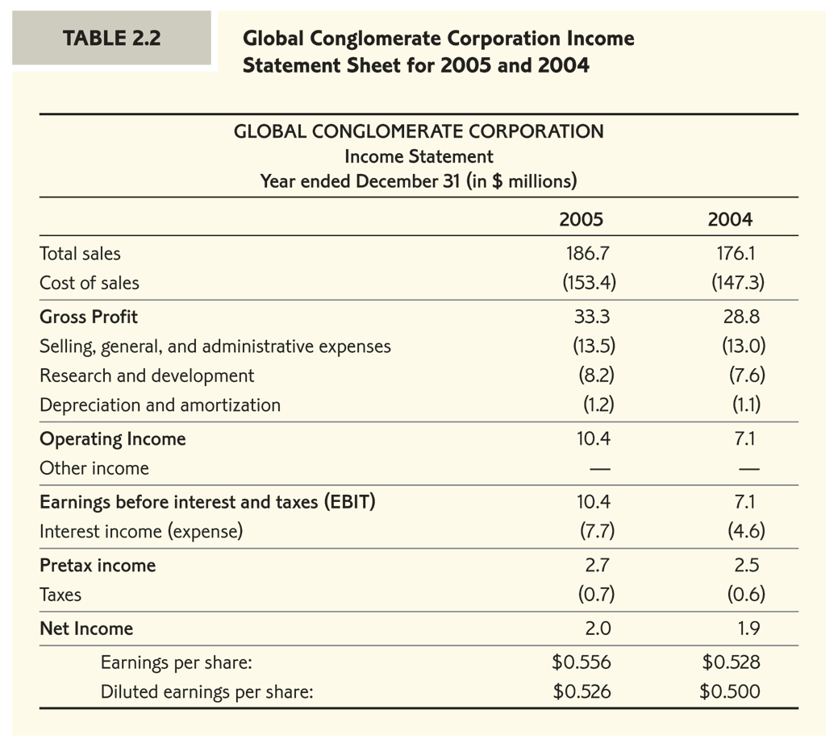
Income Statement

Slide 8
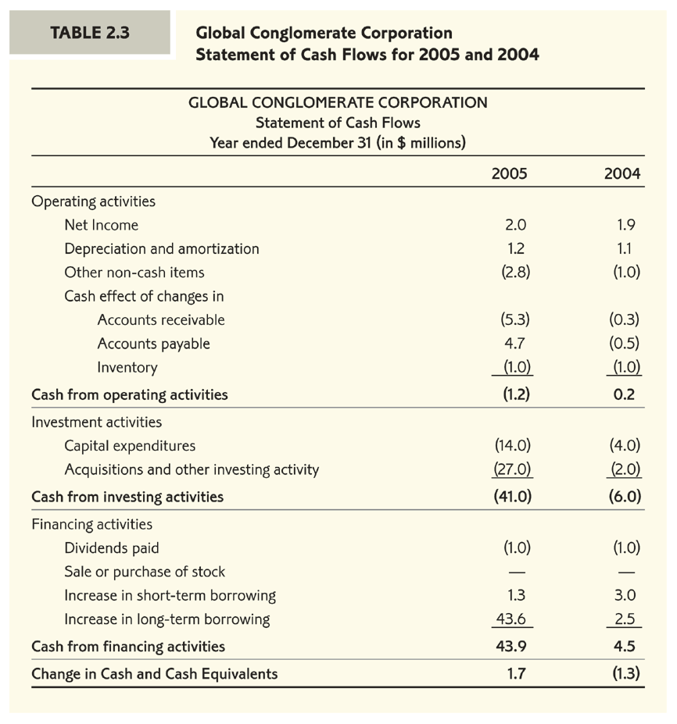
Cash Flow Statement

Slide 9
Project Data

Slide 10
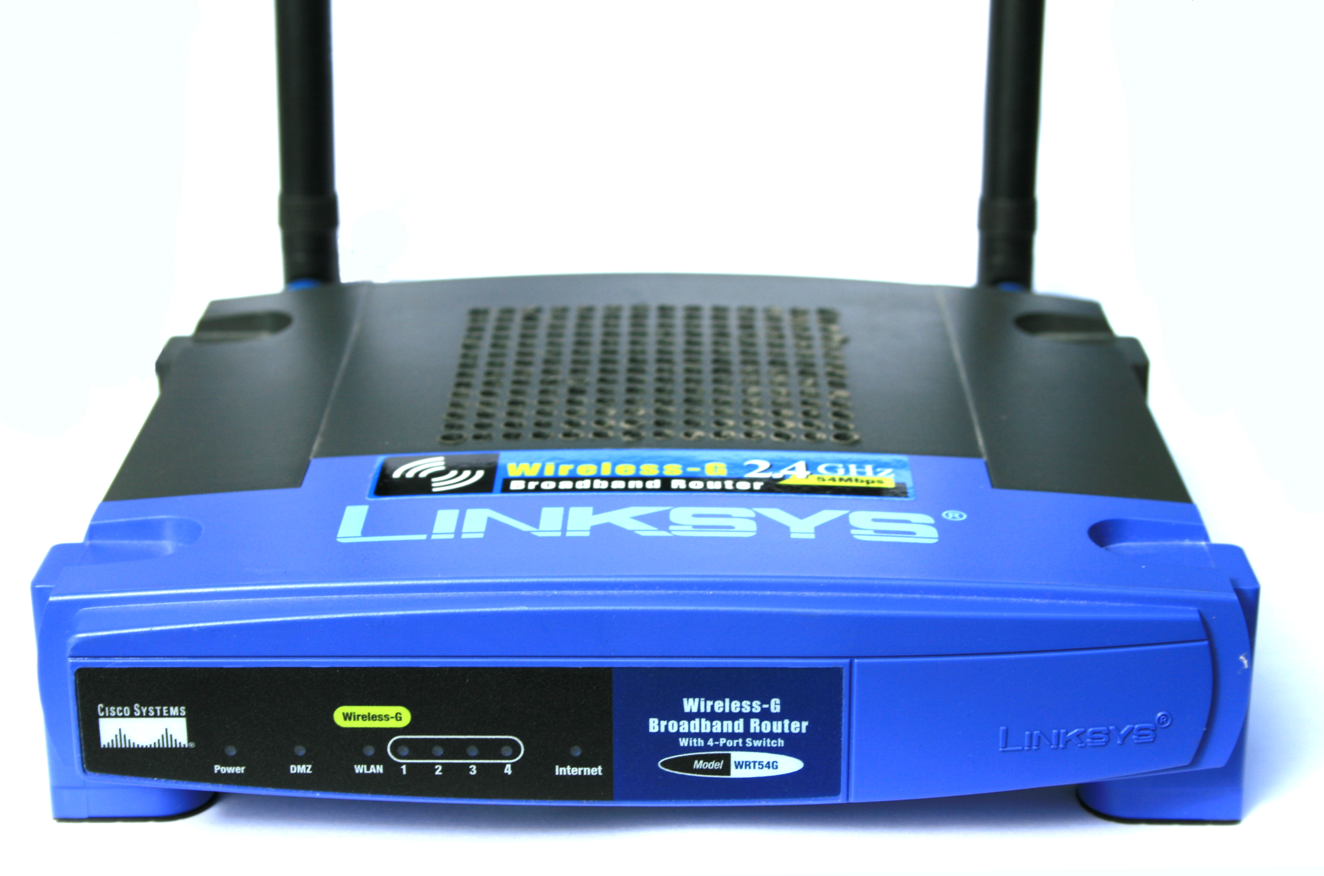
Linksys (division of Cisco Systems) is considering the development of a wireless home networking appliance – HomeNet
HomeNet will allow the consumer to run the entire home through the internet
Linksys has already conducted an intensive $300,000 feasibility study to assess the attractiveness of the new product

Slide 11
Example Continued
HomeNet targets upscale residential “smart” homes.
It expects annual sales of 100,000 units for four years, and nothing afterwards.
The product will be sold of a wholesale price of $260 (retail $375).
Hardware: the product will require total engineering and design costs of $5 million prior to production at $110 per unit.
Software: the product will require a team of 50 software engineers for a full year.

Slide 12
Example Continued
The annual cost of a software engineer is $200,000.
Linksys must also build a new lab for testing the compatibility of their product to the internet ready appliances.
The new lab will occupy existing facilities but will require an investment of $7.5 million in new equipment.
The hardware, software, and new lab will be done in one year. At that time HomeNet will be ready to ship.
Linksys expects to spend $2.8 million a year on marketing and support for the product.

Slide 13
Forecasting Earnings

Slide 14
Earnings Before Interest, Taxes, Depreciation and Amortization (EBITDA)

Slide 15
EBITDA

Slide 16
Depreciation
What about the capital expenditure of $7.5 million on the new lab?
Investments in plant, property, and equipment are not directly listed as expenses when calculating earnings even though they are a cash expense
Depreciation
The firm deducts a fraction of the cost each year as depreciation
The simplest method is straight-line depreciation
In our case – one year of set up and four years of production. This amounts to $1.5 million in depreciation at the end of each year for 5 years

Slide 17
Depreciation

Slide 18
Earnings Before Interest and Tax (EBIT)
Calculation of expected EBIT per year
How to treat taxes when earnings are negative?
Assume profitability for Cisco Systems:
If the firm pays positive tax on its total earnings then negative project-earnings serve as a tax shield

Slide 19
(Unlevered) Net Income

Slide 20
Project Externalities
Projects may impose costly or beneficial externalities
So far we have considered the project in isolation.
Project valuation is determined by the difference between total corporate earnings with and without the project.
Examples of externalities:
Production opportunity costs: using costly firm resources
Revenue cannibalism: reduction in sales of competing products

Slide 21
Opportunity Cost/Revenue Cannibalism
The lab is housed in a warehouse space that the company could have otherwise rented out for $200,000 a year during the years 1-4.
25% of HomeNet’s sales come from customers who would have purchased an existing Linksys wireless router if HomeNet were not available.
Existing routers cost $60 to produce and sell for wholesale price of $100.

Slide 22
Adjusting for Cannibalism in Revenues
Lets estimate the negative revenue externality introduced by the project
Number of existing Linksys routers not sold
25% x 100,000 = 25,000
Lost revenue from existing Linksys routers
25,000 x $100 = $2.5 million
Incremental sales are reduced to now $23.5 million
Gain in production costs of existing Linksys routers
25,000 x $60 = $1.5 million

Slide 23
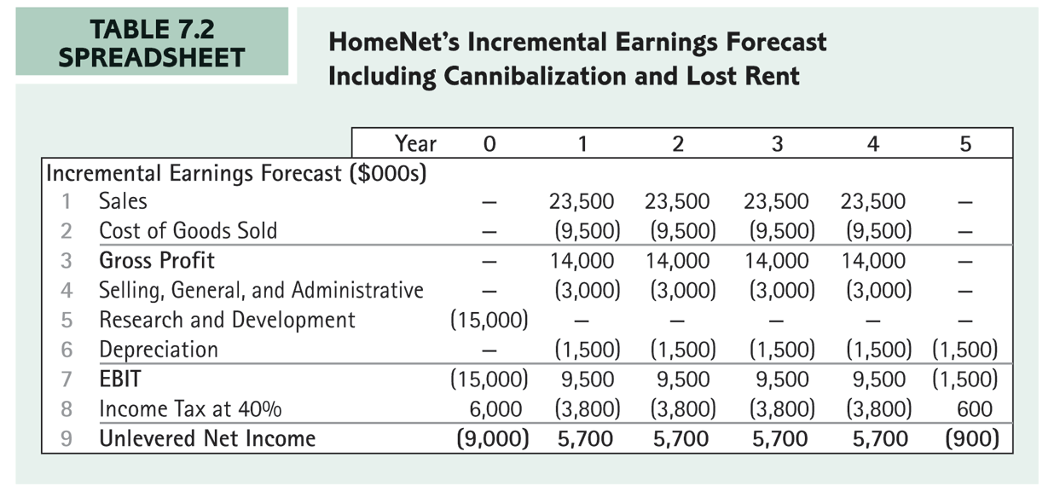
Adjusting for Cannibalism in Revenues

Slide 24
Sunk Costs
Sunk costs are not affected by our decision and therefore they should not affect our decision
Examples
Fixed overhead expenses
Past R&D expenses
The $300,000 spent already on the feasibility study cannot be recovered (whether the project is adopted or not!)

Slide 25
Other issues to consider
The valuation process should focus on the most value-relevant issues
Neglected here:
Estimating growth rate in annual sales
Trends in cost of production (new technologies)
Changes in consumer preferences
Entry by competitors
Project horizon

Slide 26
From Earnings to Cash Flows

Slide 27
Variability of Cash Flows
Earnings are better forecasted and their forecast is an important first step in the valuation process but project value is determined by its future cash flows not earnings
We forecast economic activity based on future sales growth and profit margins
Free Cash Flows are directly related to purchases of inventory, payments made to suppliers and received from clients, replacement of old equipment, establishment of new plants, and so forth – consequently more volatile

Slide 28
Corrections Required
Realizing the true cash flow implications of
Investments
Working Capital

Slide 29
Treating Investments
Capital Expenditures (investment) & Depreciation
CAPEX is a cash out flow
Depreciation is an adjustment to earnings
Not an actual out flow
Calculation cash flow implications of investments
Add depreciation expense to Unlevered Net Income
Subtract CAPEX

Slide 30
Correcting Investments for HomeNet

Slide 31
Net Working Capital
Net working capital (NWC) is defined as the difference between Current Assets and Current Liabilities
NWC = Cash + Inventory + Receivables – Payables
Expanding operations often requires changes to NWC.
Increased cash holdings
Higher levels of inventory
Higher Accounts receivables/Payables

Slide 32
NWC - HomeNet
HomeNet plans to ship products directly from the contract manufacturer to customers
The project has no cash or inventory requirements
Following other divisions in Cisco Systems:
HomeNet will grant credit to its customers and Receivables will account for 15% of annual sales
HomeNet will continue to enjoy credit from its suppliers and Payables will account for 15% of annual cost of goods sold (COGS)

Slide 33
Calculating NWC for HomeNet
Receivables
Payables
NWC

Slide 34
The NWC Adjustment to FCF
How does NWC affect the FCF from the project?
The project requires higher level of NWC ($2.1 million in our example) @ t=1-4
In other words, the project requires
a cash outflow at time t=1 of $2.1 million
a cash inflow at time t=5 of $2.1 million

Slide 35
Changes in NWC
Formally, the annual increase in NWC is treated as a cash expenditure and is subtracted from earnings
Thus we are interested in the change in NWC,
ΔNWC_{t} = NWC_{t} – NWC_{t-1}
Not to forget the recovery of NWC at the end of the life of the project - a reduction in NWC is equivalent to a cash inflow.

Slide 36
Correcting NWC for HomeNet

Slide 37
Direct Calculation of FCF
It is also possible to calculate FCF directly without going through earnings:

Slide 38
The NPV of the Project

Slide 39
Value of the Project
Project value is the present value of all future expected free cash flows generated by the project or the Project’s NPV
RISK
Assume the project has the same risk as other projects in Cisco’s Linksys divisions with the appropriate discount rate of 12%
Discount future FCF’s to yield project value

Slide 40
Possible Adjustments
Comparing alternative business plans Depreciation schedules
Capital Gains
Project Horizon
Further Tax considerations

Slide 41
Comparing business plans
When faced with alternative strategies or projects to choose from we must compare the NPV of a project to that of the alternative mutually exclusive projects and choose the project with the highest NPV
With only one project in mind
We compared the NPV to zero since we faced the decision of either adopting or not without any other alternatives
Back to our example
suppose that Cisco is considering an alternative manufacturing plan for the HomeNet product

Slide 42
In-House Production
Example continued
Under the current plan production is fully outsourced at cost of $110 per unit
Cisco can alternatively produce the product in-house for a cost of $95 per unit
Will require $5 million in upfront operating expenses
Cisco will need to maintain inventory equal to one month’s production.

Slide 43
Valuation of in-house production
To address the outsourcing versus in-house production decision we need to examine the incremental FCF’s

Slide 44
Valuation of in-house production
Now consider EBIT

Slide 45
Alternative Depreciation Schedules
The specific depreciation schedule affects the firm’s future expected tax liability and impacts the value of the project
We have assumed for simplicity the straight line depreciation method
Since depreciation reduces tax payments it is in the firm’s best interest to choose the most accelerated method of depreciation
MACRS is the most accelerated method approved by the IRS. For example for an asset with 3 year life span the schedule is 33.33%, 44.45%, 14.81%, 7.41%

Slide 46
Capital Gains from selling Equipment
Liquidation and Salvage value
Assets no longer needed often have a resale value.
Some assets may even have a negative liquidation value for example, if its parts need to be removed from the plant and disposed of
Capital gains (from selling the asset) are taxed
Capital Gain = Sale price – Book value
Book value = Purchase price – Accumulated Depreciation
After tax CF from asset sale =
Sale price – (Capital Gain)τ_{c}

Slide 47
Valuation of Long-Lived Projects
Terminal or continuation value
Sometimes FCF’s are explicitly forecasted for a shorter horizon than the full horizon of the project (e.g., an expansion usually doesn’t have a specific life span)
Depending on the setting one should apply different methods for estimating the continuation value. For long lived projects it is common practice to assume cash flows grow at some constant rate beyond the forecast horizon.

Slide 48
Further Tax Considerations
Tax carry-forwards and carry-backs
The tax code allows firms to take losses during a current year and offset them against gains in nearby years
The firm can offset losses during one year against income for the last two years, or save the losses to be offset against income during the next 20 years

Slide 49
Sensitivity Analysis

Slide 50
Forecasting Errors
Any valuation depends on an array of assumptions on future performance, growth rates, market share, profitability margins, cost of capital, corporate strategy, and so forth
The manager must make an investment decision under uncertainty
There is considerable risk regarding the assumptions made to estimate a project’s future FCF’s
How can we make investment decisions when we are uncertain regarding the project’s future cash flows and its risk?

Slide 51
Break-Even Analysis
When uncertain about an input it is useful to conduct the break-even analysis
For example, consider the cost of capital of 12% we have assumed for the HomeNet project
The question we will ask is “at what cost of capital will the HomeNet project have a zero NPV?” (the IRR of the project)

Slide 52
Break-Even for HomeNet
We can calculate the breakeven point for all other parameters of interest

Slide 53
Sensitivity Analysis
Another important tool is sensitivity analysis
By examining the sensitivity of the NPV to changes in parameter values for which there is uncertainty we learn what assumptions are most important
It also reveals what aspects of the project are most critical when managing the project

Slide 54
Sensitivity Analysis for HomeNet

Slide 55
Sensitivity Analysis for HomeNet

Slide 56
Takeaway
Seek all information relevant for the investment decision (e.g., opportunity costs)
Forecast future earnings
calculate incremental earnings
From forecasted earnings calculate future FCF
Use FCF to calculate NPV
Check sensitivity of valuation to your assumptions

Slide 57
HW Ch. 7
End of chapter questions (second edition):
2, 9, 15

