Slide 1
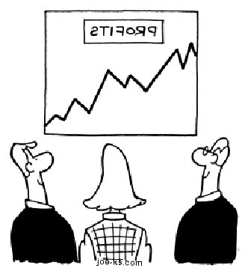
Capital budgeting and valuation with leverage
Chapter 18

Slide 2
outline
Target leverage ratio
Southwest:
Fixed versus Random levels of Debt
The WACC method
Avco Industries
Project valuation using WACC
The WACC/APV link
Project based WACC
Levering up and WACC

Slide 3
Fixed versus Random levels of Debt

Slide 4
Earnings Forecast Southwest Airlines
Suppose that Analysts’ 3 year forecast for Southwest Airlines suggests that the value of the company may either increase to $13B or decrease to $7B by the end of 2015.
Forecast Southwest’s market balance sheet for 2015

Slide 5
Fixed debt level of $3.75 Billion
V = 13
V increases by 28%
E=9.25
D=3.75
Firm Value V
V = 10.17
E=6.42
V = 7
D=3.75
V decreases by 31%
E=3.25
D=3.75
2012
Time line
2015

Slide 6
Fixed Debt to Equity ratio D/V = 36.8%
V = 13
V increases by 28%
E=8.2
D=4.79
Firm Value V
V = 10.17
E=6.42
V = 7
D=3.75
V decreases by 31%
E=4.41
D=2.58
2012
Time line
2015

Slide 7
Interest Tax Shield Forecast Southwest Airlines
Suppose that Southwest’s debt demands a 5.2% rate of return.
Comparing the two cases
Fixed debt level: annual interest payments do not change and are equal to $195M leading to annual tax shield of $67.9M
Fixed debt ratio: interest payments either increase from $195 million to $249M or decrease to $134M. The annual ITS increases to $87.15M or decreases to $46.9M.
When the debt to value ratio is constant overtime, the interest tax shield is more risky - it moves with firm value

Slide 8
Target Debt Ratio
When the dollar level of debt changes over time then the interest payments also change over time and the tax shield is no longer equal to $Dτc

Slide 9
The WACC method

Slide 10
The Weighted Average Cost of Capital (WACC) method
Calculate project’s (unlevered) FCF’s
Discount all future FCF’s with r_{wacc}
using the firm’s value of equity, debt, and their returns
Project Value = PV (unlevered FCF’s, r_{wacc} )
$$r_{wacc}=\frac{E}{E+D}r_{E}+\frac{D}{E+D}r_{D}(1−τ_{c})$$

Slide 11
Assumptions required for using WACC to discount cash-flows
Assumptions
The project is in the same line of business of the firm’s current assets
The firm’s debt-to-value ratio is fixed over time
Corporate taxes are the only imperfection
We will return to relax these assumptions later

Slide 12

Deriving the WACC method
Time t=0
The market value of the firm is ${V_{0}}_{}^{L}$=$E_{0}$+$D_{0}^{}$
Investors expect $r_{E}$ on equity and $r_{D}$ on debt
Time t=1
The expected firm value is ${V_{1}}_{}^{L}$
The expected unlevered FCF is ${FCF}_{1}$
The expected interest tax shield is $r_{D}^{}{D_{0}τ}_{C}^{}$
Notice that
$$V_{0}=\frac{{FCF}_{1}+{V_{1}}_{}^{L}}{(1+r_{WACC})}$$

Slide 13
Project Valuation using WACC

Slide 14
AVCO’s Investment Opportunity
Example Avco Inc.
Avco, Inc. is a manufacturer of custom packaging products and is considering a new line of packaging (RFX) that includes an embedded radio-frequency identification tag.
This improved technology will become absolute after 4 years. In the meanwhile it is expected to increase sales by $60 million per year.
Manufacturing costs and operating expenses are expected to be $25 million and $9 million respectively per year.

Slide 15
AVCO’s Investment Opportunity
Example continued
Developing the product will require upfront R&D and marketing expenses of $6.67 million together with an investment of $24 million in equipment.
The equipment will be obsolete in four years and will depreciate via straight-line method over that period.
Avco bills its customers in advance, and it expects no net working capital requirements for the project.
Avco’s tax rate is 40%.

Slide 16
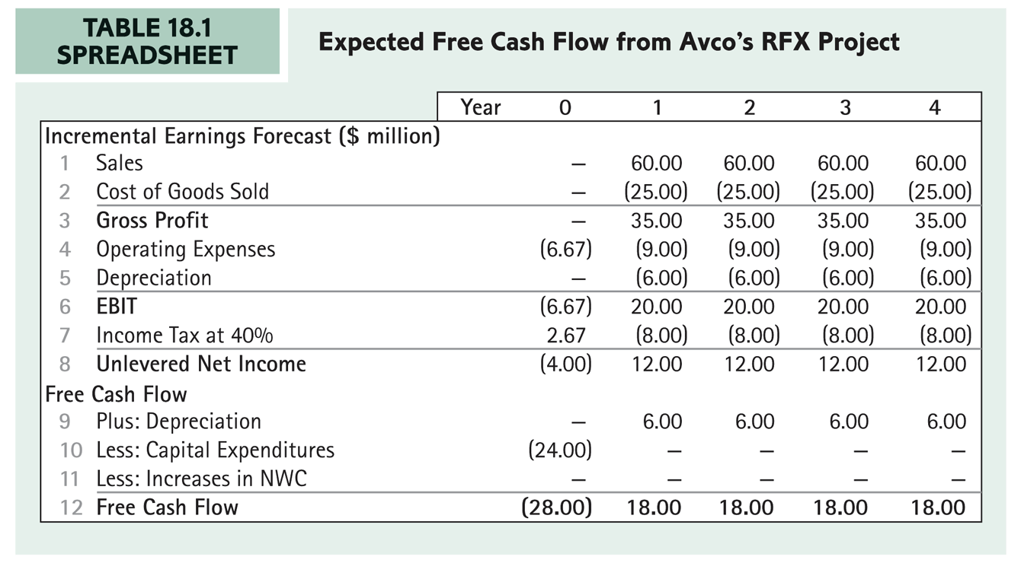
Expected future FCF’s

Slide 17
Calculating AVCO’s WACC
Example continued
The market risk of RFX is expected to be similar to that for the company’s other lines of business.
Using WACC requires
$$r_{WACC}={\frac{D}{D+E}(1−τ_{c})r}_{D}+\frac{E}{D+E}r_{E}$$

Slide 18
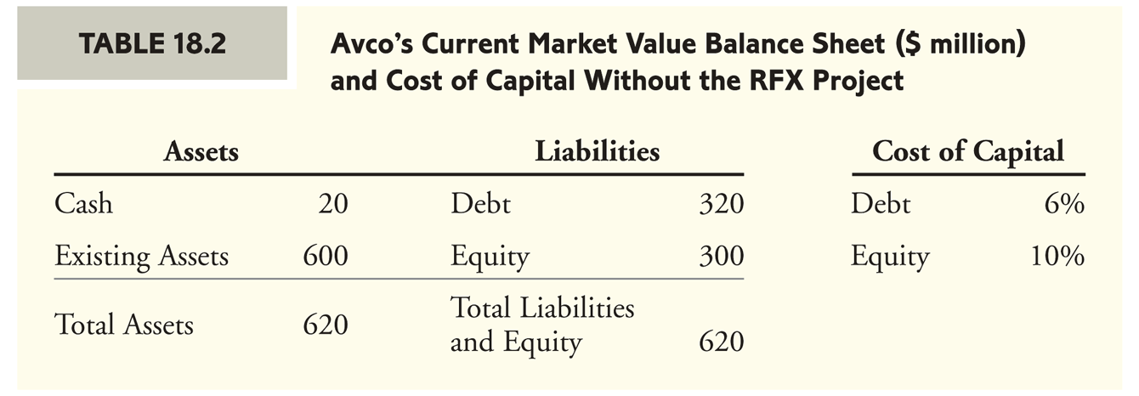
Financial Data

Slide 19
Project Valuation

Slide 20
The WACC/APV link

Slide 21
APV method when D/E ratio is fixed
Valuation
Value of future (unlevered) FCF’s
Value of future interest tax shield’s
.
$$V^{L}=V^{U}+V^{TS}$$
$$V^{U}=PV(unlevered FCF^{′}s, r_{U})$$
$$V^{TS}=PV(Int. tax shield′s, r_{U})$$
$$r_{U}={\frac{D}{D+E}r}_{D}+\frac{E}{D+E}r_{E}$$

Slide 22
Deriving the unlevered cost of capital when D/E is fixed
Time t=0
The market value of the firm is $V^{L}={ E}_{0}+D_{0}^{}=V^{U}+V^{TS}$
Investors expect $r_{E}$ on equity $r_{D}$ on debt
Investors expect $r_{U}$ on the tax shield
Time t=1
The expected net return on ${ E}_{0}$ is $E_{0}$ $r_{E}$
The expected net return on ${ D}_{0}$ is $D_{0}$ $r_{D}$
The expected net return on${ V}^{U}$ is${ V}^{U}r_{U}$
The expected net return on${ V}^{TS}$ is${ V}^{TS}r_{U}$
It follows that
$$r_{U}={\frac{D}{D+E}r}_{D}+\frac{E}{D+E}r_{E}$$

Slide 23
Unlevered value: Avco’s RFX project
What is the unlevered value of the RFX project?
Unlevered FCF’s include the initial investment of $28 million and 4 annual FCF’s of $18 million
Using the Avco’s unlevered cost of capital:
$$V_{}^{U}=\$59.62M$$

Slide 24
Implementing a D/E ratio for Avco
How can Avco manage their capital structure to maintain a fixed D/E ratio of 1?
To form the capital structure strategy we are required to examine the project’s value and required debt capacity over time

Slide 25
Project’s value and debt capacity
The value of leveraged project (in $millions):
To maintain the ratio D/E=1
time | 0 | 1 | 2 | 3 | 4
V^{L}_{t} | 61.24 | 47.42 | 32.64 | 16.86 | 0
time | 0 | 1 | 2 | 3 | 4
Debt | 30.62 | 23.71 | 16.32 | 8.43 | 0
Equity | 30.62 | 23.71 | 16.32 | 8.43 | 0

Slide 26
Project’s expected tax shields
Given debt levels (in $millions):
We calculate interest payments and tax shields with tax rate of 40% and interest of 6%
time | 0 | 1 | 2 | 3 | 4
Debt | 30.62 | 23.71 | 16.32 | 8.43 | 0
time | 0 | 1 | 2 | 3 | 4
interest | 0 | 1.84 | 1.42 | 0.97 | 0.505
Tax shield |  | 0.73 | 0.57 | 0.39 | 0.20

Slide 27
Valuation using APV
$$V^{TS}=PV(Int. tax shield′s, r_{U})$$
$$V^{L}=V^{U}+V^{TS}$$

Slide 28
Project-based cost of capital

Slide 29
GE divisions

Slide 30
Project in Different line of Business
Firms often adopt projects in different lines of business
When the cost of capital of the project does not match the cost of capital of the firm a slightly different approach is required

Slide 31
Project-based cost of capital
Comparable firms
Firm
project
$$β_{U−Project}= β_{U−Comp. Firms}$$

Slide 32
WACC: project in different line of business
Road Map
Step 1: Identify comparable firms in the same industry of the project (comparable risk) and calculate average unleveraged return of comparable firms (this is the unlevered return of the project):
Step 2: Calculate the project-equity return using capital structure of the firm that is adopting the project and your estimate for the project-debt return.
Step 3: Calculate WACC for the project by using the adopting firm’s tax rate and capital structure.
$$r_{U−Project}= r_{U−Comp. Firms}$$

Slide 33
Different Project for AVCO
Example
Avco launches a new plastics manufacturing division with different market risk than its main packaging business
WACC of Avco is no longer relevant to us and we must estimate the WACC of the project based on data from comparable firms

Slide 34
Step one: calculate unlevered cost of capital for comparable firms
You identify two single-division plastics firms that have similar business risk

Slide 35
Step two: calculate equity cost of capital for project
Avco plans to maintain its current capital structure when adopting the project. It predicts that it will continue to borrow at a 6% rate.
Using the project’s unlevered return, Avco’s capital structure, and the cost of debt issued for the project we calculate the project equity cost of capital:
$$r_{E−Project}=13\%$$

Slide 36
Step 3: calculate WACC for project
Calculate project WACC
With the project equity cost of capital, the project debt cost of capital, Avco’s marginal tax rate and capital structure we obtain the project WACC
$$r_{WACC−Project}=8.3\%$$

Slide 37
Calculating project WACC: shortcut
$$r_{WACC}=r_{U}−\frac{D}{D+E}τ_{C}r_{D}$$

Slide 38
Changing Capital Structure and
WACC

Slide 39
Levering up and WACC
What happens to the firm’s weighted average cost of capital (WACC) when it changes its capital structure, for example via buyback?
Two things can happen when levering up
First with higher interest payments, equity holders bear more risk
Second with higher interest payments, the rate of return on the firm’s debt might increase

Slide 40
Avco’s shift in leverage
Avco plans a shift in its capital structure. In particular, it plans to increase its debt-to-value ratio to 65%. As a result Avco’s debt cost of capital will increase to 6.5%.
For this example consider Avco without the RFX project
Avco currently has a debt-to-value ratio of 50%, debt cost of capital of 6%, equity cost of capital of 10%, and tax rate of 40%
Its current WACC is 6.8%

Slide 41
The wrong calculation
Calculate Avco’s new WACC.
Using Avco’s new capital structure and debt cost of capital of 6.5% the new WACC
$$r_{WACC}=0.65×0.065×0.6+0.35×10\%=6.035\%$$

Slide 42
The correct approach
To calculate Avco’s new WACC start by calculating Avco’s new return on equity and then calculate WACC

Slide 43
Assigned problems
Chapter 18 in second edition
Questions 2, 5, 14

