Slide 1
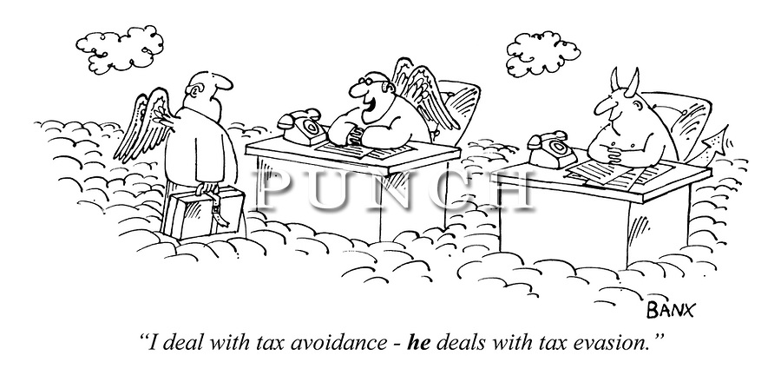
Capital Structure with Taxes
Chapter 15

Slide 2
Outline
The tax advantage of debt
Computing the interest tax shield
Valuation of the interest tax shield
Recapitalization and firm value
Limits on the tax advantage of debt

Slide 3
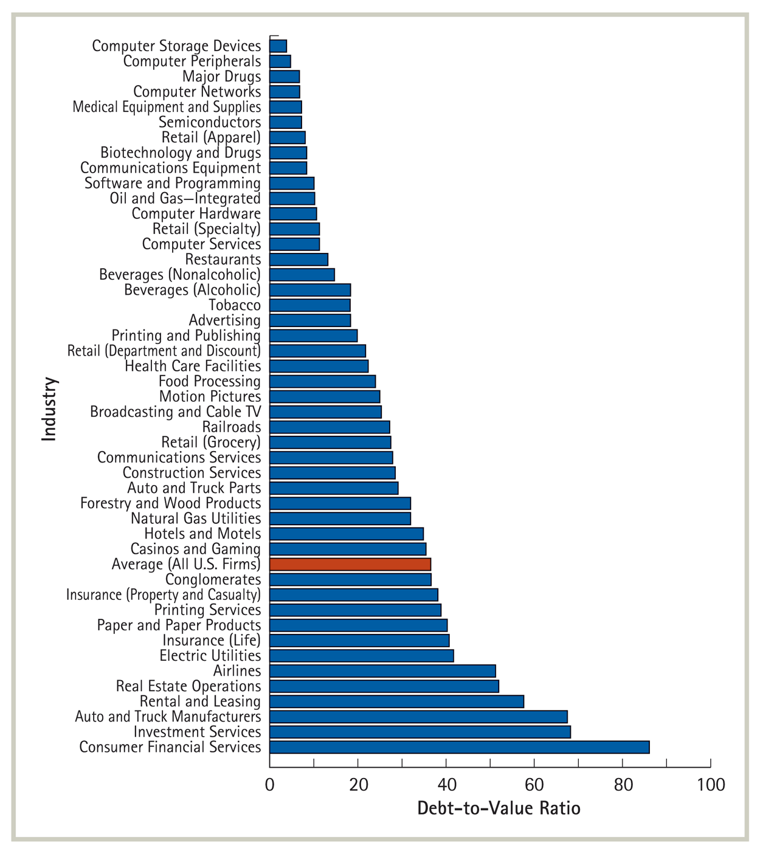
Capital Structure across different Industries (2005)

Slide 4
Government as Claim Holder
Assets
Liabilities
After Tax CF’s
debt
Cash Flows from Project
equity
Tax payments

Slide 5
Interest Payments and Tax
Corporations pay tax on the income they earn after interest payments are deducted
Interest expenses reduce the amount of corporate tax firms must pay
Net Income = EBIT-Interest-Tax
Tax = (EBIT-Interest) x τc

Slide 6
Computing the Interest Tax Shield

Slide 7
Southwest Capital Structure
Equity E = $6.42B
Debt D = $3.75B
V = $10.17
Debt-to-Value ratio
D/V = 0.36
Stock-price x (#shares)
Interest payment:
2011: $194M
2010: $167M
2009: $186M
Financial liabilities

Slide 8
Net Income and Tax of Southwest
Calculate Net Income and Tax for Southwest Airlines for the years 2009-2011 while assuming a corporate tax rate of 35%
[Income Statement]
 | 2011 | 2010 | 2009
EBIT | 693 | 988 | 262
Interest | 194 | 167 | 186
tax | 174.65 | 287.35 | 26.6
Net Income | 324.35 | 533.65 | 49.4
Operating income
(693-194)x 35%=174.65

Slide 9
Net Income and Tax of Southwest as if unlevered
Calculate Net Income and Tax for Southwest Airlines for the years 2009-2011 while assuming a corporate tax rate of 35% but as if it had no debt (or interest payments)
[Income Statement]
 | 2011 | 2010 | 2009
EBIT | 693 | 988 | 262
Interest | 0 | 0 | 0
tax | 242.55 | 345.8 | 91.7
Net Income | 450.45 | 642.2 | 170.3
No change

Slide 10
Value Created from Leverage
Levered Southwest
Total payoff to equity and debt holders in 2011: $324+$194=$518
Total tax in 2011: $174
Hypothetical unlevered Southwest
Total payoff to equity holders (no debt) in 2011: $450
Total tax in 2011: $242
Leverage reduced tax payment by $68 million in 2011
Leverage reduces the corporation’s tax liability and it also reduces its net income BUT it creates value for equity holders!

Slide 11
The Interest Tax Shield
The interest tax shield is the additional amount the firm would have paid in taxes if it did not have leverage

Slide 12
Direct calculation the Annual Interest Tax Shields
$$Interest Tax Shield=(Interest expense )×τ_{c}$$
 | 2011 | 2010 | 2009
EBIT | 693 | 988 | 262
Interest | 194 | 167 | 186
tax | 174.65 | 287.35 | 26.6
Net Income | 324.35 | 533.65 | 49.4
Interest Tax Shield | 194 x 0.35= 67.9 | 167 x 0.35= 58.45 | 186 x 0.35= 65.1

Slide 13
Valuation of the Interest Tax Shield

Slide 14
Valuation of the interest tax shield
Adjusted Present Value (APV) method
The value of the interest tax shield is the present value of all future interest tax shields
.
Value of levered firm
Value of unlevered firm
Present value of all future interest tax shields

Slide 15
Predicting future interest tax shields for Southwest
Assumptions
Southwest will keep its debt constant for five years and pay it all off
Southwest’s cost of debt equals the risk free rate of 2%
The marginal tax rate is 35%
 | 2012 | 2013 | 2014 | 2015 | 2016
Debt year start | $3.75B | $3.75B | $3.75B | $3.75B | $3.75B
Principal payment end year | $0 | $0 | $0 | $0 | $3.75
Interest year end | $75M | $75M | $75M | $75M | $75M
Tax shield year end | $26.25M | $26.25M | $26.25M | $26.25M | $26.25M
$75M x 35% = $26.25M

Slide 16
Risk of Southwest's predicted future interest tax shields
What rate should we use to discount the future interest tax shields?
 | 2012 | 2013 | 2014 | 2015 | 2016
Predicted Tax shield year end | $26.25M | $26.25M | $26.25M | $26.25M | $26.25M

Slide 17
The Risk of the interest tax shield
$$E(Interest Tax Shield)=E(Interest expense )×τ_{c}$$
Risk
Default: Southwest might not be able to pay its debt obligations
Debt size: Southwest might reduce or increase its debt outstanding
In the case of Southwest we have assumed a particular future debt schedule
What is the risk adjusted discount rate applicable for calculating the value of the tax shield of Southwest?

Slide 18
Valuation of the interest tax shield
We assumed that the debt of Southwest is risk-free, therefore so is the tax shield
.
 | 2012 | 2013 | 2014 | 2015 | 2016
Tax shield year end | $26.25M | $26.25M | $26.25M | $26.25M | $26.25M
Risk free rate is 2%
$$PV\left(Interest Tax Shield\right)=PV(PMT=\$26.25M, n=5, r=2\%)$$
$$=\$123.7M$$

Slide 19
Alternative Debt Strategy
Now…suppose that Southwest will keep its current debt level for ten years and pay it off – that is: Southwest plans to replace every loan that expires with a new one of the same amount until 2021
.
 | 2012 | 2013 | 2014 | … | 2021
Debt year start | $3.75B | $3.75B | $3.75B | $3.75B | $3.75B
Principal payment end year | $0 | $0 | $0 | $0 | $3.75B
Interest year end | $75M | $75M | $75M | $75M | $75M
Tax shield year end | $26.25M | $26.25M | $26.25M | $26.25M | $26.25M
$$PV\left(Interest Tax Shield\right)=PV(PMT=\$26.25M, n=10, r=2\%)$$
$$=\$235.8M$$
Tax shield increased

Slide 20
Permanent risk-free debt
Suppose that Southwest will keep its current debt level forever and never pay it off – that is: Southwest plans to replace every loan that expires with a new one of the same amount indefinitely
.
 | 2012 | 2013 | 2014 | 2015 | …
Debt year start | $3.75B | $3.75B | $3.75B | $3.75B | $3.75B
Principal payment end year | $0 | $0 | $0 | $0 | $0
Interest year end | $75M | $75M | $75M | $75M | $75M
Tax shield year end | $26.25M | $26.25M | $26.25M | $26.25M | $26.25M
$$PV\left(Interest Tax Shield\right)=PV(PMT=\$26.25M, n=∞, r=2\%)$$
$$=\$1,312.5M$$

Slide 21
Valuation of the interest tax shield permanent and risk-free debt
Value of (risk-free) Debt outstanding: $D
Risk free rate: r_{f}
Marginal tax rate: τ_{C}
Interest tax shield time t = ($Dr_{f})τ_{C}
.
Interest payment
Corp. Tax

Slide 22
Generalizing our Results
Permanent and risk free debt are not appropriate assumptions for most corporations
In practice:
Corporates face default risk
Debt levels change overtime
Next we consider permanent and risky debt
.
Will relax next
Will relax in ch. 18

Slide 23
Valuation of the interest tax shield: permanent and risky debt
Southwest’s yield on its risky debt is 5.2%
We will use this as r_{D} for Southwest
Projected Tax Shields
.
 | 2012 | 2013 | 2014 | 2015 | …
Debt year start | $3.75B | $3.75B | $3.75B | $3.75B | $3.75B
Principal payment end year | $0 | $0 | $0 | $0 | $0
Interest year end | $195M | $195M | $195M | $195M | $195M
Tax shield year end | $68.25M | $68.25M | $68.25M | $68.25M | $68.25M
5.2%($3.75B)
$$PV\left(Interest Tax Shield\right)=PV(PMT=\$68.25M, n=∞, r=5.2\%)$$
$$=\$1,312.5M$$

Slide 24
Valuation of the interest tax shield permanent and risky debt
Value of Debt outstanding: $D
Return on debt: r_{D}
Marginal tax rate: τ_{C}
Interest tax shield time t = τ_{C} $D r_{D}
.
Debt value

Slide 25
What would an “Unlevered Southwest” be worth?
The market value of the interest tax shield is
PV(Interest tax shield) = $1.3B
The market value of Southwest is
V^{L =} $10.17
Adjusted Present Value (APV) method
V^{L} = V^{U} + PV(Interest tax shield)
The market value of the unlevered firm is
V^{U} = $10.17B – $1.3B = $8.86B

Slide 26
Summary – Permanent Debt
The value of the interest tax shield when the level of debt is fixed over the life of the firm is simply given by the product of the marginal corporate tax rate and the market value of debt
$PV\left(Interest Tax Shield\right)=$$D $τ_{C}$

Slide 27
Creating Value through a Leveraged Recapitalization

Slide 28
Levering up to capture the tax shield
Can Southwest increase its leverage to enhance value for shareholders?
The Plan
Southwest is considering a permanent increase its debt by $1B. The increase in debt is predicted not to affect its debt cost of capital of 5.2%. Southwest plans to purchase shares with the new debt raised. Currently it has 764,286 shares outstanding that are trading at price $8.40
Lets trace this transaction and its implications for the stock price of Southwest (what do we expect?)

Slide 29
Levering up to capture the tax shield
Before announcement of the repurchase plan
Assets
Liabilities
A = $10.17B
D = $3.75B
E = $6.42B
Stock price = $8.40

Slide 30
Levering up to capture the tax shield
After announcement of the repurchase plan
But before any transactions take place
Assets
Liabilities
A =
D =
E =
Stock price =

Slide 31
Levering up to capture the tax shield
After debt is issued
Assets
Liabilities
A =
D =
E =
Stock price =

Slide 32
Levering up to capture the tax shield
After repurchase is completed
Assets
Liabilities
A =
D =
E =
Stock price =

Slide 33
Tax Advantage of Debt - limitations
Personal tax
EBIT risk and excessive leverage
Other tax shields

Slide 34
Personal taxes and the Interest Tax Shield
Firms enjoy a tax advantage on interest payments relative to dividends
Individual investors pay tax on interest payments and dividends (and capital gains)
To shareholders
To debt holders
Taxed as
Equity Income
Taxed as
Interest Income

Slide 35
The value of $1 EBIT returned to investors

Slide 36
Personal taxes in the US

Slide 37
The effective tax advantage of debt
Compare $1 of EBIT paid out as a dividend or interest in 2005

Slide 38
APV with Personal taxes
The effective tax advantage of debt
Increases in $τ_{C}$
$$τ^{∗}=1−(1−τ_{C})\left(\frac{ 1−τ_{e}}{1−τ_{i}}\right)$$
Increases in $τ_{e}$
Decreases in $τ_{i}$
The value of the levered firms with perpetual debt of D and with effective tax advantage τ*
V^{L} = V^{U} + τ* D

Slide 39
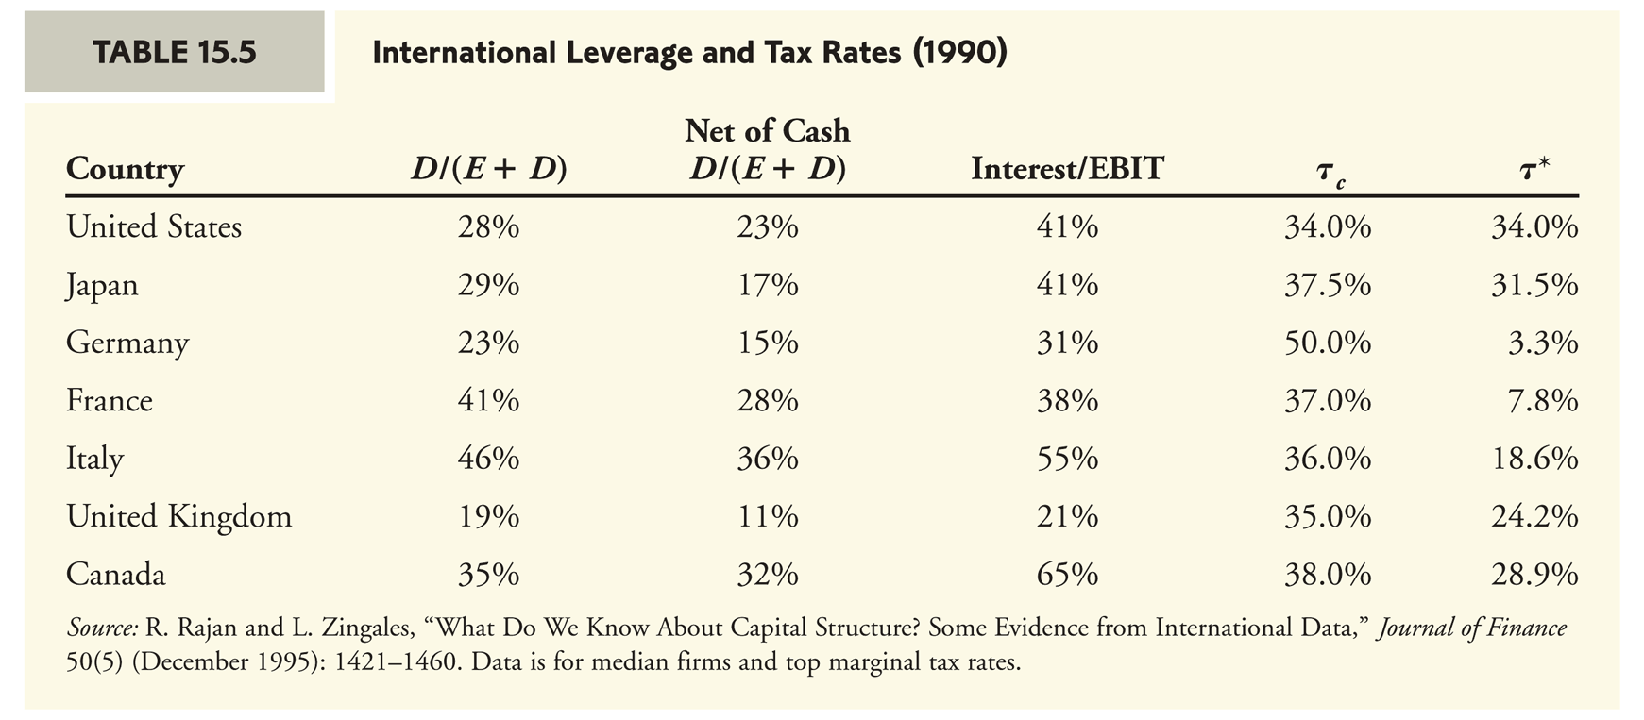
Effective Interest Tax Shield International Perspective

Slide 40
Interest payments relative to EBIT in the US

Slide 41
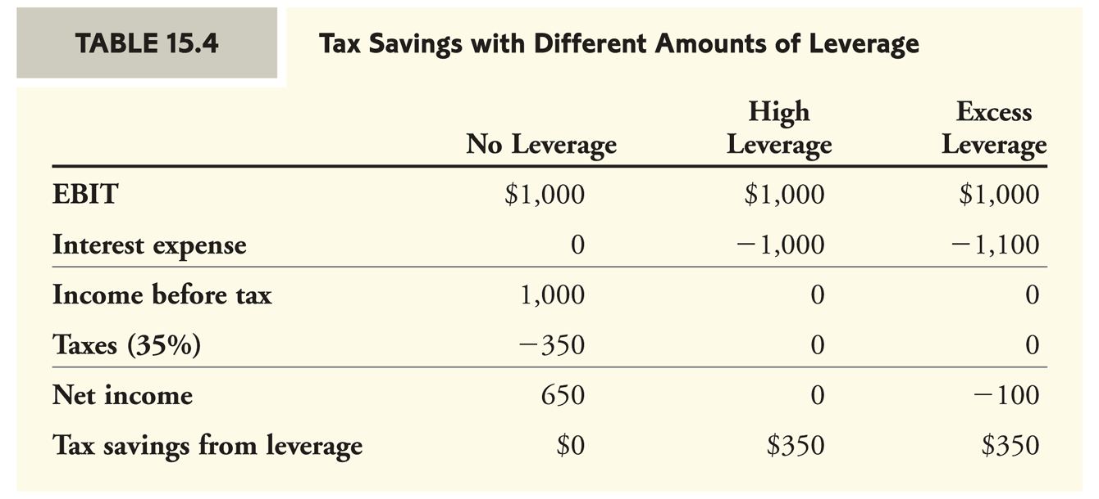
EBIT Risk and Excessive Leverage
The interest tax shield is received only if the firm is paying interest in the first place
$${τ_{ex}^{}}^{∗}=1−\left(\frac{ 1−τ_{e}}{1−τ_{i}}\right)<0 when τ_{e}<τ_{i}$$

Slide 42
EBIT Risk and Excessive Leverage

Slide 43
Other Tax Shields
Firms receive tax breaks for several reasons – reducing the value from the interest tax shield
Government subsidies for firms operating in certain regions or industries
Wal-Mart received over $1B in tax subsidies from state and local governments for expanding their operations (2012)
Clean Tech Companies enjoy an array of Tax incentives (Green Energy Credits)
Farmers for historical reasons enjoy tax subsidies

Slide 44
Assigned questions
Chapter 15 (second edition)
Questions: 1, 4, 6, 18, 24, Data Case

Slide 45
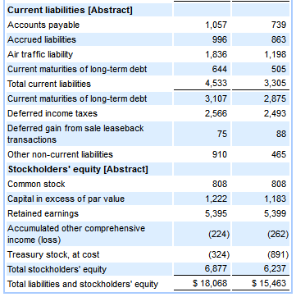
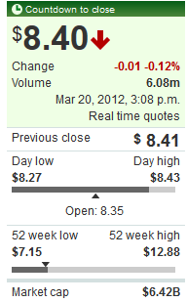
Back

Slide 46
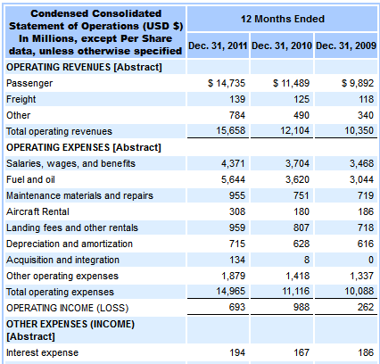
Income Statement
Back

Slide 47
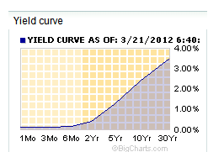
Yield Curve
back

Slide 48
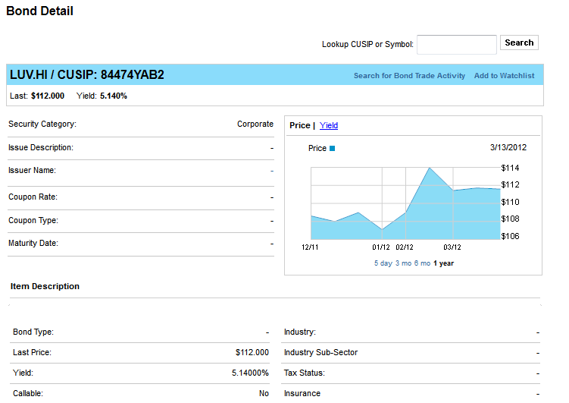
Cost of debt
back

Slide 49
