Slide 1
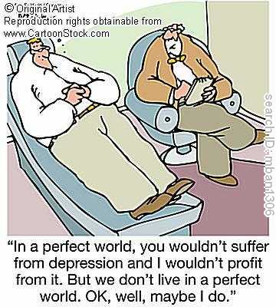
Capital Structure in Perfect Markets Chapter 14

Slide 2
Objective
Study the implications of Capital Structure for firm value and expected returns in perfect capital markets

Slide 3
Outline
Background
Modigliani Miller propositions
Equity/debt financing
Calculating return on levered equity
MM1: firm value not affected
MM2: expected returns are affected
β's of leveraged firms
Implications
Buybacks
Cash reserves
Earnings Per Share (EPS)

Slide 4
Background The Balance Sheet (Chapter 2)

Slide 5
The Balance Sheet Identity
Assets = Liabilities + Stockholders’ Equity
Assets: what the company owns
Liabilities: what the company owes
Stockholders’ Equity: the difference between the value of the firm’s assets and liabilities

Slide 6
Assets
Current Assets
Cash or expected to be turned into cash in the next year
Cash
Marketable Securities
Accounts Receivable
Inventories
Other Current Assets
Pre-paid expenses

Slide 7
Assets
Long-Term Assets
Net Property, Plant, & Equipment
Book Value
Depreciation
Goodwill
Amortization
Other Long-Term Assets

Slide 8
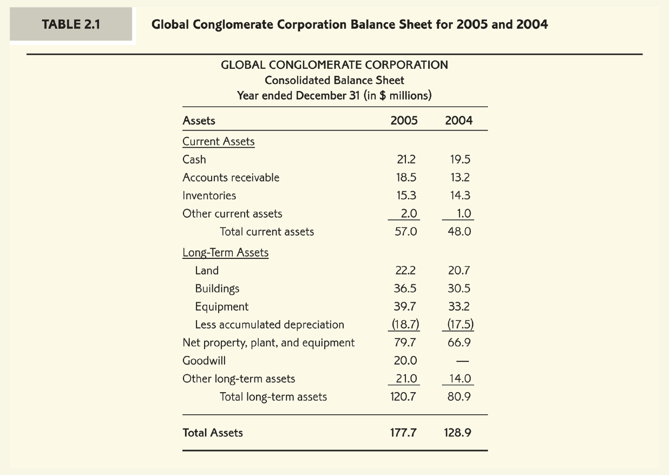
Balance Sheet Assets

Slide 9
Liabilities
Current Liabilities
Due to be paid within the next year
Accounts Payable
Notes Payable/Short-Term Debt
Current Maturities of Long-Term Debt
Other Current Liabilities
Taxes Payable
Wages Payable

Slide 10
Liabilities
Long-Term Liabilities
Long-Term Debt
Capital Leases
Deferred Taxes

Slide 11
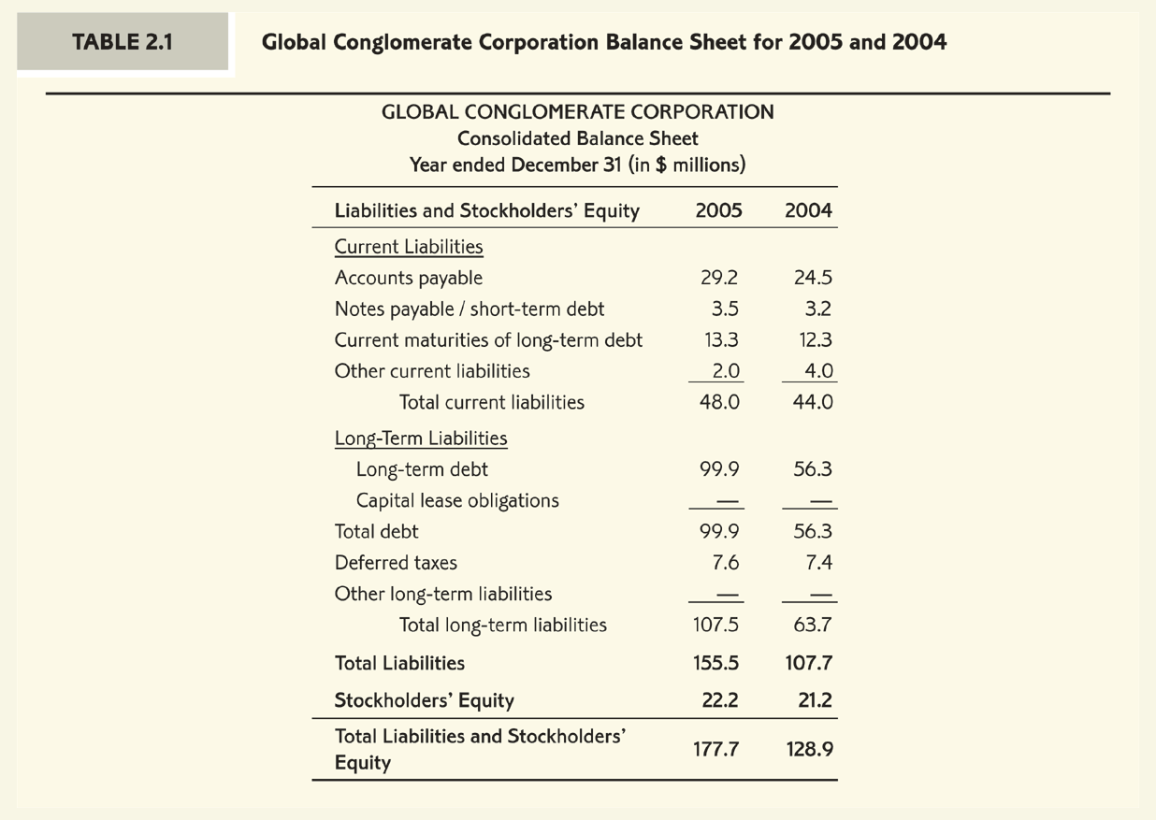
Balance Sheet Liabilities

Slide 12
Balance Sheet continued
Equity
Book Value of Equity
Book Value of Assets – Book Value of Liabilities
Could possibly be negative
Market Value of Equity (Market Capitalization)
Market Price per Share x Number of Shares Outstanding
Cannot be negative
Net Working Capital
Current Assets – Current Liabilities

Slide 13
Balance Sheet continued
Liquidation Value
Value of the firm if all assets were sold and liabilities paid
Market-to-Book Ratio
Value Stocks (low M/B ratios)
Growth Stocks (high M/B ratios)

Slide 14
Balance Sheet continued
Debt-Equity Ratio
Measures a firm’s leverage
Using Book Value versus Market Value
Enterprise Value

Slide 15
Modigliani and Miller Propositions

Slide 16
Capital Structure
How are investments financed?
debt, equity
convertible debt and other hybrid securities
(focus on cash flow rights)
Capital Structure is dynamic. It changes over time as firms grow and recapitalize
Firms buyback (repurchase) stock and repay loans
Firms issue new equity (SEO’s) take on new debt to finance new investment opportunities
Market conditions and stock value change over time

Slide 17
Value Implications of Leverage
Example
Mark is the owner of a business opportunity (or idea):
The opportunity is to invest in a project (or asset) $800 at time zero (t=0) that will generate risky future cash flows one year from now (t=1). Cash flows are either $1400 or $900 with probability one half depending on the state of the economy.
BOOM
$1400
-$800
BUST
$900

Slide 18
Value Implications of Leverage
Example (continued)
Investors require a 10% risk premium (that is above the risk free rate of 5%) for holding equity in this firm due to the sensitivity of future cash flows to the state of the economy.
What is the present value of the business opportunity?
(this means before investment takes place)
What is the present value of the project (or asset) once established?
(this means after investment takes place)
What is the NPV of the project?

Slide 19
Financing the Investment with Equity
Mark wishes not to invest capital of his own in the project and therefore plans to sell a fraction x of the firm to a diversified equity investor - John. In return for the equity share of x John will finance the initial investment of $800.
What is the smallest fraction x that Mark can offer John?
(such that John will still agree
to finance the investment)

Slide 20
Financing the Investment with Equity
The present value of Mark’s equity share equals the project NPV $200.
In efficient capital markets the total NPV of a future project goes to the current shareholders while the financier breaks even
What are John’s possible percentage returns on his investment?
Good state:
Bad state:
What is John’s expected return on his investment?
Equity in an unlevered firm (that is a firm with no debt) is called
unlevered equity.

Slide 21
Financing with Debt and Equity
Suppose now that Mark wishes to retain full ownership of equity and finance part of the investment with debt. Mark will raise $500 in debt from a Bank and the remaining $300 Mark will cover himself.
Seniority
Seniority refers to the order of repayment in case of bankruptcy. Debt claims are senior to equity claims.
What is the least repayment Mark can offer the Bank?
What is the risk of the debt repayment?

Slide 22
Financing with Debt and Equity
Equity in a levered firm (that is a firm with debt)
is called levered equity.
All cash flows are divided between claim holders
In our example the payments are:
Debt holders (Bank):
Equity holders (Mark):

Slide 23
The Value of Levered Equity
What is the value of Mark’s levered equity?
Lets find the value of levered equity by calculating the present value of the payoffs to equity holders (Mark):
Did the value of the firm now change?

Slide 24
The Value of Levered Equity
The firm’s cash flows (Assets side of balance sheet) equal exactly the sum of cash flows generated by the debt and (levered) equity securities (Liabilities side of balance sheet).
The total market value of the firm’s securities equals the present value
of its future cash flows.
(no Arbitrate principle or the law of one price)
Since the market value of debt is $500 and the present value of the firm’s future cash flows is $1000 we can conclude that the value of levered equity should be $500.
Is there a preferred financing method here?
Modigliani and Miller (1958) argued that in perfect capital markets the total value of the firm should not depend on its capital structure.

Slide 25
Notation
Liabilities (levered firm)
E is the market value of equity
D is the market value of debt
Liabilities (Unlevered firm)
U is the market value of equity in the unlevered firm
Assets
A is the market value of the firm’s assets.

Slide 26
Value Irrelevance Theorem
MM Proposition 1: In a perfect capital market the total value of the firm is equal to the market value of the total cash flows generated by its assets and is not affected by its choice of capital structure.

Slide 27
Perfect Capital Markets
Competitive financial markets (financiers have no bargaining power and always break even on their investments)
Investors and firms can trade same securities at competitive market prices
There are no taxes, transaction costs and security issuance costs
No information asymmetries (all market participants have the same information)

Slide 28
Proof using the no-arbitrage principle
Counter example: Consider firm A that has the exact same project considered in our example, has debt outstanding with repayment of $525, and the market value of its equity is $450. At the same time, firm B with the exact same project is unlevered and its unlevered equity is selling for $1000.
What is the arbitrage trading opportunity here?
Trading strategy:
Buy the levered firm’s equity and a risk free bond worth $500
Short sell the unlevered firm’s equity
Result: sure (current) profit of $50

Slide 29
Arbitrage trading strategy
strategy | Time 0 payoff | Time 1 payoff
Buy levered firm equity | -$450 | BOOM: $875 BUST: $375
Buy risk free bond | -$500 | $525
Short sell unlevered firm | $1000 | BOOM: -$1400 BUST: -$900
TOTAL PAYOFF | $50 | $0

Slide 30
Risk, Return, and Leverage

Slide 31
Risk, Return, and Leverage
The expected payoff and risk of the firm’s assets together with its capital structure determine the expected payoff and risk from holding its financial securities
Example (continued)
To see the effect of leverage on the risk of equity we compare the return distributions when Mark raises $500 from issuing equity and when $500 are raised by issuing debt to the Bank:
 | Unlevered equity | Levered equity
Initial value of equity | $1000 | $500
Return in Boom state | 1400/1000 -1 = 40% | 875/500-1=75%
Return in Bust state | 900/1000-1= - 10% | 375/500-1= - 25%

Slide 32
Risk, Return, and Leverage
Leverage increases both the expected return on equity and the risk of equity
Example (continued)
Leverage increases expected returns
Mark’s expected return on equity increases to 25% when the firm is levered relative to the 15% on unlevered equity.
Modigliani and Miller (1958) argued that in perfect capital markets considering both sources of capital together, the firm’s average cost of capital with leverage is equal to that of the unlevered firm.

Slide 33
Modigliani – Miller II
MM Proposition II: The cost of capital of levered equity is equal to the cost of capital of unlevered equity plus a premium that is proportional to the market value debt-equity ratio

Slide 34
Back to the Example
We can now verify that MM Proposition II holds for our example:
Example (continued)
What is the cost of capital of equity for our levered firm?

Slide 35
β risk and Capital Structure
Beta of Assets or βA
is measured by the risk of the cash flows generated from the firm’s assets.
is not affected by the choice of capital structure since the statistical distribution of cash flows generated from the firm’s assets is not affected by the choice of capital structure.
is equal to the beta of the unlevered equity βU

Slide 36
β risk in the Airline Industry
Ticker | Name | Equity beta | D/E ratio | Debt beta
LUV | Southwest | 1.13 | 0.15 | 0.00
ALK | Alaska Air | 1.80 | 1.06 | 0.15
SKYW | SkyWest | 1.69 | 1.05 | 0.15
MESA | Mesa | 3.27 | 3.52 | 0.30
CAL | Continental | 3.76 | 5.59 | 0.40

Slide 37
Calculating Beta Assets
Ticker | Name | Equity beta | D/E ratio | Debt beta | Assets beta
LUV | Southwest | 1.13 | 0.15 | 0.00 | 0.98
ALK | Alaska Air | 1.80 | 1.06 | 0.15 | 0.96
SKYW | SkyWest | 1.69 | 1.05 | 0.15 | 0.9
MESA | Mesa | 3.27 | 3.52 | 0.30 | 0.95
CAL | Continental | 3.76 | 5.59 | 0.40 | 0.9

Slide 38
Implications
Buybacks
Cash Reserves
EPS

Slide 39
Stock Buybacks
Firms can increase leverage by buying back their shares
(stock buyback or repurchase)
Issuing debt to finance a stock buyback
Debt/Cash increase
Number of shares decreases
Value of assets?
Expected return on equity?
Expected return on debt?

Slide 40
Leveraged Recapitalization Example
Harrison Industries Ltd.
Harrison Industries aims to increase its debt by $80 million and use the funds to repurchase shares.
Currently, Harrison Industries is an all equity firm
There are 50 million shares outstanding
Shares are traded at price of $4 per-share.
Lets follow Harrison Industries’ market value balance sheet throughout the transaction

Slide 41
Harrison Industries
Market Value Balance Sheet
(starting point)
Assets | Liabilities

Slide 42
Harrison Industries
Market Value Balance Sheet
(after issuing debt)
Assets | Liabilities

Slide 43
Harrison Industries
Market Value Balance Sheet
(after the repurchase)
Assets | Liabilities

Slide 44
Cash on the Balance Sheet and Risk
Corporations use cash and cash equivalent securities to
Manage their day to day operations
Finance future investment opportunities
A few examples (March 2013)
Apple $30B (Mkt cap $411B)
Microsoft $67B (Mkt cap $232B)
Exxon Mobil $15B (Mkt cap $400B)
Wal-Mart $8B (Mkt cap $243B)
How does cash affect the risk
of firm’s equity and debt?

Slide 45
Cash on Balance Sheet Cisco Systems
What is the risk of Cisco Systems business assets βU?
Cisco Systems (2012 data)
Equity: value of E=$104.9B and beta of βE = 1.17
Debt: value of D=$40B and beta of βD = 0
Using formula:
We obtain

Slide 46
Cash on Balance Sheet - Cisco Systems
Cisco Systems (2012 data)
Equity: value of E=$104.9B and beta of βE = 1.17
Debt: value of D=$40B and beta of βD = 0
Cash: $44.5B
Using the same formula
But now with Net Debt: Net Debt of Cisco Systems is -$4.5B
We obtain

Slide 47
Treatment of Cash on Balance Sheet
Cash holdings may distort our estimate of the risk of the firm’s business assets
Treat excessive cash as negative debt
Measure leverage in terms of net debt:
Net Debt = Debt – (Cash and Risk-Free Securities)

Slide 48
Earnings Per Share and Leverage
Calculating Earnings Per Share:
Earnings Per Share is calculated as the ratio of annual net income to number of shares outstanding

Slide 49
EPS and Leverage
How does the capital structure decision impact EPS?
Example
Levitron Industries (LVI), an all equity firm, is considering changing its capital structure by borrowing $15 million at 8% and using the proceeds to repurchase shares.
Expected EBIT at the end of the year is $10 million.
There are 10 million shares outstanding at current share price of $7.50.
Calculate LVI’s new Earnings per share (EPS)

Slide 50
EPS and Leverage
EPS before repurchase
EPS after repurchase
.

Slide 51
EPS Risk
Expected earnings per share have increased by 10%.
Should the stock price have increased as a result of the expected increase in EPS?
Realized Earnings | Realized EPS No Repurchase | Realized EPS Repurchase
$13M | 13/10 = 1.3 | (13-1.2)/8 = 1.475
$10M | 10/10 = 1 | (10-1.2)/8 = 1.1
$7M | 7/10 = 0.7 | (7-1.2)/8 = 0.725

Slide 52
Assignments
Second edition
Chapter 14 Questions: 2, 14, 19, 21, Data Case

Slide 53
back

Slide 54
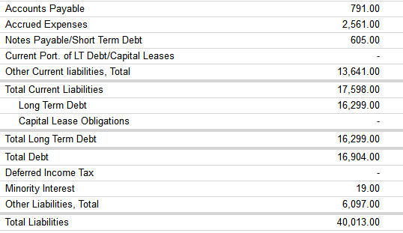
back

Slide 55
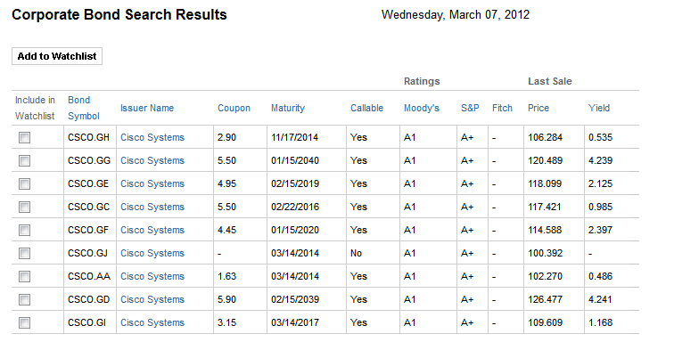
back

Slide 56
back

Slide 57
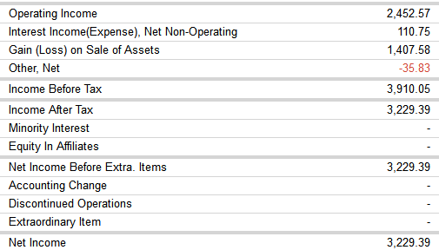
back

