Slide 1
Financial Distress
Chapter 16.1-16.4

Slide 2
outline
Financial/economic distress
Default and bankruptcy in perfect markets
Leverage does not matter
Is bankruptcy is costly?
The tradeoff theory

Slide 3
Following the September 11 terrorist attacks in 2001 the airline industry realized a major shock to its business
United airlines filed for bankruptcy court protection in December 2002
It survived the downturn and is now part of Continental airlines

Slide 4
Before the attacks United airlines was conservative with its debt
From 1996 to 2000 United reported $6 billion in EBIT relative to $1.7 billion in interest.
In hindsight United’s conservative strategy helped the company survive the downturn.

Slide 5
Is leverage costly?
Several firms use very low levels of debt
About 9% of large public non-financial firms in US from 1962-2003 have zero leverage and over 20% have less than 5% leverage
This suggests that leverage imposes costs on firms and that low leverage is optimal (efficient markets hypothesis)
We will explore various costs (and benefits) of leverage

Slide 6
“financial” versus “economic” distress
When a firm faces difficulties paying its debt obligations it is in financial distress
The firm can still operate but there is a high level of uncertainty regarding its future ability to service its debt.
When a firm fails to pay its interest or principal debt obligations (or violates debt covenants) it is in default
When in default the debt holders have the legal right to seize control through the process of bankruptcy

Slide 7
“financial” versus “economic” distress
A firm’s liquidation value equals the market value of its assets if sold separately, that is the firm seizes to exist
When the value of assets (i.e., the present value of all future FCF’s if the firm continues to exist) is lower than the liquidation value then the firm is in economic distress.
Firms may face economic distress whether they are leveraged or not

Slide 8
Can firms face financial distress but not economic distress?
Liquidation value
Economicdistress
Possible future value of assets

Slide 9
Can firms face financial distress but not economic distress?
Debt payment
Financial distress
Possible future values of assets

Slide 10
Bankruptcy in a perfect market
Capital Structure and bankruptcy in efficient capital markets:
The M&M propositions hold.
The value of the firm is independent of the firm’s capital structure
The total value of the firm to investors (both debt and equity holders) is the same regardless of the firm’s capital structure. There is no disadvantage of using debt financing.
Ownership and division of cash flows does not have implications for firm value
The possibility of bankruptcy does not affect value

Slide 11
Bankruptcy in a perfect market example
Armin Industries’ revenues have fallen dramatically in the past year. It is launching a new product this year. If it succeeds then its value next year will be $150 million, otherwise its value will be $80 million (beta project = 0, risk free rate is 5%). Both realizations are equally likely. In order to finance the required investment for the new product the company can either (1) issue stock or (2) issue one year debt with total $100 million due.

Slide 12
In the good state (value $150 M)
Equity financing: in the good state the value of equity is $150 million.
Debt financing: in the good state the payment to the debt holders is $100 million.
What if the firm doesn’t have $100 million handy to pay debt holders? Will the firm default in this case?

Slide 13
In the bad state (value $80 M)
Bad state:
Equity financing: in the bad state the value of equity is $80 million.
Debt financing: in the bad state the liability to the debt holders is still $100 million.
The value of the firm is $80 million.
Its liability to debt holders is $100 million
Can the firm come up with $100 million to repay the loan and avoid bankruptcy?
If the firm goes into bankruptcy equity holders lose control of the firm and its value is transferred to debt holders that realize a loss of $20 million

Slide 14
Financing in perfect markets
In efficient capital markets firms default when the debt liability exceeds the market value of assets
Many firms have years of negative cash flows and still do not default on their debt obligations
Remember in perfect markets we assume
the law of one price
free access to capital markets
As long as future cash flows are promising then the firm can borrow against these cash flows to service their debt
issue new equity (SEO)
role over debt: service old loans with new debt

Slide 15
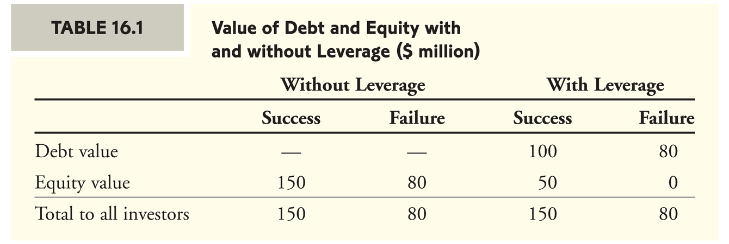
Comparing the two financing scenarios:
With leverage
Value of debt is 90/1.05 = 85.71
Value of equity is 25/1.05 = 23.81
Total firm value 109.52

Slide 16
Example - summary
Comparing the two scenarios:
In the bad state the product fails and the firm realizes a sharp decline in its assets’ value
This fact does not depend on capital structure
If leveraged then this decline in asset value leads to financial distress.
Should the firm be liquidated in the bad state? Can we tell from the data we have?

Slide 17
Chapter 7 versus Chapter 11 bankruptcy
When a firm fails to make required payments to debt holders it is in default
Creditors (banks & bond holders) can take legal action against the firm
Coordination between creditors is required to preserve value when the firm is more valuable if its assets are kept together
The U.S. Bankruptcy code is designed to organize this process
Chapter 7 liquidation
Chapter 11 reorganization

Slide 18
Bankruptcy examples
January 2002
Kmart, the second largest discounter in the US after Wal-Mart is hit by weak sales due to competition with rising Target and rival Wal-Mart
Two key suppliers announced they would stop shipments.
Fleming, a grocery distributor said it will stop delivery after Kmart failed to make its weekly payment for deliveries of food and other products
Fleming negotiated half a year earlier to be the sole supplier of grocery goods to Kmart.
Scotts, a maker of gardening products announced it would suspend shipments as well
January 22, 2002 Kmart filed for Chapter 11 bankruptcy and later merged with Sears in 2004

Slide 19
Bankruptcy examples
October 2, 2001
For the first time in its 70 year history the company reported a loss in the year 2000
Debt was up from $4.2 billion previous year to $9.2 billion
Credit constraints:
By end of September United Bank of Switzerland (UBS) and Credit Suisse First Boston (CS) were no longer willing to provide cash without drastic cuts
Eventually the banks agreed to supply credit to guarantee flights until October 3
The transfer of funds was delayed and suppliers of jet fuel denied delivery on October 2 and Swissair halted all its flights due to a severe cash shortage.
The stock price fell from $61 to $0.78
In 2002 swissair in part was liquidated and in part became the Swiss International Airlines that later was sold to Lufthansa in 2005.

Slide 20
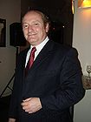
Too-Big-To-Fail Long Term Capital Management
Hedge fund managed by known economists Myron Scholes Robert C. Merton
In 1993 with start up money of hundreds of millions of dollars
In 1994 the company started trading with over $1 billion in equity
The main strategy was to trade on fixed income arbitrage
trading gov bonds of different maturities to obtain high returns

Slide 21
LTCM
In 1998 they had equity of $4.75 billion and $129 billion assets under management (D/E=25!)
Changed their strategy to more aggressive (emerging markets, equity options, junk bond arbitrage, S&P stocks, merger arbitrage)
Had derivatives (interest rate swaps) with notional value of $1.25 trillion
1997 Asian Financial Crisis/1998 Russian financial crisis
1998 LTC was not able to meet its margin calls and had to sell assets at loss
E.g., was long Royal Dutch Shell and short Shell (premium extended from 8% to 22% when liquidated by LTCM)

Slide 22
LTCM – Bailout?
Federal Reserve Bank of NY gathered the “titans” of Wall Street to discuss the possible bankruptcy of LTCM and coordinate a bailout
$300 million from Barclays, Chase, Credit Suisse, Deutsche Bank, Goldman Sachs, Merrill Lynch, J.P. Morgan, Morgan Stanley, Salomon Smith Barney, UBS
$125 million Societe Generale
Lehman Brothers $100 million
Bear Stearns did not participate
Participants received in return 90% of shares
Founders kept their management position
Liquidated two years later in early 2000
Historical turning point?
?
?

Slide 23
Administrative cost of bankruptcy
Fees to legal experts, accountants, lawyers, consultants, appraisers, auctioneers
Enron spent $30 million per month on legal and accounting fees to exceed $750 million in total
United paid $8 million per month 2003-2005
Such administrative costs are estimated to be 3%-4% of the market value of assets prior to bankruptcy but can also reach 20% according to recent estimates

Slide 24
Indirect financial distress costs
Loss of potential or existing customers
GM’s cares selling at discount following its filing for chapter 11
Demands by suppliers
Kmart’s suppliers refused to deliver goods after its stock price declined
Swiss Air was refused jet fuel
Loss of human capital
AIG faced an exodus of employees and offered expensive retention plans
Loss of receivables
Costumers may delay payments since the firm is in distress

Slide 25
Indirect financial distress costs
Fire sale of assets
Airline companies sell their assets at 15%-40% discount
control
Competitive strategies limited by bankruptcy courts
Managerial focus
Management focus is on recovery from bankruptcy instead of creating value through new investments
Very difficult to estimate these costs
Financial distress costs (incremental to economic distress costs) are estimated as 10-20%

Slide 26
Bankruptcy and firm value
Suppose a fixed cost of bankruptcy
in the event of bankruptcy
$B are wasted
The expected cost of bankruptcy can be calculated as the probability of bankruptcy times the fixed cost of bankruptcy

Slide 27
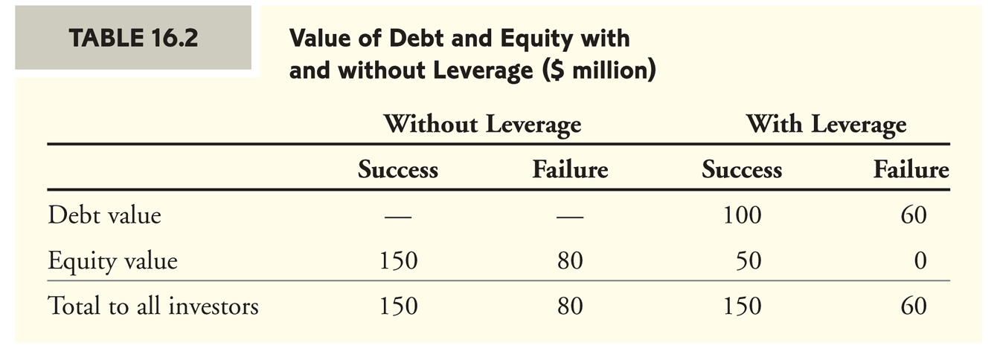
The impact of bankruptcy on firm value example
Suppose $20 million financial distress costs to debt holders
Value of debt is 80/1.05 = 76.19
Value of equity is 25/1.05 = 23.81
Total firm value 100

Slide 28
Who bares the cost of financial distress?
In our example the payment to debt holders in the bad state is $20 million lower when there are bankruptcy costs
Why would equity holders care about these costs?
When securities are fairly priced, the original shareholders of a firm pay the present value of the costs associated with bankruptcy and financial distress

Slide 29
Who bares the cost of financial distress? example
Example (page 500)
Armin industries has 10 million shares outstanding and no debt. Armin then announces a plan to issue one-year debt with face value of $100 million and to use the proceeds to repurchase shares. What will happen to the stock price?

Slide 30
Example (page 500) solution

Slide 31
Optimal Capital Structure: The Tradeoff Theory
Optimal capital structure is determined by its costs associated with bankruptcy and benefits from the interest tax shield
We solve the problem
Max V^{L}
where
V^{L} = V^{U} + PV(Interest tax shield)
- PV(Financial distress costs)

Slide 32
The Present value of Financial distress costs
Two things determine the PV(financial distress costs)
The probability that the firm will enter financial distress.
Increases with the amount of the firm’s liabilities relative to its assets
Increases with the volatility of the firm’s cash flows and asset values (and liability values)
The magnitude of the cost once in financial distress
Varies by industry (Technology firms / real estate firms)

Slide 33
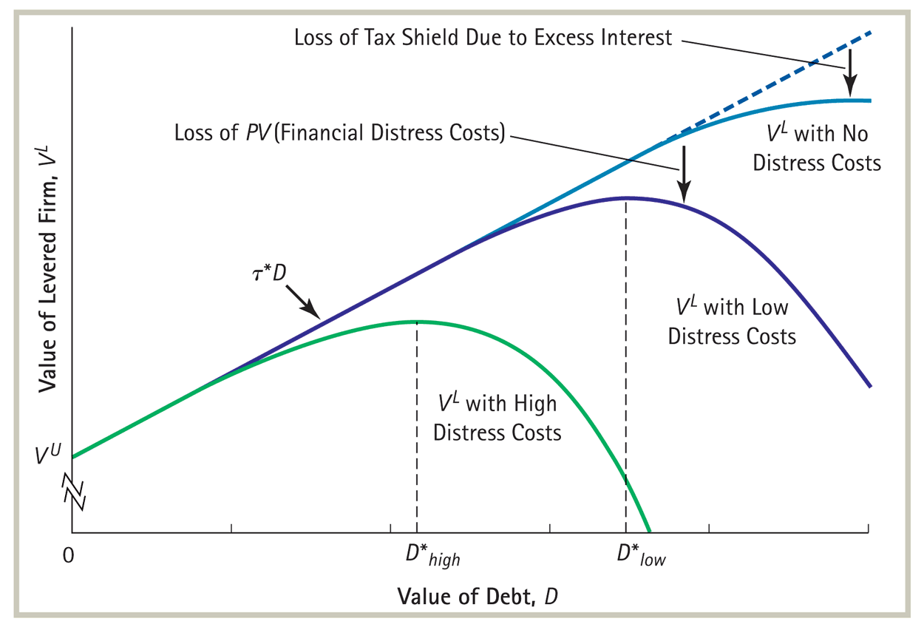
Optimal Capital Structure

Slide 34
Takeaway
Economic distress is not caused by but could lead to financial distress
Financial distress could occur even when the firm is not in economic distress
Chapter 7 and chapter 11 bankruptcy
In perfect markets leverage is not costly
Introducing direct (e.g., administrative) and indirect costs associated with bankruptcy that are incremental to the costs of economic distress leads to the tradeoff theory
Optimal capital structure balances the tax advantage of debt and the expected financial distress cost

Slide 35
Assignment
Chapter 16
Problems 2, 3, 8, 12, 14, 20

