Slide 1
Debt and Taxes
Chapter 15

Slide 2
In Perfect Markets
Capital Structure is irrelevant
Risks of debt and equity (beta’s) are affected by leverage
EPS risk changes with capital structure
WACC (used to calculate firm value) not affected
Recapitalization is zero-NPV
Seasoned Equity Offerings (SEO’s) do not dilute shareholder value
Share repurchase does not increase share price.

Slide 3
Today
The tax advantage of debt
Computing the interest tax shield
Permanent debt
Fixed debt to equity ratio
The WACC
Value of recapitalization
Personal taxes
Other limits to the tax advantage of debt
Use of debt around the world

Slide 4
Actual Leverage Levels
In reality, however, firms manage their capital structure very carefully
Different firms, e.g., in different industries or different stages of growth, have different capital structures
Firm | Debt | Equity | D/E
CAT | $28.4B | $63.9B | 0.44
AAPL | $0 | $324.3B | 0
HP | $20.4B | $90.7B | 0.22
DELL | $6B | $29.49B | 0.20
PEP | $24.9B | $102.2B | 0.24
MIC | $28.6B | $198.1B | 0.14
JPM | $1,941.5B | $178.8B | 10.8

Slide 5
Government as Claim Holder
Firm X
Value of all future cash flows from project
Shareholders
Debt holders
Government

Slide 6
Debt Tax Advantage
Corporations pay tax on the income they earn after interest payments are deducted
Interest expenses reduce the amount of corporate tax firms must pay
This introduces a benefit for using debt
Consider the example of Safeway, Inc. a grocery store chain.

Slide 7
Interest and tax deduction
Example (page 460)
Earnings before interest and tax (EBIT) were $1.25 billion in 2005, interest expenses were $400 million, and its marginal corporate tax rate was 35%.
Lets calculate the effect of leverage on Safeway’s net income by considering two scenarios: without leverage and with leverage as it is now.

Slide 8
Calculating tax payments
Example continued

Slide 9
Value implications
Example continued
Leverage reduces the corporation’s tax liability and its net income
But it creates value for equity holders!
Look at the total value of the firm – that is, the payoffs to claims issued by the firm
With leverage total payoff is $552+$400=$952 while without leverage its $812.
The government is paid the $140 difference.
Leverage increased firm value by $140 million.

Slide 10
The Interest Tax Shield
Example continued
The loan of $400 million reduced tax payments by $400 (0.35) = $140
This is referred to as the interest tax shield
The interest tax shield is the additional amount the firm would have paid in taxes if it did not have leverage

Slide 11
Cash flows and leverage

Slide 12
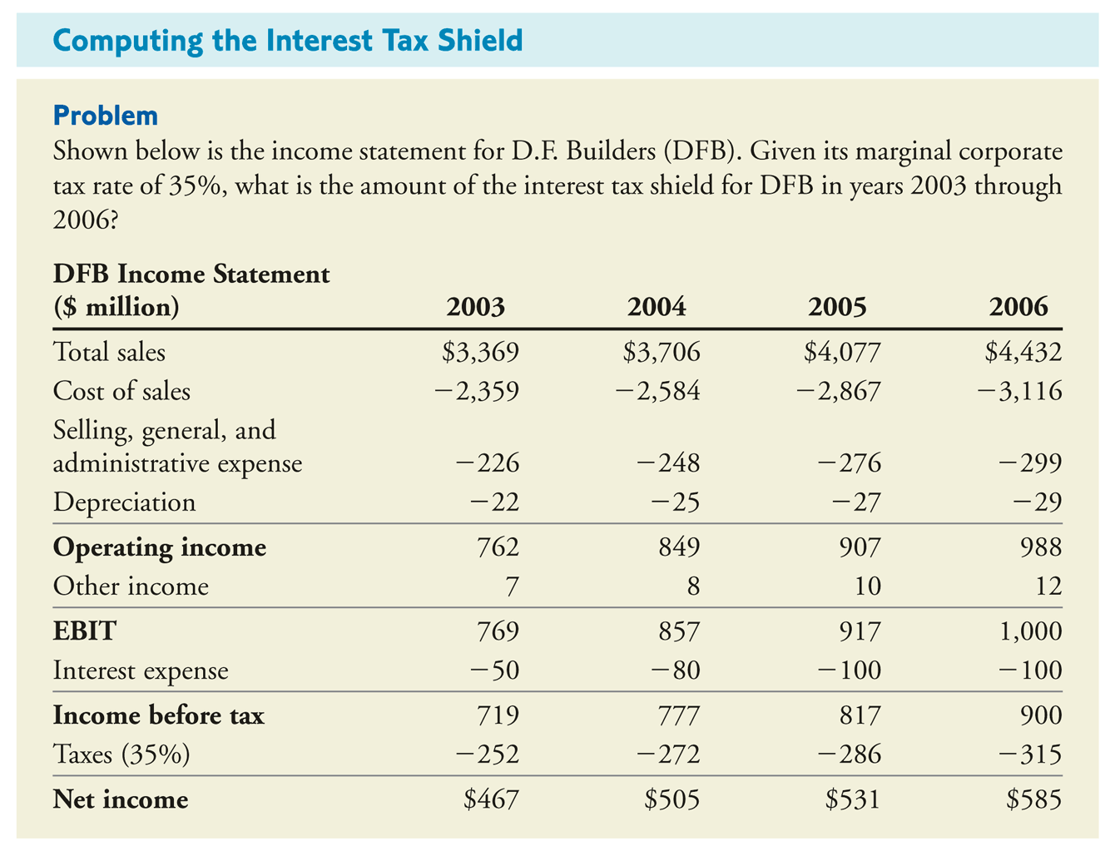
Computing the interest tax shield
Example page 461

Slide 13
Computing the interest tax shield
Example continued

Slide 14
Computing the interest tax shield
Example continued

Slide 15
Valuing the interest tax shield
The interest tax shield is positive when EBIT exceeds the interest payment
The value of the interest tax shield is the present value of all future interest tax shields
The value of a levered firm exceeds the value of an all else equal unlevered firm by the value of the interest tax shield
APV method
V^{L} = V^{U} + PV(Interest tax shield)

Slide 16
Valuing the interest tax shield
Example page 463
DFB takes a ten year loan of $2 billion at the risk free interest rate of 5%.
DFB will pay interest of $100 million at the end of each year for the ten years and will repay the principal at maturity
DFB’s marginal tax rate is 35%
Lets calculate the PV(interest tax shield)

Slide 17
Valuing the interest tax shield

Slide 18
….now suppose the firm will roleover the debt for another 10 years upon maturity

Slide 19
Calculating PV of Interest Tax Shield
To calculate the PV of the interest tax shield we need some assumptions
In practice:
Debt changes overtime
Interest rates change overtime
Default risk changes overtime
Tax rates vary with profitability
We will first consider a simple case of Permanent Debt
Fixed Debt/interest rate/tax rate

Slide 20
The interest tax shield: permanent debt
Debt outstanding: $D (assume risk free debt)
Marginal tax rate: τ_{C}
Risk free rate: r_{f}
Calculate:
Annual interest payment
Annual tax shield
PV(interest tax sheild)

Slide 21
The Assumptions made:
Assumptions:
Debt payments are risk free
The firm can cover its debt payments at all times with zero probability for default
These assumptions fit very few transactions
Actually, we don’t need such strong assumptions. From the no-arbitrage principle:
PV(Interest payments) = ?

Slide 22
The interest tax shield: permanent debt
PV(Interest tax shield) = τ_{C} x D

Slide 23
Levering up to capture the tax shield
Leveraged recaps were very popular in mid to late 1980’s
By doing so firms reduced their tax liability (among other things…)
Example page 468
Midco has 20m shares @ $15 and no debt
Its tax rate is 35%
It plans to borrow $100m to repurchase shares
Lets trace this transaction and its implications for the stock price of Midco (what do you expect?)

Slide 24
Leveraging up to capture the tax shield

Slide 25
Leveraging up to capture the tax shield

Slide 26
Leveraging up to capture the tax shield

Slide 27
Personal taxes and the interest tax shield
Debt allows corporations to pay more of its cash flows to debt holders
For individuals
Interest payments are taxed as income
Dividends and capital gains are taxed separately
What are the consequences of investors’ taxes on firm value?

Slide 28
Personal taxes and the interest tax shield

Slide 29
Personal taxes and the interest tax shield

Slide 30
Personal taxes and the interest tax shield

Slide 31
Personal taxes and the interest tax shield
The effective tax advantage of debt
τ* = 1 – (1-τ_{c})(1-τ_{e})/(1-τ_{i})
The interest tax shield with personal taxes
V^{L} = V^{U} + τ* D

Slide 32
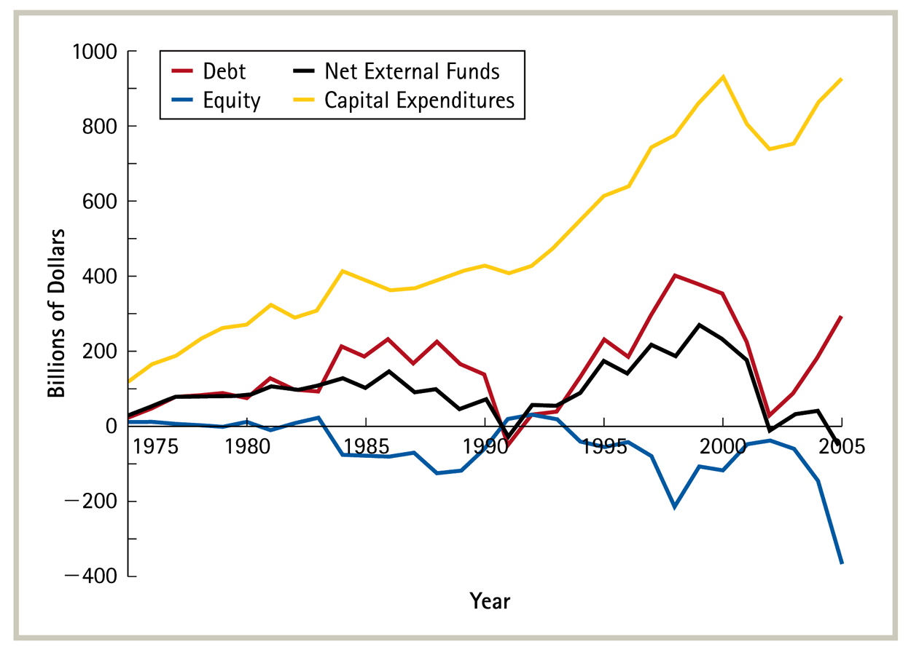
Optimal Capital Structure with taxes
When raising new capital from investors firms primarily do so by issuing debt

Slide 33
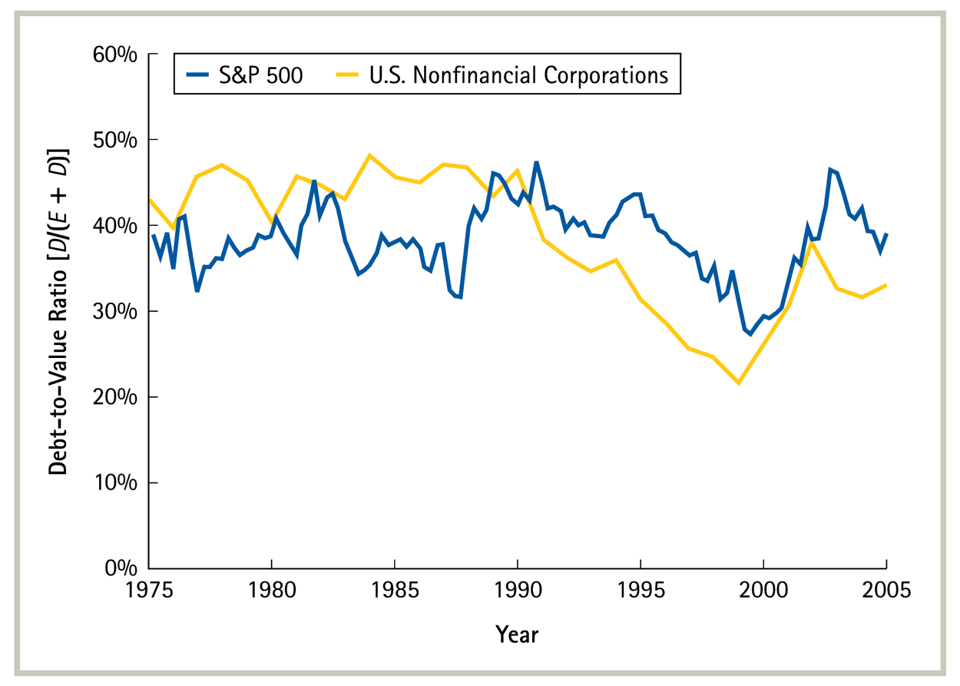
Optimal Capital Structure with taxes
For the average firm debt accounts for 30%-45% of firm value depending on the year

Slide 34
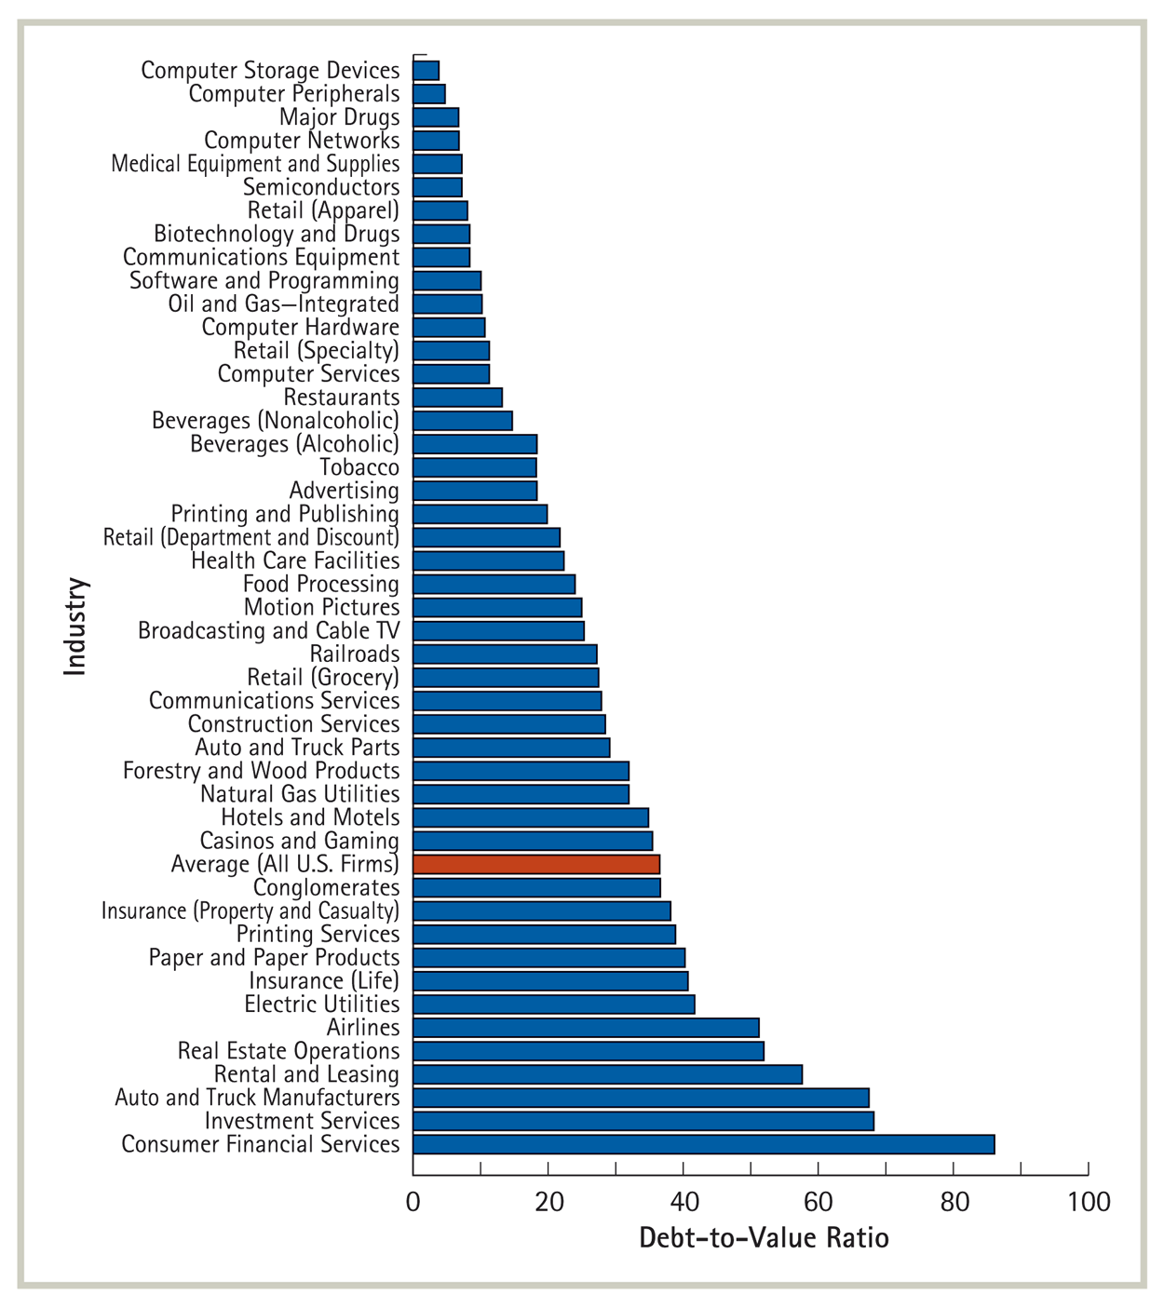
Optimal capital structure with taxes
There are large differences across industries (2005)

Slide 35
Limits to the tax benefit of debt
There is a tax advantage to debt only if the firm is paying taxes in the first place
No corporate tax benefit arises from interest payments in excess of EBIT
There is a cost associated with such excess leverage

Slide 36
Limits to the tax benefit of debt
It is optimal (from a tax perspective) to set interest payments equal to EBIT
Can a firm predict its EBIT?
What does risk associated with EBIT do to the value of the tax shield?

Slide 37
Limits to the tax benefit of debt
Consider high growth firms
Firms in early stages of development have little earnings if at all
Optimal debt is proportional to current earnings
Value of equity is determined by future earnings
From a tax perspective, high growth firms optimally aim for lower debt to value ratios

Slide 38
Limits to the tax benefit of debt
Alternative tax shields
Several firms pay their employees stock options – that is the option to purchase the stock at the strike price some time in the future (as a substitute to salary)
IRS allows the firm to deduct the discount relative to the current price but it didn’t affect EBIT under GAAP
Result – Microsoft, Cisco, Dell, Qualcomm had no taxable income (reported in 2000)
Stock option deductions for entire Nasdaq 100 exceeded aggregate pretax earnings

Slide 39
Comparing interest payments to EBIT

Slide 40
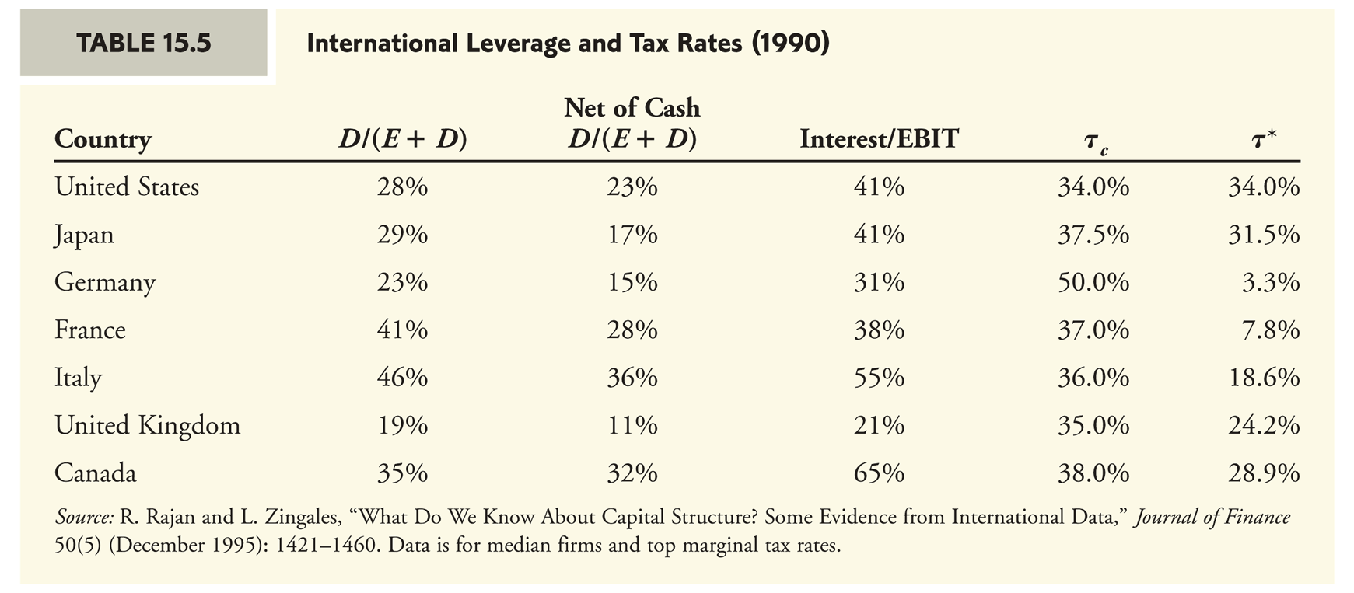
The low leverage puzzle
Firms shield about one third of their earnings before interest and tax
True internationally

Slide 41
Assigned questions
Chapter 15
1, 4, 6, 13, 18
Data case 1-6

