Slide 1
Assignment Five
Underwriting Property and Liability Insurance

Slide 2
Underwriting Property and
Liability Insurance
Origin of Property Insurance
  London Fire – 1660
  In US Fire Insurance in Philadelphia by Benjamin Franklin
  Fire Marks

Slide 3
COPE
Construction
Occupancy
Protection
Exposures

Slide 4
Construction
First consideration
Relates to ability to withstand damage by fire and other perils and wind
ISO uses 6 classifications based on
  Materials used in construction
  Materials used in roof and floors
  Fire resistance of material used

Slide 5
Class 1
Frame
  All or mostly all wood most dwellings; small commercial buildings – motels
Some may have brick or stone veneer or aluminum siding

Slide 6
Class 2 – Joisted Masonry
  Masonry, brick, wood joisted, brick joisted called ordinary construction. Found in northern states using heavy timber
  Also called mill construction
Class 3 – Non-combustible
  Walls, roof, floor, non-combustible material, are not fire resistive and metal frames twist with heat

Slide 7
Modified Fire Resistive
Class 4
  Masonry non-combustible
  Exterior walls FR one hour or masonry
  Roof and floors non-combustible
Class 5
  Same as FR except rating 1-2 hours
Typical
  Masonry non-bearing wall surface
  Concrete floor
  Metal deck roof
  Unprotected metal frame

Slide 8
Fire Resistive
Class 6
  The ability of the members of the load bearing members of the structure to withstand damage by fire for two hours
Fire Resistive superior to other types but is not “fireproof”
May also have a fire protective coating
  Concrete, masonry plaster or gypsum but with two hour rating

Slide 9
Construction Materials
Interior finish – fuel load
Insulation – can add problems
Insulation can contain heat of a fire within a building, concentrating it on structural members causing early collapse

Slide 10
Roofing
Roof serves as a weather seal and a barrier against exposure fires
UL evaluates and classifies roofing materials
Asphalt, shingles, built-up tar roof, wood shingles

Slide 11
Other Considerations
Age
Building Height
Fire Divisions
Building Openings
Building Codes

Slide 12
Occupancy
Ignition Sources
Combustibility
Damageability

Slide 13
Occupancy
Habitational – apartments, hotels, motels, nursing homes
Office – low hazard
Institutional – schools, churches, hospitals, government property
Mercantile – department, hardware and specialty stores
Service – dry cleaners, laundries, auto service stations
Manufacturing – nature of product

Slide 14
Hazards & Occupancy
Common hazards
  Housekeeping
  Heating equipment
  Electrical equipment
  Smoking materials

Slide 15
Special Hazards
Special hazards of the class – increase likely frequency or security of loss
Special hazards of the risk – example: a body shop is part of a trucking fleet or taxi fleet
Usually requires onsite inspection
Special hazards of the risk – not typically an occupancy

Slide 16
Protection
Public – available thru governmental authorities – city, country, volunteer
Evaluated with a Public Protection Classification (PPC)
  1-ideal protection to 10-no protection
Key may be location of water supply and fire hydrants
Mutual Aid – Houston Ship Channel Industries

Slide 17
Public Fire Protection
AAIS – protection classification
Protected – within 1000 feet of hire hydrant within 5 miles of responding fire fighters
Partially protected – more distance than 1000 feet but within 5 miles
Unprotected – none of either

Slide 18
Private Protection
Detection – guard service, private patrol, detectors, smoke and heat, alarm systems, central station alarm
Suppression – portable extinguishers, standpipes and hoses, automatic sprinkler system, private fire brigades
Halon systems no longer installed – for computers chlorofluorocarbon

Slide 19
External Loss Exposures
Outside control of insured/policyholder
  Single occupancy
  Exposing buildings
  Hazardous exposures
    Lumber yards, gasoline storage tanks
  Multi-occupancy

Slide 20
Property Policy Provisions Underwriting Consideration
Insurable interest
Valuing losses
Insurance to value
  Higher limits and premiums
  Adequate insured book
  Competitive statues for insurer

Slide 21
Measure of Potential Loss Severity
Policy amount – obvious
Single fire division
Amount subject – worst case scenario
Probable Maximum Loss (PML)
  High Rise
    Less than full value
    McCormick Place, WTC
  Fire Walls breached
  Judgment
  Reinsurance consideration
Maximum Foreseeable Loss (MFL)

Slide 22
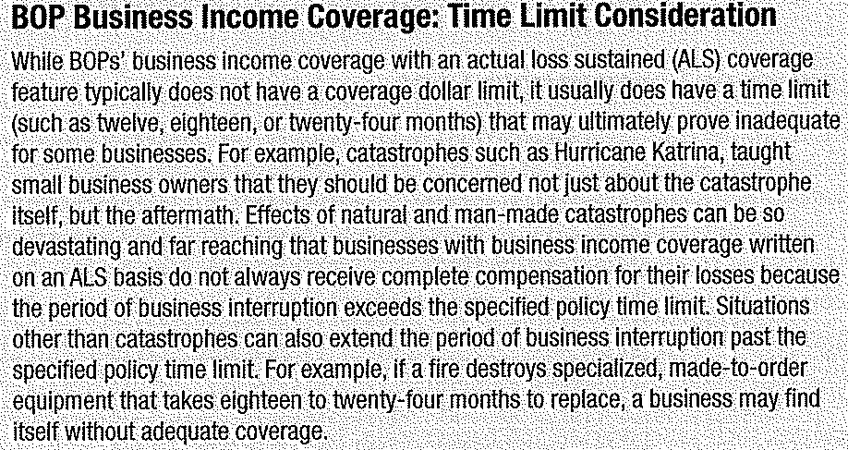
Business Income & Extra Expense Coverage

Slide 23
Business Income & Extra Expense
Probable Maximum Loss
  Calculate most serious loss
  Calculate longest period of restoration
  Compute longest loss of business income
Factors of Interruption
  Custom made machinery
  Seasonality
  Bottlenecks
  Computer systems
  Long production processes
  Availability of substitutes
Need for CPA/accounting firm

Slide 24
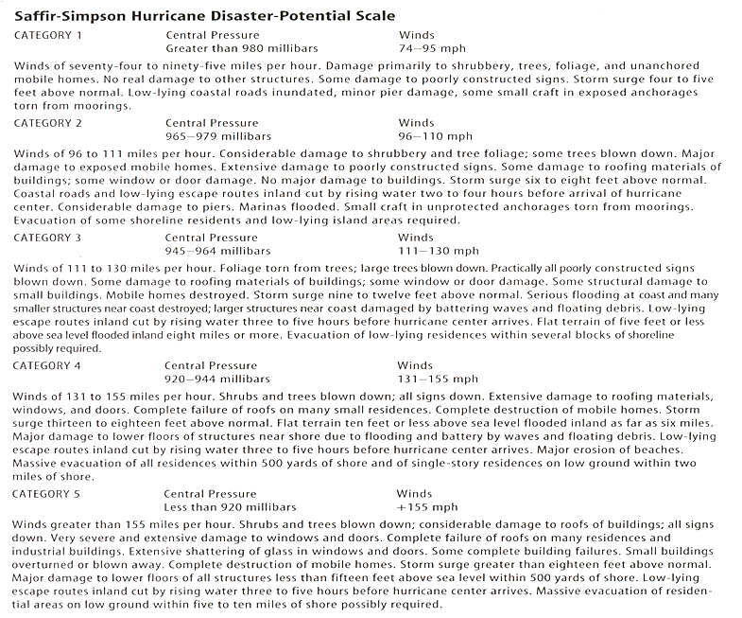
Damage

Slide 25
Crime Insurance
Crimes committed by employees – employee dishonesty
Crimes committed by others – burglary, robbery, theft

Slide 26
Employee Dishonesty
Unique to
  Employees have ready access to valuable property
  Losses can be hidden from discovery
  Large losses are common
  Insured often reluctant to face facts
  Management may be reluctant to prosecute employees
  Employee crime losses are estimated to cost employers more than any other forms of crime (White Collar)

Slide 27
Underwriting Employee Dishonesty
Management and moral character
Profitability
Burglary and robbery loss control deter employee crime
Limits
Management controls evidence of managements care and concern

Slide 28
Management Controls
Screen new hires and reference checks
Review before move into sensitive positions
Substance abuse programs
Level of turnover
Defined termination procedures, password control
Sensitive to employee behavior
Bank reconciliation
Required annual vacations
Duties rotated
Dual person control

Slide 29
Other Crime
Burglary – evidence of forceful entry
Robbery – illegally taking property or threat
Theft – stealing
Disappearance – no reasonable explanation
Inventory Shortage – more from shrinkage

Slide 30
Underwriting
Property susceptibility
Location
Nature of occupancy
Public protection
Modification of coverage

Slide 31
Crime and Loss Control
Safes and vaults
Cages, special rooms
Lighting
Fences and walls
Protection of openings
Guard service
Electronic surveillance
Inventory control

Slide 32
Underwriting Commercial General Liability
CGL, 3rd Party Liability, Public Liability
Combines
  Premises and operations
  Products and completed operations
  Personal and advertising injury liability
  Premises medical payments liability

Slide 33
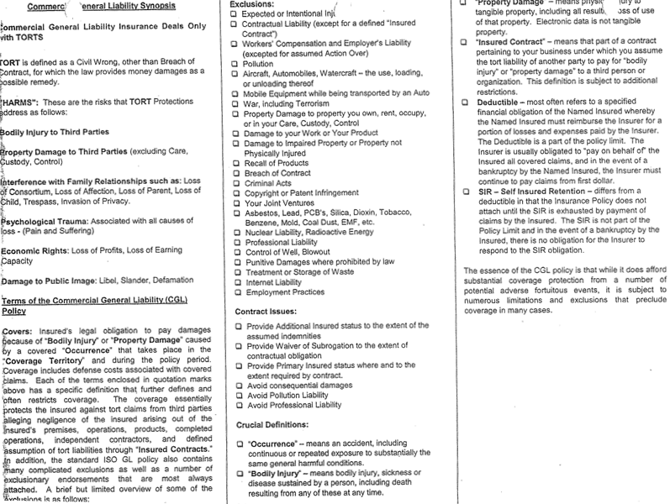
CGL Synopsis

Slide 34
Premises and Operation
Store Risks vs. Contractors Operations
Evaluation has to do with extent of liability exposure to public
Exposure – location, type of business, time in business, traffic key exposure
Legal status of persons – adults vs. children
Common hazards
  Slips and falls, stairs, carpet, lighting
Special class – chemicals
Special risk – unique to operation
Property damage – fire, damage by contractors
Heavy machinery operation

Slide 35
Contractors and Subcontractors
Vicarious Liability of Subs
  Subcontractors purchase separate insurance
Use of Subcontractors
  Quality of work, timeliness, availability
Use of Certificate of Insurance

Slide 36
Products and Completed Operations
Created by defect in product or service
Products Liability
  Breach of warranty – guarantee of safety
    Implied warranty – reasonably fit
    Fitness – catalogues
  Negligence – design, manufacture, inspections
  Strict Liability – most products liability imposes liability on any person who produces an unreasonable dangerous product

Slide 37
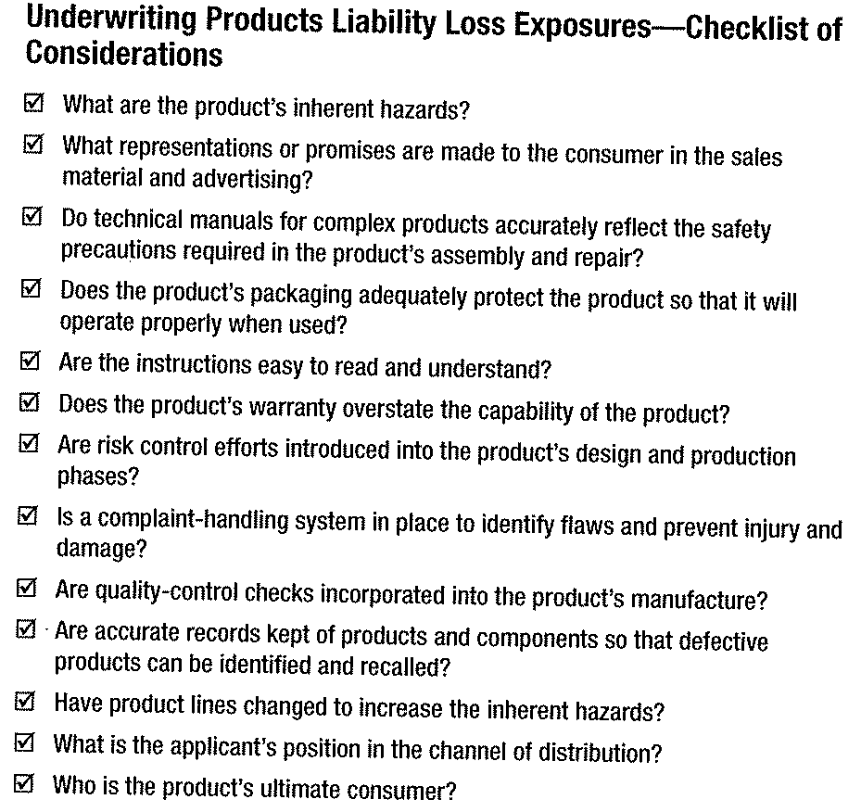
Underwriting Products Liability

Slide 38
Completed Operations
Construction, service, repair and maintenance
Quality of work
Careless or faulty work
Construction – tunnel in Boston; apartment/highrise
Personal and Advertising Liability
  Automatically included
Premises Medical
  No fault automatically included; low limit 5 or 10,000

Slide 39
Personal Auto Insurance
Underwriting Factors
  Age of Operators
  Age and type of auto
  Auto use
  Driving record
  Territory
  Gender and marital status
  Occupation
  Personal characteristics
  Physical condition of driver
  Safety equipment
Credit Scoring
  Some states prohibit – not Texas

Slide 40
Commercial Auto Underwriting
MVR
Accident History
Experience
Vehicle Weight
Vehicle Use
Radius of Operation
Special Industry
  Truckers
  Food
  Waste disposal
  Farmers
  Dump & transit
  contractors

Slide 41
Loss Control Services
Fleet Safety Programs
Risk Control Reports
Share risk prevention measures
Written safety program
  Vehicle use
  Driver selection
  Vehicle maintenance
  Accident reporting
  Given to employee
Extensive state and federal guidelines for safety

Slide 42
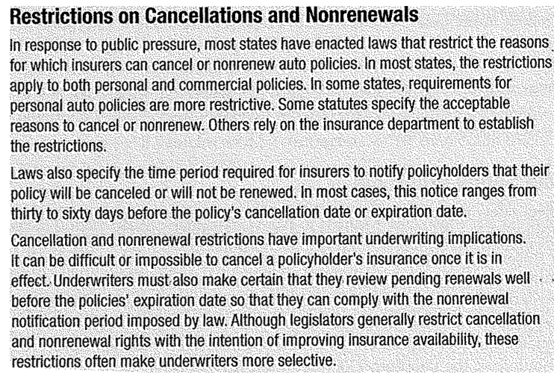
Cancellations of Nonrenewals

Slide 43
Underwriting Workers’ Compensation
History
States dictate coverage, benefits, limits
Same policy for all states
  Workers’ Compensation
  Employers Liability
  Other states

Slide 44
Underwriting
Not all companies offer
  Strict underwriting guidelines
  Experience modifier – NCCI mandatory
Problems
  Temporary and seasonal
  Subcontractors
  Maritime employments
    Maritime liability
    USL & HW

Slide 45
Considerations
Premiums size
Concentration – World Trade Center
Management Attitudes
On premises
  House keeping
  Maintenance
Occupation diseases
Cumulative trauma
Off premises travel

Slide 46
Umbrella and Excess Liability
Umbrella
  Provide excess liability above underlying policies
  Provide coverage with aggregate considerations
  Provide coverage for gaps in coverage
Excess – individual policies
Defense cost – included in primary

