Slide 1
Assignment Ten
Reinsurance

Slide 2
Basic Terms and Concepts
Reinsurance – “insurance for insurers”
Reinsurance is the transfer from one insurer (primary insurer) to another (the reinsurer) of some of the financial consequences covered by the primary insured’s policies
Transfer of liability – the reinsured, the ceding company, the cedent, the direct insurer or the primary insurer
Transacted through a reinsurance agreement which specifies terms provided
Agreement usually requires primary insurer to retain part of original amount or liability
Other terms – reinsurance premiums, ceding commission, retrocession, the retrocedent and retrocessionaire

Slide 3
Reinsurance Functions
Stabilization loss experience
Increase large line capacity – property, hull, marine
Financing (surplus relief) – mostly for growing insurers as mismatch of accounting reduces surplus
Provide catastrophe protection – property, auto, consumer products
Provide underwriting assistance
Facilitate withdrawal from a market segment

Slide 4
Large Line Capacity
Provides ability to provide high limits of liability on a single policy
State regulations prohibits more than 10% of surplus on any one loss exposure
Example: $100,000,000 office building
$010,000,000 retain
$090,000,000 reinsurance

Slide 5
Provide
Catastrophe protection for
  Earthquakes
  Windstorm (hurricane, tornado and other wind damage)
  Fire
  Industrial explosions
  Plane crashes
Single catastrophe reinsurance with limit $50,000,000 coverage per hurricane

Slide 6
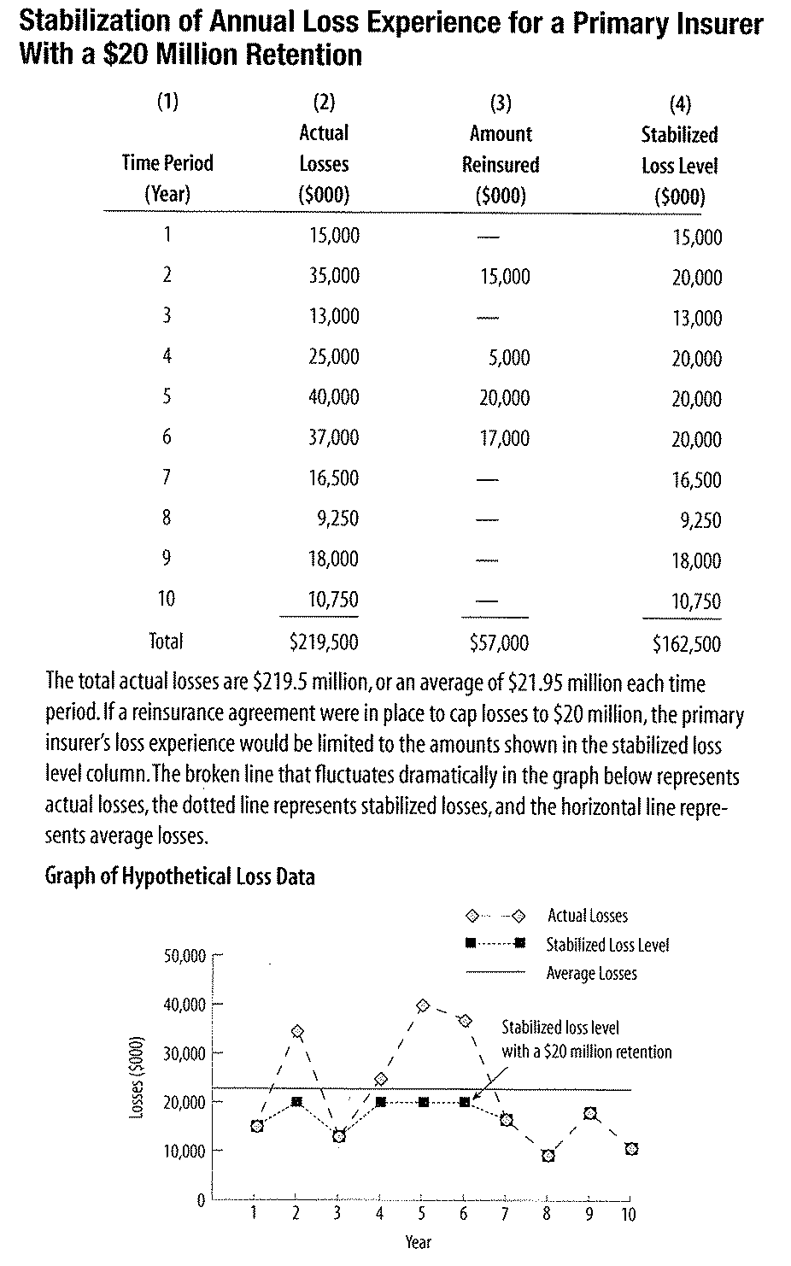
Stabilization

Slide 7
Provide Surplus Relief
Insurer limited to amount of premiums
Ratio 3-1. (Kenny Theory)
Due to prepaid, expense portions of unearned premiums
Statutory insurance accounting results in income and expense mismatched
Surplus relief – gained by ceding commission from reinsurer as a flow of funds from reinsurer to primary insurer

Slide 8
Withdrawal From Market Segment & Underwriting Guidance
Provide underwriting guidance – reinsurers deal with many primary insurers and gather much information
Withdrawing from state/territory – can facilitate a business decision and transfer all liability to a reinsurer
  Alternatives are
    Allow to runoff
    Cancel – and there are prohibitions
    Stop writing

Slide 9
Reinsurance Sources
Professional reinsurers
Reinsurance departments of primary insurers
Reinsurance pools, syndicates and associations
Non-admitted alien reinsurer – not licensed in US but operates here

Slide 10
Professional Reinsurance
Primary insures dealing with direct writing reinsurers often use fewer reinsurers in their reinsurance program
Reinsurance intermediaries often use more than on reinsurer to develop a reinsurance program for primary insurer
Reinsurance intermediaries can often help secure high coverage limits and catastrophe coverage
Reinsurance intermediaries usually have access to various reinsurance solutions from both domestic and international markets
Reinsurance intermediaries can usually obtain reinsurance under favorable terms and at a competitive price because they can determine prevailing market conditions and work repeatedly in this market with many primary insurers

Slide 11
Other Sources
Reinsurance Departments of Primary Insurer
Reinsurance Pools, Syndicates and Associations
Reinsurance Professional and Trade Organizations
  IRU
  BRMA
  RAA

Slide 12
Reinsurance Transactions
Treaty Reinsurance
  One agreement for entire class or portfolio
  Also called obligatory reinsurance
  Agree in advance terms
  Terms and price of each treaty individually negotiated
  Most require primary reinsurer to cede all eligible loss exposure
  Integrity and experience of primary insurer very important

Slide 13
Facultative Reinsurance
A separate agreement for each loss exposure
Serves four functions
  Provide large line capacity
  Reduce exposure in given geographic area
  Insure a large loss exposure
  Insure a particular class excluded under treaty
Facultative is very expensive vs. treaty since individual underwriting

Slide 14
Type of Reinsurance
Each agreement negotiated
Reflect primary insurers needs and willingness of reinsurer to meet
Divided as to
  Excess of loss and
  Pro rata

Slide 15
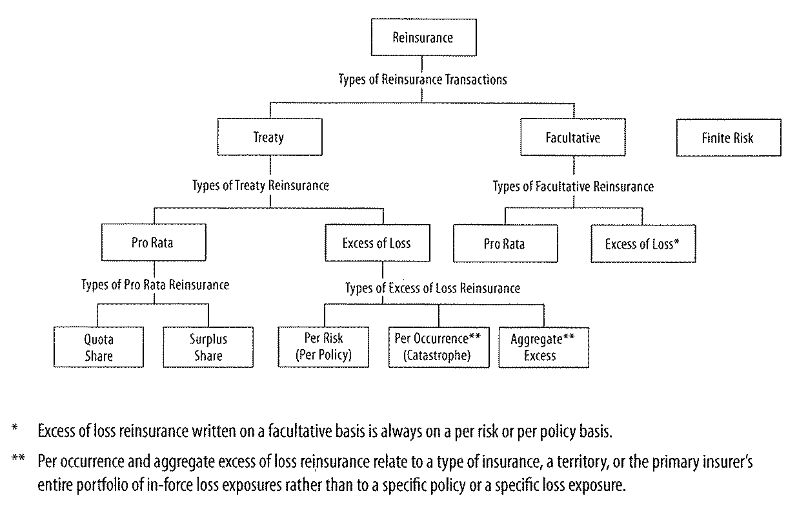
Types of Reinsurance

Slide 16
Pro Rata Reinsurance
Primary cedes a portion of original premium
Reinsurer pays a ceding commission
If fixed, a flat commission
Can includes a profit sharing commission
Can adjust to actual profitability with a sliding scale commission

Slide 17
Types of Pro Rata Reinsurance
Quota Share:
  A fixed predetermined percentage of
  Every risk
  Mostly property treaties
  Does not improve underwriting
Surplus Share:
  Are pro rata or proportional but are different in that the retention is a dollar amount
  Not all risks insured and requires a report of risks or bordereau and increases expense
  Provides large line capacity
  May have occurrence limit by reinsurer

Slide 18
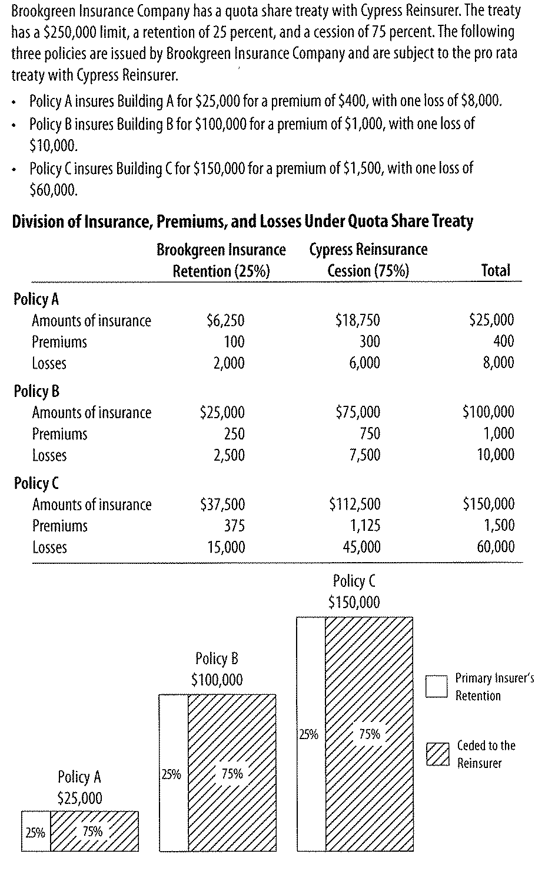
Quota Share Example

Slide 19
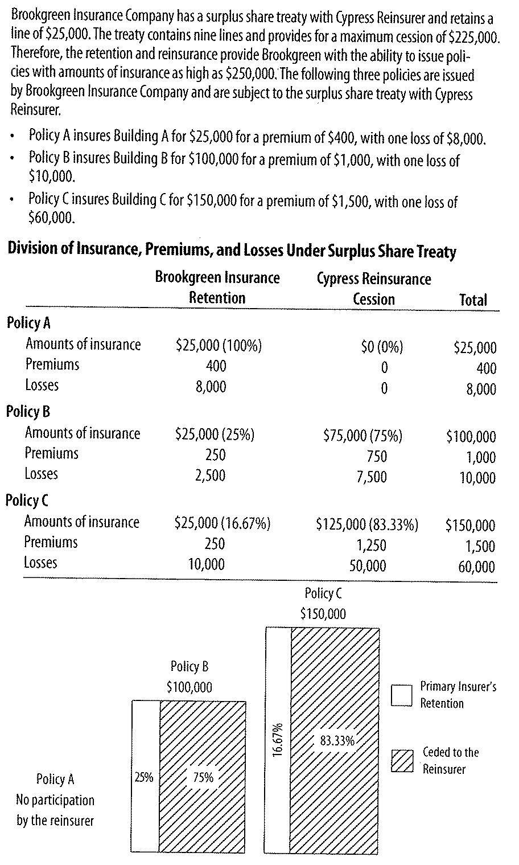
Surplus Share Example

Slide 20
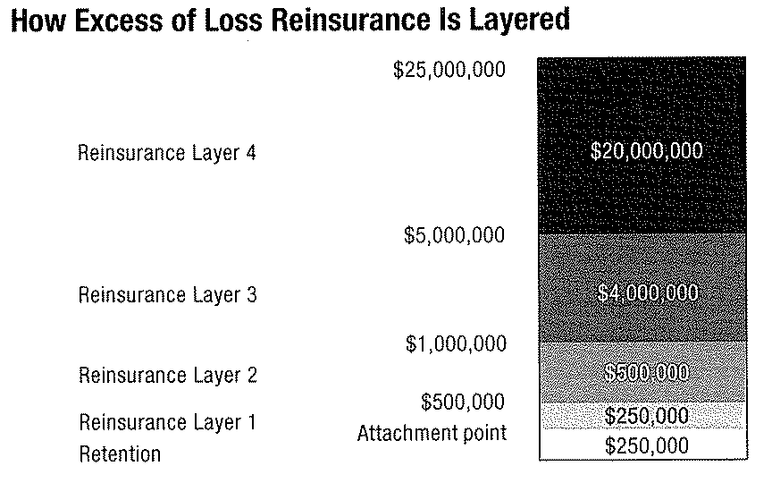
Excess of Loss Reinsurance
Also called non-proportional reinsurance
Layering

Slide 21
Excess of Loss Function
Attachment point – responds only after loss exceeds this limit
Premiums express as a ratio of the primary insured premium
May include a profit commission
If so, attachment point set a low level meaning losses expected, referred to as a working cover
Primary may also participate in higher levels and called co-participation provision
Loss adjustments are substantial and often are specific as to participation by excess insurers
Either pro rata or add total to loss

Slide 22
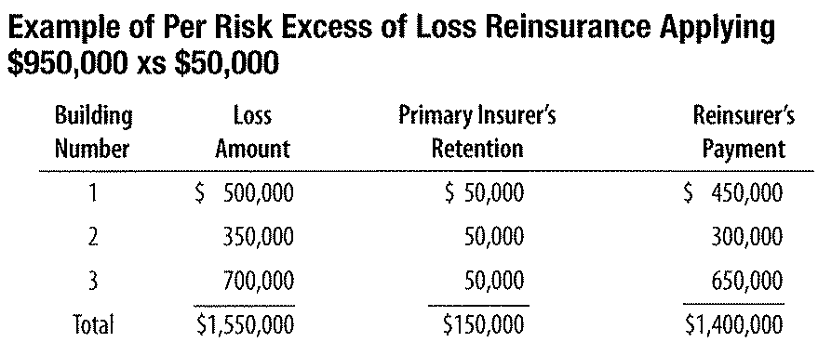
Types of Excess of Loss Reinsurance
Per Risk Excess of Loss
  Generally used with property and applied separately to each loss

Slide 23
Catastrophe Excess of Loss
Protects primary insured from accumulation of retained losses from single catastrophe (correlated losses)
See with tornadoes, hurricane and earthquakes
Attachment point set high enough so that it would be exceeded only if loss would impair surplus
Usually includes a co-participation provision
Critical is inclusion of a loss occurrence clause
Clause specifies a time period
Usually 72 hours for hurricanes and 168 hours for earthquakes

Slide 24
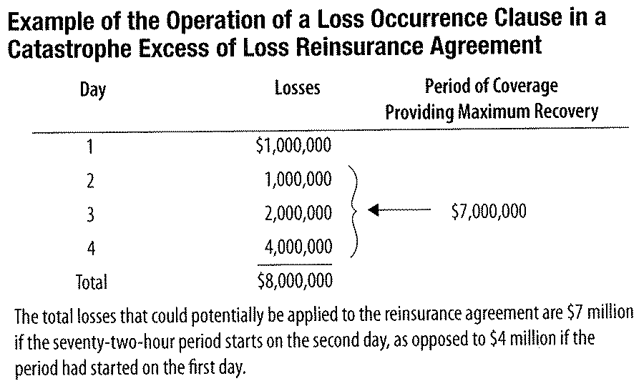
Example of Loss Occurrence Clause
Payments reduce the limits
Primary must pay addition premium to reinstate the limits

Slide 25
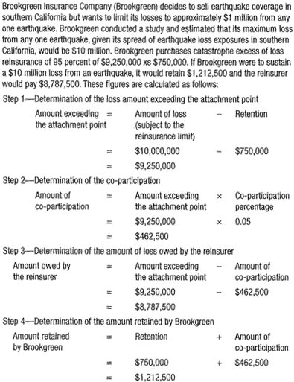
Catastrophe Excess of Loss Example

Slide 26
Per Policy Excess
  Used with liability insurance and applies attachment point and reinsurance limit separately to each policy
Per Occurrence Excess
  Used for liability insurance and applies the attachment point and reinsurance limit to total losses from single event

Slide 27
Example of Per Policy Excess
Example of Per Occurrence Excess

Slide 28
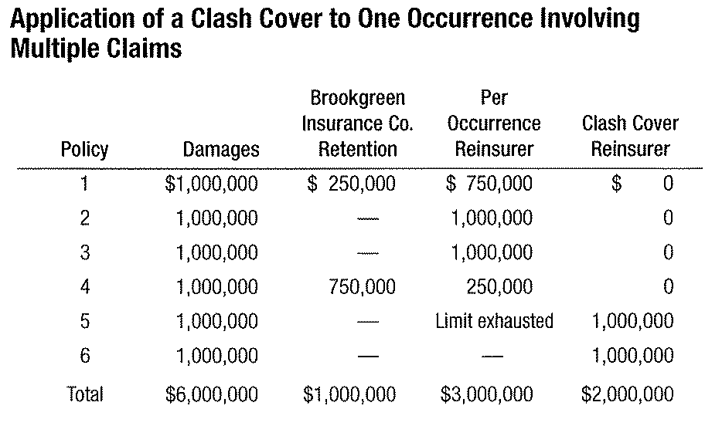
Clash Cover
Can be provided for a combination of liability insurance, auto general, professional and workers compensation
Attachment point higher than any of the limits of underlying application and clash cover

Slide 29
Aggregate
Can be used for property or liability
Attachment stated either as $ dollar amount or as a loss ratio
Are more expensive than other excess of loss
Includes a co-participation clause
Protects primary against catastrophe and unforeseen accumulations of non catastrophe losses

Slide 30
Alternative to Traditional Reinsurance
Finite Risk Reinsurance
  Usually multi-year in term
  Protect against a traditionally insurable loss exposure and a traditionally uninsurable loss
  Long term protection
  Predictable reinsurance cost
  Premium will be high percentage of limit
  Must be risk of underwriting and financial risk

Slide 31
Capital Market Alternatives
Securitization of risk using SPV
Some based on insurance derivatives
Catastrophe bond – transfers insurable catastrophe to investors
Issue by SPV, large reinsurers or large corporations
Used for insurable risk – hurricanes, earthquakes, and other adverse weather – winter storms in Europe
Catastrophe Risk Exchange – a primary insurer can trade for risk in other geographic area
Contingent Surplus Notes – primary insurer gains instant funds with issuance

Slide 32
Alternative (con’t.)
Industry Loss Warrant
Catastrophe options
Lines of Credit
Sidecar – permits primary insurer to write property catastrophe coverage through a quota share agreement with investors
  Can include profit commission

Slide 33
Reinsurance Program Design
To determine reinsurance needs must consider
  Growth Plans – rapid growth requires replenishment of capital
Types of insurance sold – ability to project losses
Geographic spread of loss
Insurer size
Insurer structure
Insurer financial strength
Senior management risk tolerance

Slide 34
Selection of Retention
Cost and
Two functions – regulatory requirements and primary insureds financial strength
Maximum amount the primary insurer can retain
Maximum amount the primary insurer wants to retain
Minimum retention sought by the reinsurer
Co-participation provision

Slide 35
Factors Affecting Limit Selection
Cost and
Maximum policy limit
Extra-contractual obligations
Loss adjustment expenses
Clash cover
Catastrophe exposure

Slide 36
Reinsurance Design Case Studies
Atley Insurance Company
  Situation 1 – special program for office condominiums
  Situation 2 – growth for catastrophe exposure

Slide 37
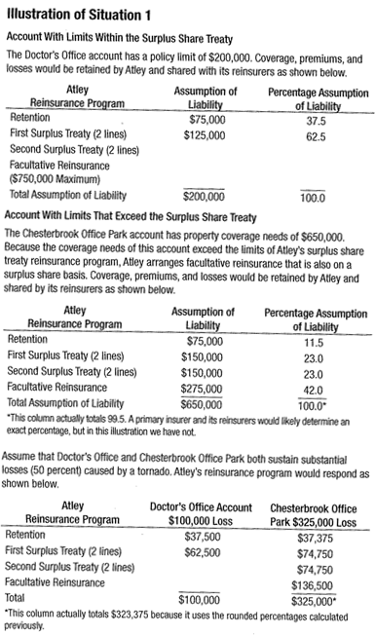
Situation 1

Slide 38
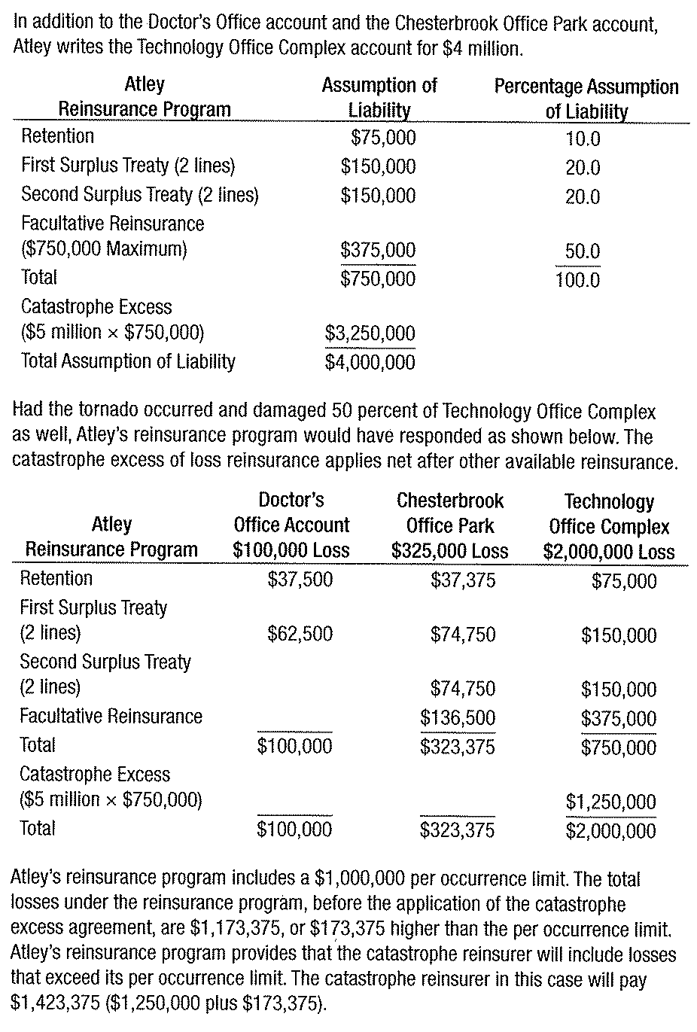
Situation 2

Slide 39
Insurance Regulation
Reinsurance subject to same solvency regulations as primary insurers
Some concerns with unlicensed reinsurers
Regulation aimed at primary insurer

Slide 40
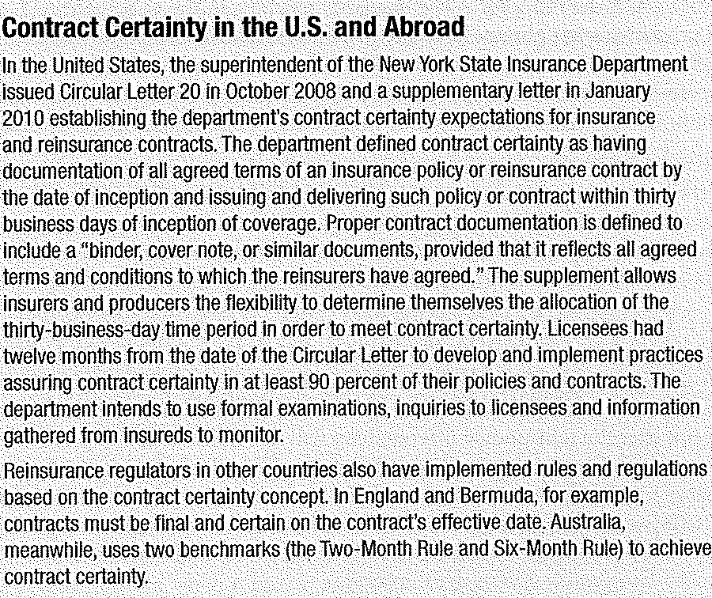
Contract Certainty
World Trade Center created “Nine-Month Rule” by NY and NAIC

Slide 41
Credit for Reinsurance Transactions
Primary insurers take credit for reinsurance
  reduces drain on surplus due to new business
Some states allow credit only
  If reinsured licensed in state (of primary)
Some permit if have pre-approval from any state
Some permit even if not licensed with pre-approval
Some states (NY) require intermediary clause to address credit risk of primary reinsurer

