Slide 1
PowerPoint Slides for Professors
Spring 2010 Version
This file as well as all other PowerPoint files for the book, “Risk Management and Insurance: Perspectives in a Global Economy” authored by Skipper and Kwon and published by Blackwell (2007), has been created solely for classes where the book is used as a text. Use or reproduction of the file for any other purposes, known or to be known, is prohibited without prior written permission by the authors.
Visit the following site for updates:
http://facpub.stjohns.edu/~kwonw/Blackwell.html.
To change the slide design/background,
[View] → [Slide Master]
W. Jean Kwon, Ph.D., CPCU School of Risk Management, St. John’s University 101 Murray Street New York, NY 10007, USA
Phone: +1 (212) 277-5196 E-mail: Kwonw@stjohns.edu

Slide 2
Risk Management and Insurance: Perspectives in a Global Economy 21. Life Insurance
Click Here to Add Professor and Course Information

Slide 3
Study Points
Policies sold by life insurance companies
Selected life insurance markets

Slide 4
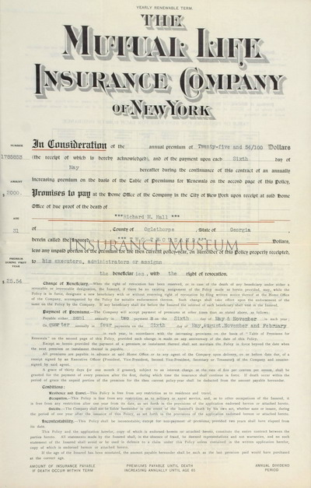
Life Insurance Policies

Slide 5
Fundamentals
Historically, policies sold by life insurers involved only life contingencies
Payments to policyholders or their beneficiaries are determined by whether insureds are alive or dead.
Definitions within the life branch are not always consistent internationally.
Types of policies
Mortality-based insurance policies
Morbidity-based insurance policies

Slide 6
Mortality-based Policies
Life insurance (assurance) and endowments
Annuities

Slide 7
Life Insurance Policies
Key Words
Classification
Face amount (sum assured)
Insured
Applicant
Policyowner (policyholder)
Beneficiary
Term life insurance
Cash value life insurance

Slide 8
Term Life Insurance
Coverage period
Yearly renewable term (YRT)
10- and 20-year (level-premium) term policies
Life-expectancy term
Term-to-age 65
Other features
Conversion
Reentry
Low premium but with no cash value

Slide 9
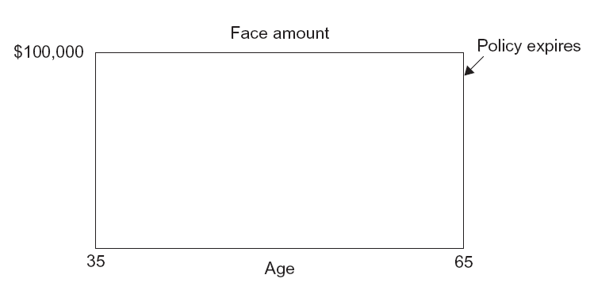
Illustration of Term-to-Age 65 Policy (Figure 21.1)

Slide 10
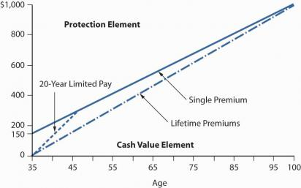
Cash Value Life Insurance
Fundamentals
Cash value
Net amount at risk (see Figure 21.2)
Cost of insurance (COI) rate
Participating vs. nonparticipating policies with respect to:
Mortality experience
Insurer expense experience
Investment experience
Types
Universal life
Whole life
Endowment insurance

Slide 11
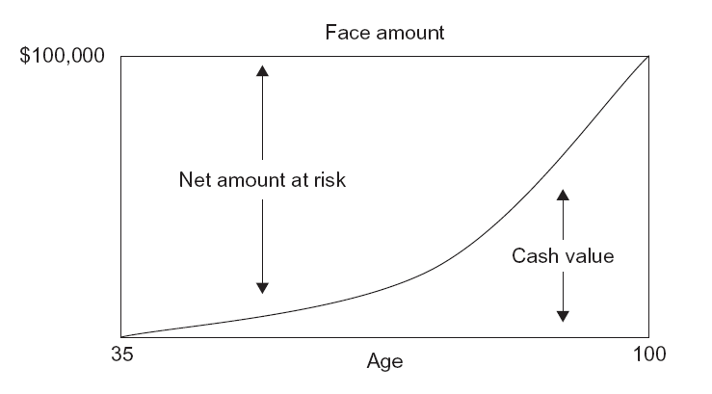
Illustration of Whole Life Policy (Figure 21.2)

Slide 12
Universal Life
Flexible-premium, adjustable death benefit contract
Policy transparency
Surrender charge – back-end load
Variable universal life (unit-linked) universal life
Compare VUL with variable life in the next section!

Slide 13
Whole Life
Unlike universal life policies, premiums for whole life
Are directly related to the amount of insurance purchased
Must be paid when due (or the policy will terminate)
Are calculated to sure that the policy will remain in effect for the entire life time of the insured
Classification based on premium-payment period
Ordinary life (level premium whole life)
Limited-payment whole life
Single-premium whole life
Paid-up policy

Slide 14
Whole Life
Classification based on policyholder participation
Current assumption whole life
Also called as interest sensitive or fixed premium universal life
Variable (unit-linked) whole life
The premium is fixed.
The policy is guaranteed to remain in effect for the whole of the insured’s life.
Not only the cash value but also the face amount can vary.
Classification based on the number of lives
Single life (by default)
First-to-die (joint) life
Second-to-die (survivor) life

Slide 15
Endowment Insurance
Two mutually exclusive insurer promises to pay the face amount if the insured
Dies during the policy period → level-premium term life element
Survives to the end of the period → pure endowment element
Various policy durations
Year-based
Age-at-maturity based

Slide 16
Annuities
Living benefits
Classification based on
Number of lives covered
Premium payment options
When benefit payments begin
Benefit receipt options
Redemption value
Insurer obligations during
The accumulation period
The liquidation period

Slide 17
Annuities - Typo
(First Edition, First Printing)
Typo in Figure 21.3
Second row of the boxes; Middle box – “When benefit payments begin”
The correct is “When benefit payments begin”
The figure in the next slide contains no such an error.

Slide 18
Classification of Annuities (Figure 21.3)
Annuities
Number of lives
covered
Premium payment
options
Beginning of
benefit payments
Benefit receipt
options
Redemption
options
Single
Single
Immediate
Life annuity
Currency
Multiple
Periodic
Deferred
Temporary
Local
Fixed
Period-certain
Foreign
Flexible
Reversionary
Unit-linked
Life with refund
Fixed units
Installment
Cash
Variable units

Slide 19
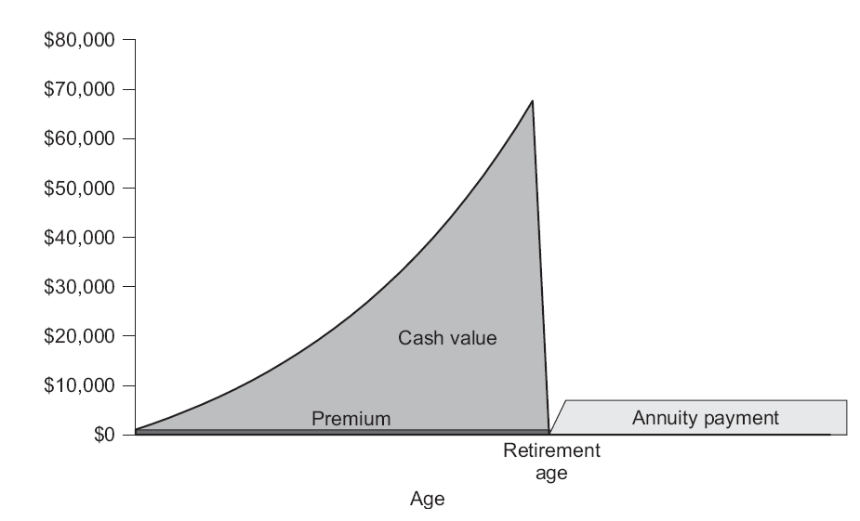
Illustration of Level-Premium Deferred Annuity (Figure 21.4)

Slide 20
Morbidity-based Insurance Policies
Potential economic losses associated with the health risk
Medical expenses
Expenses to provide long-term case
Reduction (elimination) of income during the affected period
Types of policies
Health insurance
Long-term care insurance
Disability income insurance

Slide 21
Health Insurance Policies
Types
(supplemental) health insurance
Hospital confinement indemnity insurance
Specified-disease insurance
Dread-disease insurance
Guaranteed renewal vs. non-guaranteed renewal
Ask students to check the story of cancer insurance offering by AFLAC in Japan!

Slide 22
Long Term Care (LTC) Insurance
A rise in LTC needs in modern society
Policy trigger based on daily living activities
Scopes of coverage vary from market to market.
A wide array of options (including the length of benefit period, maximum daily benefits, and the waiting period) available in selected markets
Individual LTC may be offered on a guaranteed renewable basis.

Slide 23
Disability Income Insurance
Three major sources of external finance for the disabled
Government → social insurance
Group plan → from the employer
Individual disability income insurance
Disability income insurance
Provides monthly benefits to replace lost income during the period of disability
Three basic components
The elimination period
The benefit amount
The benefit period

Slide 24
Disability Income Insurance
Definitions of disability
Any occupation
Own occupation
Supplemental benefits
Residual disability benefits
Partial disability benefits
Inflation protection benefits
Provisions for increased benefit amounts

Slide 25
Selected Life Insurance Market – the U.S.

Slide 26
The Americas – the U.S.
The world’s largest market
A mature market
International interest by U.S. insurers has increased dramatically.
The U.S. market is mature
The attractive growth rates existing in various overseas markets
The search for more profitable business
Increasing competition in U.S. market

Slide 27
The Americas – the U.S.
A wide array of products invented and sold
1,200 insurers compete ← a significant reduction from 2,343 in 1998
Distribution mainly by agents and brokers (90%)
More companies experiment alternative distribution systems
Bancassurance not popular
Market issues
Financial modernization
Regulatory concerns
Health insurance reform
Emphasis on financial stability
Implementation of risk-based capital

Slide 28
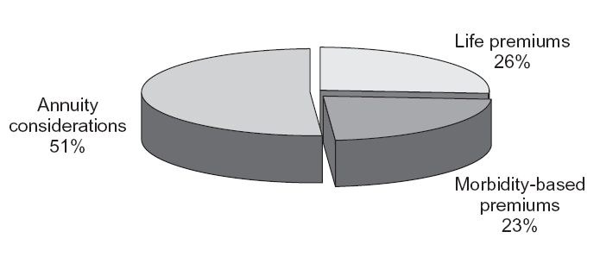
The Americas – the U.S. (Figure 21.5)

Slide 29
2010 U.S. Healthcare Reform
http://www.reuters.com/article/idUSN1914020220100319; http://www.reuters.com/subjects/healthcare

Slide 30
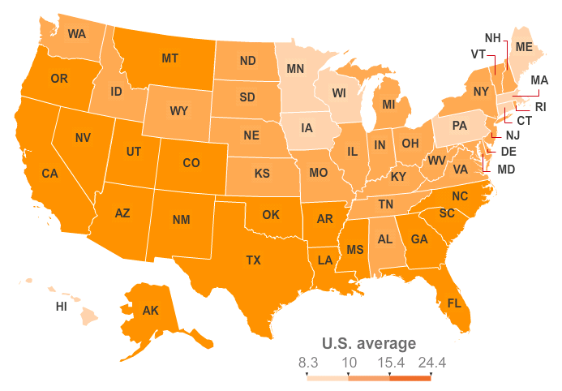
Percentage Uninsured Relative to State Population – Three Year Average, 2005-2007

Slide 31
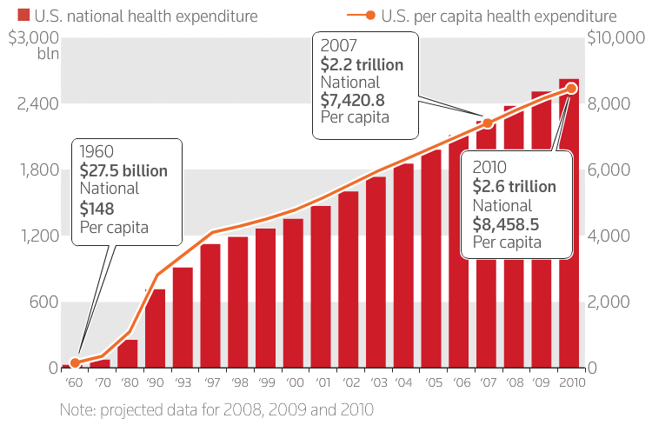
Healthcare Expenditure – 1960-2010

Slide 32
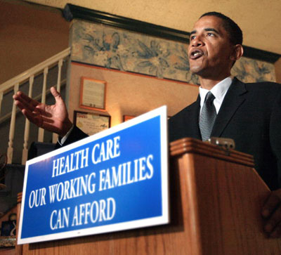
The 2010 Reform (Based on Draft)

Slide 33
In 2010 (Selected)
Affecting Current Practices
Somewhat New
Insurers not allowed to drop coverage when they get sick
Lifetime coverage limits eliminated
Annual limits restricted
Dependent children with a pre-existing condition not excluded
Dependent children covered until age 26
Tax credit available for small businesses providing coverage for workers.
Uninsured adults with a pre-existing conditions being able to obtain coverage through a new program
The new program expires once insurance exchanges begin operating in 2014.
A temporary reinsurance program help companies maintain health coverage for early retirees between the ages of 55 and 64.
This program expires in 2014.

Slide 34
In 2011 (Selected)
Medicare & Medicaid
Other
Provides 10% bonus to primary care physicians and general surgeons
A free annual wellness visit and personalized prevention plan service.
New plans required to cover preventive services with little or no cost to patients.
Payments to insurers offering Medicare Advantage services frozen at 2010 levels.
A new program under the Medicaid plan for the poor allows states to offer home/community-based care for the disabled that might otherwise require institutional care.
Employers required to disclose the value of health benefits on employees' W-2 tax forms
An annual fee imposed on pharmaceutical companies according to market share.
Not applicable to companies with sales of $5 million or less

Slide 35
In 2012 (Selected)
Physician payment reforms implemented in Medicare
To enhance primary care services
Doctors to form "accountable care organizations" to improve quality and efficiency of care
An incentive program in Medicare for acute care hospitals to improve quality outcomes
The Centers for Medicare and Medicaid Services, which oversees the government programs, begin tracking hospital readmission rates and puts in place financial incentives to reduce preventable readmissions.

Slide 36
In 2013 (Selected)
A national pilot program established for Medicare on payment bundling
To encourage doctors/hospitals/other providers to better coordinate patient care
The threshold for claiming medical expenses on itemized tax returns raised to 10% from 7.5% of income
Remains at 7.5% for the elderly until 2016
The Medicare payroll tax is raised to 2.35% from 1.45% for
Individuals earning >$200,000 and married >$250,000
2.9% excise tax on the sale of medical devices
Excluding those generally purchased at the retail level by the public
Financing!
Financing!
Financing!

Slide 37
In 2014 (Selected)
Opens “state health insurance exchanges” for small businesses and individuals
Most people required to obtain health insurance coverage
A fine imposed if they do not
Healthcare tax credits available to people with incomes up to 400% of poverty
Medicaid available to people with income up to 133% of the poverty level
Health plans no longer exclude people due to pre-existing conditions
Employers ≥ 50 workers face a fine of $2,000 for each employee if any worker receives subsidized insurance on the exchange
The first 30 employees are not counted for the fine.
Health insurance companies begin paying a fee based on their market share.
Financing!

Slide 38
In 2015 (Selected)
Medicare creates a physician payment program
To reward quality of care rather than volume of services

Slide 39
In 2018 (Selected)
An excise tax (40%?) on high cost employer-provided plans
The first $27,500 of a family plan and $10,200 for individual coverage is exempt from the tax.
Higher levels are set for plans covering retirees and people in high risk professions.
Financing!
Initially billed to begin in 2013 but postponed until 2018

Slide 40
By 2020 (Selected)
Gradually close the gap in drug coverage for Medicare beneficiaries

Slide 41
Selected Life Insurance Markets Internationally
Updated market information from
the Insurance Information Institute

Slide 42
The Americas – Canada
The market
About 90% of the 105 insurers are federally regulated
Products and distribution systems
Annuity and morbidity-based sectors accounted for 32% and 35% of the life insurance market
Life insurance share continues to decline
About 60% of business by full-time career agents
Market issues
Solvency crisis
Entry of banks into market
Québec Sovereignty issue

Slide 43
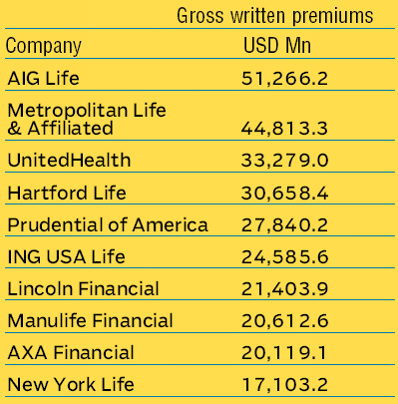
Leading Life Insurers in the U.S. (2008)
Source: International Insurance Factbook

Slide 44
The Americas – Latin America
Fundamentals
Remains relatively small in a global comparison
Three major markets are Brazil, Mexico and Chile)
Sporadic political and economic instability harming the growth of life insurance markets
Still very strong growth potential
A rise in foreign insurer presence
Products and distribution systems
A rise in product scope, including hard currency-denominated policies
Distribution traditionally by agents
Recently, independent agents, brokers, marketing firms and international brokers have entered
Bancassurance grows rapidly in Brazil

Slide 45
The Americas – Latin America
Market issues
Regional trade agreements
NAFTA
MERCOSUR
Economic and political stability

Slide 46
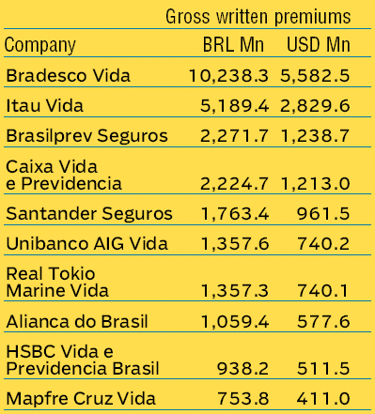
Leading Life Insurers in Brazil (2008)

Slide 47
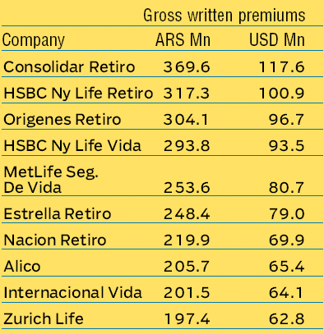
Leading Life Insurers in Argentina (2008)

Slide 48
Europe
Fundamentals
Products characterized as life insurance in many European countries would not meet the usual definition of life insurance, as they are pure investment/savings products with little or no mortality risk.
Similarly in South Africa and selected Asian countries
Represented 39% of the global life insurance market
Numerous leading markets in Western Europe, such as the U.K., France, Switzerland, Belgium, Finland and Germany
Key developments
Expansion of the E.U. and the single market/license policy
Bancassurance
France, Italy, Spain and Germany

Slide 49
Europe – the United Kingdom
Three market sectors
Life insurance comprising basic life insurance and annuities, pension business, individual savings account business, overseas life insurance business, and basic life reinsurance business
Other long-term business such as permanent health insurance and pension fund management activity
Other than long-term business
Features
The largest life insurance market in Europe
Life insurance and pensions funds as traditionally preferred savings vehicles
160 insurers compete in the market

Slide 50
Europe – the United Kingdom
Insight 21.1
Features (continued)
Bonuses are a key feature of many policies.
Reversionary bonuses
Terminal bonuses
Personal Equity Plan (PEP) as a means to increase saving
Bancassurance not yet significant
Distribution
The Financial Services Act of 1986 and the independent financial advisor (IFA) as a new, now dominating, distribution channel
Brokers, albeit still strong, continue to lose their market share.

Slide 51
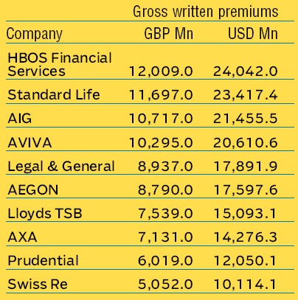
Leading Life Insurers in the U.K. (2007)

Slide 52
Europe – France
Features
One of the largest and most highly developed life insurance industries in the world
Caisse Nationale de Prévoyance (CNP), AXA, Predica, BNP Parabas Assurance and Generali lead the market.
Products and distributions
A variety of products available, including capital redemption bonds
Bancassurance dominates new policy markets

Slide 53
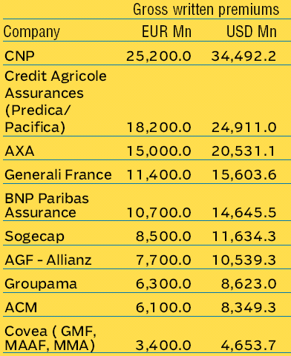
Leading Life Insurers in France (2007)

Slide 54
Europe – Germany
Features
Largest companies were locally incorporated – Allianz, Hamburg-Mannheimer, Aschener und Munchener, R&V, and Deutsche Herold
Products and distributions
Annuities and endowment insurance most popular
Policy dividend treatment similar to that of the U.K.
Tied agents as the main distributors, followed by independent agents and brokers
Issues
Tax reforms (no longer tax deductions for premium payments by individuals)

Slide 55
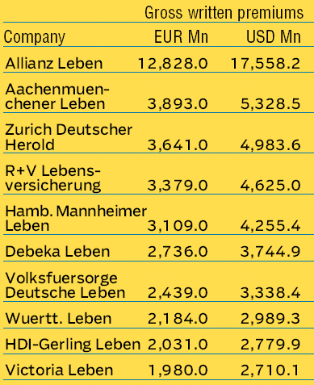
Leading Life Insurers in Germany (2007)

Slide 56
Europe – Russia
Features
Largest European market by population
Recently privatized, now with 1,500 life and nonlife insurance companies
Rapid market growth in recent years
Issues
Rudimentary legal framework for free free-market insurance activities
What legally constitutes an insurance company?
What legal ownership it may take?

Slide 57
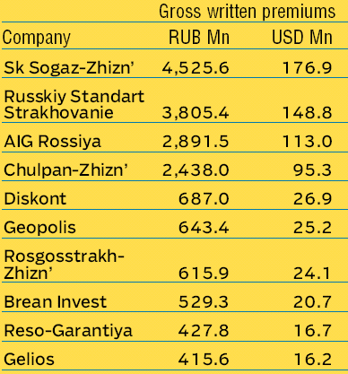
Leading Life Insurers in Russia (2007)

Slide 58
Europe – Market Issues
E.U. harmonization
Introduction of International Financial Reporting Standards (IFRS)
Bancassurance movement
Direct response marketing
Recession and unemployment
The evolving pension and health market

Slide 59
Asia-Pacific
Features
The world’s greatest life insurance potential
Displays immense diversity in level of economic and political development, ethnicity, culture and religion
Already developed include Australia, New Zealand, Japan, Korea, Taiwan, and Singapore
China and India
In economically affluent countries, life insurance products with strong savings elements predominate.

Slide 60
Asia-Pacific – Japan
Features
World’s second largest after the U.S.
Major reforms in financial services in the 1990s and 2000s
Insurance Business Law revised in 1996
Life market liberalization as par of the reforms
The third-sector in the life insurance market
Industry associations greatly influence the market.
Products and distributions
Traditional life policies remain popular
Large network of part-time, female agents
Insight 21.2

Slide 61
Asia-Pacific – Japan
Issues
Role of non-conventional life insurers
Kampo
Zenkyoren
Mega mergers and acquisitions
Fallout from the bubble economy
Aging population
Westernization of the younger generation
The deflationary economic condition is another risk Japan faces.

Slide 62
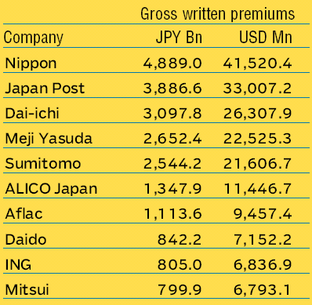
Leading Life Insurers in Japan (2007)

Slide 63
Asia-Pacific – Korea
Features
The world’s seventh largest
The economy has recovered from the Asian economy crisis
Several key reformatory measures in the market
Industry associations greatly influence the market.
Chronic problem of policy lapses and surrenders
Products and distributions
Bancassurance strongly promoted by government
Issues
Products with limited period (up to 10 years) and pensions also sold by nonlife insurance companies

Slide 64
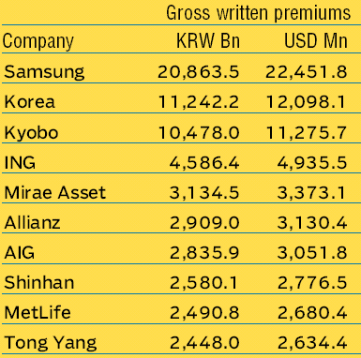
Leading Life Insurers in Korea (2007)

Slide 65
Asia-Pacific – Taiwan
Features
A strong life insurance industry and the world’s highest life insurance penetration
30 life insurance companies – including eight foreign companies – operate.
Products and distributions
Traditional products such as whole life and endowment have the largest proportions of in-force business
Unit-linked life and annuity products have shown strong recent sales
Distribution mainly by part-time agents
Brokerage channel and bancassurance growing rapidly

Slide 66
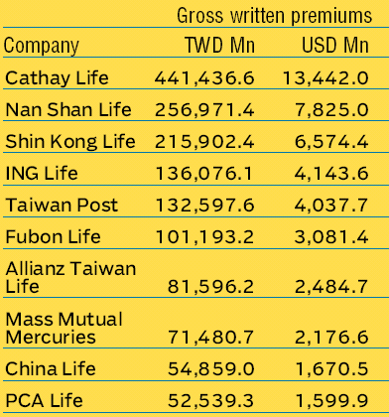
Leading Life Insurers in Taiwan (2007)

Slide 67
Asia-Pacific – China
Features
The greatest growth potential in the world
Life insurance premium growth at about 25% per year during the last decade
Foreign insurer participation in its market only during the 1990s
Local insurers still dominate – China Life, Ping An, and China Pacific Life
Products and distributions
Simple products thus far and via exclusive agents
Issues
Further market liberalization and deregulation
Transparency
Hong Kong and Macau

Slide 68
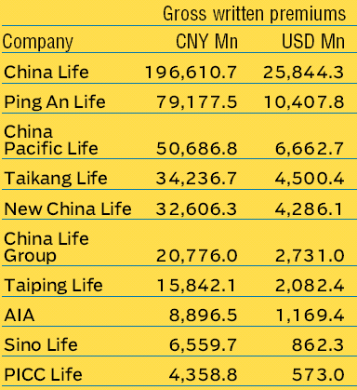
Leading Life Insurers in China (2007)

Slide 69
Asia-Pacific – India
Features
Annual life premium growth averaged about 13%
Privatized since 1999
Low consumption and penetration ratios
Products and distributions
Bancassurance and broker system introduced
Provision of health insurance in the private sector emphasized
Issues
Further deregulation
Foreign ownership of local company

Slide 70
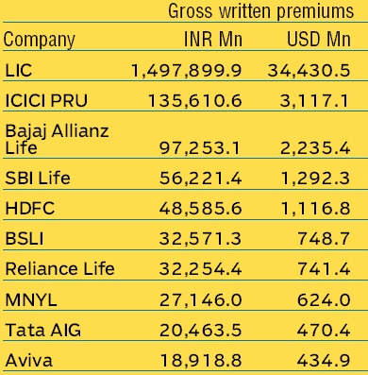
Leading Life Insurers in India (2007)

Slide 71
Asia-Pacific – Australia and New Zealand
Features
Along with New Zealand, one of the world’s most sophisticated markets
Incredibly competitive, strict disclosure requirements, and strong consumer protection, solvency and actuarial standards
Dominated by several large companies such as Australian Mutual Provident, National Australia, and ING (Australia)
Products and distributions
The largest product sales in superannuation
Bank-owned life insurers accounted for 38% of new premiums written in 2005

Slide 72
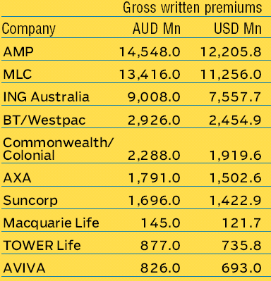
Leading Life Insurers in Australia (2007)

Slide 73
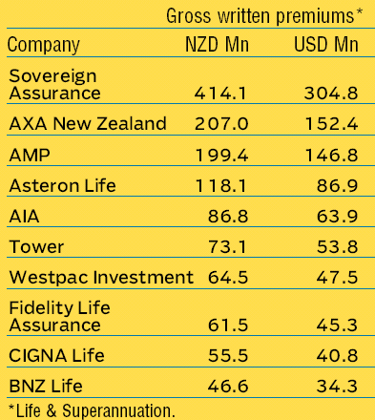
Leading Life Insurers in New Zealand (2007)

Slide 74
Asia-Pacific – ASEAN
Features
Both developed and developing economies
Diversity in ethnic backgrounds
Already a large number of foreign insurers in the market
Products and distributions
Mainly traditional whole life and endowment but with unit-linked and annuity business growing rapidly in a few markets.
Distribution almost exclusively on face-to-face selling by part-time, male and female captive agents
Issues
The image of life insurance in some societies or communities

Slide 75
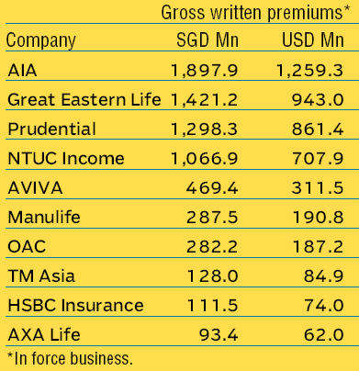
Leading Life Insurers in Singapore (2007)

Slide 76
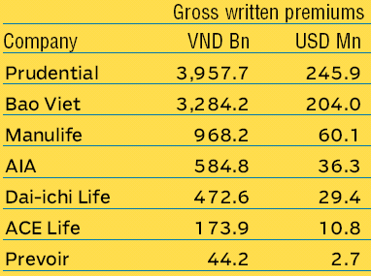
Leading Life Insurers in Vietnam (2007)

Slide 77
Africa
Features
Most markets long been hampered by political and economic turmoil
African life insurance figures are dominated by South Africa.
South Africa with the world’s second highest life insurance penetration
Other markets, such as Namibia, Mauritius and Botswana, slowly grow.
Still the least known regional market in the world
Exception: South Africa

Slide 78
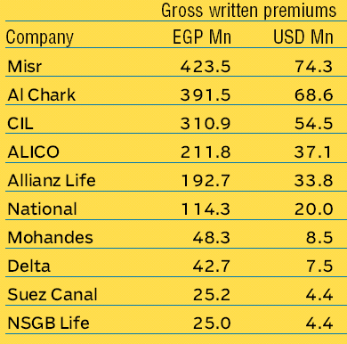
Leading Insurers in Egypt (2006)

Slide 79
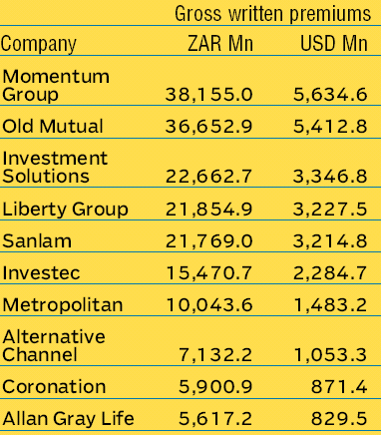
Leading Insurers in South Africa (2006)

Slide 80
Discussion Questions

Slide 81
Discussion Question 1
As the ASEAN insurance industry grows, we can expect continuing tensions between ASEAN countries with a well-developed market economy and those with more restrictive regimes. What advice would you give to an ASEAN insurance company that wishes to operate throughout the region?

Slide 82
Discussion Question 2
Many U.S. life insurers have been reluctant to enter international markets. Why have they been reluctant historically to do so? Why do you believe U.S. insurers have begun to increase their international activities? Do you believe they will succeed?

Slide 83
Discussion Question 3
In Europe, the direct marketing and bancassurance movements have gained enormous momentum. In many other countries, insurance is still sold through personal contact with an agent. What do you see as the strengths and weaknesses from the consumer’s point of view of these three different strategies for selling life insurance?

